Slide 1
Neuro.ZERO: A Zero-Energy Neural Network Accelerator for Embedded Sensing and Inference Systems
Seulki Lee and Shahriar Nirjon
UNC Chapel Hill
(University of North Carolina at Chapel Hill)
SenSys 2019, November 10-13, 2019, New York, NY, USA

Slide 2
Battery-Free Smart Devices are the Future
Harvesting energy from sunlight, kinetic, human body…
Advantages: Perpetual, maintenance-free, environment-friendly.
System
Energy
Source

Slide 3
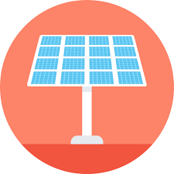
Problem 1: Intermittent Execution
Energy is not harvestable all the time making systems intermittent.
Device On
Device Off

Slide 4
Problem 1: Intermittent Execution
Energy is not harvestable all the time making systems intermittent.
Device On
Device Off

Slide 5
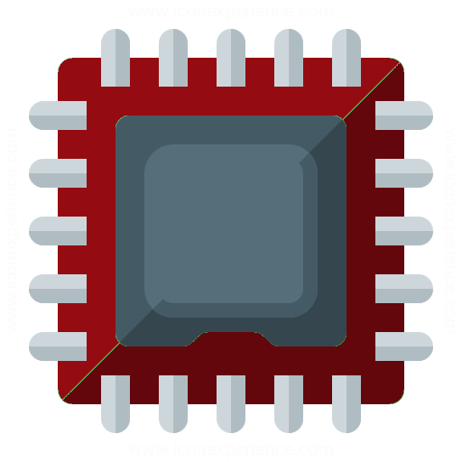
Problem 2: Limited Computation for DNNs
Deep Neural Networks (DNNs) are computationally challenging to embedded devices.
Deep Neural Network (DNN)
MCU
800,000 neurons
100,000 neurons
Compute-intensive
Limited computation-power

Slide 6
Challenges/Goal
We create a long-term sensing and inference system that provides guaranteed execution of state-of-the-art DNNs.
Guaranteed Execution
DNN Performance Up
Intermittent Execution
Limited Computation for DNNs

Slide 7
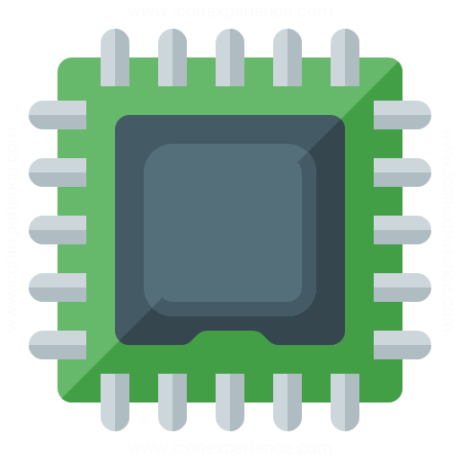
We Propose – Neuro.ZERO
A co-processor architecture consisting of a main MCU that executes scaled-down versions of a DNN with a battery, and an accelerator MCU that is powered by harvested energy.
+
Co-MCU
Architecture
Multiple Modes of DNN Execution
Intermittent Energy-Aware
Algorithms

Slide 8
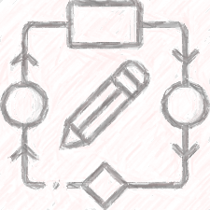
We Propose – Neuro.ZERO
A co-processor architecture consisting of a main MCU that executes scaled-down versions of a DNN with a battery, and an accelerator MCU that is powered by harvested energy.
+
Co-MCU
Architecture
Multiple Modes of DNN Execution
Intermittent Energy-Aware
Algorithms

Slide 9
Neuro.ZERO Architecture
A co-processor architecture: Main MCU + Accelerator MCU
Main MCU
Always on
Guaranteed execution
Battery
+
On/Off
Opportunistic
performance
improvement
Energy-harvester
Accelerator MCU

Slide 10
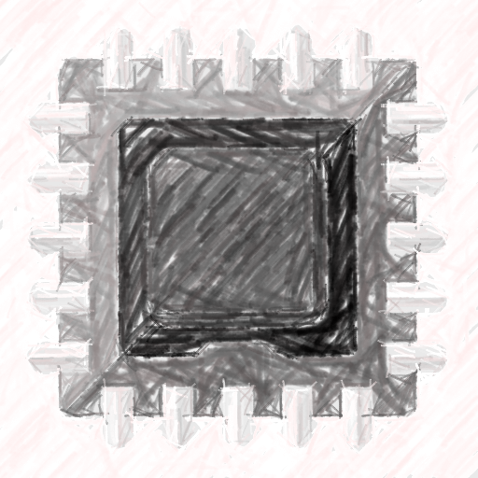
Neuro.ZERO Architecture
A co-processor architecture: Main MCU + Accelerator MCU
+
+
Prediction accuracy: 95%
Prediction accuracy: 80%
Performance up
Guaranteed Execution

Slide 11
Neuro.ZERO vs. Alternatives
Battery-powered MCU
Energy-harvested MCU
Single MCU
Multiple MCU
Neuro.ZERO
+
+
Guaranteed Execution
Computation
Scaling
Energy
Efficiency

Slide 12
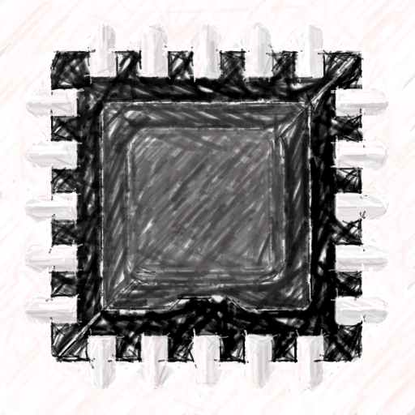
We Propose – Neuro.ZERO
A co-processor architecture consisting of a main MCU that executes scaled-down versions of a DNN with a battery, and an accelerator MCU that is powered by harvested energy.
+
Co-MCU
Architecture
Multiple Modes of DNN Execution
Intermittent Energy-Aware
Algorithms

Slide 13
Multiple Modes of DNN Execution
Neuro.ZERO supports four acceleration execution of a DNN.
Mode 1
Inference
Speedup
Mode 2
Inference
Improvement
Mode 3
Multi-DNNs
(Ensemble)
Mode 4
Adaptation
(On-device Training)
Deep neural network
(DNN)
Accelerated
Execution of DNN

Slide 14
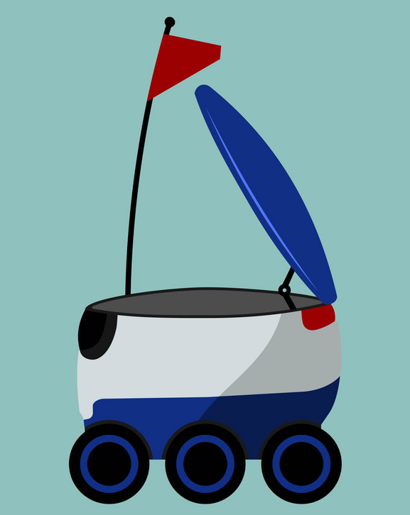
Example Application
A traffic sign recognizer DNN for autonomous robots.
A STOP sign ahead.
Delivery robot

Slide 15
Acceleration Scenario 1: Inference Speedup
Slow running
2 seconds
OK, Main MCU is enough.
20 km/h
Fast running
1 second
OK, I’ll use the accelerator as well for faster recognition.
40 km/h

Slide 16
Acceleration Scenario 1: Inference Speedup
Inference speedup by offloading a part of the DNN to the accelerator MCU.
Main MCU
Accelerator MCU
+
Offloading
Original DNN
(Execution time: 100ms)
Execution time: 100ms
Execution time: 60ms

Slide 17
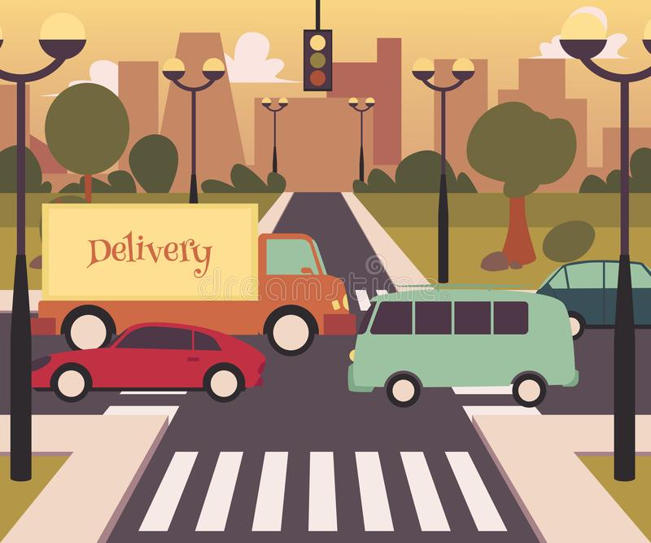
Acceleration Scenario 2: Improved Inference
Open road
Crowded road
Busy road! I’ll use the accelerator for
better recognition.
OK, Main MCU is enough.

Slide 18
Acceleration Scenario 2: Improved Inference
Performance improvement by extending the DNN (i.e. increasing inference accuracy).
Main MCU
Accelerator MCU
+
Extending
Original DNN
(Accuracy: 80%)
Accuracy: 80%
Accuracy: 95%

Slide 19
Acceleration Scenario 3: Multi-DNN (Ensemble)
Sunny
Snowy
Let’s use the accelerator to run a DNN for the second camera.
OK, Main MCU is enough.
Snowy. I cannot see the signs. Let’s use the second camera.

Slide 20
Acceleration Scenario 3: Multi-DNN (Ensemble)
Run a different DNN that provides a second opinion for the task.
Main MCU
Accelerator MCU
+
Executing
a different DNN
Original DNN
(Single DNN)
Original DNN
Second DNN
Ensembled DNN
(Multi-Model DNNs)

Slide 21
Acceleration Scenario 4: DNN Adaptation
Familiar road signs
New road signs
OK, Let’s use the accelerator to learn new traffic signs here.
OK, Main MCU is enough.
What does the sign mean?

Slide 22
Acceleration Scenario 4: DNN Adaptation
Enables retraining of the DNN on the accelerator. Training happens separately on the accelerator.
Main MCU
Accelerator MCU
+
DNN model
update
Execute inference
Perform training

Slide 23
We Propose – Neuro.ZERO
A co-processor architecture consisting of a main MCU that executes scaled-down versions of a DNN with a battery, and an accelerator MCU that is powered by harvested energy.
+
Co-MCU
Architecture
Multiple Modes of DNN Execution
Intermittent Energy-Aware
Algorithms

Slide 24
Acceleration Algorithm 1: Step-Up Inference
Energy-aware inference acceleration: The amount of acceleration is proportional to the currently-available harvested energy.
Main MCU
Accelerator MCU
Mid level of
Harvested energy
High level of
Harvested energy
Low level of
Harvested energy
+
Extending
the DNN
Extended DNN
(Accuracy: 85%)
Extended DNN
(Accuracy: 90%)
Original DNN
(Accuracy: 80%)
Extended DNN
(Accuracy: 95%)

Slide 25
Acceleration Algorithm 2: Skip-Out Training
Energy-aware training: Only train a part of the weight parameters proportional to the currently-available harvested energy.
Low harvested energy
Mid harvested energy
High harvested energy
Weight to be trained
Weight to be skipped

Slide 26
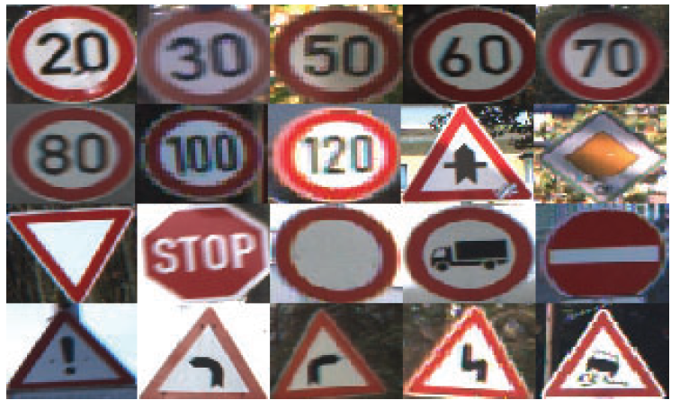
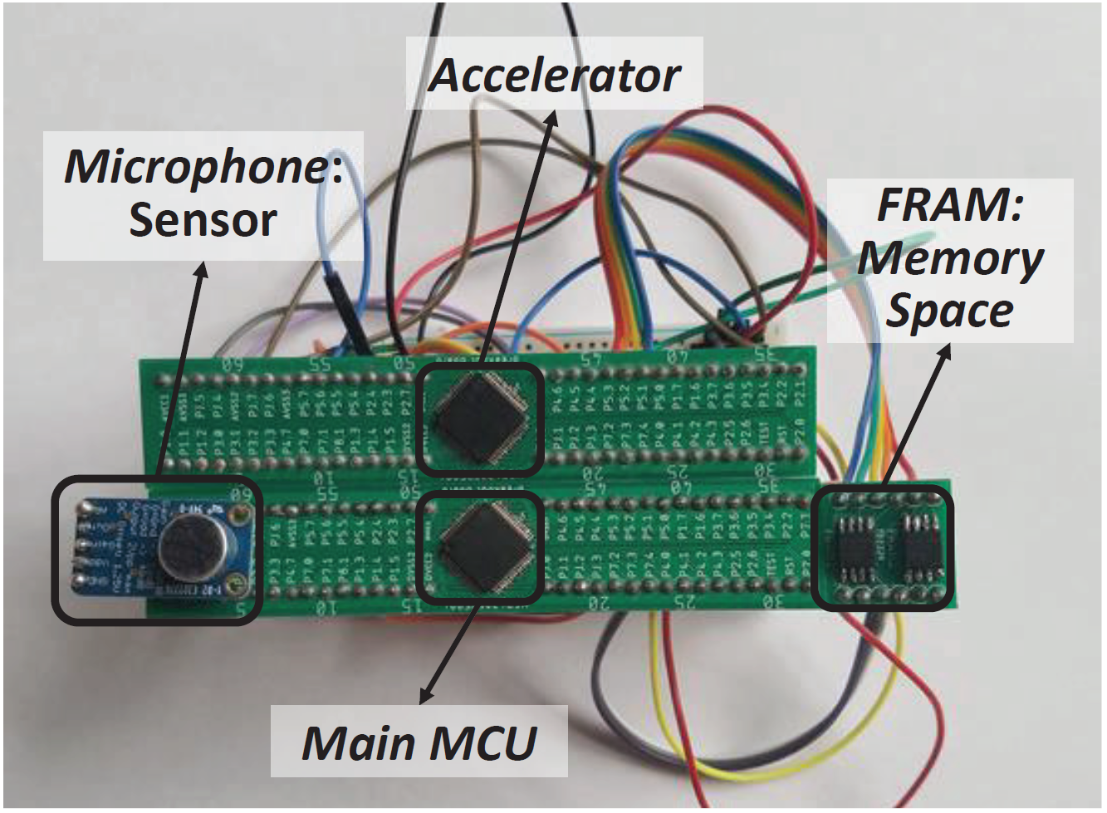
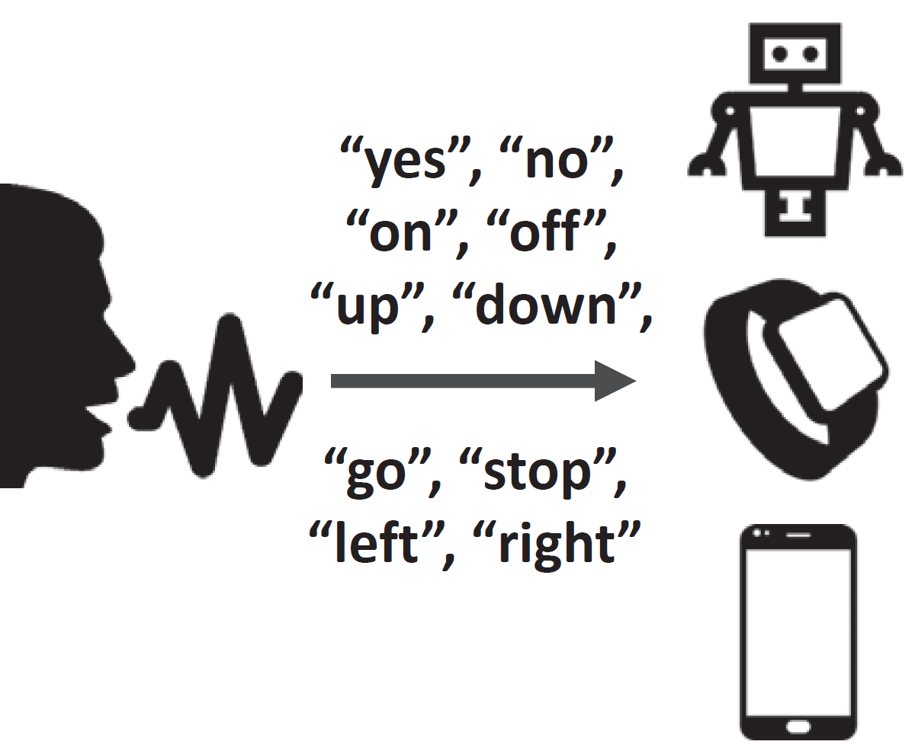
Implementation
App1: Traffic sign recognizer
Neuro.Zero Prototype Hardware
App2: Voice Command Recognizer

Slide 27
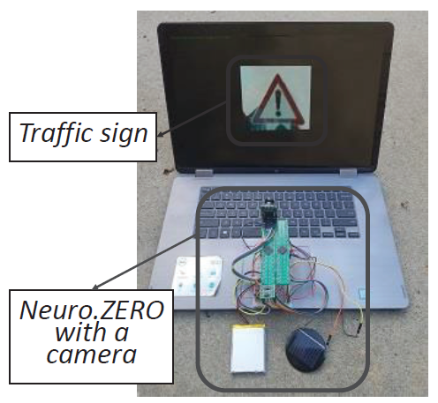
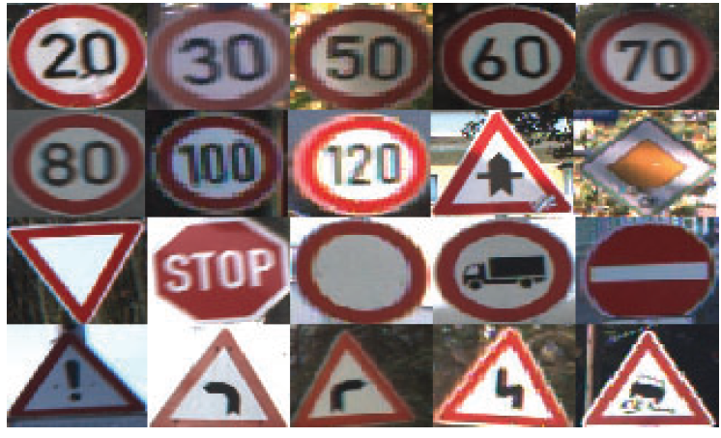
Evaluation: Traffic Sign Recognizer
Main MCU: MSP430 powered by a battery
Accelerator MCU: MSP430 powered by a solar panel
Dataset: GTSB (43 traffic signs)
Battery
Solar panel

Slide 28
Result: Traffic Sign Recognizer
Inference Speedup
78%
2
Clock-cycle
(${10}^{7}$)
78%
79%
1
0
Main MCU
(no accelerator)
Neuro.ZERO
(Main MCU + Accelerator)
(Low harvested energy)
Neuro.ZERO
(Main MCU + Accelerator)
(High harvested energy)

Slide 29
Result: Traffic Sign Recognizer
Accuracy Improvement
89%
90
87%
85
Accuracy
(%)
83%
79%
80
75
Main MCU
(no accelerator)
Neuro.ZERO
(Main MCU + Accelerator)
(Low harvested energy)
Neuro.ZERO
(Main MCU + Accelerator)
(Mid harvested energy)
Neuro.ZERO
(Main MCU + Accelerator)
(High harvested energy)

Slide 30
Result: Traffic Sign Recognizer
Multi-DNNs and Ensemble
90
86%
85
Accuracy
(%)
83%
82%
80
75
Main MCU
(First DNN)
Neuro.ZERO
Accelerator
(Second DNN)
Neuro.ZERO
Ensembled
(First + Second DNN)
+

Slide 31
Result: Traffic Sign Recognizer
DNN Adaptation: On-Device (Accelerator) Training of DNN
70
60
50
40
Accuracy (%)
30
20
10
0
0
20
40
60
80
100
Time (hours)

Slide 32
Conclusion
We introduce Neuro.ZERO, an intermittently-powered accelerator that draws no system energy and opportunistically accelerates the performance of a DNN with four modes of accelerations.
To enable zero-energy acceleration, energy-aware acceleration algorithms are proposed.
A traffic sign and a voice command recognizer are implemented, and they have been demonstrated that the inference accuracy and speed increase.
Future Work: Multi-core accelerator architecture

Slide 33
Thank You

