Slide 1
Wrap Up
Don Porter

Slide 2
What else can we do?
… to improve speed?

Slide 3
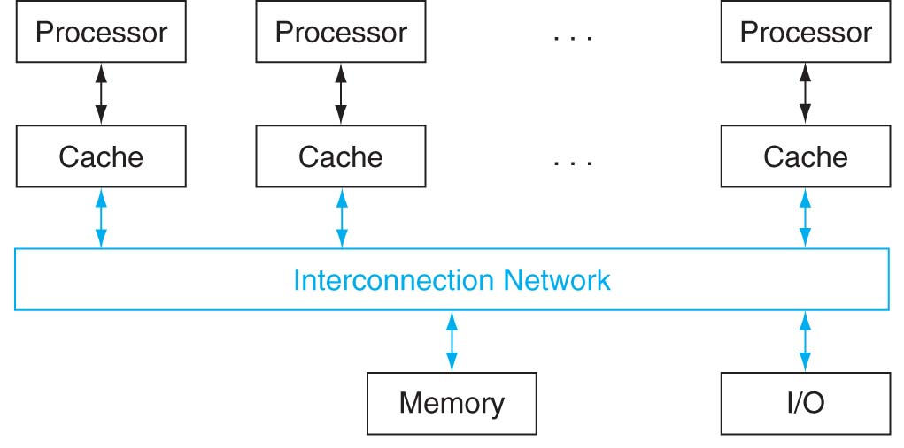
Multicore/multiprocessor
Use more than one processor = multiprocessor
called multicore when they are all on the same chip
read all about it in Chapter 6 of textbook

Slide 4
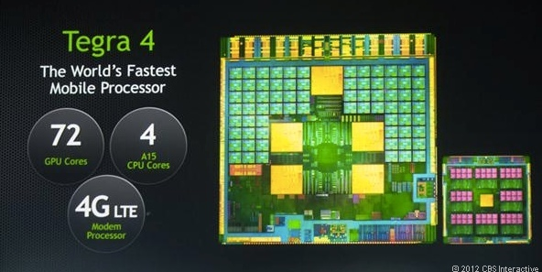
GPUs for data-intensive tasks
Originally developed for graphics
Now rapidly gaining importance for general-purpose computing
Main advantages
Massively data-parallel
Fast memory architectures

Slide 5
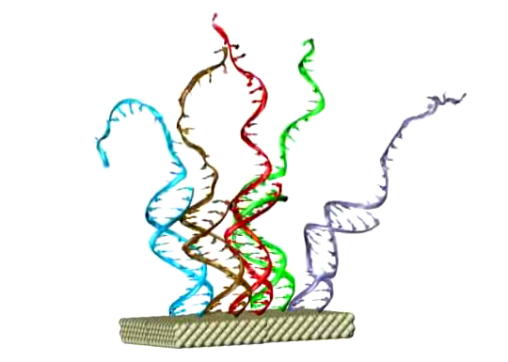
Nanotechnology
Nanoelectronics
DNA based self-assembled electronics
Use DNA to fabricate tinier transistors than possible today using laser/lithographic techniques

Slide 6
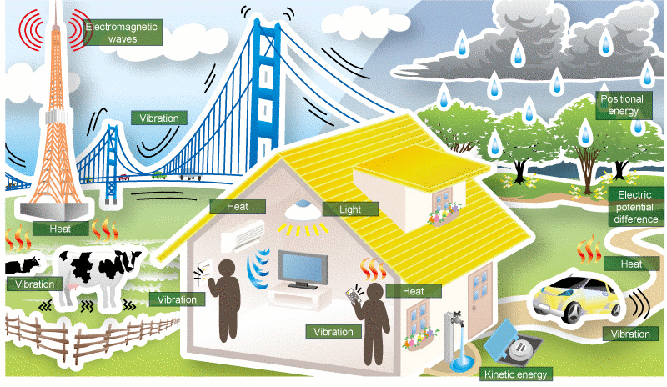
Energy-efficient design
Many many research directions…
A new and very interesting one is “energy harvesting”
Smart home: Internet-of-Things

Slide 7
That’s it folks!
So, what did we learn this semester?

Slide 8
What we learnt this semester
You now have a pretty good idea about how computers are designed and how they work:
How performance is measured
How data and instructions are represented
How arithmetic and logic operations are performed
How ALU and control circuits are implemented
How registers and memory are implemented
Lots of lower-level programming experience:
C and MIPS
This is how programs are actually executed!
This is how OS/networking code is actually written!
Java and other higher-level languages are convenient high-level abstractions. You probably have new appreciation for them!

Slide 9
Where to go from here?
Courses you can take in the future:
COMP 530: Operating Systems
COMP 541: Digital Logic and Computer Design
COMP 740: Computer Architecture [grad]

Slide 10
Final Exam? Grades?
We are trying to wrap up all grading!
Final Exam is on Mon, May 7, 12-2pm
Also, don’t forget to submit your course evaluation!

Slide 11
Final Exam
Material covered:
Everything, but more emphasis on post-midterm material
Open-book, open-notes, calculator allowed
Laptop required:
Answers will be entered in Sakai (as in the midterm)
Sample questions (from past exams) on website
Date/time:
Mon, May 7, 12-2pm

Slide 12
Grading
Lab X (mini project)
scores will be available by the final exam
Lowest drops
Sakai already has been set up to drop
lowest 1 lab (amongst Labs 1-10 only)
lowest 1 homework; lowest 2 quizes
Some of you are missing some scores
will be eventually set to 0 for non-submission
Letter grade cut-offs
Will only move lower (in your favor) if at all, but not higher

Slide 13
Good luck for all your finals!
Do not forget to submit your course evaluation!

