Slide 1
Modular Arithmetic with Applications to Cryptography
Cryptography is the study of methods for sending secret messages.
It involves encryption, in which a message, called plaintext, is converted into a form, called ciphertext, that may be sent over channels possibly open to view by outside parties. The receiver of the ciphertext uses decryption to convert the ciphertext back into plaintext.
In the past the primary use of cryptography was for government and military intelligence, and this use continues to be important.

Slide 2
Modular Arithmetic with Applications to Cryptography
For instance, an encryption system once used by Julius Caesar, and now called the Caesar cipher, encrypts messages by changing each letter of the alphabet to the one three places farther along, with X wrapping around to A, Y to B, and Z to C.
In other words, say each letter of the alphabet is coded by its position relative to the others—so that A = 01, B = 02, . . . , Z = 26. If the numerical version of the plaintext for a letter is denoted M and the numeric version of the ciphertext is denoted C, then

Slide 3
Modular Arithmetic with Applications to Cryptography
The receiver of such a message can easily decrypt it by using the formula
For reference, here are the letters of the alphabet, together with their numeric equivalents:

Slide 4
Example 1 – Encrypting and Decrypting with the Caesar Cipher
To encrypt the message “HOW ARE YOU” …
Translate the letters into their numeric equivalents:
08 15 23 01 18 05 25 15 21.
Add 3 to each number. The result is
11 18 26 04 21 08 02 18 24.
Substitute the letters that correspond to these numbers. The encrypted message becomes
KRZ DUH BRX.

Slide 5
Example 1 – Encrypting and Decrypting with the Caesar Cipher
To decrypt the message “L DP ILQH” …
Translate the letters into their numeric equivalents:
12 04 16 09 12 17 08.
Subtract 3 from each number. The result is
09 01 13 06 09 14 05.
Then translate back into letters to obtain the original message: I AM FINE.

Slide 6
Properties of Congruence Modulo n

Slide 7
Properties of Congruence Modulo n
Given integers a and n with n > 1:
The residue of a modulo n is a mod n, the non-negative remainder when a is divided by n.
The numbers 0, 1, …, n – 1 are the complete set of residues mod n.
To reduce a modulo n means to set a to be a mod n.

Slide 8
Modular Arithmetic
Theorem: Let a, b, c, d and n be integers with n > 1, and suppose a ≡ c (mod n) and b ≡ d (mod n). Then,
a + b ≡ c + d (mod n)
a – b ≡ c – d (mod n)
ab ≡ cd (mod n)
a^{m} ≡ c^{m} (mod n) for all integers m

Slide 9
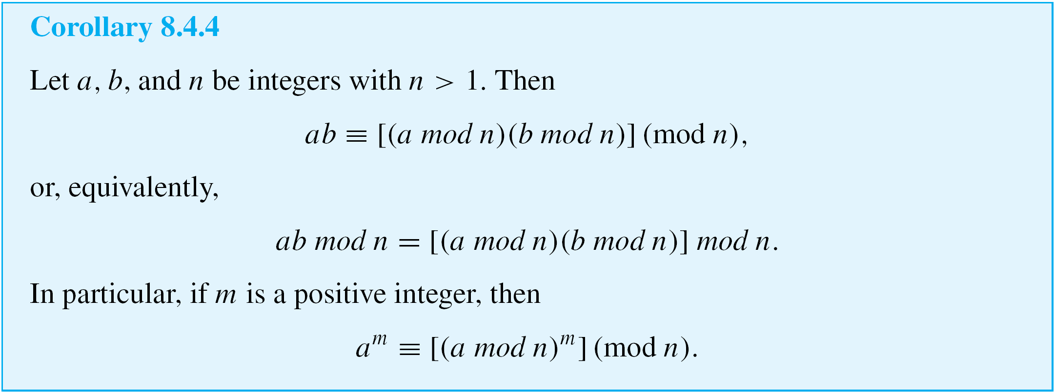
Modular Arithmetic

Slide 10
Antisymmetry
We have defined three properties of relations: reflexivity, symmetry, and transitivity. A fourth property of relations is called antisymmetry.
In terms of the arrow diagram of a relation, saying that a relation is antisymmetric is the same as saying that whenever there is an arrow going from one element to another distinct element, there is not an arrow going back from the second to the first.

Slide 11
Antisymmetry
By taking the negation of the definition, you can see that a relation R is not antisymmetric if, and only if,
there are elements a and b in A such that a R b and b R a but a ≠ b.

Slide 12
Example 2 – Testing for Antisymmetry of “Divides” Relations
Let R₁ be the “divides” relation on the set of all positive integers, and let R₂ be the “divides” relation on the set of all integers.
a. Is R₁ antisymmetric? Prove or give a counterexample.
b. Is R₂ antisymmetric? Prove or give a counterexample.

Slide 13
Example 2 – Solution
a. R₁ is antisymmetric.
Proof: Suppose a and b are positive integers such that a R₁ b and b R₁ a. [We must show that a = b.] By definition of R₁, a | b and b | a.
Thus, by definition of divides, there are integers k₁ and k₂ with b = k₁a and a = k₂b. It follows that
Dividing both sides by b gives

Slide 14
Example 2 – Solution
cont’d
Now since a and b are both integers k₁ and k₂ are both positive integers also.
But the only product of two positive integers that equals 1 is 1  1.
Thus
and so
[This is what was to be shown.]

Slide 15
Example 2 – Solution
cont’d
b. R₂ is not antisymmetric.
Counterexample:
Let a = 2 and b = –2. Then a | b [since –2 = (–1)  2] and b | a [since 2 = (–1)(–2)].
Hence a R₂ b and b R₂ a but a ≠ b.

Slide 16
Partial Order Relations
A relation that is reflexive, antisymmetric, and transitive is called a partial order.
Two fundamental partial order relations are the “less than or equal to” relation on a set of real numbers and the “subset” relation on a set of sets.
These can be thought of as models, or paradigms, for general partial order relations.

Slide 17
Example 4 – A “Divides” Relation on a Set of Positive Integers
Let | be the “divides” relation on a set A of positive integers. That is, for all a, b ∈ A,
Prove that | is a partial order relation on A.
Solution: | is reflexive: [We must show that for all a ∈ A, a | a.] Suppose a ∈ A. Then a = 1  a, so a | a by definition of divisibility.

Slide 18
Example 4 – Solution
cont’d
| is antisymmetric: [We must show that for all a, b ∈ A, if a | b and b | a then a = b.] The proof of this is virtually identical to that of Example 2(a).
| is transitive: To show transitivity means to show that for all a, b, c ∈ A, if a | b and b | c then a | c. But this was proved as Theorem 4.3.3.
Since | is reflexive, antisymmetric, and transitive, | is a partial order relation on A.

Slide 19
Partial Order Relations

Slide 20
Partially and Totally Ordered Sets
Given any two real numbers x and y, either x ≤ y or y ≤ x. In a situation like this, the elements x and y are said to be comparable.
On the other hand, given two subsets A and B of {a, b, c}, it may be the case that neither A ⊆ B nor B ⊆ A.
For instance, let A = {a, b} and B = {b, c}. Then and
In such a case, A and B are said to be noncomparable.

Slide 21
Partially and Totally Ordered Sets
When all the elements of a partial order relation are comparable, the relation is called a total order.

Slide 22
Partially and Totally Ordered Sets
A set that is partially ordered but not totally ordered may have totally ordered subsets. Such subsets are called chains.
Observe that if B is a chain in A, then B is a totally ordered set with respect to the “restriction” of to B.

Slide 23
Example 9 – A Chain of Subsets
The set is partially ordered with respect to the subset relation. Find a chain of length 3 in
Solution:
Since the set
is a chain of length 3 in

Slide 24
Partially and Totally Ordered Sets
A maximal element in a partially ordered set is an element that is greater than or equal to every element to which it is comparable. (There may be many elements to which it is not comparable.)
A greatest element in a partially ordered set is an element that is greater than or equal to every element in the set (so it is comparable to every element in the set). Minimal and least elements are defined similarly.

Slide 25
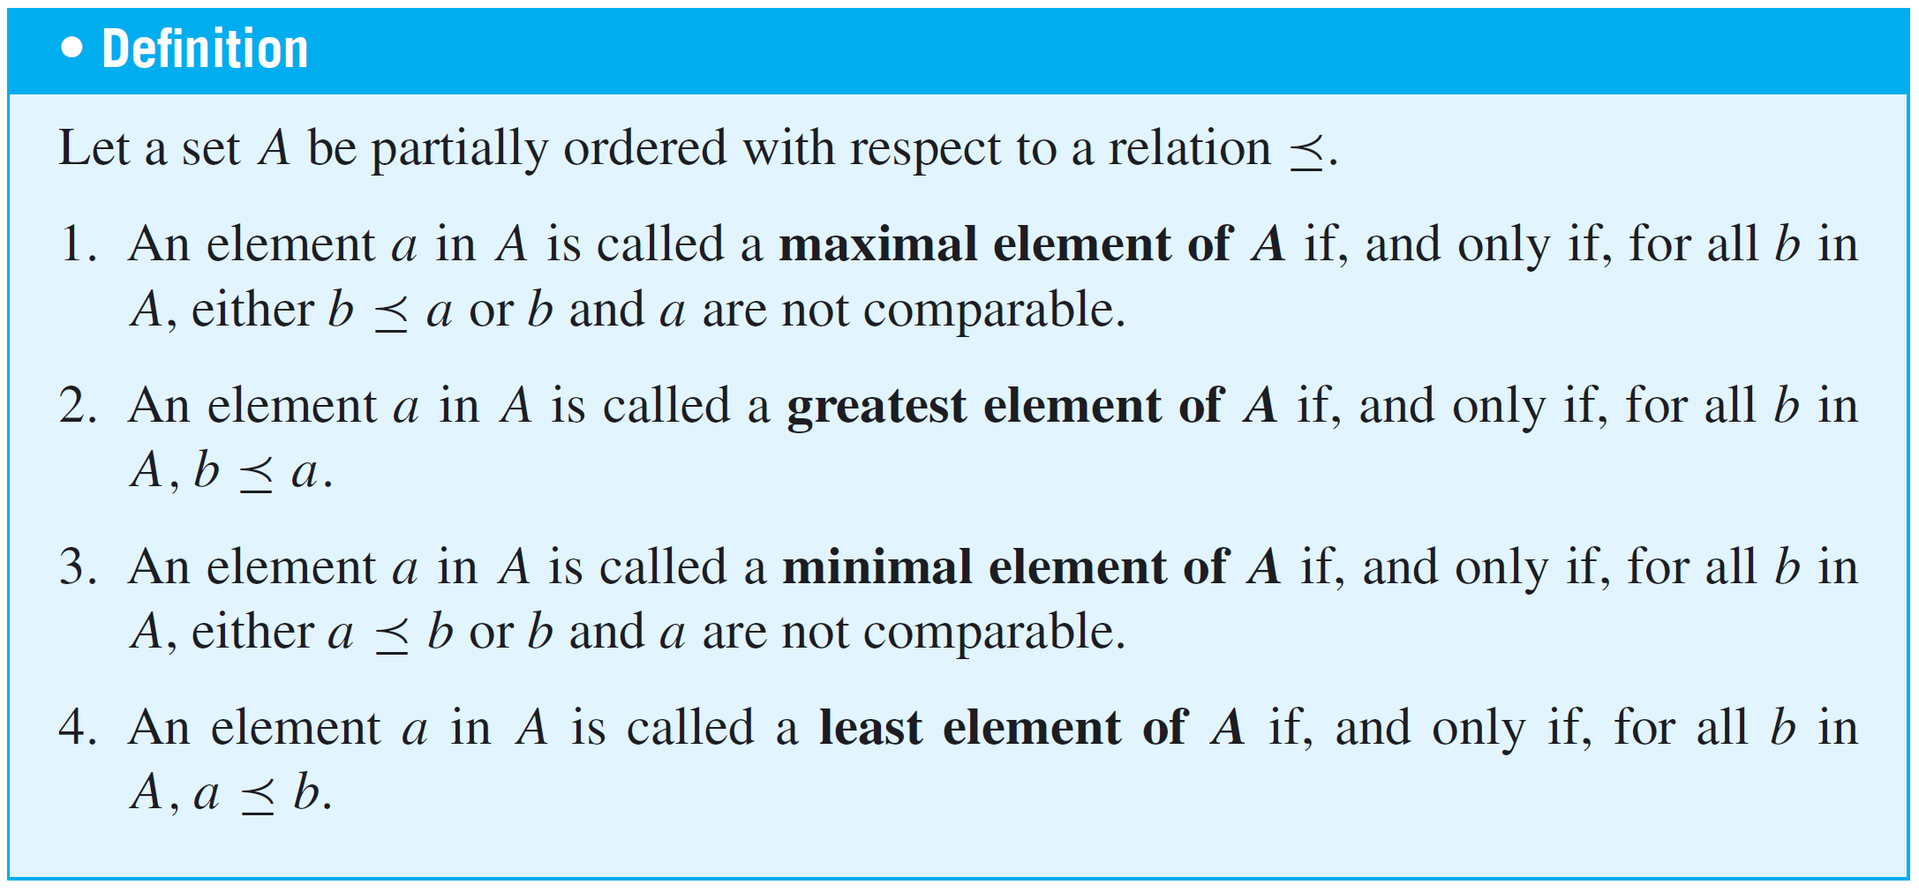
Partially and Totally Ordered Sets

Slide 26
Partially and Totally Ordered Sets
A greatest element is maximal, but a maximal element need not be a greatest element. However, every finite subset of a totally ordered set has both a least element and a greatest element.
Similarly, a least element is minimal, but a minimal element need not be a least element. Furthermore, a set that is partially ordered with respect to a relation can have at most one greatest element and one least element, but it may have more than one maximal or minimal element.

Slide 27
Topological Sorting
Is it possible to input the sets of into a computer in a way that is compatible with the subset relation ⊆ in the sense that if set U is a subset of set V, then U is input before V?
The answer, as it turns out, is yes. For instance, the following input order satisfies the given condition:
Another input order that satisfies the condition is

Slide 28
Topological Sorting
Given an arbitrary partial order relation on a set A, is there a total order on A that is compatible with ? If the set on which the partial order is defined is finite, then the answer is yes. A total order that is compatible with a given order is called a topological sorting.

