Slide 1
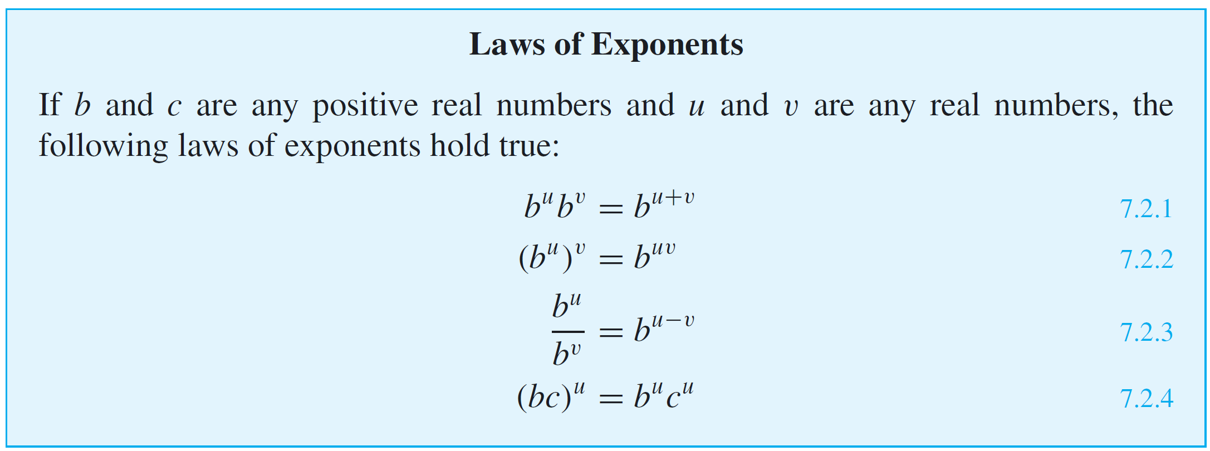
Relations between Exponential and Logarithmic Functions
When working with the exponential function, it is useful to recall the laws of exponents from elementary algebra.

Slide 2
Relations between Exponential and Logarithmic Functions
Equivalently, for each positive real number x and real number y,
It can be shown that both the exponential and logarithmic functions are injective and surjective.
Therefore, by definition of injective, the following properties hold true:

Slide 3
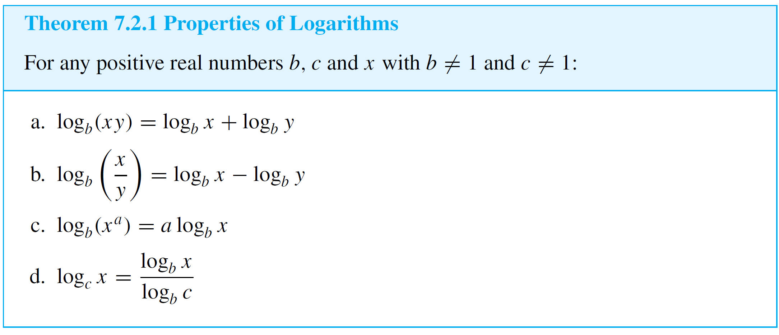
Relations between Exponential and Logarithmic Functions
These properties are used to derive many additional facts about exponents and logarithms. In particular we have the following properties of logarithms.

Slide 4
Composition of functions
f, g are functions defined on R → R
f(x) = x+2; g(x) = 2x.
What is f(g(x))?
What is g(f(x))?
What is f(f(x))?
What is f(g(f(x)))?

