Slide 1
Probability Axioms and Formulas
We have known that a sample space is a set of all outcomes of a random process or experiment and that an event is a subset of a sample space.

Slide 2
Probability Axioms and Formulas

Slide 3
Expected Value

Slide 4
Expected Value of a Lottery
Suppose that 100 people pay $1 each to play a lottery game with a single prize of $98 for exact one winner.
What is the expected value of a ticket?

Slide 5
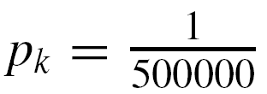
Example 5 – Expected Value of a Lottery
Suppose that 500,000 people pay $5 each to play a lottery game with the following prizes:
a grand prize of $1,000,000, 10 second prizes of $1,000 each, 1,000 third prizes of $500 each, and 10,000 fourth prizes of $10 each.
What is the expected value of a ticket?
Solution:
Each of the 500,000 lottery tickets has the same chance as any other of containing a winning lottery number, and so for all k = 1, 2, 3, . . . , 500000.

Slide 6
Example 5 – Solution
cont’d
Let a₁, a₂, a₃, . . . , a₅₀₀₀₀₀ be the net gain for an individual ticket, where a₁ = 999995 (the net gain for the grand prize ticket, which is one million dollars minus the $5 cost of the winning ticket),
a₂ = a₃ = ・・・ = a₁₁ = 995 (the net gain for each of the 10 second prize tickets),
a₁₂ = a₁₃ = ・・・ = a₁₀₁₁ = 495 (the net gain for each of the 1,000 third prize tickets), and
a₁₀₁₂ = a₁₀₁₃ = ・・・ = a₁₁₀₁₁ = 5 (the net gain for each of the 10,000 fourth prize tickets).

Slide 7
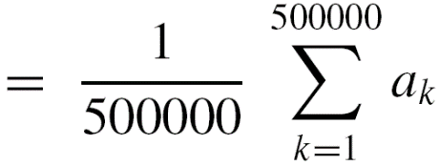
Example 5 – Solution
cont’d
Since the remaining 488,989 tickets just lose $5, a₁₁₀₁₂ = a₁₁₀₁₃ = ・・・ = a₅₀₀₀₀₀ = –5.
The expected value of a ticket is therefore

Slide 8
Example 5 – Solution
cont’d
In other words, a person who continues to play this lottery for a very long time will probably win some money occasionally but on average will lose $1.78 per ticket.

Slide 9
Excercise

Slide 10
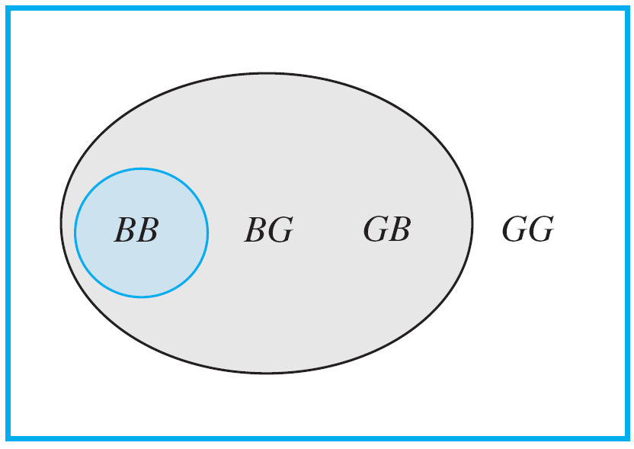
Conditional Probability
Imagine a couple with two children, each of whom is equally likely to be a boy or a girl. Now suppose you are given the information that one is a boy. What is the probability that the other child is a boy?
Figure 9.9.1 shows the four equally likely combinations of gender for the children.
Figure 9.9.1

Slide 11
Conditional Probability
You can imagine that the first letter refers to the older child and the second letter to the younger.
Thus the combination BG indicates that the older child is a boy and the younger is a girl.
The combinations where one of the children is a boy are shaded gray, and the combination where the other child is also a boy is shaded blue-gray.
Given that you know one child is a boy, only the three combinations in the gray region could be the case, so you can think of the set of those outcomes as a new sample space with three elements, all of which are equally likely.

Slide 12
Conditional Probability
Within the new sample space, there is one combination where the other child is a boy (in the region shaded blue-gray).
Thus it would be reasonable to say that the likelihood that the other child is a boy, given that at least one is a boy, is
1/3 = 33 %.
Note that because the original sample space contained four outcomes,
also.

Slide 13
Conditional Probability
A generalization of this observation forms the basis for the following definition.
Note that when both sides of the formula for conditional probability (formula 9.9.1) are multiplied by P(A), a formula for P(A ∩ B) is obtained:

Slide 14
Independent Events
Informally, two events are independent: the probability of one event to happen does not depend on whether the other happens or not.
Formally, events A and B can be independent in the sense that P(A | B) = P(A) and P(B | A) = P(B).

Slide 15
Conditional Probability v.s. Repeated Independent Experiments
Now suppose you are given the information that the first child of a couple is a boy.
What is the probability that the other child is a boy?

Slide 16
Conditional Probability v.s. Repeated Independent Experiments
We are tossing a fair coin two times.
Suppose we know the information that one of the result is head. What is the probability that the other result is head?
Suppose we get the result of the first tossing is head. What is the probability that the second tossing also gets head?

Slide 17
Bayes’ Theorem
Suppose that one urn contains 3 blue and 4 gray balls and a second urn contains 5 blue and 3 gray balls. A ball is selected by choosing one of the urns at random and then picking a ball at random from that urn. If the chosen ball is blue, what is the probability that it came from the first urn?
This problem can be solved by carefully interpreting all the information that is known and putting it together in just the right way.
Let A be the event that the chosen ball is blue, B₁ the event that the ball came from the first urn, and B₂ the event that the ball came from the second urn.

Slide 18
Bayes’ Theorem
Because 3 of the 7 balls in urn one are blue, and 5 of the 8 balls in urn two are blue,
And because the urns are equally likely to be chosen,

Slide 19
Bayes’ Theorem
Moreover, by formula (9.9.2),
But A is the disjoint union of (A ∩ B₁) and (A ∩ B₂), so by probability axiom 3,

Slide 20
Bayes’ Theorem
Finally, by definition of conditional probability,
Thus, if the chosen ball is blue, the probability is approximately 40.7% that it came from the first urn.
The steps used to derive the answer in the previous example can be generalized to prove Bayes’ Theorem.

Slide 21
Bayes’ Theorem

Slide 22
Example 3 – Applying Bayes’ Theorem
Most medical tests occasionally produce incorrect results, called false positives and false negatives.
When a test is designed to determine whether a patient has a certain disease, a false positive result indicates that a patient has the disease when the patient does not have it.
A false negative result indicates that a patient does not have the disease when the patient does have it.

Slide 23
Example 3 – Applying Bayes’ Theorem
cont’d
When large-scale health screenings are performed for diseases with relatively low incidence, those who develop the screening procedures have to balance several considerations: the per-person cost of the screening, follow-up costs for further testing of false positives, and the possibility that people who have the disease will develop unwarranted confidence in the state of their health.
Consider a medical test that screens for a disease found in 5 people in 1,000. Suppose that the false positive rate is 3% and the false negative rate is 1%.

Slide 24
Example 3 – Applying Bayes’ Theorem
cont’d
Then 99% of the time a person who has the condition tests positive for it, and 97% of the time a person who does not have the condition tests negative for it.
a. What is the probability that a randomly chosen person who tests positive for the disease actually has the disease?
b. What is the probability that a randomly chosen person who tests negative for the disease does not indeed have the disease?

Slide 25
Example 3 – Solution
Consider a person chosen at random from among those screened. Let A be the event that the person tests positive for the disease, B₁ the event that the person actually has the disease, and B₂ the event that the person does not have the disease.
Then
Also, because 5 people in 1,000 have the disease,

Slide 26
Example 3 – Solution
cont’d
a. By Bayes’ Theorem,
Thus the probability that a person with a positive test result actually has the disease is approximately 14.2%.

Slide 27
Example 3 – Solution
cont’d
b. By Bayes’ Theorem,
Thus the probability that a person with a negative test result does not have the disease is approximately 99.995%.

