Slide 1
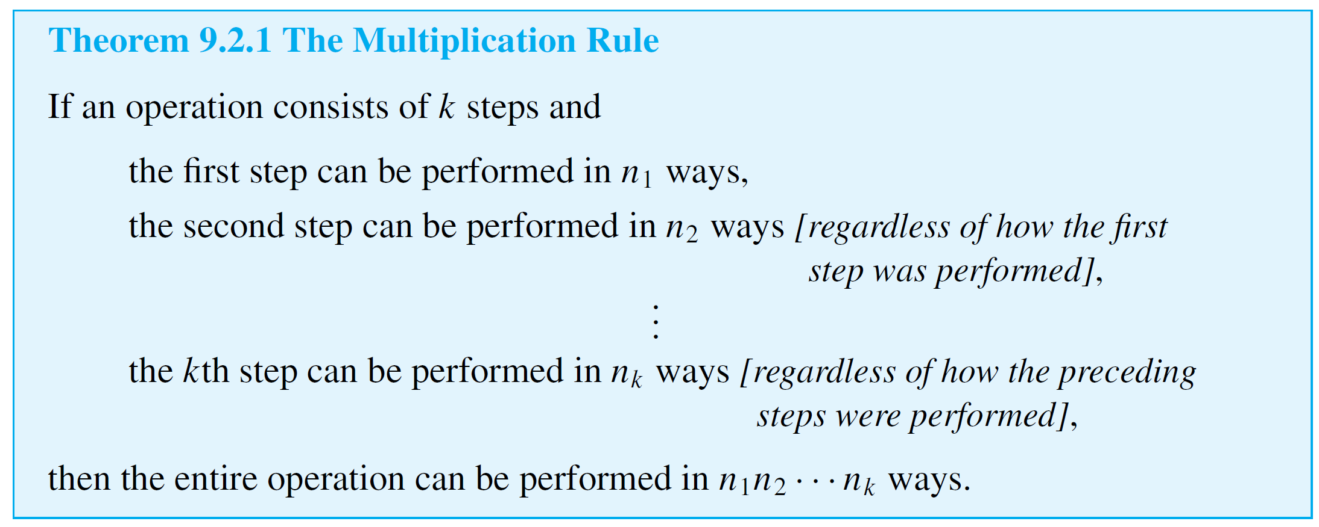
The Multiplication Rule
We are going to draw a colored symbol. The color can be red, blue, green, or yellow, and the shape can be circle, triangle, or square.
How many different resulting symbols can we get?

Slide 2
The Multiplication Rule
We generate a positive integer with each digit in the set {1,2,3,4}.
How many different 3-digit integers can be generated?

Slide 3
The Multiplication Rule
We generate a positive integer with each digit in the set {1,2,3,4}.
How many different 3-digit integers with no repeated digits can be generated?

Slide 4
The Multiplication Rule
We generate a positive integer with each digit in the set {1,2,3,4}.
How many different 3-digit even integers with no repeated digits can be generated?

Slide 5
The Addition Rule
We generate a positive integer with each digit in the set {1,2,3,4}.
How many different such integers that are less than 1000 can be generated?

Slide 6
The Difference Rule
We generate a positive integer with each digit in the set {1,2,3,4}.
How many different 3-digit integers with some repeated digits can be generated?

Slide 7
The Inclusion/Exclusion Rule
We generate a positive integer with each digit in the set {1,2,3,4}.
How many different 3-digit integers where the highest digit is 1 or the lowest digit is 4 can be generated?

Slide 8
The Inclusion/Exclusion Rule
We generate a positive integer with each digit in the set {1,2,3,4}.
How many different 3-digit integers where the highest digit is 1 or the middle digit is 2 or the lowest digit is 4 can be generated?

Slide 9
Permutations
A permutation of a set of objects is an ordering of the objects in a row. For example, the set of elements a, b, and c has six permutations.
abc acb cba bac bca cab
In general, given a set of n objects, how many permutations does the set have?
Solution: There are n − k + 1 choices for the k-th component of the permutation. Hence, by the multiplication rule, there are
n(n – 1)(n – 2) · · · 2  1 = n!
ways to perform the entire operation.

Slide 10
Permutations
In other words, there are n! permutations of a set of n elements.

Slide 11
Permutations of Selected Elements
Given the set {a, b, c}, there are six ways to select two letters from the set and write them in order.
ab ac ba bc ca cb
Each such ordering of two elements of {a, b, c} is called a 2-permutation of {a, b, c}.

Slide 12
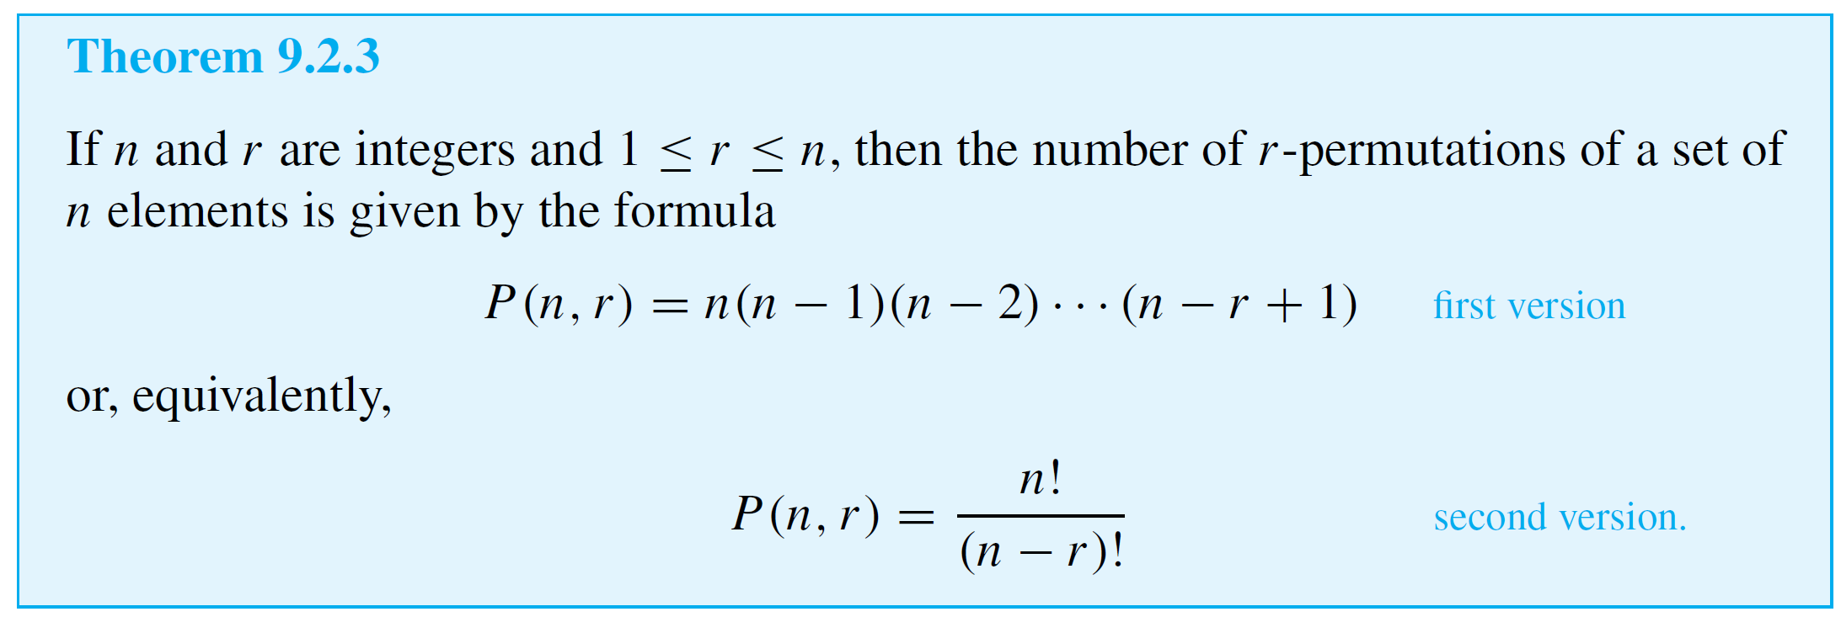
Permutations of Selected Elements

Slide 13
Example 8 – Permutations of the Letters in a Word
How many ways can the letters in the word COMPUTER be arranged in a row?
Solution: All the eight letters in the word COMPUTER are distinct, so the number of ways in which we can arrange the letters equals the number of permutations of a set of eight elements. This equals 8! = 40,320.

Slide 14
Example 8 – Permutations of the Letters in a Word
How many ways can the letters in the word COMPUTER be arranged if the letters CO must remain next to each other (in order) as a unit?
Solution: If the letter group CO is treated as a unit, then there are effectively only seven objects that are to be arranged in a row.
Hence there are as many ways to write the letters as there are permutations of a set of seven elements, namely 7! = 5,040.

Slide 15
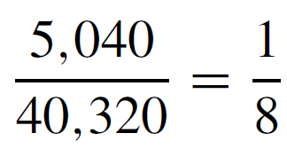
Example 8 – Permutations of the Letters in a Word
If letters of the word COMPUTER are randomly arranged in a row, what is the probability that the letters CO remain next to each other (in order) as a unit?
Solution: When the letters are arranged randomly in a row, the total number of arrangements is 40,320, and the number of arrangements with the letters CO next to each other (in order) as a unit is 5,040.
Thus the probability is

Slide 16
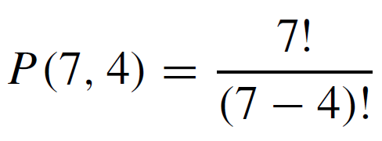
Example 10 – Evaluating r-Permutations
How many 4-permutations are there of a set of seven objects?
Solution:

Slide 17
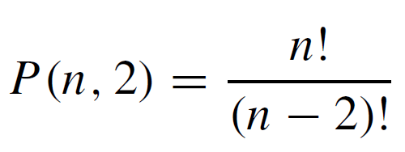
Example 12 – Proving a Property of P (n, r)
Prove that for all integers n ≥ 2,
P(n, 2) + P(n, 1) = n².
Solution: Suppose n is an integer that is greater than or equal to 2. By Theorem 9.2.3,

Slide 18
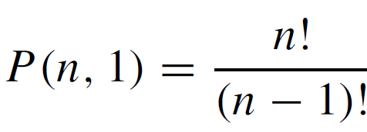
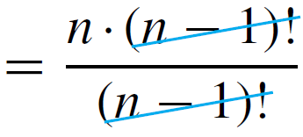
Example 12 – Solution
cont’d
and
Hence
which is what we needed to show.

Slide 19
Combinations
Given a set S with n elements, how many subsets of size r can be chosen from S?
The number of subsets of size r that can be chosen from S equals the number of subsets of size r that S has.
Each individual subset of size r is called an r-combination of the set.

Slide 20
Combinations
We have known that calculators generally use symbols like C(n, r), _{n}C_{r} , C_{n,r} , or ^{n}C_{r} instead of .

Slide 21
Permutations v.s. Combinations
r-permutation and r-combination are two distinct methods that can be used to select r objects from a set of n elements.
r-permutation is an ordered selection, it is not only what elements are chosen but also the order in which they are chosen that matters.
r-combination is an unordered selection, on the other hand, it is only the identity of the chosen elements that matters.

Slide 22
Permutations v.s. Combinations
r-permutation: in our class, we randomly select r students to stand in a line in front of me. How many different lines can we get?
P(n,r)=$\frac{\text{n}\text{!}}{\left(\text{n}\text{-}\text{r}\right)\text{!}}$
Step 1: choose r students to come to the front
$$\left({\text{n} \atop \text{r}}\right)$$
Step 2: choose an order of the r students just chosen
P(r,r)=r!

Slide 23
Permutations v.s. Combinations

Slide 24
Example 10 – Permutations of a Set with Repeated Elements
Consider various ways of ordering the letters in the word MISSISSIPPI:
IIMSSPISSIP, ISSSPMIIPIS, PIMISSSSIIP, and so on.
How many distinguishable orderings are there?

Slide 25
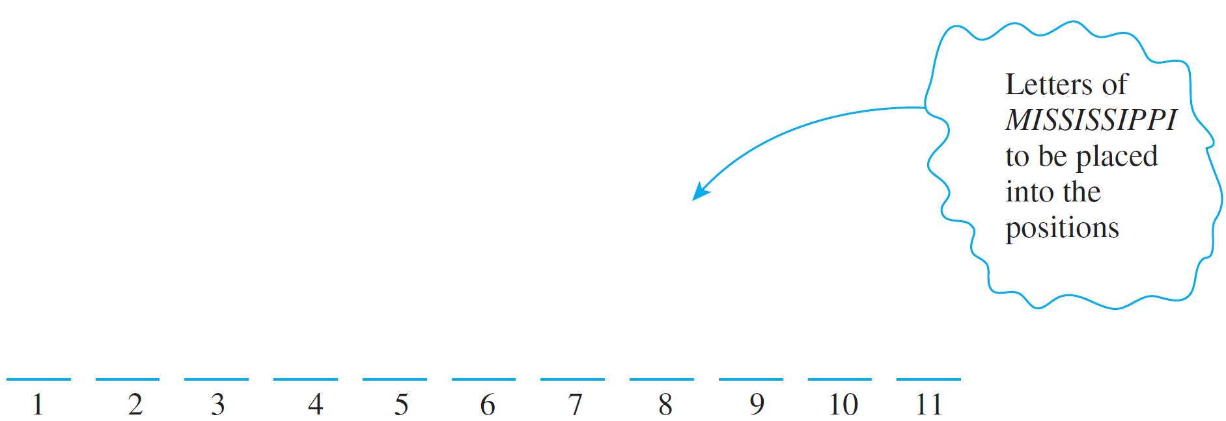
Example 10 – Solution
Imagine placing the 11 letters of MISSISSIPPI one after another into 11 positions.
Because copies of the same letter cannot be distinguished from one another, once the positions for a certain letter are known, then all copies of the letter can go into the positions in any order.

Slide 26
Example 10 – Solution
cont’d
It follows that constructing an ordering for the letters can be thought of as a four-step process:
Step 1: Choose a subset of four positions for the S’s.
Step 2: Choose a subset of four positions for the I’s.
Step 3: Choose a subset of two positions for the P’s.
Step 4: Choose a subset of one position for the M.
Since there are 11 positions in all, there are $\left({11 \atop 4}\right)$ subsets of four positions for the S’s.

Slide 27
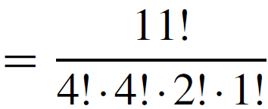
Example 10 – Solution
cont’d
Once the four S’s are in place, there are seven positions that remain empty, so there are $\left({7 \atop 4}\right)$subsets of four positions for the I’s.
After the I’s are in place, there are three positions left empty, so there are $\left({3 \atop 2}\right)$ subsets of two positions for the P’s.
That leaves just $\left({1 \atop 1}\right)$ position for the M.
Hence by the multiplication rule,

Slide 28
Counting Subsets of a Set: Combinations
The reasoning used in this example can be used to derive the following general theorem.

Slide 29
Excercise
Consider various ways of ordering the letters in the word STUDENT: How many distinguishable orderings are there?
Consider various ways of ordering the letters in the word BANANA: How many distinguishable orderings are there?

Slide 30
Common Incorrect Solutions: Double Counting
Be sure not to double-count!
Example: A group consists of five men and seven women. How many teams of five contain at least one man?
Incorrect Solution Imagine constructing the team as a two-step process:
Step 1: Choose a subset of one man from the five men.
Step 2: Choose a subset of four others from the remaining eleven people.

Slide 31
Common Incorrect Solutions: Double Counting
cont’d
Hence, by the multiplication rule, there are  = 1,650 five-person teams that contain at least one man.
Analysis of the Incorrect Solution The problem with the solution is that some teams are counted more than once. Suppose the men are Anwar, Ben, Carlos, Dwayne, and Ed and the women are Fumiko, Gail, Hui-Fan, Inez, Jill, Kim, and Laura.
According to the method described previously, one possible outcome of the two-step process is as follows:
Outcome of step 1: Anwar
Outcome of step 2: Ben, Gail, Inez, and Jill.

Slide 32
Common Incorrect Solutions: Double Counting
cont’d
In this case the team would be {Anwar, Ben, Gail, Inez, Jill}. But another possible outcome is
Outcome of step 1: Ben
Outcome of step 2: Anwar, Gail, Inez, and Jill,
which also gives the team {Anwar, Ben, Gail, Inez, Jill}.
Thus this one team is given by two different branches of the possibility tree, and so it is counted twice.

