Slide 1
Probability
Imagine tossing two coins and observing whether 0, 1, or 2 heads are obtained. It would be natural to guess that each of these events occurs about one-third of the time, but in fact this is not the case.
The table below shows actual data obtained from tossing two quarters 50 times.
Experimental Data Obtained from Tossing Two Quarters 50 Times

Slide 2
Probability
There is a 1 in 4 chance of obtaining two heads and a 1 in 4 chance of obtaining no heads.
The chance of obtaining one head, however, is 2 in 4 because either A could come up heads and B tails or B could come up heads and A tails.
Equally Likely Outcomes from Tossing Two Balanced Coins

Slide 3
Probability
So if you repeatedly toss two balanced coins and record the number of heads, you should expect relative frequencies similar to those shown below.
To formalize this analysis and extend it to more complex situations, we introduce the notions of random process, sample space, event and probability.
Experimental Data Obtained from Tossing Two Quarters 50 Times

Slide 4
Probability
To say that a process is random means that when it takes place, one outcome from some set of outcomes is sure to occur, but it is impossible to predict with certainty which outcome that will be.
In case an experiment has finitely many outcomes and all outcomes are equally likely to occur, the probability of an event (set of outcomes) is just the ratio of the number of outcomes in the event to the total number of outcomes.

Slide 5
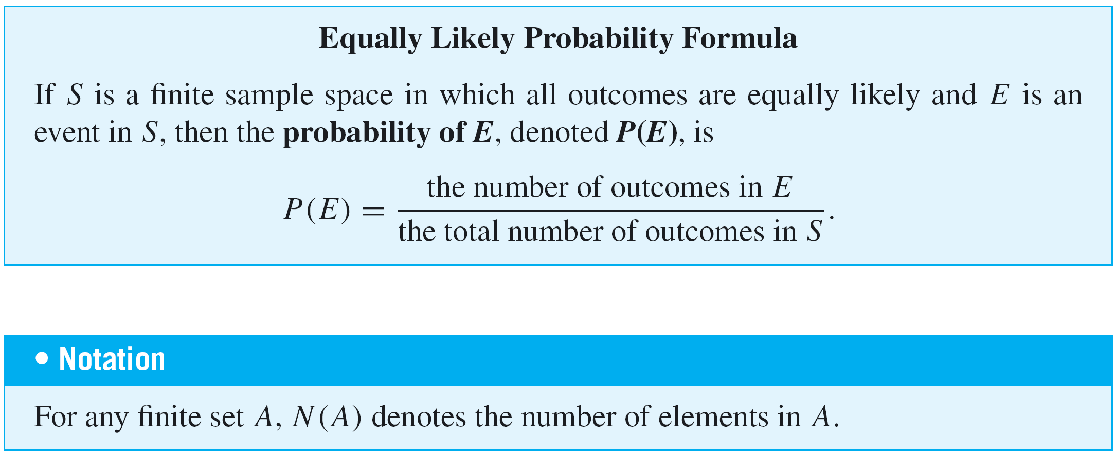
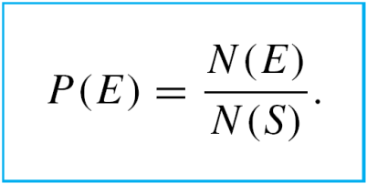
Probability
With this notation, the equally likely probability formula becomes

Slide 6
Example 2 – Rolling a Pair of Dice
Suppose a blue die and a gray die are rolled together, and the numbers of dots that occur face up on each are recorded. The possible outcomes can be listed as follows.

Slide 7
Example 2 – Rolling a Pair of Dice
cont’d
A more compact notation identifies, say, with the
notation 24, with 53, and so forth.
Use this notation to write the event E that the numbers showing face up have a sum of 6 and find the probability of this event.
Solution: E = {15, 24, 33, 42, 51}.
Let P(E) be the probability of the event of the numbers
whose sum is 6. Then,

Slide 8
Example 4 – Counting the Elements of a Sublist
What is the probability that a randomly chosen three-digit integer is divisible by 5?
Solution:
The answer is
Number of three-digit integers divisible by 5
Number of three-digit integers

Slide 9
Example 4 – Solution
cont’d
Note that there are n – m + 1 integers in [m, n] if n > m.
There are 999 – 100 + 1 = 900 integers from [100, 999].
There are 199 – 20 + 1 = 180 three-digit integers that are divisible by 5, since there are as many three-digit multiples of 5 as there are integers in [20, 199].
Hence the probability that a randomly chosen three-digit integer is divisible by 5 is 180/900 = 1/5.

