Slide 1
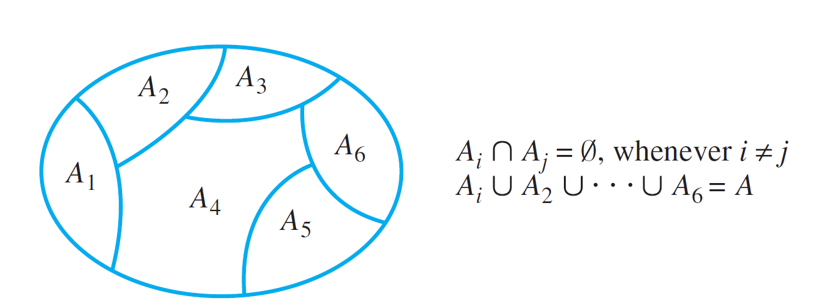
The Relation Induced by a Partition
A partition of a set A is a finite or infinite collection of nonempty, mutually disjoint subsets whose union is A. The diagram below illustrates a partition of a set A by subsets A₁, A₂, . . . , A₆.
A Partition of a Set

Slide 2
The Relation Induced by a Partition

Slide 3
Example 1 – Relation Induced by a Partition
Let A = {0, 1, 2, 3, 4} and consider the following partition of A:
{0, 3, 4}, {1}, {2}.
Find the relation R induced by this partition.
Solution: Since {0, 3, 4} is a subset of the partition,
0 R 3 because both 0 and 3 are in {0, 3, 4},
3 R 0 because both 3 and 0 are in {0, 3, 4}, …
Hence
R = {(0, 0), (0, 3), (0, 4), (1, 1), (2, 2), (3, 0), (3, 3), (3, 4), (4, 0), (4, 3), (4, 4)}.

Slide 4
The Relation Induced by a Partition
A relation induced by a partition of a set satisfies all three properties: reflexivity, symmetry, and transitivity.

Slide 5
Definition of an Equivalence Relation
A relation on a set that satisfies the three properties of reflexivity, symmetry, and transitivity is called an equivalence relation.
Thus, the relation induced by a partition is an equivalence relation.

Slide 6
Example 2 – An Equivalence Relation on a Set of Subsets
Let X be the set of all nonempty subsets of {1, 2, 3}. Then
X = {{1}, {2}, {3}, {1, 2}, {1, 3}, {2, 3}, {1, 2, 3}}
Define a relation R on X as follows: For all A and B in X,
A R B ⇔ the least element of A equals the least element of B.
Prove that R is an equivalence relation on X.

Slide 7
Example 2 – Solution
R is reflexive: Suppose A is a nonempty subset of {1, 2, 3}. [We must show that A R A.]
The least element of A equals the least element of A. Thus, by definition of R, A R A.
R is symmetric: Suppose A and B are nonempty subsets of {1, 2, 3} and A R B. [We must show that B R A.]
Since A R B, the least element of A equals the least element of B.
But this implies that the least element of B equals the least element of A, and so, by definition of R, B R A.

Slide 8
Example 2 – Solution
cont’d
R is transitive: Suppose A, B, and C are nonempty subsets of {1, 2, 3}, A R B, and B R C. [We must show that A R C.]
Since A R B, the least element of A equals the least element of B and since B R C, the least element of B equals the least element of C.
Thus the least element of A equals the least element of C, and so, by definition of R, A R C.

Slide 9
Equivalence Classes of an Equivalence Relation
Suppose there is an equivalence relation on a certain set. If a is any particular element of the set, then one can ask, “What is the subset of all elements that are related to a?” This subset is called the equivalence class of a.

Slide 10
Equivalence Classes of an Equivalence Relation
When several equivalence relations on a set are under discussion, the notation [a]_{R} is often used to denote the equivalence class of a under R.
The procedural version of this definition is

Slide 11
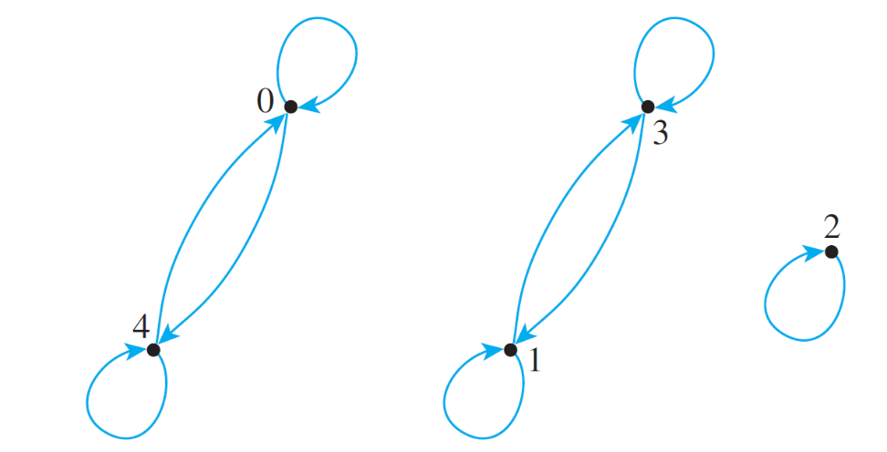
Example 5 – Equivalence Classes of a Relation Given as a set of Ordered Pairs
Let A = {0, 1, 2, 3, 4} and define a relation R on A as follows:
R = {(0, 0), (0, 4), (1, 1), (1, 3), (2, 2), (3, 1), (3, 3), (4, 0), (4, 4)}.
The directed graph for R is as shown below. As can be seen by inspection, R is an equivalence relation on A. Find the distinct equivalence classes of R.

Slide 12
Example 5 – Solution
First find the equivalence class of every element of A.
Note that [0] = [4] and [1] = [3]. Thus the distinct equivalence classes of the relation are
{0, 4}, {1, 3}, and {2}.

Slide 13
Equivalence Classes of an Equivalence Relation

Slide 14
Example 10 – Equivalence Classes of Congruence Modulo 3
Let R be the relation of congruence modulo 3 on the set Z of all integers. That is, for all integers m and n,
Describe the distinct equivalence classes of R.
Solution: For each integer a,
So,

Slide 15
Example 10 – Solution
cont’d
By the quotient-remainder theorem with d = 3, the equivalence classes of R are
[0] = {x ∈ Z | x = 3k for some integer k}
[1] = {x ∈ Z | x = 3k + 1 for some integer k}
[2] = {x ∈ Z | x = 3k + 2 for some integer k}
In words, the three classes of congruence modulo 3 are (1) the set of all integers that are divisible by 3, (2) the set of all integers that leave a remainder of 1 when divided by 3, and (3) the set of all integers that leave a remainder of 2 when divided by 3.

Slide 16
Congruence Modulo n

Slide 17
Example 11 – Evaluating Congruences
Determine which of the following congruences are true and which are false.
a. b. c.
Solution:
a. True. 12 – 7 = 5 = 5  1. Hence 5 | (12 – 7), and so 12 ≡ 7 (mod 5).
b. False. 6 – (–8) = 14, and because 14 ≠ 4  k for any integer k. Consequently,
c. True. 3 – 3 = 0 = 7  0. Hence 7 | (3 – 3), and so 3 ≡ 3 (mod 7).

Slide 18
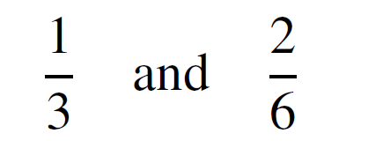
A Definition for Rational Numbers
For a moment, forget what you know about fractional arithmetic and look at the numbers
as symbols. Considered as symbolic expressions, these appear quite different. In fact, if they were written as ordered pairs
(1, 3) and (2, 6)
they would be different.

Slide 19
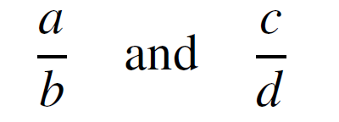
A Definition for Rational Numbers
The fact that we regard them as “the same” is a specific instance of our general agreement to regard any two numbers
as equal provided the cross products are equal: ad = bc. This can be formalized as follows, using the language of equivalence relations.

Slide 20
Example 12 – Rational Numbers Are Really Equivalence Classes
Let A be the set of all ordered pairs of integers for which the second element of the pair is nonzero. Symbolically,
Define a relation R on A as follows: For all (a, b), (c, d) ∈ A,
Then, R is an equivalence relation.

Slide 21
Example 12(a) – Solution
Proof that R is transitive: Suppose (a, b), (c, d), and (e, f ) are particular but arbitrarily chosen elements of A such that (a, b) R (c, d ) and (c, d ) R (e, f ).
[We must show that (a, b) R (e, f ).] By definition of R,
Since the second elements of all ordered pairs in A are nonzero, b ≠ 0, d ≠ 0, and f ≠ 0.

Slide 22
Example 12(a) – Solution
cont’d
Multiply both sides of equation (1) by f and both sides of equation (2) by b to obtain
Thus
and, since d ≠ 0, it follows from the cancellation law for multiplication that
It follows, by definition of R, that (a, b) R (e, f ) [as was to be shown].

Slide 23
Example 12(b) – Solution
cont’d
There is one equivalence class for each distinct rational number.
Each equivalence class consists of all ordered pairs (a, b) that, if written as fractions a/b, would equal each other.
The reason for this is that the condition for two rational numbers to be equal is the same as the condition for two ordered pairs to be related.

Slide 24
Example 12(b) – Solution
cont’d
For instance, the class of (1, 2) is
since and so forth.

