Slide 1
Reflexivity, Symmetry, and Transitivity
Let A = {2, 3, 4, 6, 7, 9} and define a relation R on A as follows: For all x, y ∈ A,
Then
2 R 2 because 2 – 2 = 0, and 3 | 0.
and similarly
3 R 3, 4 R 4, 6 R 6, 7 R 7, and 9 R 9.
Also
6 R 3 because 6 – 3 = 3, and 3 | 3.
3 R 6 because 3 – 6 = –(6 – 3) = –3, and 3 | (–3).
Similarly, 3 R 9, 9 R 3, 6 R 9, 9 R 6, 4 R 7, and 7 R 4.

Slide 2
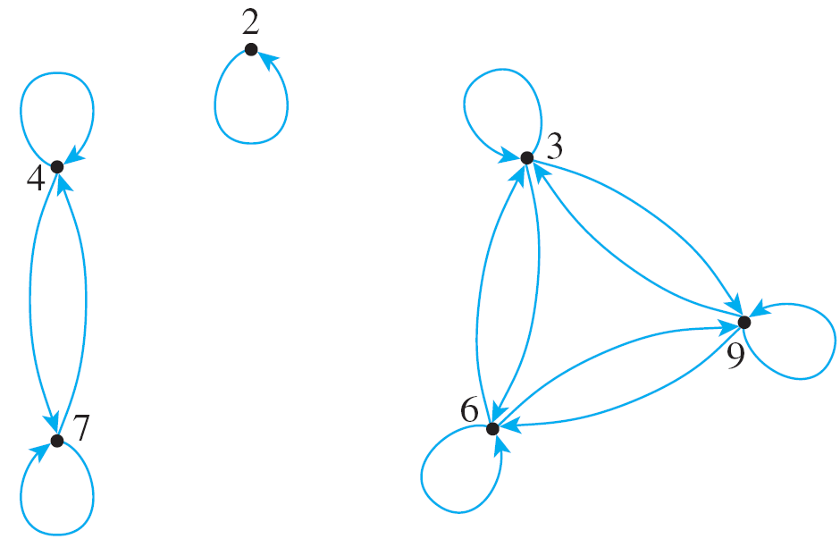
Reflexivity, Symmetry, and Transitivity
Thus the directed graph for R has the appearance shown at the right.
This graph has three important properties:
1. Each point of the graph has an arrow looping around from it back to itself.
2. In each case where there is an arrow going from one point to a second, there is an arrow going from the second point back to the first.

Slide 3
Reflexivity, Symmetry, and Transitivity
3. In each case where there is an arrow going from one point to a second and from the second point to a third, there is an arrow going from the first point to the third.
Properties (1), (2), and (3) correspond to properties of general relations called reflexivity, symmetry, and transitivity.

Slide 4
Reflexivity, Symmetry, and Transitivity
Because of the equivalence of the expressions x R y and (x, y) ∈ R for all x and y in A, the reflexive, symmetric, and transitive properties can also be written as follows:

Slide 5
Reflexivity, Symmetry, and Transitivity
In informal terms, properties (1)–(3) say the following:
1. Reflexive: Each element is related to itself.
2. Symmetric: If any one element is related to any other element, then the second element is related to the first.
3. Transitive: If any one element is related to a second and that second element is related to a third, then the first element is related to the third.
Note that the definitions of reflexivity, symmetry, and transitivity are universal statements.

Slide 6
Reflexivity, Symmetry, and Transitivity
This means that to prove a relation has one of the properties, you use either the method of exhaustion or the method of generalizing from the generic particular.
Now consider what it means for a relation not to have one of the properties defined previously. We have known that the negation of a universal statement is existential.
Hence if R is a relation on a set A, then
1. R is not reflexive ⇔ there is an element x in A such that [that is, such that (x, x) R].

Slide 7
Reflexivity, Symmetry, and Transitivity
2. R is not symmetric ⇔ there are elements x and y in A such that x R y but [that is, such that (x, y) ∈ R but (y, x) R].
3. R is not transitive ⇔ there are elements x, y and z in A such that x R y and y R z but [that is, such that (x, y) ∈ R and (y, z) ∈ R but (x, z) R].
It follows that you can show that a relation does not have one of the properties by finding a counterexample.

Slide 8
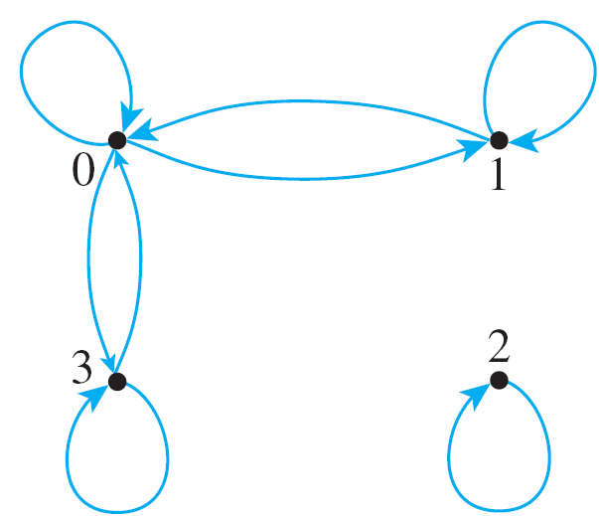
Example 1 – Properties of Relations on Finite Sets
Let A = {0, 1, 2, 3} and define relation R on A as follows:
R = {(0, 0), (0, 1), (0, 3), (1, 0), (1, 1), (2, 2), (3, 0), (3, 3)},
Is R reflexive? symmetric? transitive?
Solution: The directed graph of R is
Reflexive?
Yes
Symmetric?
Yes
Transitive?
No

Slide 9
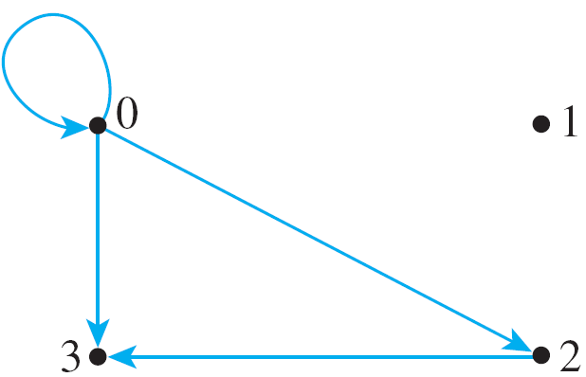
Example 1 – Properties of Relations on Finite Sets
Let A = {0, 1, 2, 3} and define relation S on A as follows:
S = {(0, 0), (0, 2), (0, 3), (2, 3)}
Is S reflexive? symmetric? transitive?
Solution: The directed graph of S is
Reflexive?
No
Symmetric?
No
Transitive?
Yes

Slide 10
Example 1 – Properties of Relations on Finite Sets
Let A = {0, 1, 2, 3} and define relation T on A as follows:
T = {(0, 1), (2, 3)}
Is T reflexive? symmetric? transitive?
Solution: The directed graph of T is
Reflexive?
No
Symmetric?
No
Transitive?
Yes (vacuously)

Slide 11
Properties of Relations on Infinite Sets
Suppose a relation R is defined on an infinite set A. To prove the relation is reflexive, symmetric, or transitive, first write down what is to be proved. For instance, for symmetry you need to prove that
∀ x, y ∈ A, if x R y then y R x.
Then use the definitions of A and R to rewrite the statement for the particular case in question. For instance, for the “equality” relation on the set of real numbers, the rewritten statement is
∀ x, y ∈ R, if x = y then y = x.

Slide 12
Example 2 – Properties of Equality
Define a relation R on R (the set of all real numbers) as follows: For all real numbers x and y.
Is R reflexive? symmetric? transitive?
Reflexive?
Yes
Symmetric?
Yes
Transitive?
Yes

Slide 13
Example 4 – Properties of Congruence Modulo 3
Define a relation T on Z (the set of all integers) as follows: For all integers m and n,
This relation is called congruence modulo 3.
Is T reflexive?
Solution: T is reflexive if and only if m T m for any m in Z. But m – m = 0 and 3 | 0 since 3 ⋅ 0 = 0. That is, m T m and so T is reflexive.

Slide 14
Example 4 – Properties of Congruence Modulo 3
Define a relation T on Z (the set of all integers) as follows: For all integers m and n,
This relation is called congruence modulo 3.
Is T symmetric?
Solution: To show that T is symmetric, we need to show that for all m, n ∈ Z, if m T n then n T m.
Suppose m and n are particular but arbitrarily chosen integers such that 3 | (m – n).

Slide 15
Example 4(b) – Solution
cont’d
By definition of “divides,” since
3 | (m – n),
then
m – n = 3k for some integer k
–(m – n) = –3k
n – m = 3(–k)
Since –k is an integer, this equation shows that
3 | (n – m).
It follows that T is symmetric.

Slide 16
Example 4 – Properties of Congruence Modulo 3
Define a relation T on Z (the set of all integers) as follows: For all integers m and n,
This relation is called congruence modulo 3.
Is T transitive?
Solution: To show that T is transitive, we need to show that for all m, n, p ∈ Z, if m T n and n T p then m T p.

Slide 17
Example 4(c) – Solution
cont’d
By definition of “divides,” since
3 | (m – n) and 3 | (n – p),
then m – n = 3r for some integer r,
and n – p = 3s for some integer s.
Add these two equations together to obtain
(m – n) + (n – p) = 3r + 3s,
which is equivalent to m – p = 3(r + s). Since r and s are integers, r + s is an integer. So this equation shows that
3 | (m – p).
It follows that T is transitive.

Slide 18
The Transitive Closure of a Relation
The transitive closure of a relation is the smallest transitive relation that contains the relation.

Slide 19
Example 5 – Transitive Closure of a Relation
Let A = {0, 1, 2, 3} and consider the relation R defined on A as follows:
R = {(0, 1), (1, 2), (2, 3)}.
Find the transitive closure of R.
Solution:
Every ordered pair in R is in R ^{t}, so
{(0, 1), (1, 2), (2, 3)} ⊆ R ^{t}.
Thus the directed graph of R contains the arrows shown at the right.

Slide 20
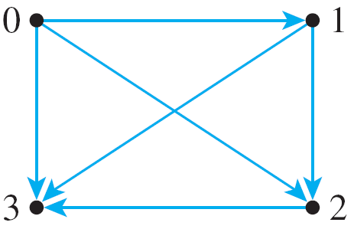
Example 5 – Solution
cont’d
Since there are arrows going from 0 to 1 and from 1 to 2, R ^{t} must have an arrow going from 0 to 2.
Hence (0, 2) ∈ R ^{t}. Then (0, 2) ∈ R ^{t} and (2, 3) ∈ R ^{t}, so since R ^{t} is transitive, (0, 3) ∈ R ^{t}.
Also, since (1, 2) ∈ R ^{t} and (2, 3) ∈ R ^{t}, then (1, 3) ∈ R ^{t}.
Thus R ^{t} contains at least the following ordered pairs:
{(0, 1), (0, 2), (0, 3), (1, 2), (1, 3), (2, 3)}.
But this relation is transitive; hence it equals R ^{t}. Note that the directed graph of R ^{t} is as shown at the right.

