Slide 1
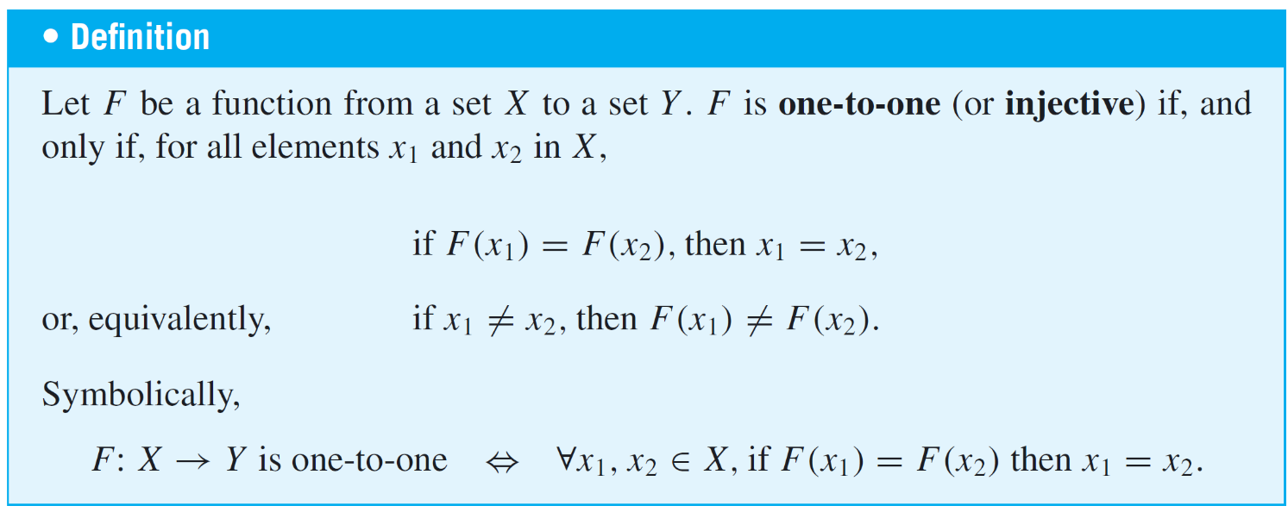
Injections
A function is one-to-one (injective) if each element of the range is the image of at most one element of the domain.
To obtain a precise statement of what it means for a function not to be injective, take the negation of one of the equivalent versions of the definition above.

Slide 2
Injections
Thus:
That is, if elements x₁ and x₂ can be found that have the same function value but are not equal, then F is not injective.

Slide 3
Injective Functions on Infinite Sets
Now suppose f is a function defined on an infinite set X. By definition, f is injective if, and only if, the following universal statement is true:
Thus, to prove f is injective, you will generally use the method of direct proof:
suppose x₁ and x₂ are elements of X such that f (x₁) = f (x₂)
and show that x₁ = x₂.

Slide 4
Injective Functions on Infinite Sets
To show that f is not injective, you will ordinarily
find elements x₁ and x₂ in X so that f (x₁) = f (x₂) but x₁ ≠ x₂.

Slide 5
Example 2 – Proving or Disproving That Functions Are Injective
Define f : R → R as follows:
Is f injective?
Yes. Let x₁ and x₂ be any two real numbers. Then,
f(x₁) = f(x₂) ⇒ 4x₁ – 1 = 4x₂ – 1
⇒ 4x₁ = 4x₂
⇒ x₁ = x₂

Slide 6
Example 2 – Proving or Disproving That Functions Are Injective
Define g: Z → Z as follows:
Is g injective?
No. For example, g(−1) = (−1)² = (1)² = g(1), but −1 ≠ 1.

Slide 7
Surjections
If every element of a function’s co-domain is the image of some element of its domain, then the function is called onto or surjective. When a function is surjective, its range is equal to its co-domain.

Slide 8
Surjections
To obtain a precise statement of what it means for a function not to be surjective, take the negation of the definition:
That is, there is some element in Y that is not the image of any element in X.
In terms of arrow diagrams,
A function is surjective if each element of the co-domain has an arrow pointing to it from some element of the domain.
A function is not surjective if at least one element in its co-domain does not have an arrow pointing to it.

Slide 9
Surjective Functions on Infinite Sets
Now suppose F is a function from a set X to a set Y, and suppose Y is infinite. By definition, F is surjective if, and only if, the following universal statement is true:
Thus to prove F is surjective, you will ordinarily use the method of generalizing from the generic particular:
suppose that y is any element of Y
and show that there is an element X of X with F(x) = y.
To prove F is not surjective, you will usually
find an element y of Y such that y ≠ F(x) for any x in X.

Slide 10
Example 5 – Proving or Disproving That Functions Are Surjective
Define f : R → R as follows:
Is f surjective?
Yes. Let y be any real number, and let x = (y+1)/4. Then, x is a real number, and
f(x) = 4x – 1
= 4 ((y+1)/4) – 1
= (y+1) – 1
= y

Slide 11
Example 5 – Proving or Disproving That Functions Are Surjective
Define h: Z → Z as follows:
Is h surjective?
No. Suppose there is an n ∈ Z such that h(n) = 0. Then,
h(n) = 0 ⇒ 4n – 1 = 0
⇒ n = ¼
But ¼ is not an integer.

Slide 12
Bijections
Suppose F: X → Y is both injective and surjective.
It’s a function: every element in X has exactly one outgoing arrow.
It’s injective: every element in Y has at most one incoming arrow.
It’s surjective: every element in Y has at least one incoming arrow.
Therefore, every element in Y has exactly one incoming arrow.
Thus, a function that is injective and surjective sets up a pairing between the elements of X and the elements of Y that matches each element of X with exactly one element of Y and each element of Y with exactly one element of X.

Slide 13
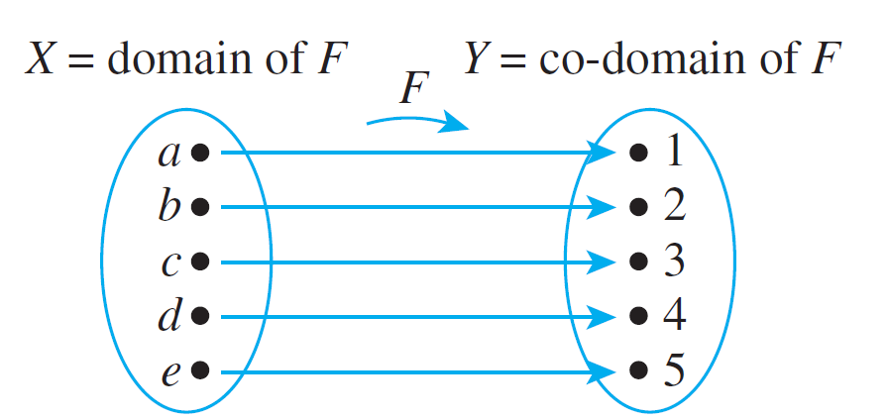
Bijections
A one-to-one correspondence or bijection and is illustrated by the arrow diagram below.
An Arrow Diagram for a Bijection

Slide 14
Example 10 – A Function of Two Variables
Define a function
F: R × R → R × R as follows: For all (x, y) ∈ R × R,
Is F a bijection from R × R to itself?
Solution: The answer is yes. To show that F is a bijection, you need to show both that F is injective and that F is surjective.

Slide 15
Example 10 – Solution
cont’d
Proof that F is injective: Suppose that (x₁, y₁) and (x₂, y₂) are any ordered pairs in R × R such that
[We must show that (x₁, y₁) = (x₂, y₂).] By definition of F,
For two ordered pairs to be equal, both the first and second components must be equal. Thus x₁, y₁, x₂, and y₂ satisfy the following system of equations:

Slide 16
Example 10 – Solution
cont’d
Adding equations (1) and (2) gives that
Substituting x₁ = x₂ into equation (1) yields
Thus, by definition of equality of ordered pairs, (x₁, y₁) = (x₂, y₂). [as was to be shown].

Slide 17
Example 10 – Solution
cont’d
Scratch Work for the Proof that F is surjective: To prove that F is surjective, you suppose you have any ordered pair in the co-domain R × R, say (u, v), and then you show that there is an ordered pair in the domain that is sent to (u, v) by F.
If there is such a pair (r, s), then
F(r, s) = (r + s, r – s) = (u, v)
and so
r + s = u
r – s = v
2r = u + v
Now check that r = (u+v)/2 and s = (u–v)/2 work, in the sense that r, s ∈ R and F(r, s) = (u, v).
⇒
2s = u – v

Slide 18
Example 10 – Solution
cont’d
Proof that F is surjective: Suppose (u, v) is any ordered pair in the co-domain of F. [We will show that there is an ordered pair in the domain of F that is sent to (u, v) by F.]
Let
Then (r, s) is an ordered pair of real numbers and so is in the domain of F. In addition:

Slide 19
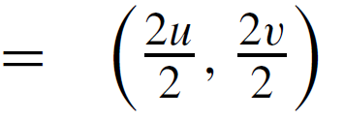
Example 10 – Solution
cont’d
[This is what was to be shown.]

Slide 20
Inverse Functions
If F is a bijection from a set X to a set Y, then there is a function from Y to X that “undoes” the action of F; that is, it sends each element of Y back to the element of X that it came from. This function is called the inverse function for F.

Slide 21
Inverse Functions
The proof of Theorem 7.2.2 follows immediately from the definition of injective and surjective.
Given an element y in Y, there is an element x in X with F(x) = y because F is surjective; x is unique because F is injective.

Slide 22
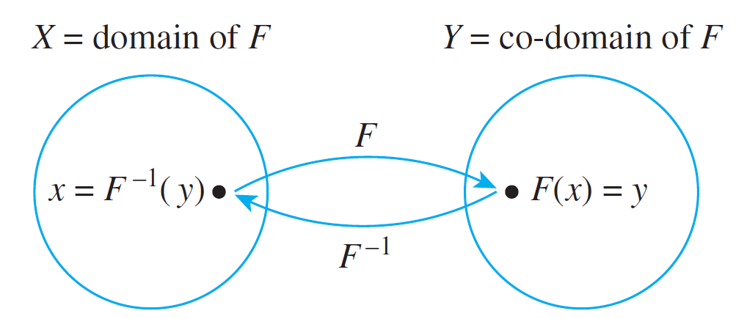
Inverse Functions
The diagram that follows illustrates the fact that an inverse function sends each element back to where it came from.

Slide 23
Example 13 – Finding an Inverse Function for a Function Given by a Formula
The function f : R → R defined by the formula
was shown to be injective in Example 2 and surjective in Example 5. Find its inverse function.
Solution:
For any [particular but arbitrarily chosen] y in R, by definition of f ^{–1},
f ^{–1}(y) = that unique real number x such that f (x) = y.

Slide 24
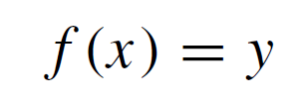
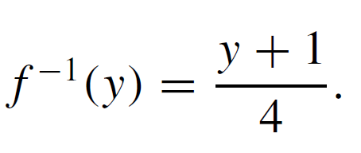
Example 13 – Solution
cont’d
But
Hence

Slide 25
Inverse Functions
The following theorem follows easily from the definitions.

Slide 26
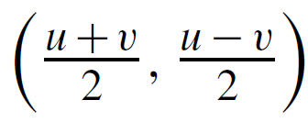
Example 14 – Finding an Inverse Function for a Function of Two Variables
Define the inverse function F^{–1} : R × R → R × R for the bijection given in Example 10.
Solution:
The solution to Example 10 shows that
Because F is injective, this means that the unique ordered pair in the domain of F that is sent to (u, v) by F.
Thus, F^{–1} is defined as follows: For all (u, v) ∈ R × R,
$$F\left(\frac{u+v}{2},\frac{u−v}{2}\right)=\left(u,v\right)$$

