Slide 1
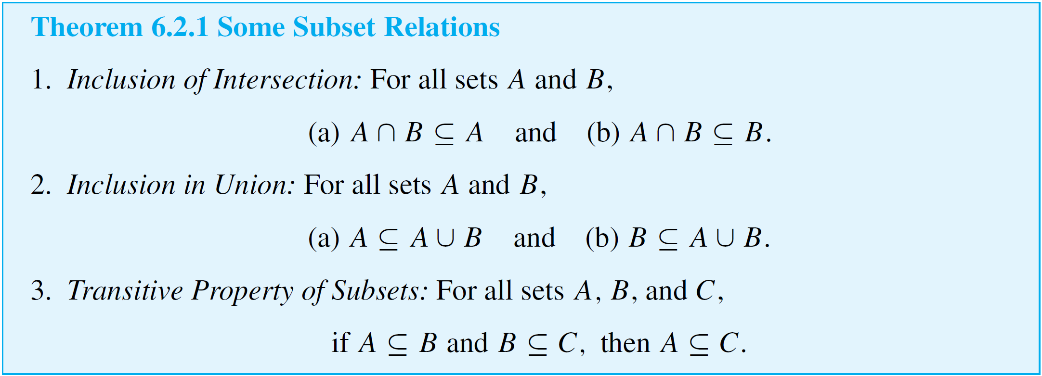
Properties of Sets
We begin by listing some set properties that involve subset relations.

Slide 2
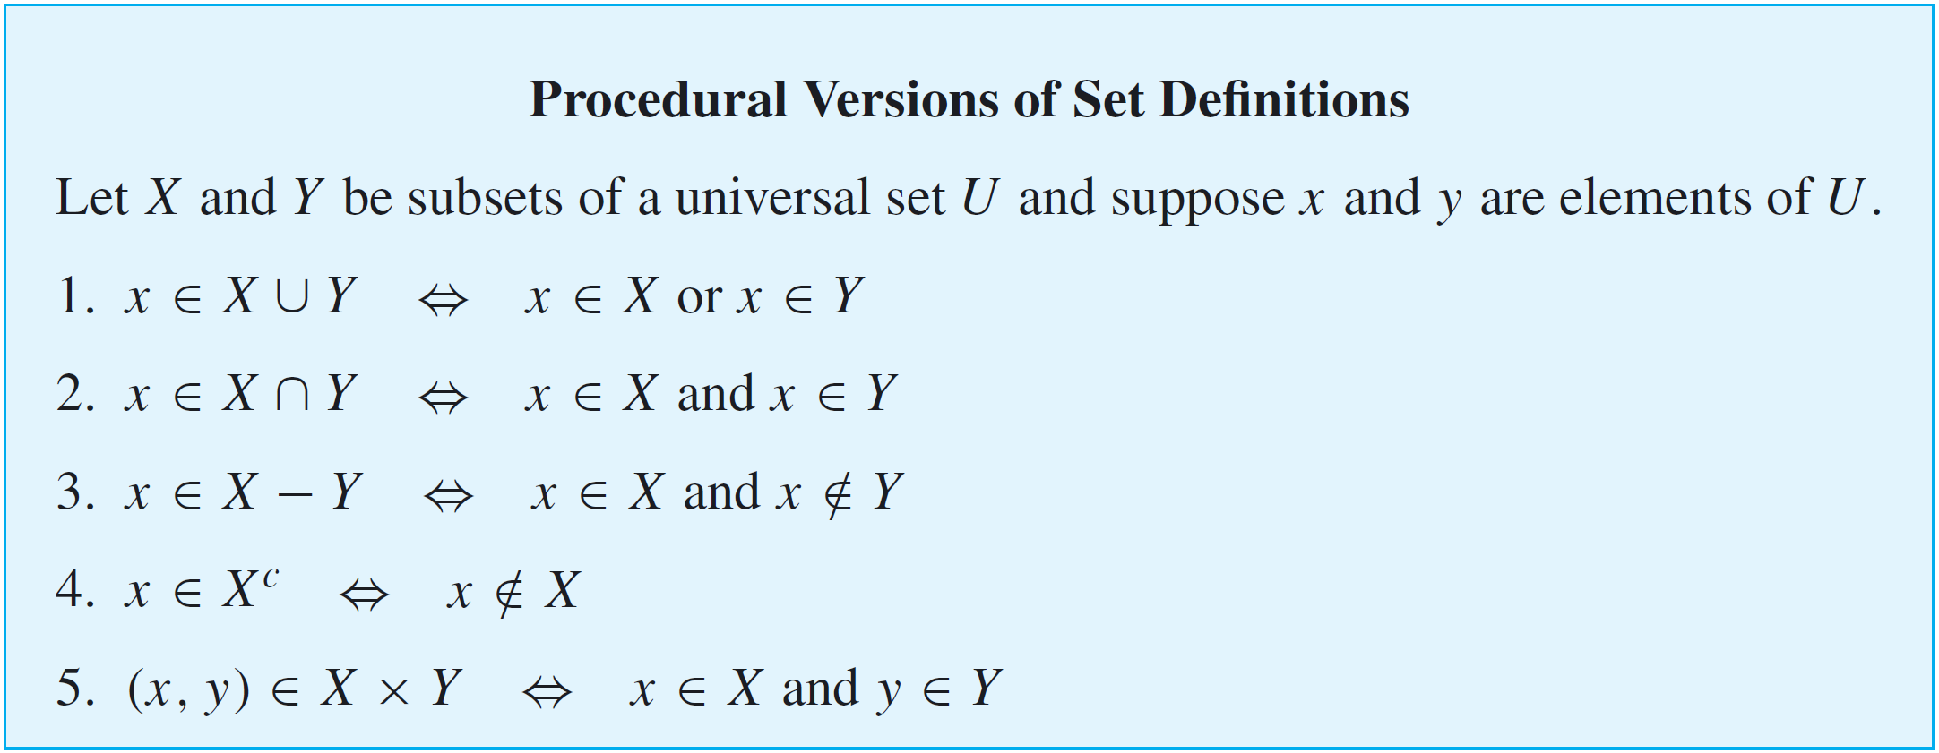
Properties of Sets
Procedural versions of the definitions of the other set operations are derived similarly and are summarized below.

Slide 3
Set Identities
An identity is an equation that is universally true for all elements in some set. For example, the equation a + b = b + a is an identity for real numbers because it is true for all real numbers a and b.
The collection of set properties in the next theorem consists entirely of set identities. That is, they are equations that are true for all sets in some universal set.

Slide 4
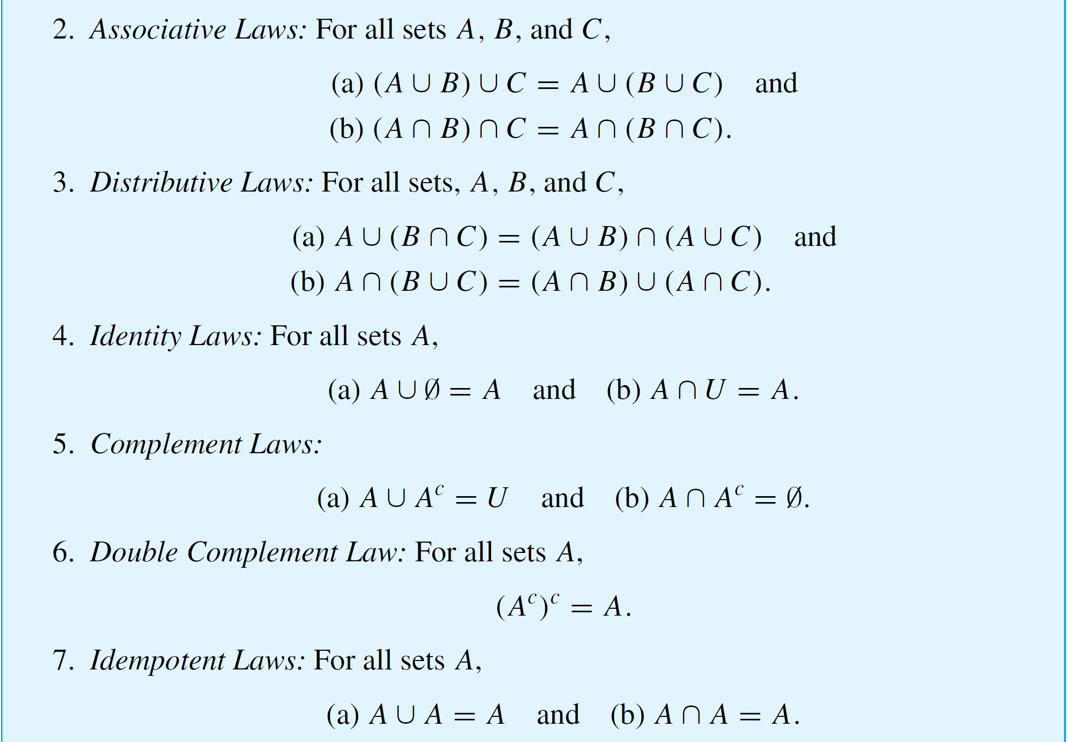
Set Identities
cont’d

Slide 5
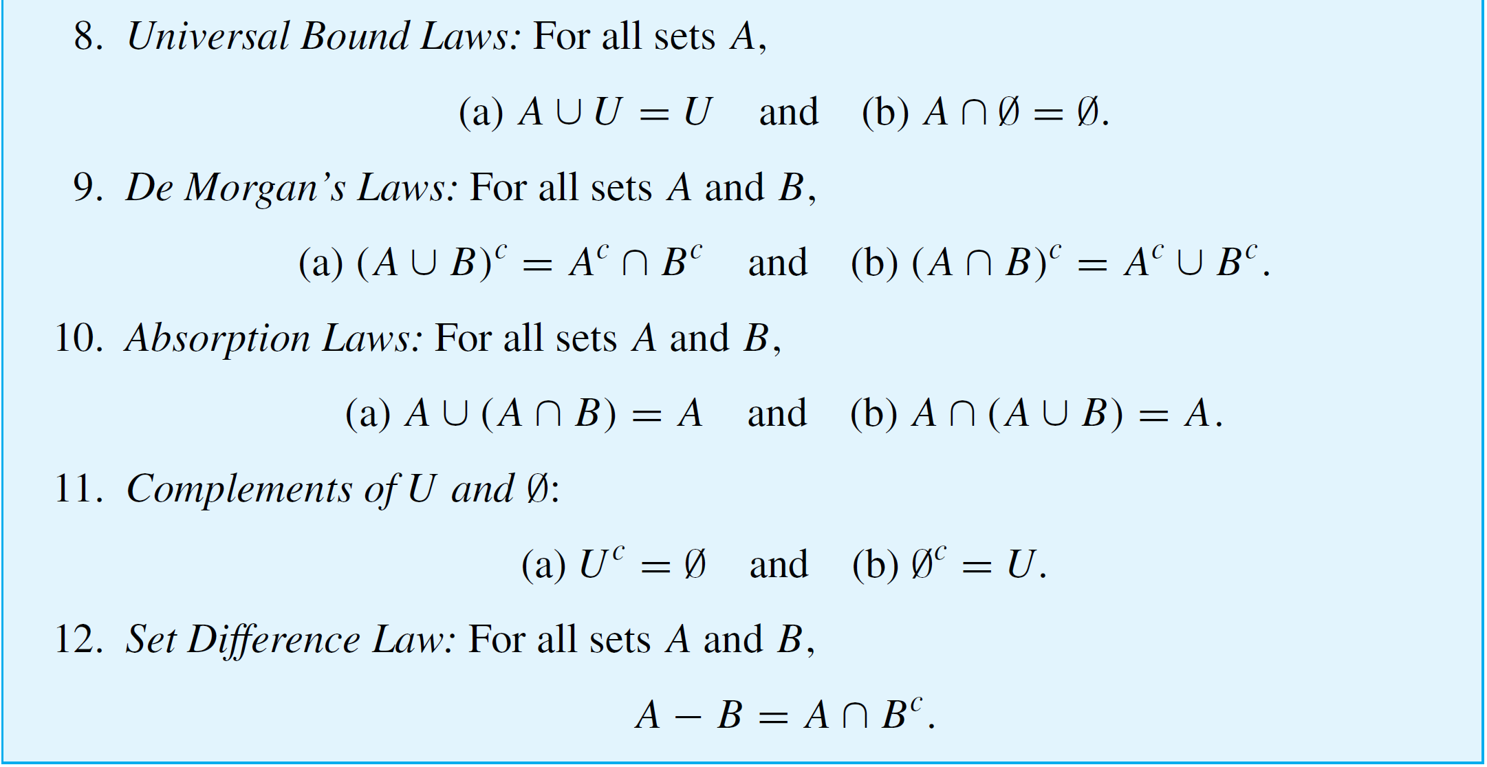
Set Identities
cont’d

Slide 6
Proving Set Identities
As we have known,
Two sets are equal ⇔ each is a subset of the other.
The method derived from this fact is the most basic way to prove equality of sets.

Slide 7
Example 2 – Proof of a Distributive Law
Prove that for all sets A, B, and C,
A ∪ (B ∩ C) = (A ∪ B) ∩ (A ∪ C).
Solution:
Part 1: Show that A ∪ (B ∩ C) ⊆ (A ∪ B) ∩ (A ∪ C).
Suppose x ∈ A ∪ (B ∩ C). Then, x ∈ A or x ∈ (B ∩ C).
Case 1: x ∈ A ⇒ x ∈ (A ∪ B) and x ∈ (A ∪ C)
⇒ x ∈ (A ∪ B) ∩ (A ∪ C)
Case 2: x ∈ (B ∩ C) ⇒ x ∈ B and x ∈ C
⇒ x ∈ (A ∪ B) and x ∈ (A ∪ C)
⇒ x ∈ (A ∪ B) ∩ (A ∪ C)
by “inclusion in union”
by “inclusion in union”

Slide 8
Example 2 – Proof of a Distributive Law
Part 2: Show that (A ∪ B) ∩ (A ∪ C) ⊆ A ∪ (B ∩ C).
Suppose x ∈ (A ∪ B) ∩ (A ∪ C). Then,
x ∈ A ∪ B and x ∈ A ∪ C [1]
Case 1: x ∈ A ⇒ x ∈ A ∪ (B ∩ C)
Case 2: x ∉ A ⇒ x ∈ B and x ∈ C
⇒ x ∈ B ∩ C
⇒ x ∈ A ∪ (B ∩ C)
by “inclusion in union”
by [1]
by “inclusion in union”

Slide 9
Proving Set Identities
Suppose A and B are arbitrarily chosen sets.

Slide 10
Proving Set Identities
The set property given in the next theorem says that if one set is a subset of another, then their intersection is the smaller of the two sets and their union is the larger of the two sets.

Slide 11
The Empty Set
If E is a set with no elements and A is any set, then to say that E ⊆ A is the same as saying that
∀x, if x ∈ E, then x ∈ A.
But since E has no elements, this conditional statement is vacuously true.

Slide 12
The Empty Set
For since there is only one set with no elements (namely Ø), if the given set has no elements, then it must equal Ø.

Slide 13
Example 5 – Solution
cont’d
Proof: Suppose A, B, and C are any sets such that A ⊆ B and B ⊆ C^{c}. We must show that A ∩ C = Ø.
Suppose not. That is, suppose there is an x in A ∩ C.
x ∈ A ∩ C ⇒ x ∈ A and x ∈ C [1]
x ∈ A ⇒ x ∈ B since A ⊆ B
⇒ x ∈ C^{c} since B ⊆ C^{c}
⇒ x ∉ C [2]
But [1] and [2] contradict. So the supposition that there is an element x in A ∩ C is false, and thus A ∩ C = Ø.

Slide 14
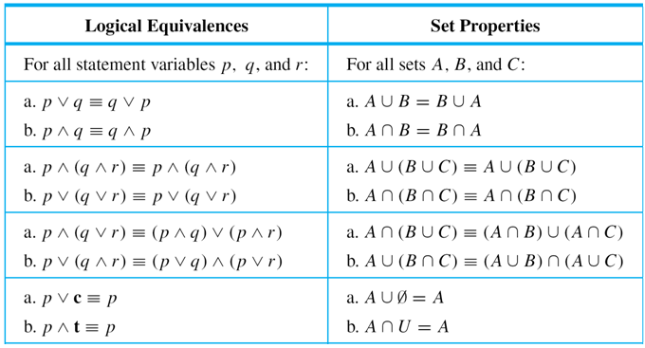
Boolean Algebras
Table 6.4.1 summarizes the main features of the logical equivalences from Theorem 2.1.1 and the set properties from Theorem 6.2.2. Notice how similar the entries in the two columns are.
Table 6.4.1

Slide 15
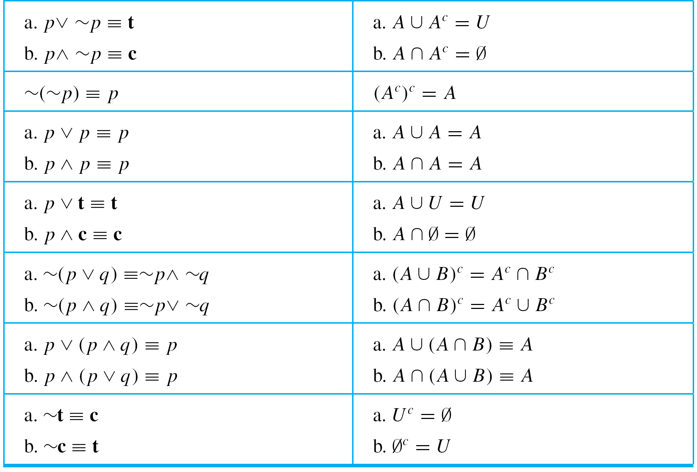
Boolean Algebras
Table 6.4.1 (continued)

