Slide 1
The Language of Sets
Intuitively, a set is simply a collection of elements.
unordered, no duplicate
If S is a set, then
  “x ∈ S” means x is an element of S
  “x ∉ S” means x is not an element of S
Set-roster notation:
  S = {1, 2, 3}
  S = {1, 2, …, 100}
  S = {1, 2, …}
Set-builder notation:
  { x ∈ S | P(x) } where the “|” is read “such that”.
  S = {x ∈ S | x≥1 }
  S = {x ∈ S | 1 ≤ x ≤100}

Slide 2
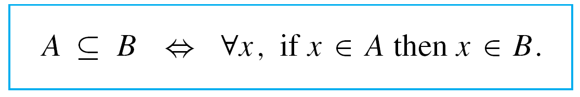
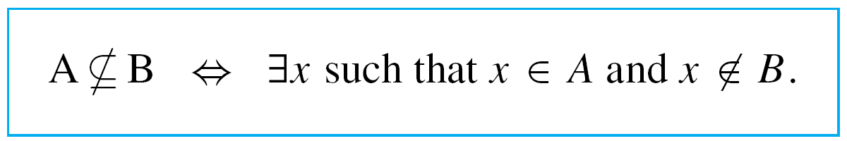
Subsets: Proof and Disproof
We begin by rewriting what it means for a set A to be a subset of a set B as a formal universal conditional statement:
The negation is, therefore, existential:

Slide 3
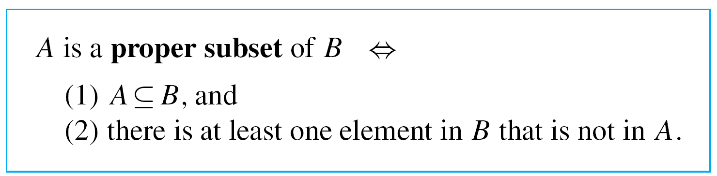
Subsets: Proof and Disproof
A proper subset of a set is a subset that is not equal to its containing set. Thus

Slide 4
Example
Let A = {1} , B = {1,2}, C = {1, 2, {1}}.
Is A ⊆ B?
Is A ⊆ C?
Is B ⊆ C?
Is 1 ∈ C?
Is A ∈ C?
Is B ∈ C?

Slide 5
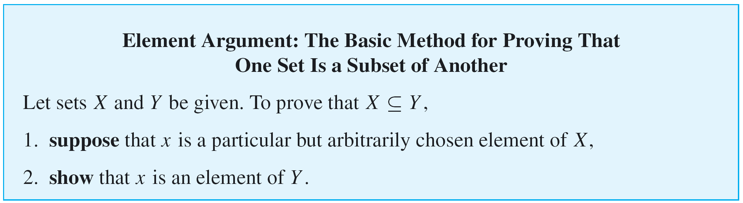
Subsets: Proof and Disproof

Slide 6
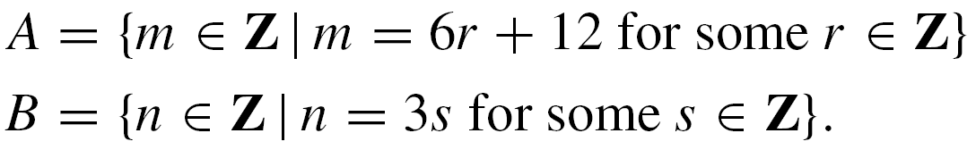
Example 2 – Proving and Disproving Subset Relations
Define sets A and B as follows:
Prove that A ⊆ B.
Proof:
Suppose x is a particular but arbitrarily chosen element of A. [We must show that x∈B, i.e., that x = 3s for some integer s.]

Slide 7
Example 2 – Solution
cont’d
By definition of A, there is an integer r such that
x = 6r + 12.
Let s = 2r + 4. Then s is an integer because products and sums of integers are integers. Also,
3s = 6r + 12 = x
and so x ∈ B.

Slide 8
Example 2 – Solution
cont’d
Disprove that B ⊆ A.
To disprove a statement means to show that it is false, and to show it is false that B ⊆ A, you must find an element of B that is not an element of A.
By the definitions of A and B, this means that you must find an integer x of the form 3  (some integer) that cannot be written in the form 6  (some integer) + 12.

Slide 9
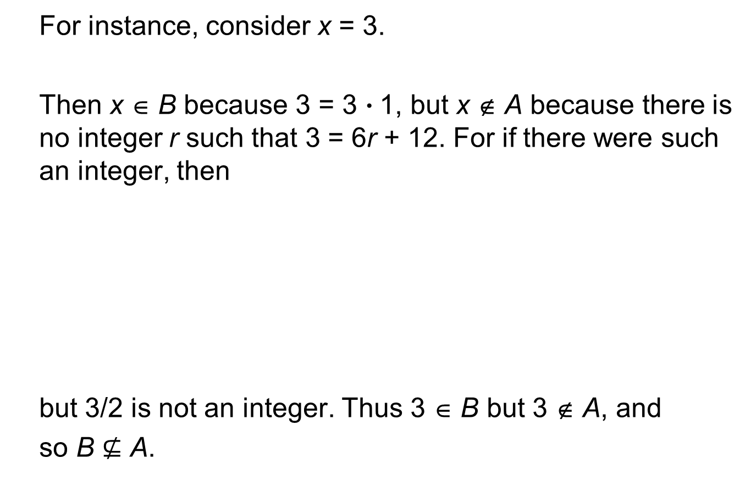
Example 2 – Solution
For instance, consider x = 3.
Then x ∈ B because 3 = 3  1, but x ∉ A because there is no integer r such that 3 = 6r + 12. For if there were such an integer, then
but 3/2 is not an integer. Thus 3 ∈ B but 3 ∉ A, and
so B $⊈$ A.

Slide 10
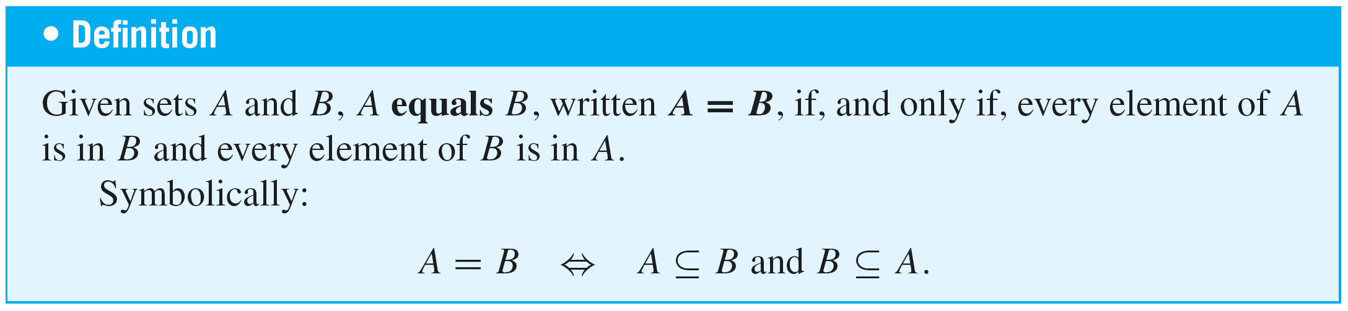
Set Equality
We have known that by the axiom of extension, sets A and B are equal if, and only if, they have exactly the same elements.
We restate this as a definition that uses the language of subsets.

Slide 11
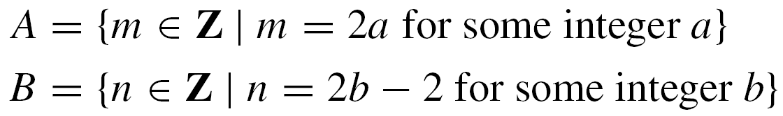
Example 3 – Set Equality
Define sets A and B as follows:
Is A = B?
Solution:
Yes. To prove this, both subset relations A ⊆ B and B ⊆ A must be proved.

Slide 12
Example 3 – Solution
cont’d
Part 1, Proof That A ⊆ B:
Suppose x is a particular but arbitrarily chosen element of A.
By definition of A, there is an integer a such that x = 2a.
Let b = a + 1. Then b is an integer because it is a sum of integers.
Also 2b – 2 = 2(a + 1) – 2 = 2a + 2 – 2 = 2a = x,
Thus, by definition of B, x is an element of B.
Part 2, Proof That B ⊆ A:
Similarly we can prove that B ⊆ A. Hence A = B.

Slide 13
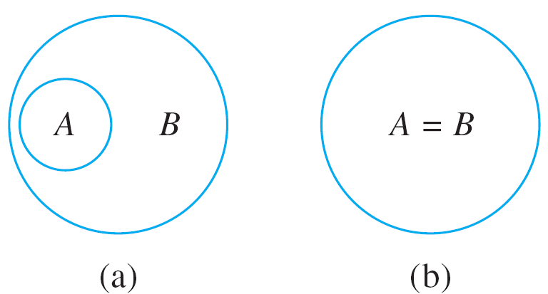
Venn Diagrams
If sets A and B are represented as regions in the plane, relationships between A and B can be represented by pictures, called Venn diagrams, that were introduced by the British mathematician John Venn in 1881.
For instance, the relationship A ⊆ B can be pictured in one of two ways, as shown below.
A ⊆ B

Slide 14

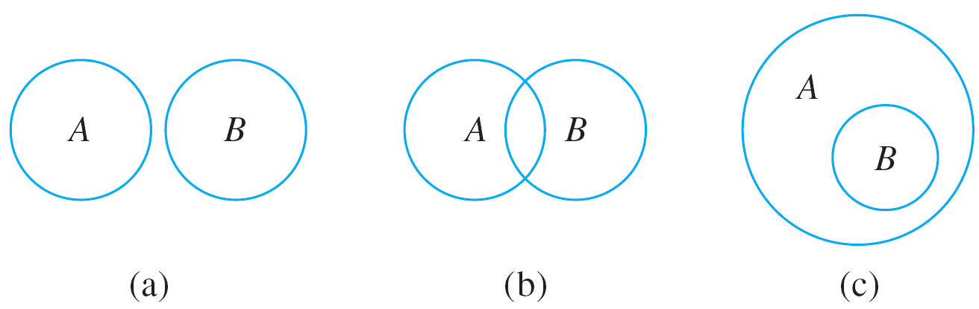

Venn Diagrams
The relationship A B can be represented in three different ways with Venn diagrams, as shown below.
A B

Slide 15


Example 4 – Relations among Sets of Numbers
Since Z, Q, and R denote the sets of integers, rational numbers, and real numbers, respectively, Z is a subset of Q because every integer is rational (any integer n can be written in the form ).
Q is a subset of R because every rational number is real (any rational number can be represented as a length on the number line).
Z is a proper subset of Q because there are rational numbers that are not integers (for example, ).

Slide 16


Example 4 – Relations among Sets of Numbers
cont’d
Q is a proper subset of R because there are real numbers that are not rational (for example, ).
This is shown diagrammatically below.

Slide 17
Operations on Sets
Most mathematical discussions are carried on within some context. For example, in a certain situation all sets being considered might be sets of real numbers.
In such a situation, the set of real numbers would be called a universal set or a universe of discourse for the
discussion.

Slide 18
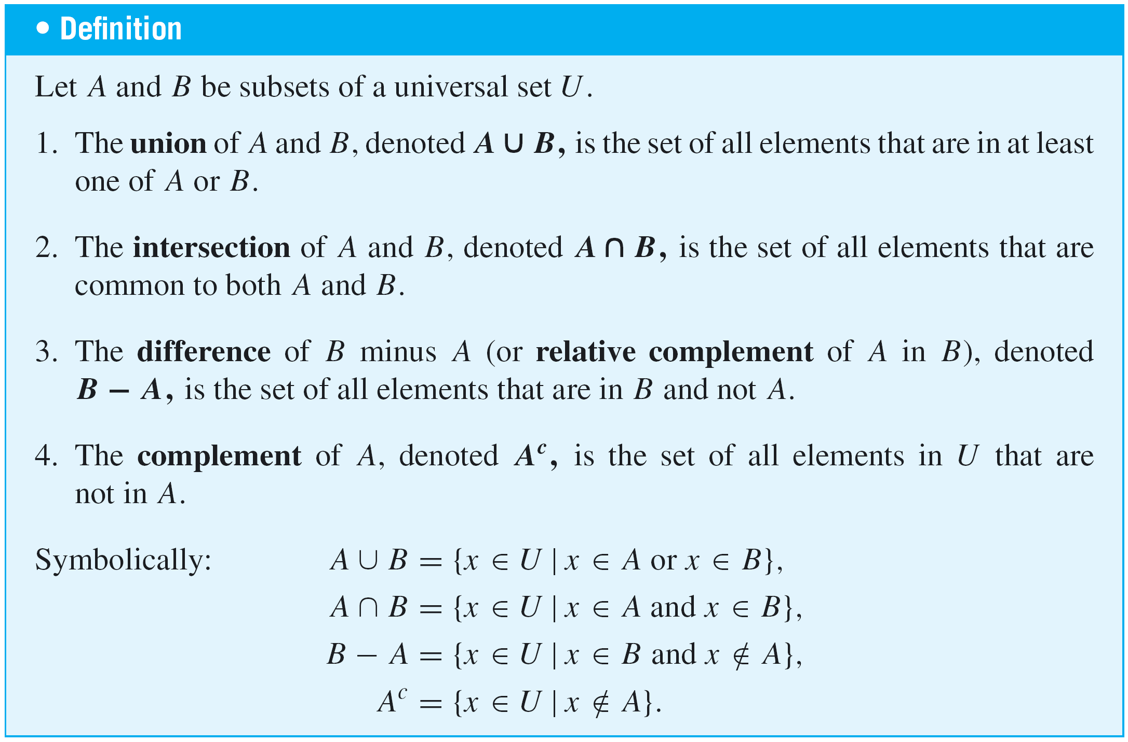
Operations on Sets

Slide 19
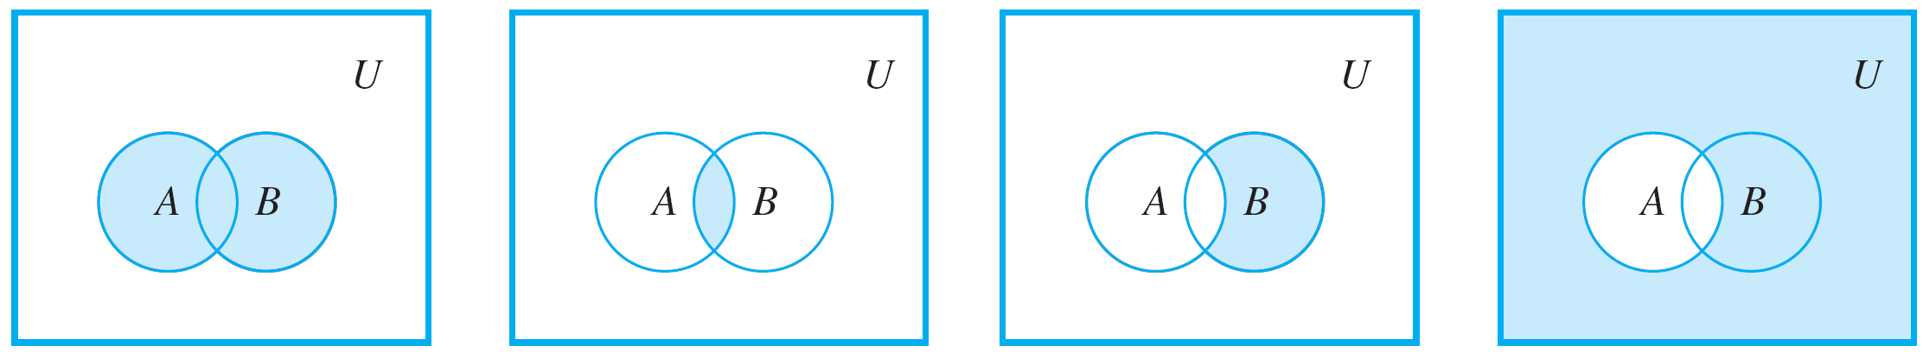
Operations on Sets
Venn diagram representations for union, intersection, difference, and complement are shown below.
Shaded region
represents A ∪ B.
Shaded region
represents A ∩ B.
Shaded region
represents B – A.
Shaded region
represents A^{c}.

Slide 20




Example 5 – Unions, Intersections, Differences, and Complements
Let the universal set be the set U = {a, b, c, d, e, f, g} and let A = {a, c, e, g} and B = {d, e, f, g}. Find A ∪ B, A ∩ B,
B – A, and A^{c}.
Solution:

Slide 21
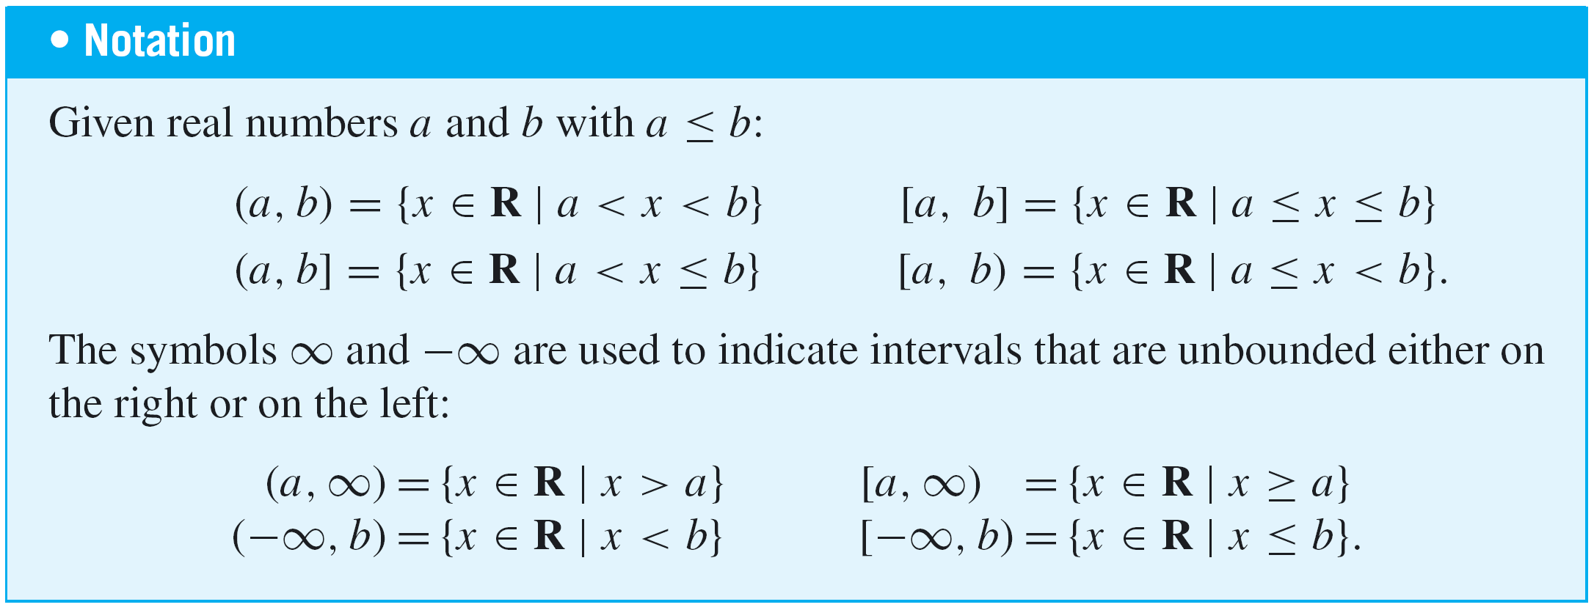
Operations on Sets
There is a convenient notation for subsets of real numbers that are intervals.
Observe that the notation for the interval (a, b) is identical
to the notation for the ordered pair (a, b). However, context
makes it unlikely that the two will be confused.

Slide 22
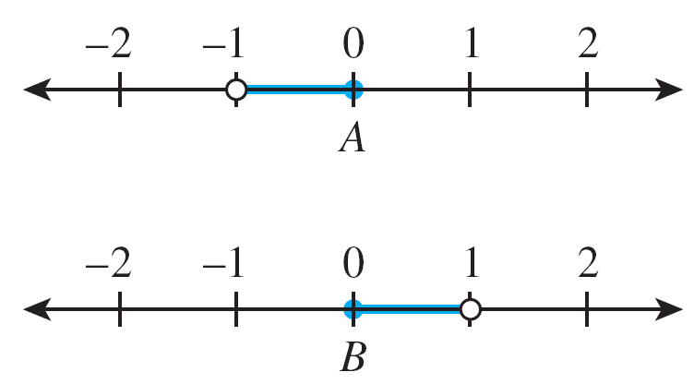
Example 6 – An Example with Intervals
Let the universal set be the set R of all real numbers and let
These sets are shown on the number lines below.
Find A ∪ B, A ∩ B, B – A, and A^{c}.

Slide 23
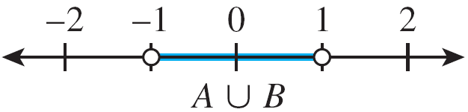
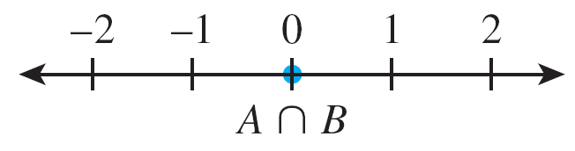
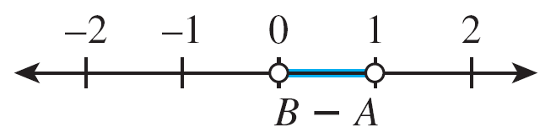
Example 6 – Solution

Slide 24
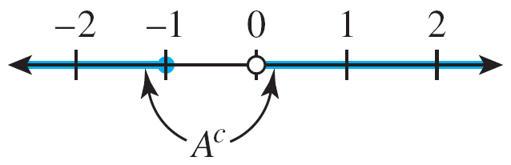
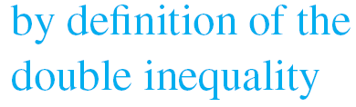
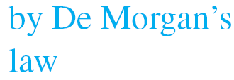
Example 6 – Solution
cont’d

Slide 25
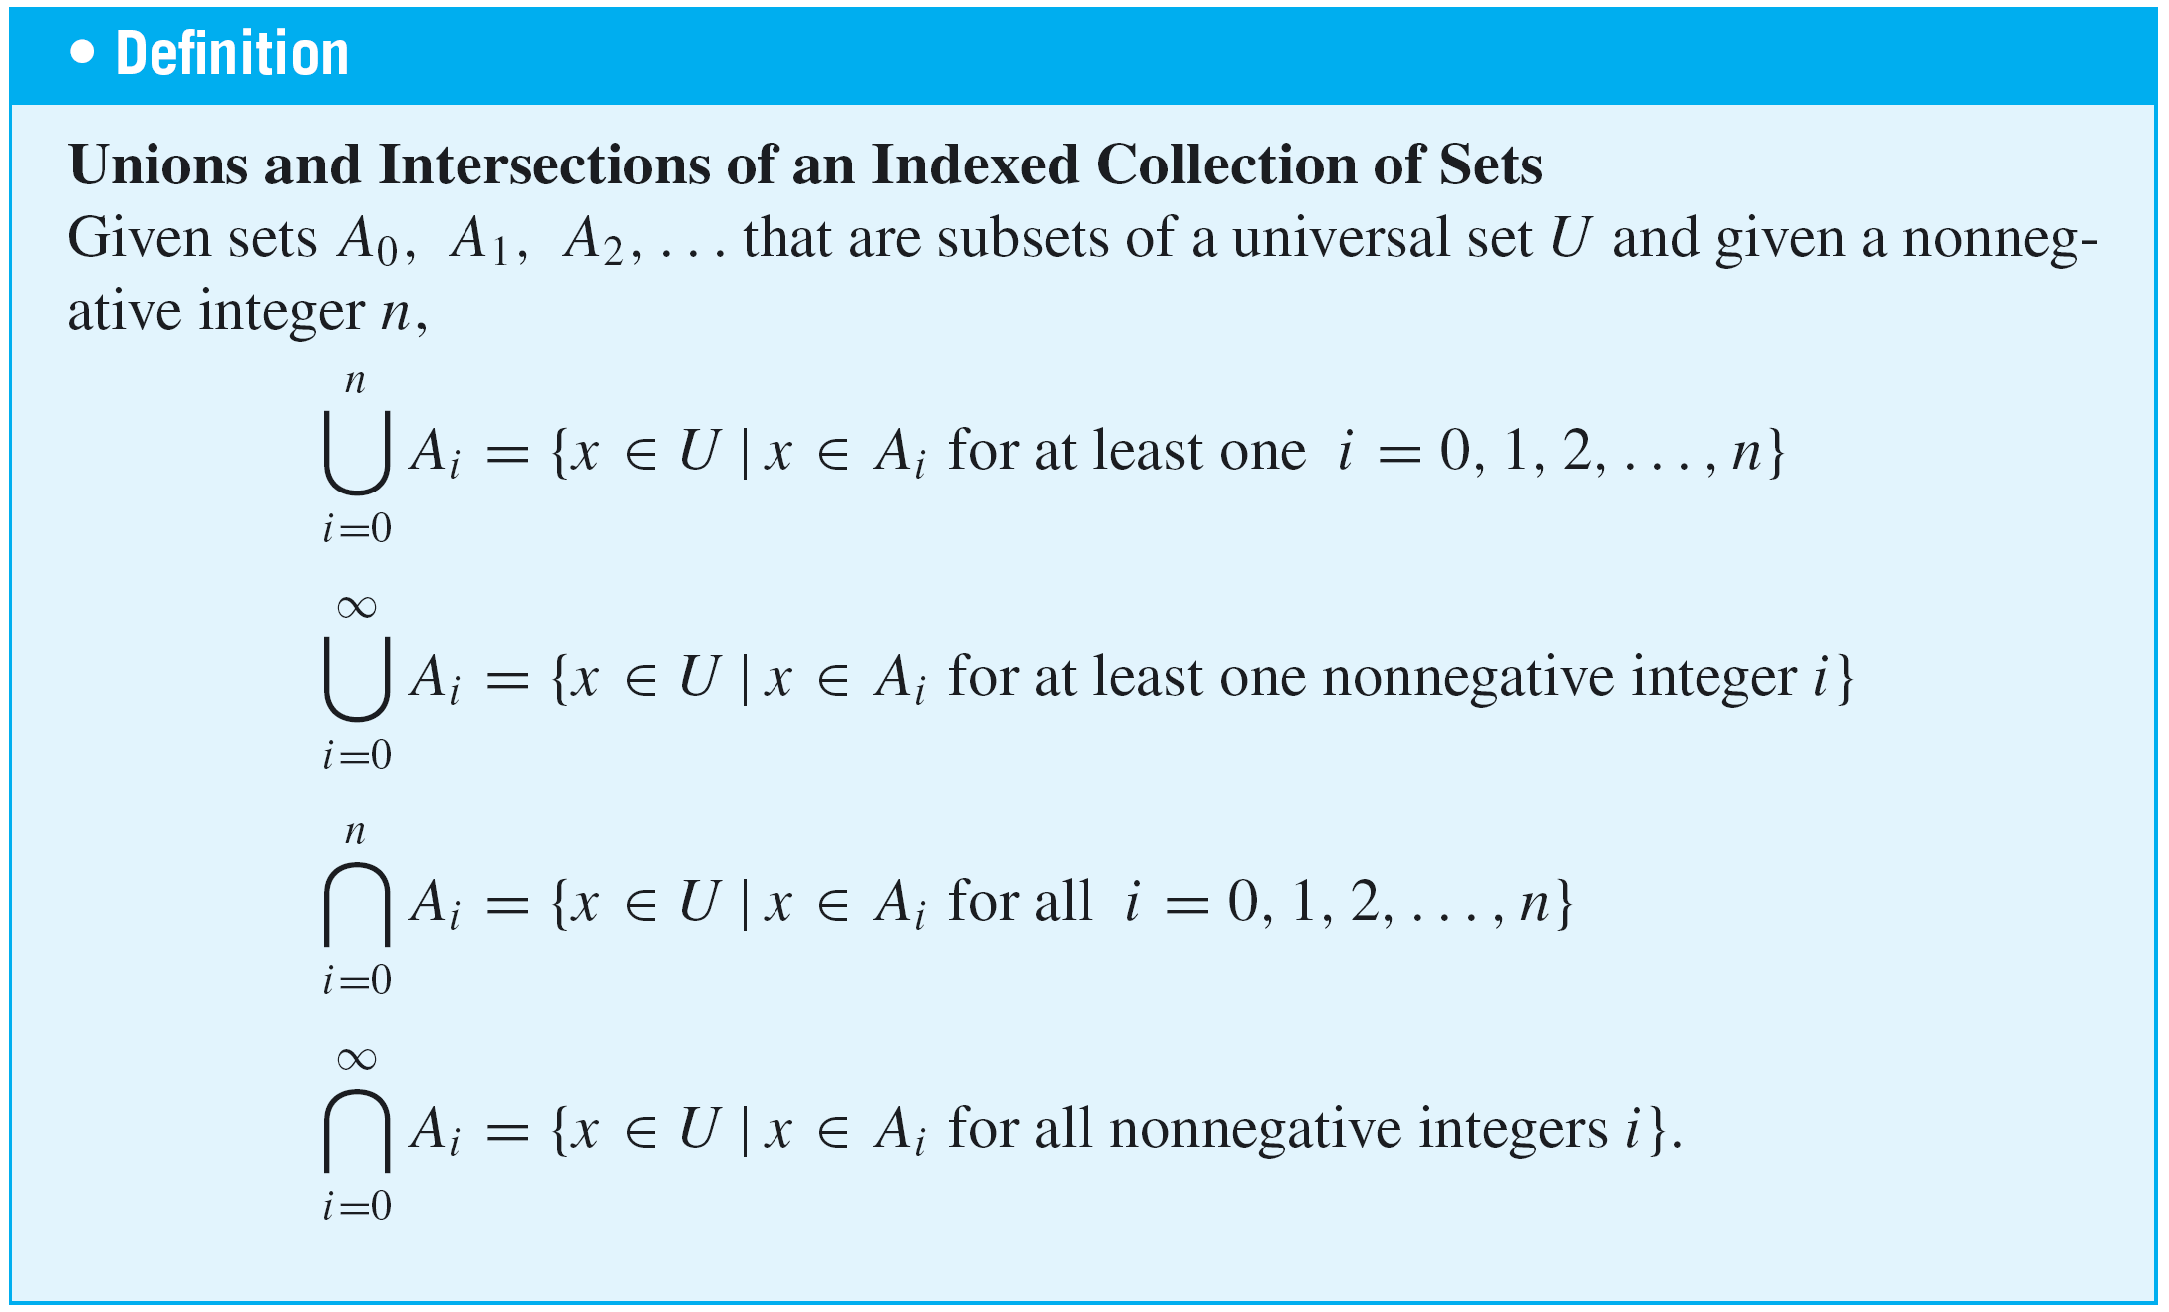
Operations on Sets
The definitions of unions and intersections for more than two sets are very similar to the definitions for two sets.

Slide 26
Operations on Sets
An alternative notation for and an
alternative notation for

Slide 27
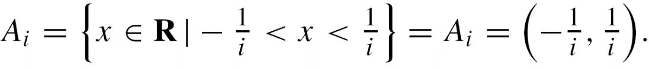
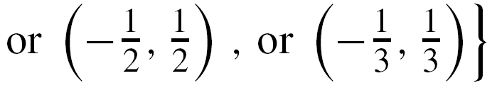
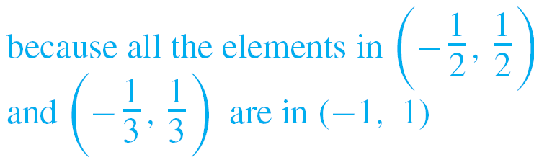


Example 7 – Finding Unions and Intersections of More than Two Sets
For each positive integer i, let
Find A₁ ∪ A₂ ∪ A₃.

Slide 28
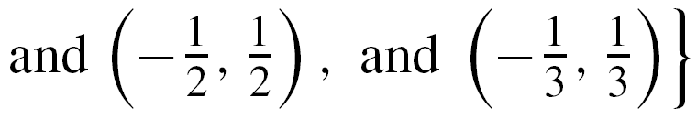
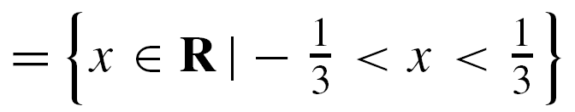
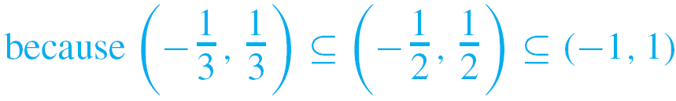
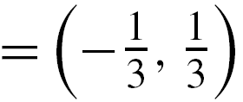
Example 7 – Finding Unions and Intersections of More than Two Sets
For each positive integer i, let
Find A₁ ∩ A₂ ∩ A₃.

Slide 29
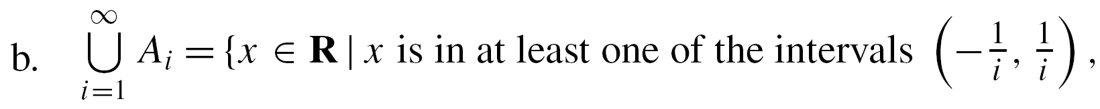

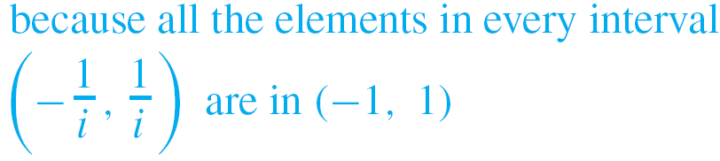


Example 7 – Finding Unions and Intersections of More than Two Sets
For each positive integer i, let
Find $\bigcup_{i=1}^{∞}{A_{i}}$.

Slide 30


Example 7 – Finding Unions and Intersections of More than Two Sets
For each positive integer i, let
Find $\bigcap_{i=1}^{∞}{A_{i}}$.

Slide 31
The Empty Set
We have stated that a set is defined by the elements that compose it. This being so, can there be a set that has no elements? It turns out that it is convenient to allow such a
set.
Because it is unique, we can give it a special name. We call it the empty set (or null set) and denote it by the symbol Ø.
Thus {1, 3} ∩ {2, 4} = Ø and {x ∈ R| x² = –1} = Ø.

Slide 32
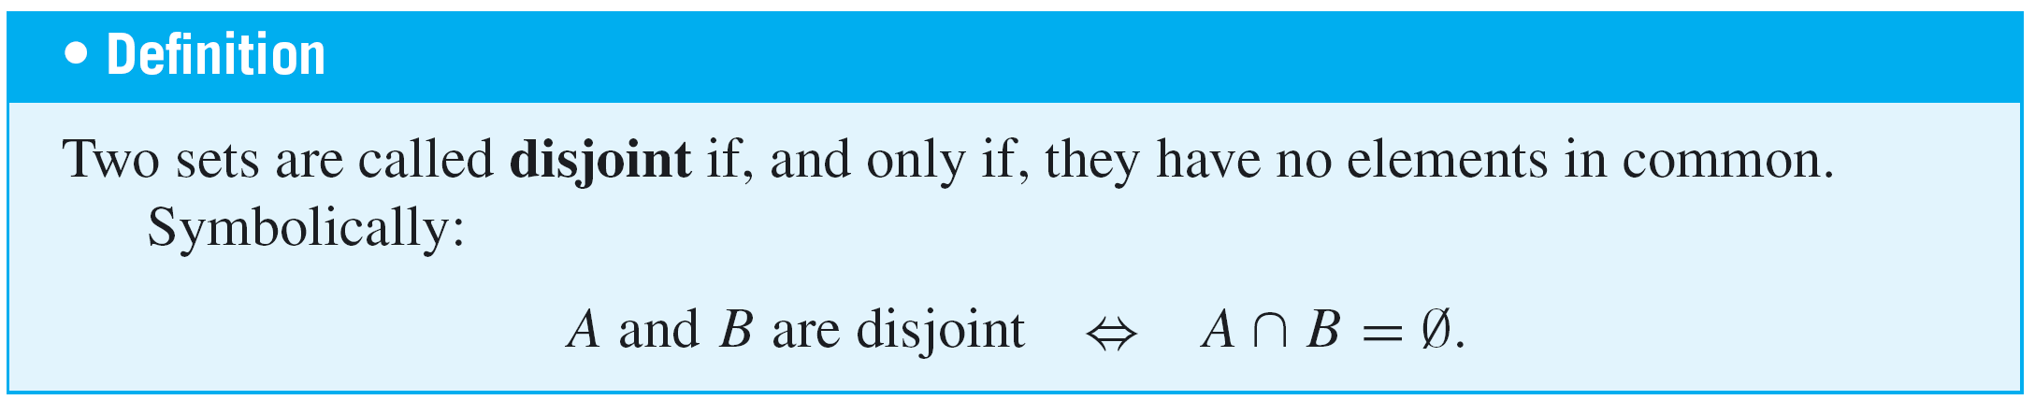
Partitions of Sets
In many applications of set theory, sets are divided up into nonoverlapping (or disjoint) pieces. Such a division is called a partition.

Slide 33
Example 9 – Disjoint Sets
Let A = {1, 3, 5} and B = {2, 4, 6}. Are A and B disjoint?
Solution:
Yes. By inspection A and B have no elements in common, or, in other words, {1, 3, 5} ∩ {2, 4, 6} = Ø.

Slide 34
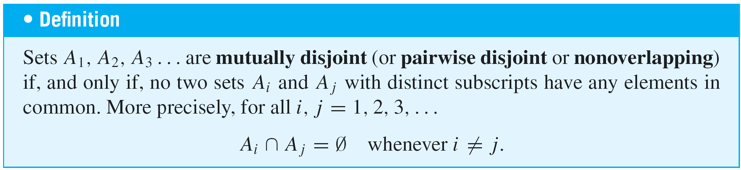
Partitions of Sets

Slide 35
Example 10 – Mutually Disjoint Sets
Let A₁ = {3, 5}, A₂ = {1, 4, 6}, and A₃ = {2}. Are A₁, A₂, and A₃ mutually disjoint?
Yes. A₁ and A₂ have no elements in common, A₁ and A₃ have no elements in common, and A₂ and A₃ have no elements in common.
Let B₁ = {2, 4, 6}, B₂ = {3, 7}, and B₃ = {4, 5}. Are B₁, B₂, and B₃ mutually disjoint?
No. B₁ and B₃ both contain 4.

Slide 36
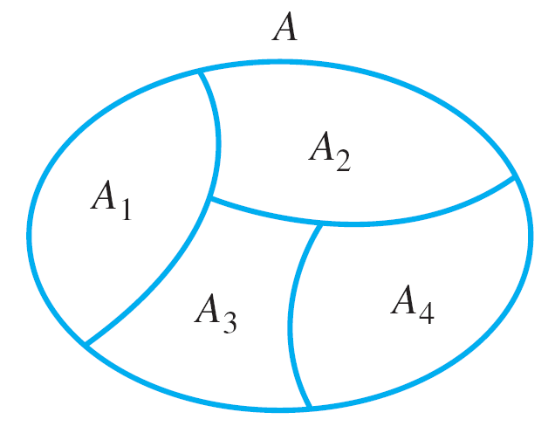
Partitions of Sets
Suppose A, A₁, A₂, A₃, and A₄ are the sets of points represented by the regions shown below.
Then A₁, A₂, A₃, and A₄ are subsets of A, and
A = A₁ U A₂ U A₃ U A₄.
A Partition of a Set

Slide 37
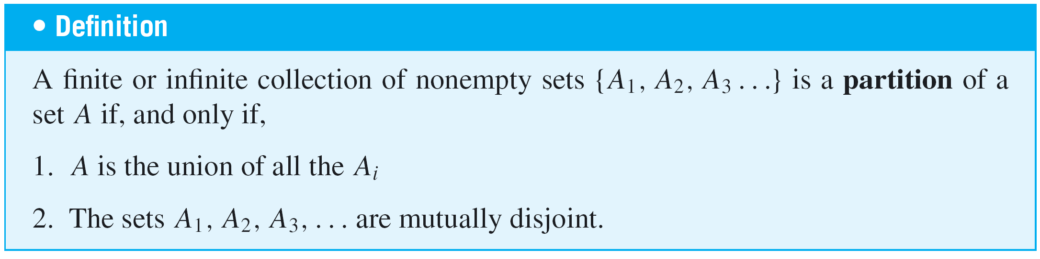
Partitions of Sets
Suppose further that boundaries are assigned to the regions representing A₁, A₂, A₃, and A₄ in such a way that these sets are mutually disjoint.
Then A is called a union of mutually disjoint subsets, and the collection of sets {A₁, A₂, A₃, A₄} is said to be a
partition of A.

Slide 38
Example 11 – Partitions of Sets
Let A = {1, 2, 3, 4, 5, 6}, A₁ = {1, 2}, A₂ = {3, 4}, and
A₃ = {5, 6}. Is {A₁, A₂, A₃} a partition of A?
Yes. By inspection, A = A₁ ∪ A₂ ∪ A₃ and the sets A₁, A₂, and A₃ are mutually disjoint.

Slide 39
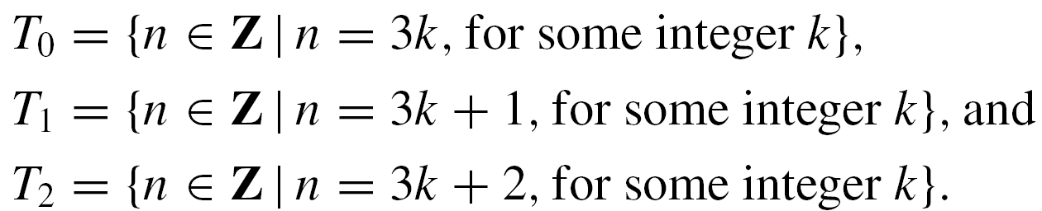
Example 11 – Solution
Let Z be the set of all integers and let
Is {T₀, T₁, T₂} a partition of Z?
Yes. By the quotient-remainder theorem, every integer n can be represented in exactly one of the three forms
for some integer k.

Slide 40
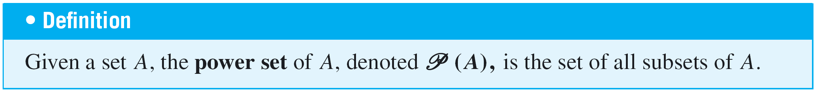
Power Sets
There are various situations in which it is useful to consider the set of all subsets of a particular set.
The power set axiom guarantees that this is a set.

Slide 41


Example 12 – Power Set of a Set
Find the power set of the set {x, y}. That is, find ({x, y}).
Solution:
({x, y}) is the set of all subsets of {x, y}. We know that Ø is a subset of every set, and so Ø ∈ ({x, y}).
Also any set is a subset of itself, so {x, y} ∈ ({x, y}). The only other subsets of {x, y} are {x} and {y}, so

Slide 42
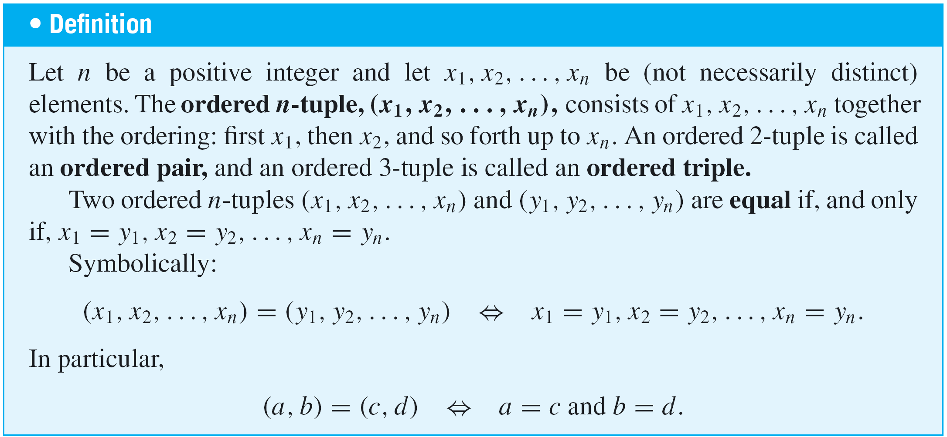
Tuples
ordered, duplicates are allowed.

Slide 43
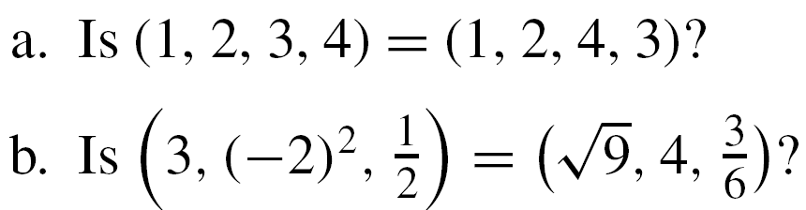
Example 13 – Ordered n-tuples
No. By definition of equality of ordered 4-tuples,
But 3 ≠ 4, and so the ordered 4-tuples are not equal.
Yes. By definition of equality of ordered triples,

Slide 44
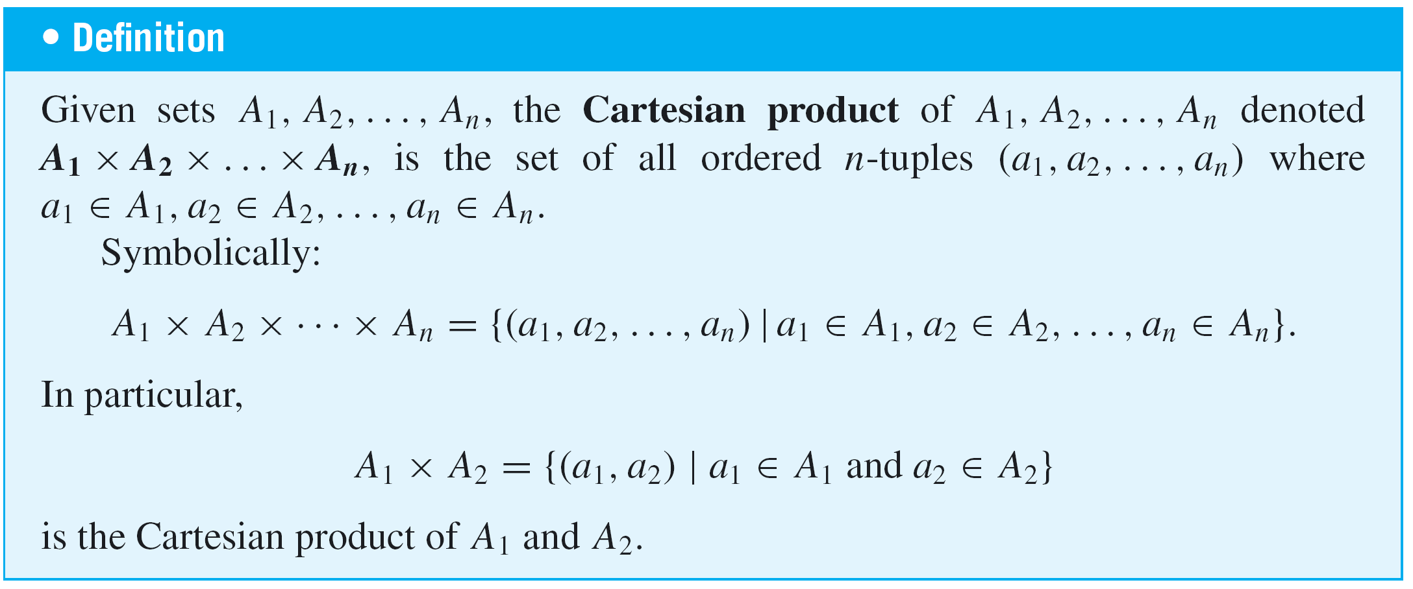
Cartesian Products

Slide 45
Example 14 – Cartesian Products
Let A₁ = {x, y}, A₂ = {1, 2, 3}, and A₃ = {a, b}.
Find A₁ × A₂.
A₁ × A₂ = {(x, 1), (x, 2), (x, 3), (y, 1), (y, 2), (y, 3)}

Slide 46
Example 14 – Cartesian Products
Let A₁ = {x, y}, A₂ = {1, 2, 3}, and A₃ = {a, b}.
Find (A₁ × A₂) × A₃.
The Cartesian product of A₁ and A₂ is a set, so it may be
used as one of the sets making up another Cartesian
product. This is the case for (A₁ × A₂) × A₃.

Slide 47

Example 14 – Cartesian Products
Let A₁ = {x, y}, A₂ = {1, 2, 3}, and A₃ = {a, b}.
Find A₁ × A₂ × A₃.
By definition of Cartesian product,

