Slide 1
Fibonacci Numbers
Fibonacci Numbers: 1,1,2,3,5,8,13,…
Defined recursively: F₀ = 1 F₁ = 1 F_{n} = F_{n-1} + F_{n-2} for any integer n≥2
Theorem: F_{n} ≤ 2^{n} for any integer n≥0.

Slide 2
Example 1 – Finding an Explicit Formula
Let a₀, a₁, a₂, . . . be the sequence defined recursively as follows: For all integers k ≥ 1,
Use iteration to guess an explicit formula for the sequence.
Solution:
We know that to say
means

Slide 3
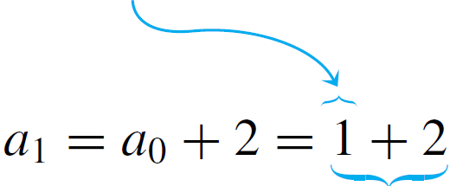
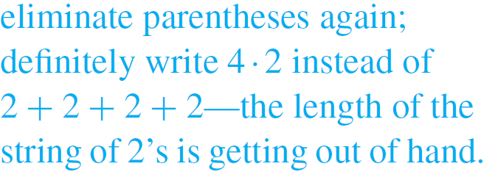
Example 1 – Solution
cont’d
Here’s how the process works for the given sequence:

Slide 4
Fibonacci Numbers
Fibonacci Numbers: 1,1,2,3,5,8,13,…
Defined recursively: F₀ = 1 F₁ = 1 F_{n} = F_{n-1} + F_{n-2} for any integer n≥2
Theorem: $F_{n+2}∙F_{n}−F_{n+1}^{2}={(−1)}^{n}$for any integer n≥0.

Slide 5
Fibonacci Numbers
Can you prove $\sum_{i=0}^{n}{{\left(\frac{1}{2}\right)}^{i}<2}$ by induction?
Can you prove $\sum_{i=0}^{n}{{\left(\frac{1}{2}\right)}^{i}=2−\frac{1}{2^{n}}}$ by induction?
In order to prove $\sum_{i=0}^{n}{{\left(\frac{1}{2}\right)}^{i}<2}$, you must prove something stronger, i.e., $\sum_{i=0}^{n}{{\left(\frac{1}{2}\right)}^{i}=2−\frac{1}{2^{n}}}$

Slide 6
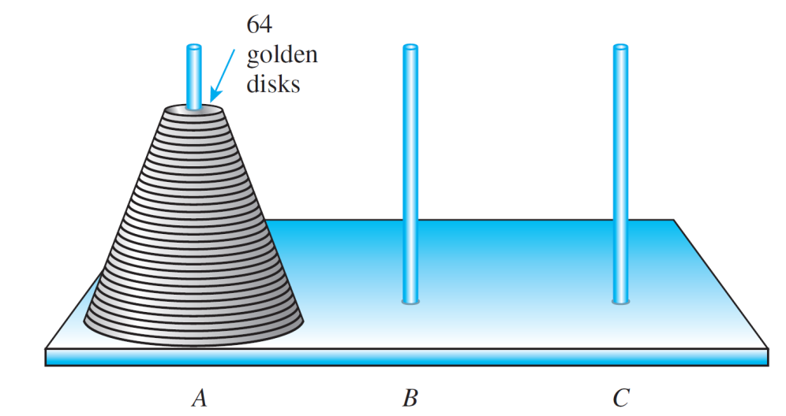
Example 5 – The Tower of Hanoi
A puzzle consisting of disks with holes in their centers, which are piled in order of decreasing size on one pole in a row of three.
Goal: Move all the disks one by one from one pole to another, never placing a larger disk on top of a smaller one.
How many moves are needed to do so?

Slide 7
Example 5 – Solution
An elegant and efficient way to solve this problem is to think recursively.
Suppose that you, somehow or other, have found the most efficient way possible to transfer a tower of k – 1 disks one by one from one pole to another, obeying the restriction that you never place a larger disk on top of a smaller one.
What is the most efficient way to transfer a tower of k disks from one pole to another?

Slide 8
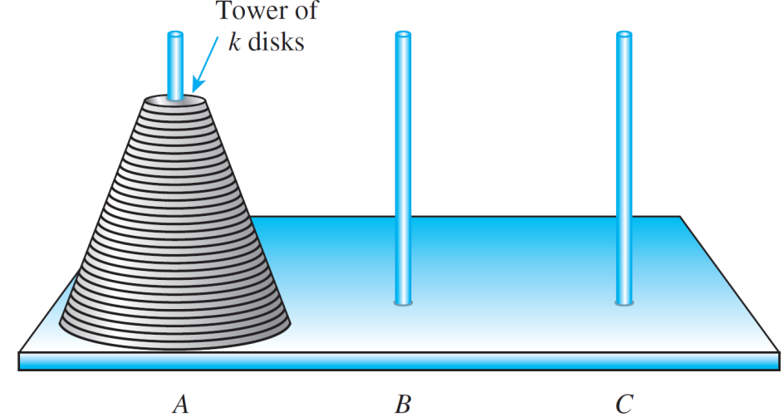
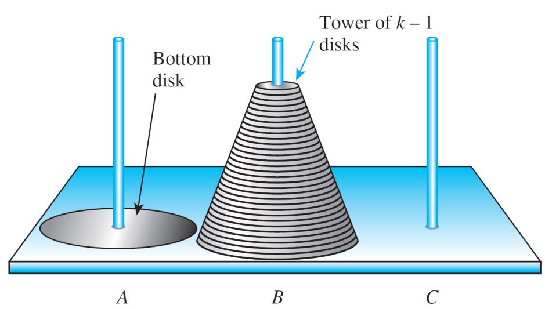
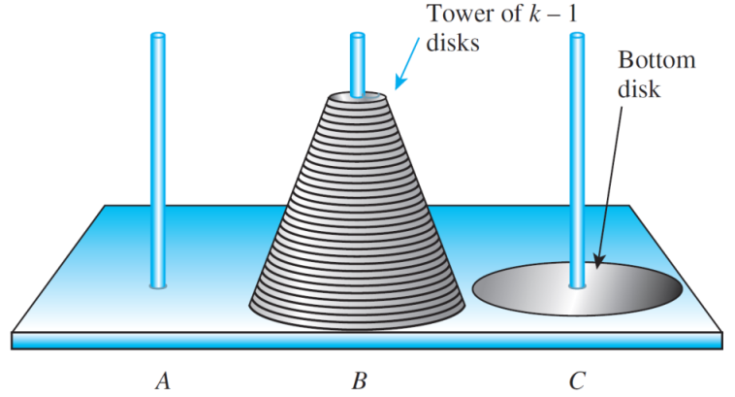
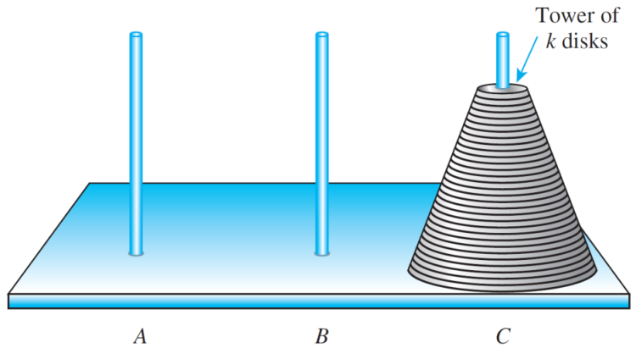
Example 5 – Solution
cont’d
Initial Position
(a)
Position after Transferring k – 1 Disks from A to B
(b)
Position after Moving the Bottom Disk from A to C
(c)
Position after Transferring k – 1 Disks from B to C
(d)
Moves for the Tower of Hanoi

