Slide 1
Exercise
Use mathematical induction to prove the following formula.
For all positive integers n,
$$\sum_{i=1}^{n}{i^{2}=\frac{n(n+1)(2n+1)}{6}}$$

Slide 2
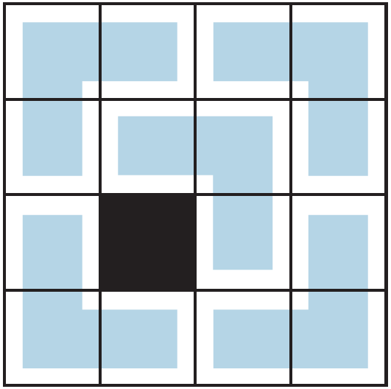
Tiling with L’s
Tiling a square board by such (3-unit) L-shaped tiles.
It is a beautiful example of an argument by mathematical induction.

Slide 3
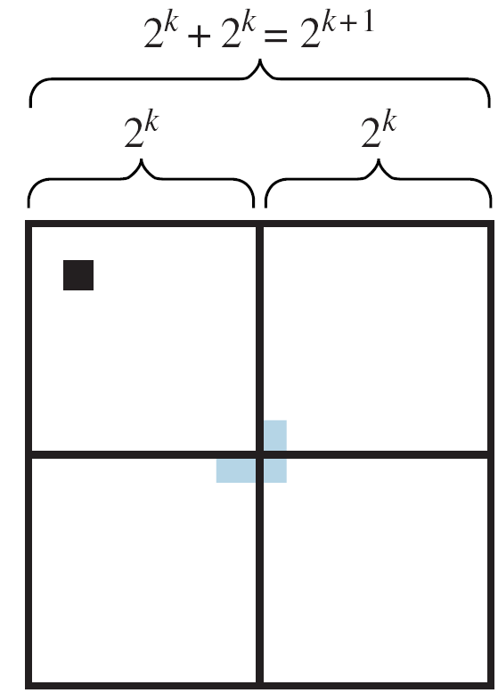
Tiling with L’s

Slide 4
Strong Mathematical Induction and the Well-Ordering Principle for the Integers
Strong mathematical induction is similar to ordinary mathematical induction in that it is a technique for establishing the truth of a sequence of statements about integers.
Also, a proof by strong mathematical induction consists of a basis step and an inductive step. However, …
the basis step may contain proofs for several initial values, and
in the inductive step, the truth of the predicate P(n) is assumed not just for one value of n but for all values through k, and then the truth of P(k + 1) is proved.

Slide 5
Strong Mathematical Induction and the Well-Ordering Principle for the Integers

Slide 6
Applying Strong Mathematical Induction
The divisibility-by-a-prime theorem states that any integer greater than 1 is divisible by a prime number.
We prove this theorem using strong mathematical induction.
Theorem 1: Any integer greater than 1 is divisible by a prime number.

Slide 7
Applying Strong Mathematical Induction
We also can prove the existence part of the Unique Factorization of Integers Theorem using strong mathematical induction.
Theorem 2: Every integer greater than 1 is either a prime number or a product of prime numbers.

