Slide 1
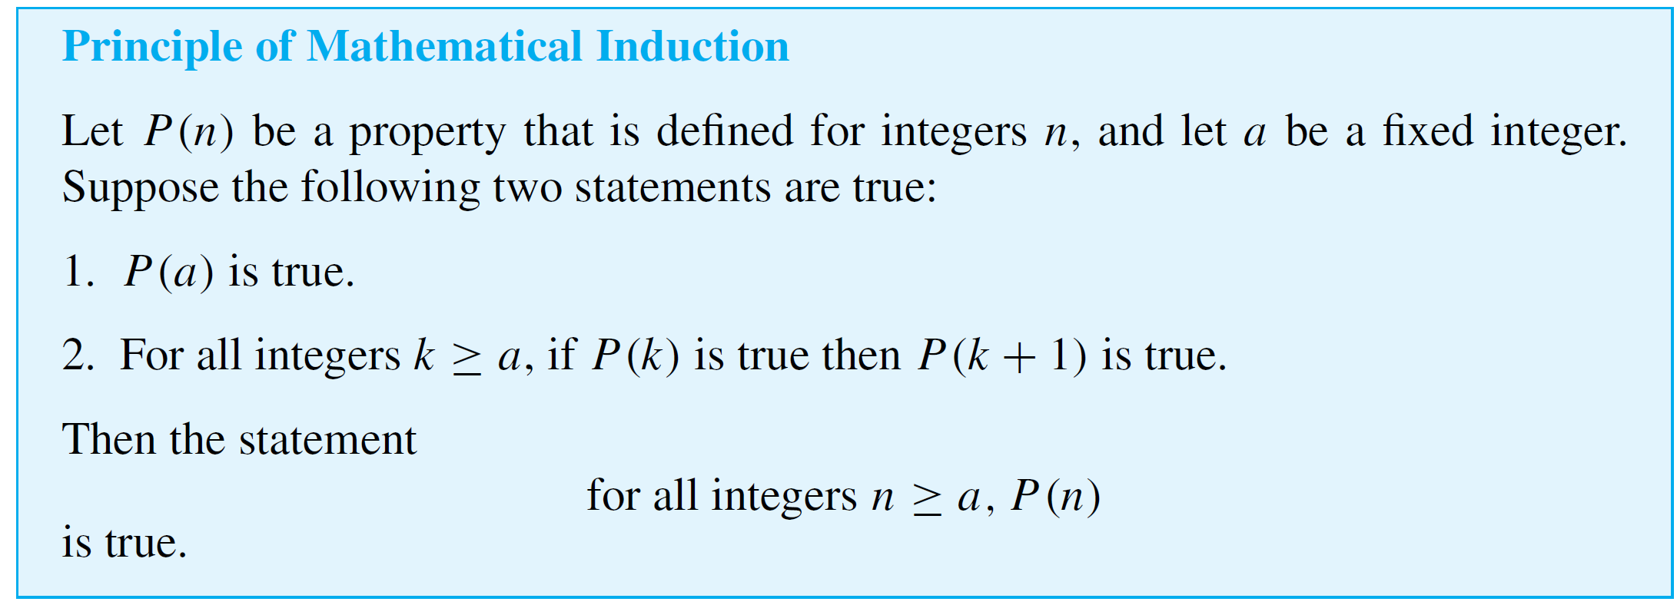
Mathematical Induction I
In general, mathematical induction is a method for proving that a property defined for integers n is true for all values of n that are greater than or equal to some initial integer.

Slide 2
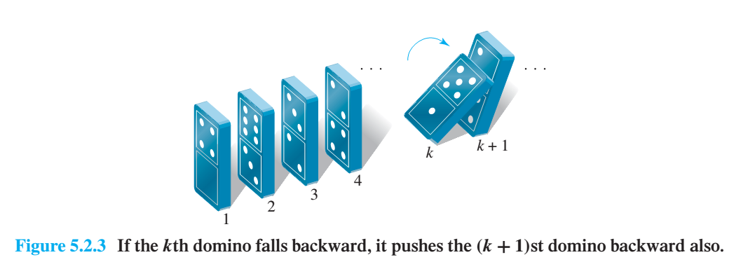
Mathematical Induction I

Slide 3
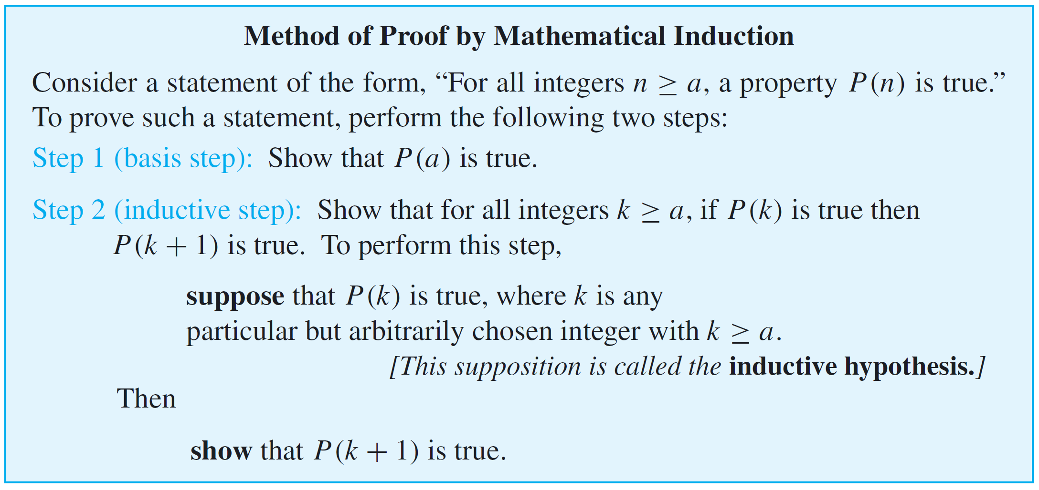
Mathematical Induction I
Proving a statement by mathematical induction is a two-step process. The first step is called the basis step, and the second step is called the inductive step.

Slide 4
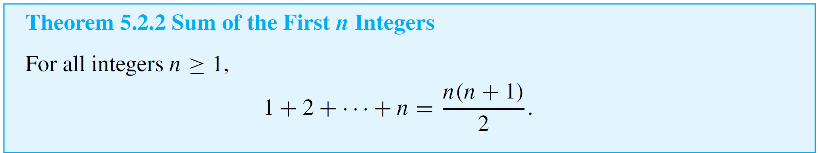
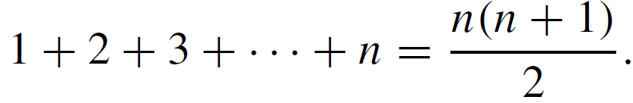

Example 1 – Sum of First n Natural Numbers
Proof (by mathematical induction):
Let the property P(n) be the equation

Slide 5
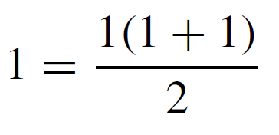

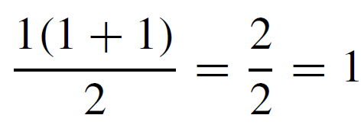
Example 1 – Solution
cont’d
Show that P(1) is true:
To establish P(1), we must show that
But the left-hand side of this equation is 1 and the right-hand side is
also. Hence P(1) is true.

Slide 6
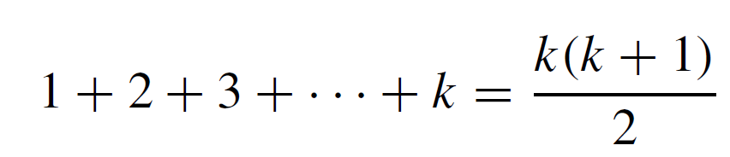
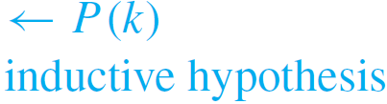
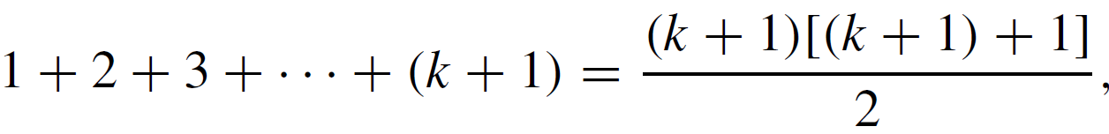
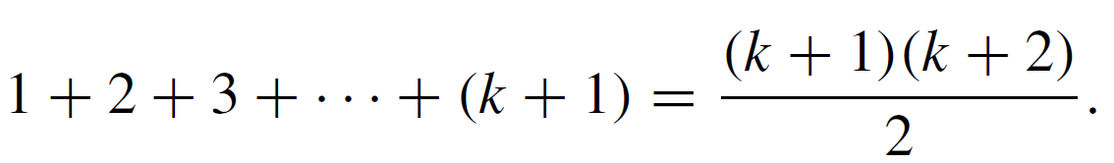

Example 1 – Solution
cont’d
Show that for all integers k ≥ 1, if P(k) is true then
P(k + 1) is also true:
[Suppose that P(k) is true for a particular but arbitrarily chosen integer k ≥ 1.That is:] Suppose that k is any integer with k ≥ 1 such that
[We must show that P(k + 1) is true. That is:] We must show that
or, equivalently, that

Slide 7

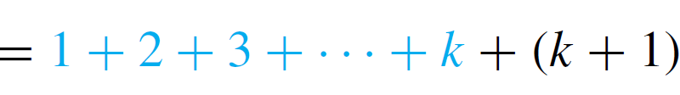
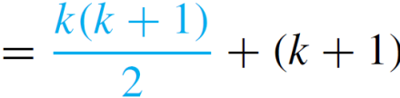
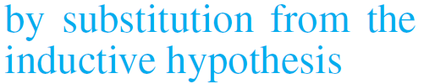
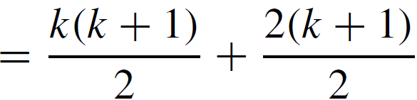
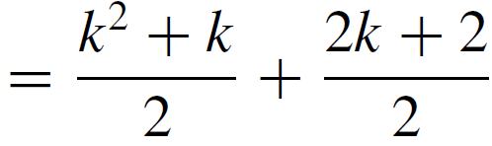
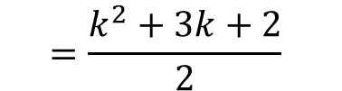

Example 1 – Solution
cont’d
The left-hand side of P(k + 1) is
$$=\frac{k^{2}+3k+2}{2}$$
$$=\frac{(k+1)(k+2)}{2}$$

Slide 8
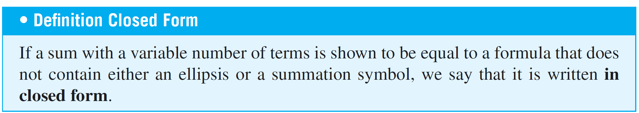
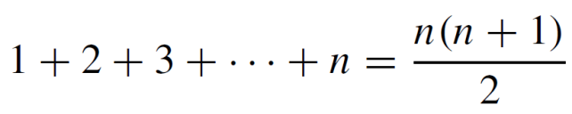
Mathematical Induction I
For example, writing
expresses the sum 1 + 2 + 3 +· · ·+ n in closed form.

Slide 9
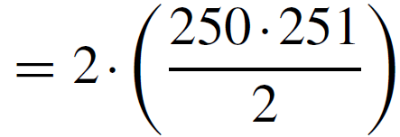


Example 2 – Applying the Formula for the Sum of the First n Integers
a. Evaluate 2 + 4 + 6 +· · ·+ 500.

Slide 10
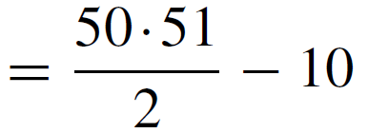


Example 2 – Solution
b. Evaluate 5 + 6 + 7 + 8 +· · ·+ 50.

Slide 11
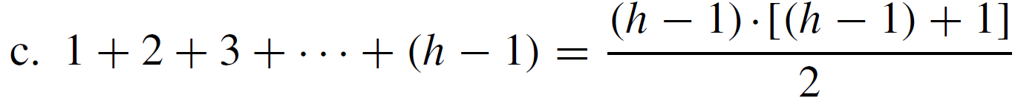
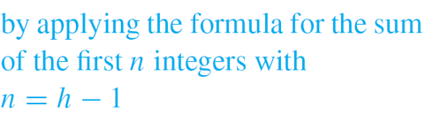
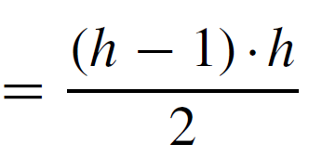
Example 2 – Solution
cont’d
c. For an integer h ≥ 2, write 1 + 2 + 3 +· · ·+ (h – 1) in closed form.

Slide 12
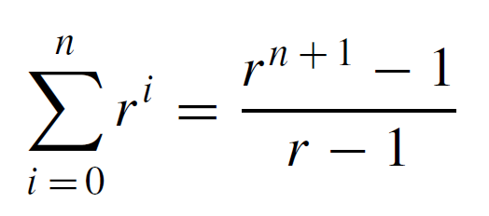
Mathematical Induction I
In a geometric sequence, each term is obtained from the preceding one by multiplying by a constant factor.
If the first term is 1 and the constant factor is r, then the sequence is 1, r, r ², r ³, . . . , r ^{n}, . . . .
The sum of the first n terms of this sequence is given by the formula
for all integers n ≥ 0 and real numbers r not equal to 1.

Slide 13
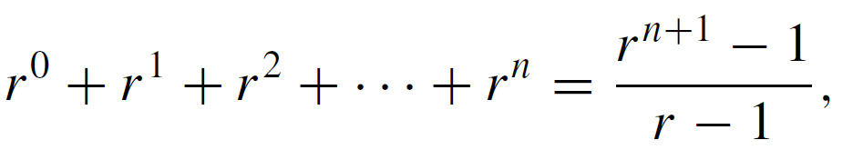
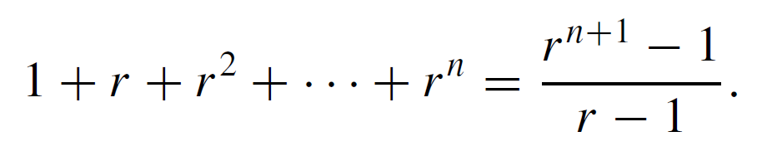
Mathematical Induction I
The expanded form of the formula is
and because r ⁰ = 1 and r ¹ = r, the formula for n ≥ 1 can be rewritten as

Slide 14
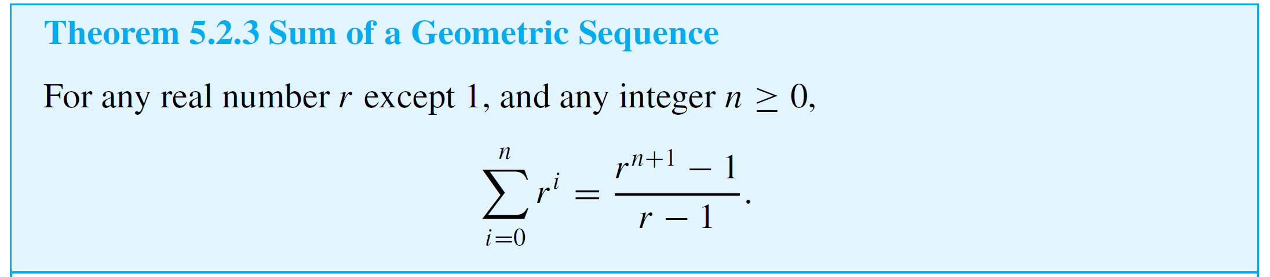
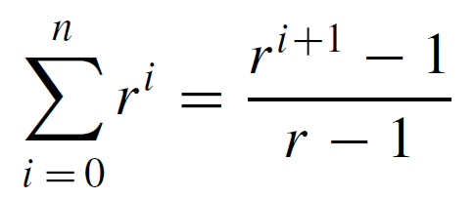

Example 3 – Sum of Terms of a Geometric Sequence
Proof (by mathematical induction):
Suppose r is a particular but arbitrarily chosen real number that is not equal to 1, and let the property P(n) be the equation
We must show that P(n) is true for all integers n ≥ 0. We do this by mathematical induction on n.

Slide 15
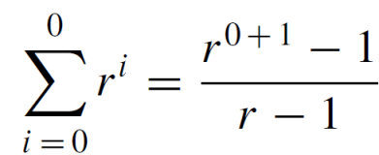

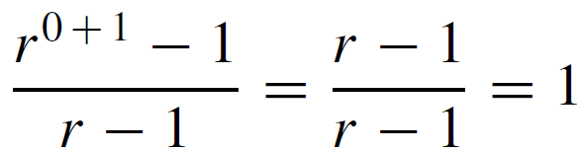
Example 3 – Solution
cont’d
Show that P(0) is true:
To establish P(0), we must show that
The left-hand side of this equation is r ⁰ = 1 and the right-hand side is
also because r ¹ = r and r ≠ 1. Hence P(0) is true.

Slide 16
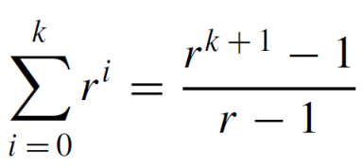
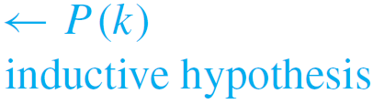
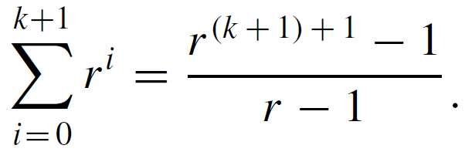
Example 3 – Solution
cont’d
Show that for all integers k ≥ 0, if P(k) is true then P(k + 1) is also true:
[Suppose that P(k) is true for a particular but arbitrarily chosen integer k ≥ 0. That is:]
Let k be any integer with k ≥ 0, and suppose that
[We must show that P(k + 1) is true. That is:] We must show that

Slide 17
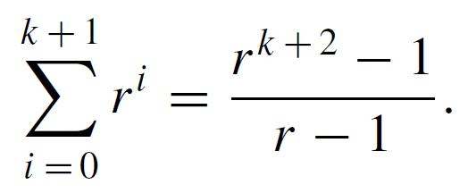

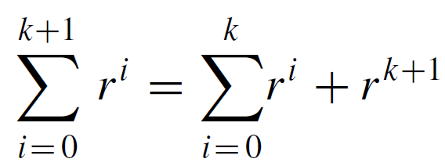
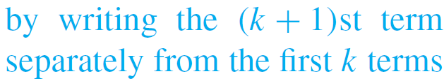
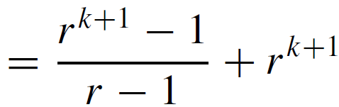
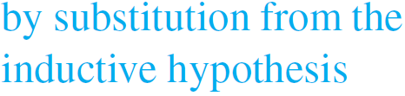
Example 3 – Solution
cont’d
Or, equivalently, that
[We will show that the left-hand side of P(k + 1) equals the right-hand side.] The left-hand side of P(k + 1) is

Slide 18
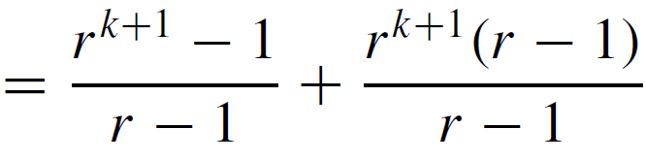
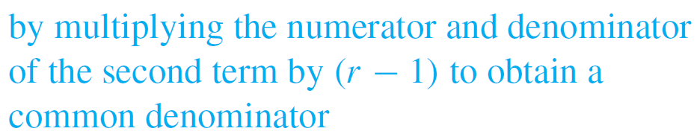
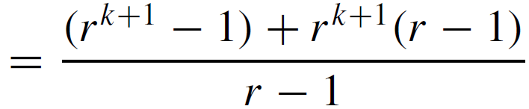

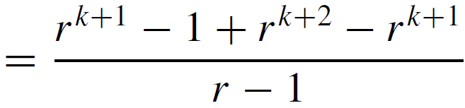
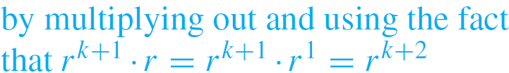
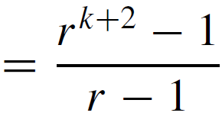

Example 3 – Solution
cont’d
which is the right-hand side of P(k + 1) [as was to be shown.]
[Since we have proved the basis step and the inductive step, we conclude that the theorem is true.]

Slide 19

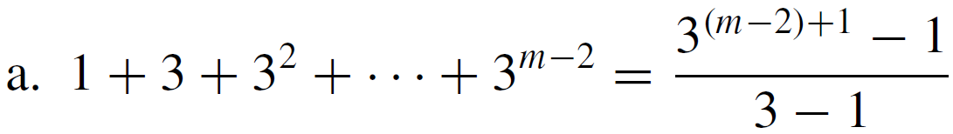
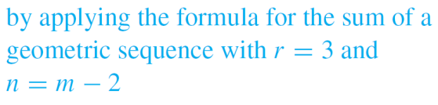
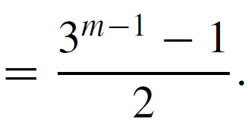


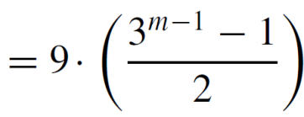

Example 4 – Applying the Formula for the Sum of a Geometric Sequence
In each of (a) and (b) below, assume that m is an integer that is greater than or equal to 3. Write each of the sums in closed form.
a.
b.

Slide 20



Deducing Additional Formulas
As with the formula for the sum of the first n integers, there is a way to think of the formula for the sum of the terms of a geometric sequence that makes it seem simple and intuitive. Let
Then
and so

Slide 21


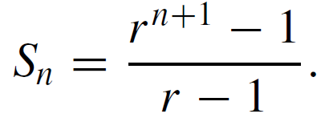
Deducing Additional Formulas
But
Equating the right-hand sides of equations (5.2.1) and (5.2.2) and dividing by r – 1 gives

Slide 22

Existence Part of the Quotient-Remainder Theorem
Claim 1. For any nonnegative integer n and positive integer d, there exist integers q and r such that
n = dq+r and 0 ≤ r < d
It suffices to prove that, [given a particular but arbitrarily chosen positive integer d,] for any nonnegative integer n, there exist integers q and r such that
n = dq+r and 0 ≤ r < d
Proof by induction on n.

Slide 23

Exercise
Prove the following statement by induction.
For all integers $n≥3$, $2n+1<2^{n}$.

