Slide 1
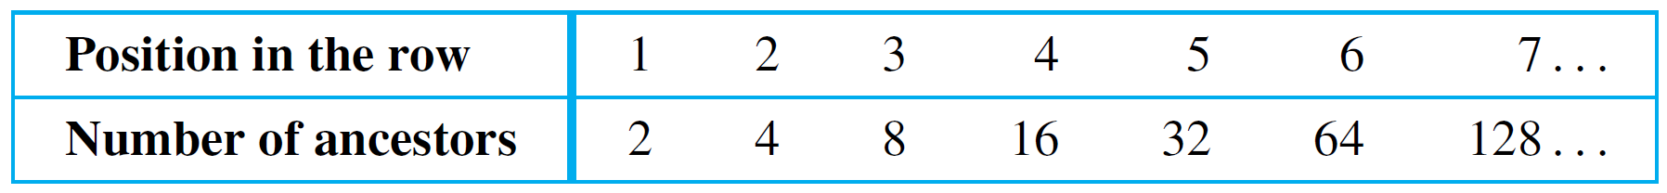
Sequences
Imagine that a person decides to count his ancestors. He has two parents, four grandparents, eight great- grandparents, and so forth, These numbers can be written in a row as
2, 4, 8, 16, 32, 64, 128,…
The symbol “…” is called an ellipsis. It is shorthand for “and so forth.”
To express the pattern of the numbers, suppose that each is labeled by an integer giving its position in the row.

Slide 2
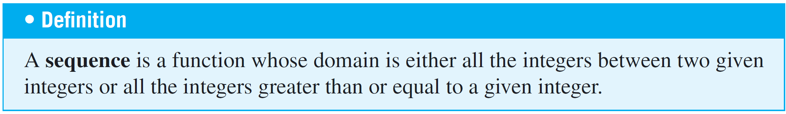

Sequences
We typically represent a sequence as a set of elements written in a row. In the sequence denoted
each individual element a_{k} (read “a sub k”) is called a term.

Slide 3

Sequences
The k in a_{k} is called a subscript or index, m (which may be any integer) is the subscript of the initial term, and n (which must be greater than or equal to m) is the subscript of the final term. The notation
denotes an infinite sequence. An explicit formula or general formula for a sequence is a rule that shows how the values of a_{k} depend on k.

Slide 4
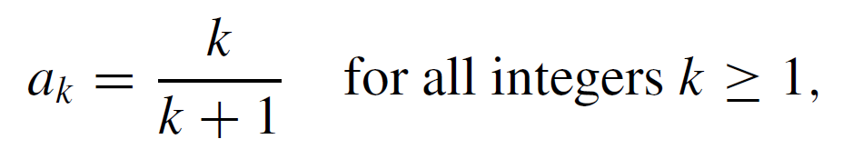
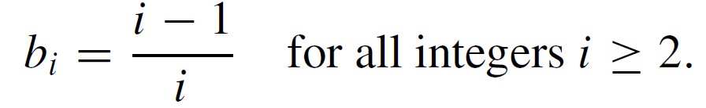
Example 1 – Finding Terms of Sequences Given by Explicit Formulas
Define sequences a₁, a₂, a₃,… and b₂, b₃, b₄,… by the following explicit formulas:
This example shows that it is possible for two different formulas to give sequences with the same terms.

Slide 5
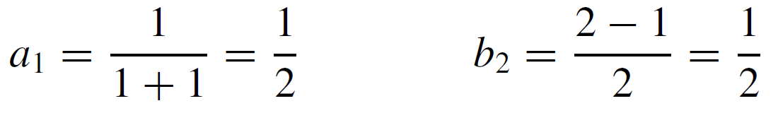
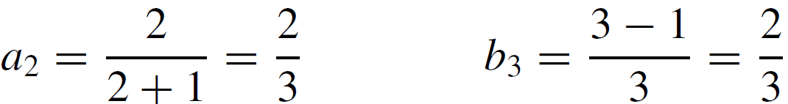
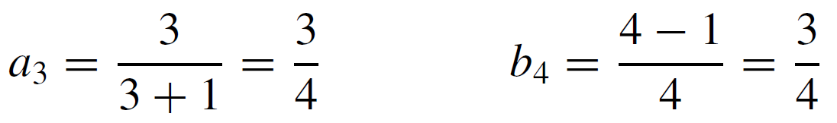
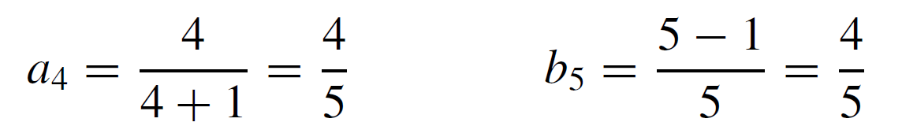
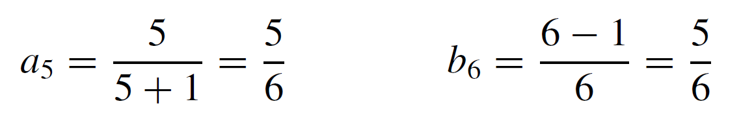
Example 1 – Solution
cont’d

Slide 6
Summation Notation
Consider the example in which A_{k} = 2^{k} represents the number of ancestors a person has in the kth generation back. What is the total number of ancestors for the past six generations?
The answer is
It is convenient to use a shorthand notation to write such
sums.

Slide 7
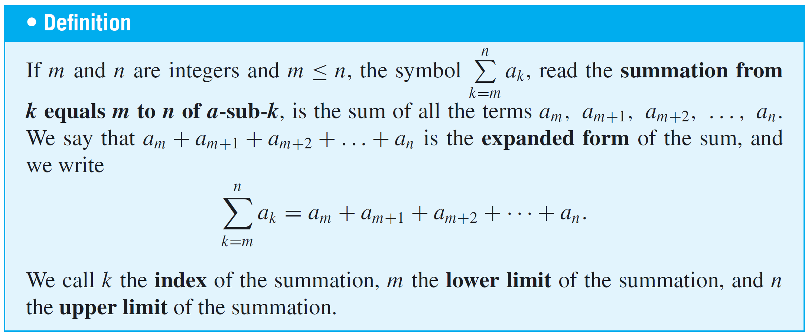
Summation Notation
In 1772 the French mathematician Joseph Louis Lagrange introduced the capital Greek letter sigma, Σ, to denote the word sum (or summation), and defined the summation notation as follows:

Slide 8
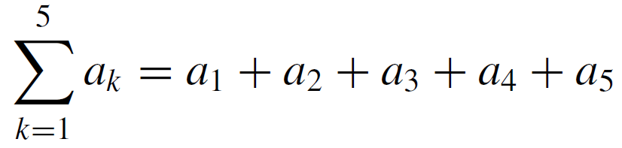
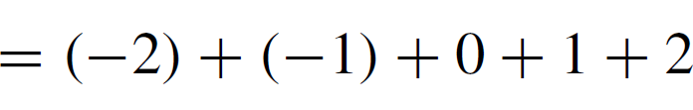

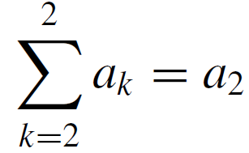

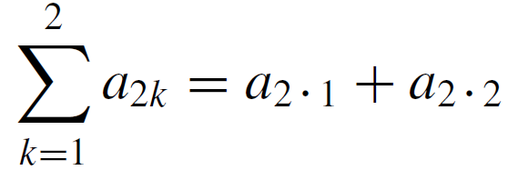
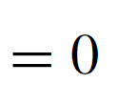
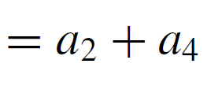
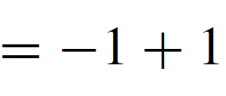
Example 4 – Computing Summations
Let a₁ = −2, a₂ = −1, a₃ = 0, a₄ = 1, and a₅ = 2. Compute the following:
a.
b.
c.

Slide 9
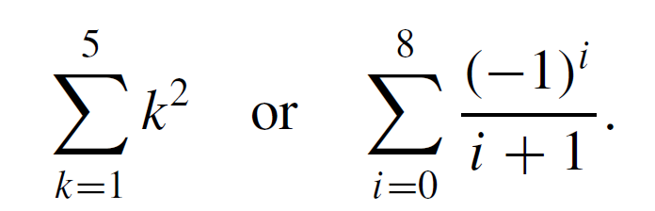
Summation Notation
Oftentimes, the terms of a summation are expressed using an explicit formula.
For instance, it is common to see summations such as

Slide 10
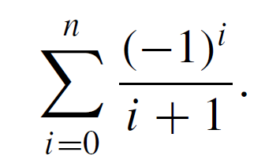
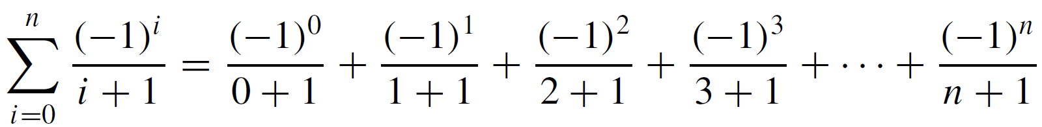
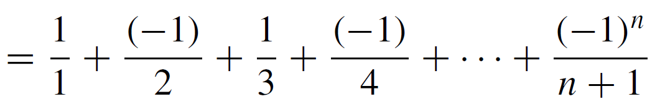
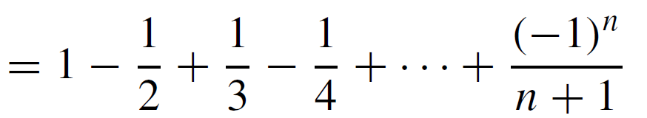
Example 6 – Changing from Summation Notation to Expanded Form
Write the following summation in expanded form:
Solution:

Slide 11
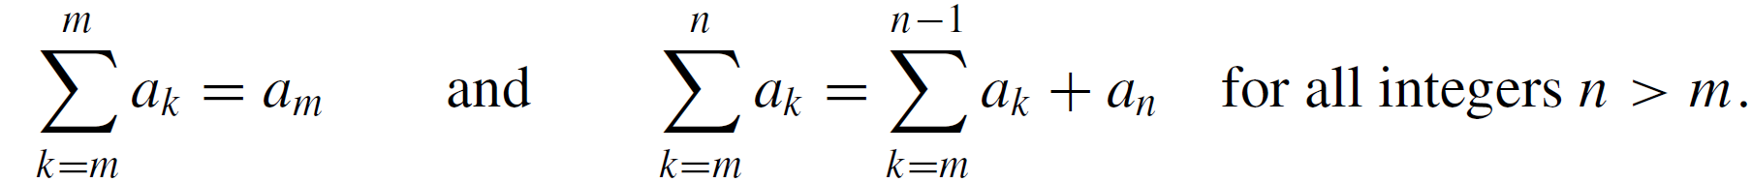
Summation Notation
A more mathematically precise definition of summation, called a recursive definition, is the following:
If m is any integer, then
When solving problems, it is often useful to rewrite a summation using the recursive form of the definition, either by separating off the final term of a summation or by adding a final term to a summation.

Slide 12
Summation Notation
In certain sums each term is a difference of two quantities.
When you write such sums in expanded form, you sometimes see that all the terms cancel except the first and the last.
Successive cancellation of terms collapses the sum like a telescope.

Slide 13
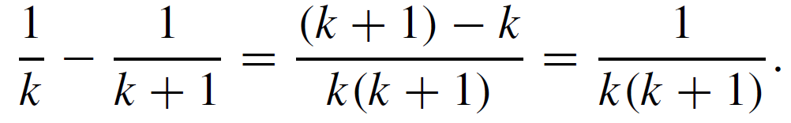
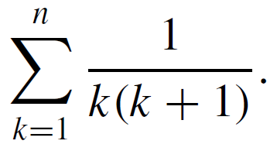
Example 10 – A Telescoping Sum
Some sums can be transformed into telescoping sums, which then can be rewritten as a simple expression.
For instance, observe that
Use this identity to find a simple expression for

Slide 14
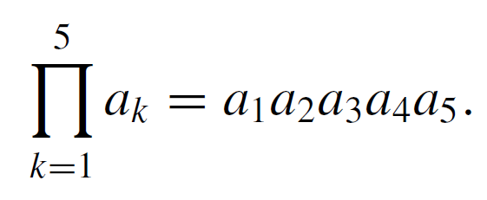
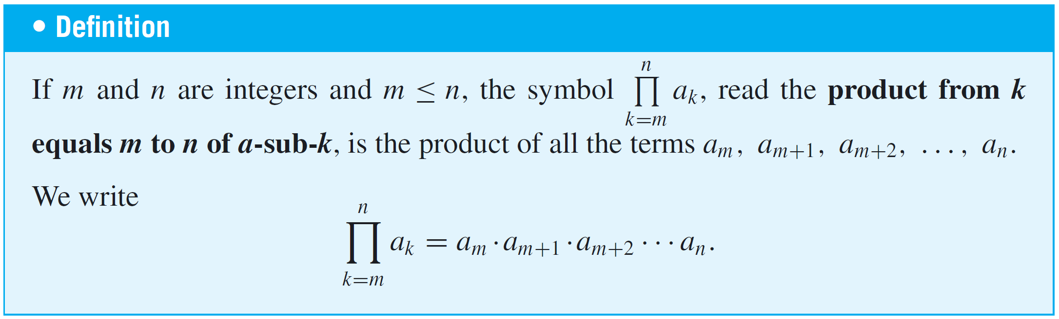
Product Notation
The notation for the product of a sequence of numbers is analogous to the notation for their sum. The Greek capital letter pi, , denotes a product. For example,

Slide 15
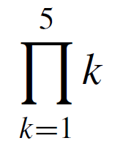
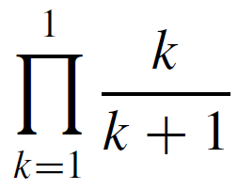
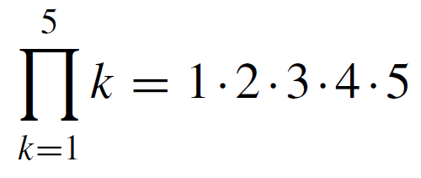
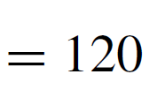
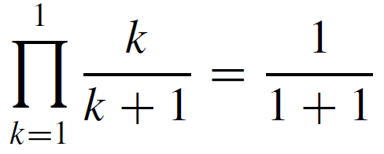
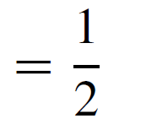
Example 11 – Computing Products
Compute the following products:
a.
b.
Solution:
a.
b.

Slide 16
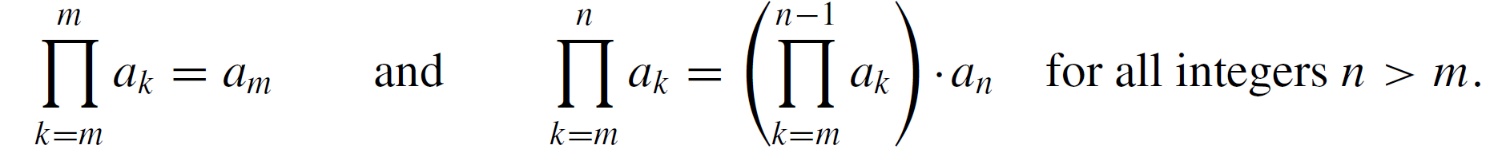
Product Notation
A recursive definition for the product notation is the following: If m is any integer, then

Slide 17
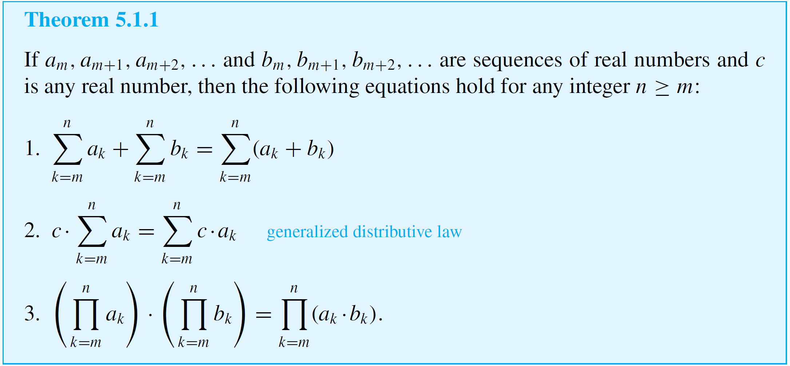
Properties of Summations and Products
The following theorem states general properties of summations and products.

Slide 18
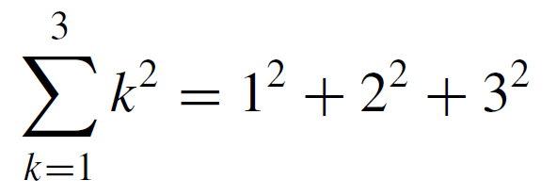
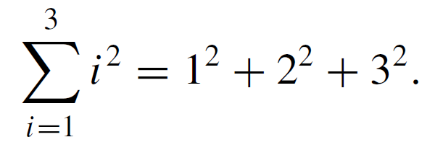
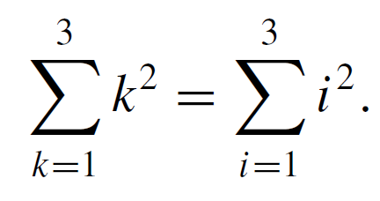
Change of Variable
Observe that
and also that
Hence
This equation illustrates the fact that the symbol used to represent the index of a summation can be replaced by any other symbol as long as the replacement is made in each location where the symbol occurs.

Slide 19
Change of Variable
As a consequence, the index of a summation is called a dummy variable.
A dummy variable is a symbol that derives its entire meaning from its local context. Outside of that context (both before and after), the symbol may have another meaning
entirely.
A general procedure to transform the first summation into the second is illustrated in Example 13.

Slide 20
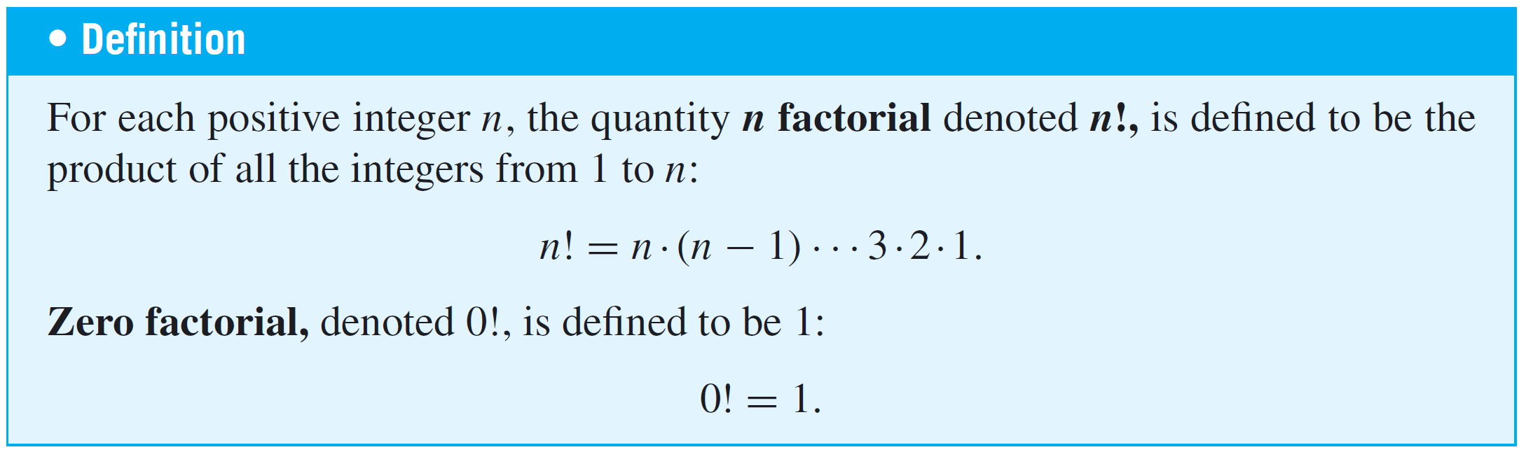
Factorial and “n Choose r ” Notation
The product of all consecutive integers up to a given integer occurs so often in mathematics that it is given a special notation—factorial notation.

Slide 21
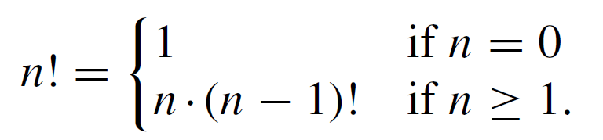
Factorial and “n Choose r ” Notation
A recursive definition for factorial is the following: Given any nonnegative integer n,
The next example illustrates the usefulness of the recursive definition for making computations.

Slide 22
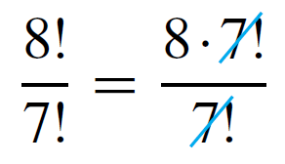
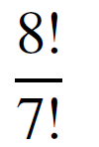
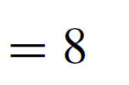
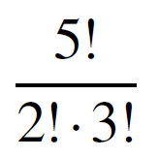
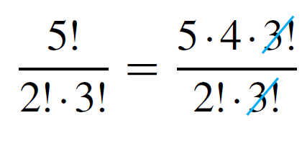
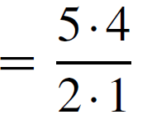
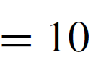
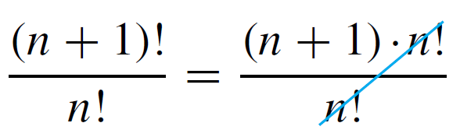
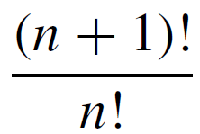
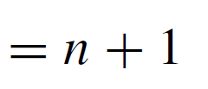




Example 16 – Computing with Factorials
Simplify the following expressions:

Slide 23





Example 16 – Computing with Factorials
cont’d

Slide 24


Factorial and “n Choose r ” Notation
An important use for the factorial notation is in calculating values of quantities, called n choose r, that occur in many branches of mathematics, especially those connected with the study of counting techniques and probability.
Observe that the definition implies that will always be an integer because it is a number of subsets.

Slide 25

Factorial and “n Choose r ” Notation
The computational formula:
Many electronic calculators have keys for computing values of . These are denoted in various ways such as nCr,
C(n, r), ^{n}C_{r} , and C_{n,r}.
The letter C is used because the quantities are also called combinations. Sometimes they are referred to as binomial coefficients because of the connection with the binomial theorem.

Slide 26










Example 17 – Computing by Hand
Use the formula for computing to evaluate the following expressions:

