Slide 1
Direct Proof and Counterexample I: Introduction
Both discovery and proof are integral parts of problem solving. When you think you have discovered that a certain statement is true, try to figure out why it is true.
If you succeed, you will know that your discovery is genuine. Even if you fail, the process of trying will give you insight into the nature of the problem and may lead to the discovery that the statement is false.

Slide 2
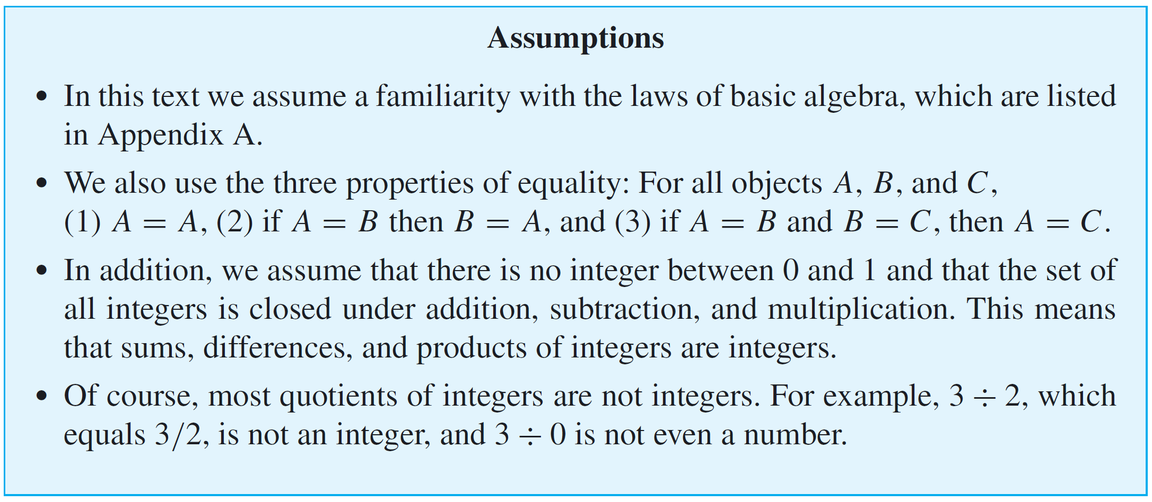
Direct Proof and Counterexample I: Introduction
For complex problems, the interplay between discovery and proof is not reserved to the end of the problem-solving process but, rather, is an important part of each step.

Slide 3
Definitions
In order to evaluate the truth or falsity of a statement, you must understand what the statement is about. In other words, you must know the meanings of all terms that occur in the statement. Mathematicians define terms very carefully and precisely and consider it important to learn definitions virtually word for word.

Slide 4
Example 1 – Even and Odd Integers
Use the definitions of even and odd to justify your answers to the following questions.
Is 0 even?
Yes, 0 = 2·0.
b. Is −301 odd?
Yes, –301 = 2(–151) + 1.
c. If a and b are integers, is 6a²b even?
Yes, 6a²b = 2(3a²b), and since a and b are integers, so is 3a²b (being a product of integers).
d. If a and b are integers, is 10a + 8b + 1 odd?
Yes, 10a + 8b + 1 = 2(5a + 4b) + 1, and since a and b are integers, so is 5a + 4b (being a sum of products of integers).

Slide 5
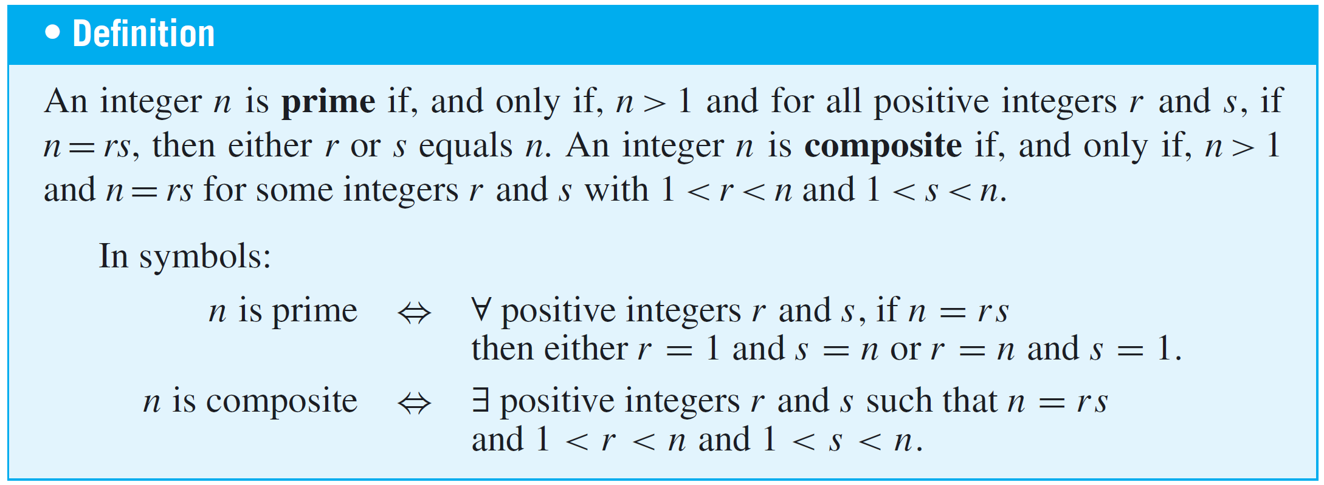
Definitions
The integer 6, which equals 2  3, is a product of two smaller positive integers.
On the other hand, 7 cannot be written as a product of two smaller positive integers; its only positive factors are 1 and 7. A positive integer, such as 7, that cannot be written as a product of two smaller positive integers is called prime.

Slide 6
Example 2 – Prime and Composite Numbers
a. Is 1 prime?
b. Is every integer greater than 1 either prime or composite?
c. Write the first six prime numbers.
d. Write the first six composite numbers.
Solution:
a. No. A prime number is required to be greater than 1.
b. Yes. Let n be any integer that is greater than 1. Consider all pairs of positive integers r and s such that n = rs. There exist at least two such pairs, namely r = n and s = 1 and r = 1 and s = n.

Slide 7
Example 2 – Solution
cont’d
Moreover, since n = rs, all such pairs satisfy the inequalities 1 ≤ r ≤ n and 1 ≤ s ≤ n. If n is prime, then the two displayed pairs are the only ways to write n as rs.
Otherwise, there exists a pair of positive integers r and s such that n = rs and neither r nor s equals either 1 or n. Therefore, in this case 1 < r < n and 1 < s < n, and hence n is composite.
c. 2, 3, 5, 7, 11, 13
d. 4, 6, 8, 9, 10, 12

Slide 8
Proving Existential Statements
We have known that a statement in the form
∃x ∈ D such that Q(x)
is true if, and only if,
Q(x) is true for at least one x in D.
One way to prove this is to find an x in D that makes Q(x) true.
Another way is to give a set of directions for finding such an x.
Both of these methods are called constructive proofs of existence.

Slide 9
Example 3 – Constructive Proofs of Existence
a. Prove the following: ∃ an even integer n that can be written in two ways as a sum of two prime numbers.
b. Suppose that r and s are integers. Prove the following:
∃ an integer k such that 22r + 18s = 2k.
Solution:
a. Let n = 10. Then 10 = 5 + 5 = 3 + 7 and 3, 5, and 7 are all prime numbers.
b. Let k = 11r + 9s. Then k is an integer because it is a sum of products of integers; and by substitution, 2k = 2(11r + 9s), which equals 22r + 18s by the distributive law of algebra.

Slide 10
Proving Existential Statements
A nonconstructive proof of existence involves showing either (a) that the existence of a value of x that makes Q(x) true is guaranteed by an axiom or a previously proved theorem or (b) that the assumption that there is no such x leads to a contradiction.
The disadvantage of a nonconstructive proof is that it may give virtually no clue about where or how x may be found.

Slide 11
Disproving Universal Statements by Counterexample
To disprove a statement means to show that it is false. Consider the question of disproving a statement of the form
∀x in D, if P(x) then Q(x).
Showing that this statement is false is equivalent to showing that its negation is true. The negation of the statement is existential:
∃x in D such that P(x) and not Q(x).

Slide 12
Disproving Universal Statements by Counterexample
But to show that an existential statement is true, we generally give an example, and because the example is used to show that the original statement is false, we call it a counterexample. Thus the method of disproof by counterexample can be written as follows:

Slide 13
Example 4 – Disproof by Counterexample
Disprove the following statement by finding a counterexample:
∀ real numbers a and b, if a² = b² then a = b.
Solution:
To disprove this statement, you need to find real numbers a and b such that the hypothesis a² = b² is true and the conclusion a = b is false.
The fact that both positive and negative integers have positive squares helps in the search.

Slide 14
Example 4 – Solution
cont’d
If you flip through some possibilities in your mind, you will quickly see that 1 and –1 will work (or 2 and –2, or 0.5 and –0.5, and so forth).

Slide 15
Proving Universal Statements
The vast majority of mathematical statements to be proved are universal. In discussing how to prove such statements, it is helpful to imagine them in a standard form:
∀x ∈ D, if P(x) then Q(x).
When D is finite or when only a finite number of elements satisfy P(x), such a statement can be proved by the method of exhaustion.

Slide 16
Example 5 – The Method of Exhaustion
Use the method of exhaustion to prove the following statement:
∀n ∈ Z, if n is even and 4 ≤ n ≤ 26, then n can be written as a sum of two prime numbers.
Solution:

Slide 17
Proving Universal Statements
The most powerful technique for proving a universal statement is one that works regardless of the size of the domain over which the statement is quantified.
It is called the method of generalizing from the generic particular. Here is the idea underlying the method:

Slide 18
Example 6 – Generalizing from the Generic Particular
At some time you may have been shown a “mathematical trick” like the following.
You ask a person to pick any number, add 5, multiply by 4, subtract 6, divide by 2, and subtract twice the original number.
Then you astound the person by announcing that their final result was 7. How does this “trick” work?

Slide 19
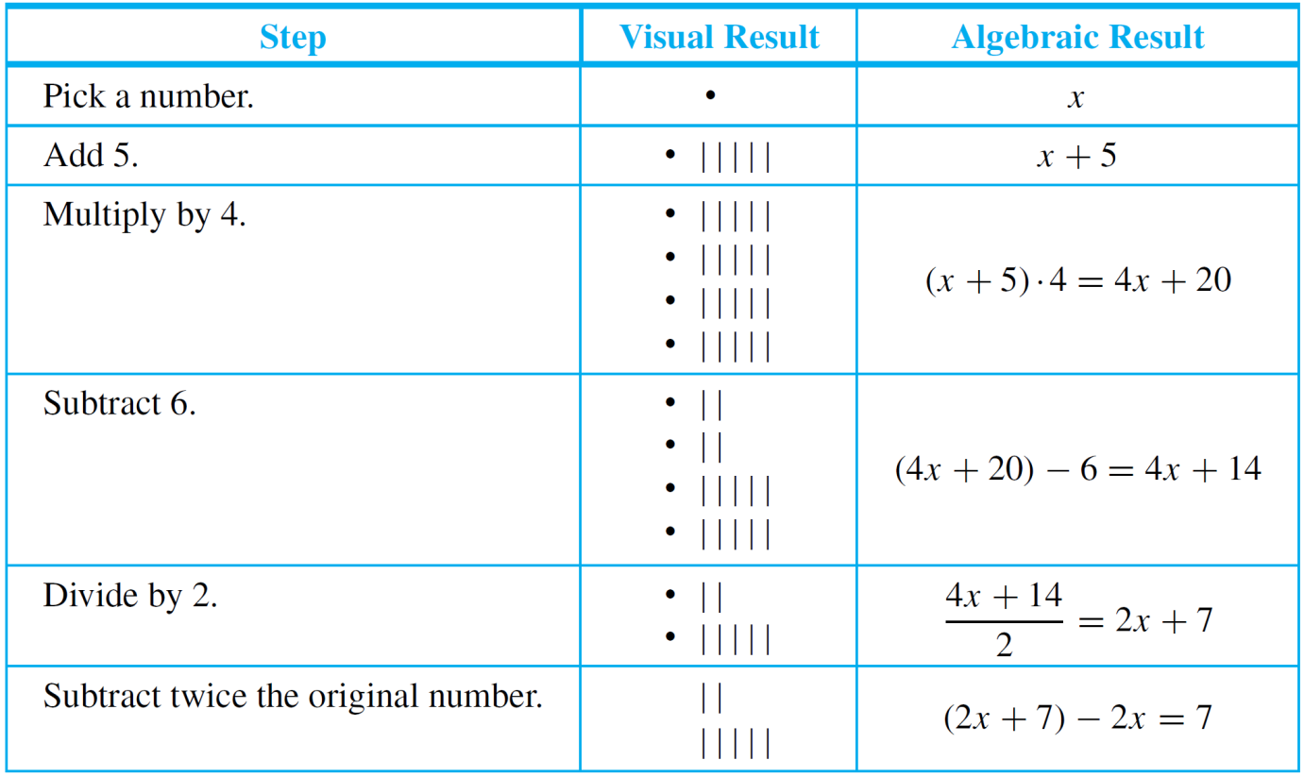
Example 6 – Generalizing from the Generic Particular
cont’d
Let an empty box or the symbol x stand for the number the person picks.
Here is what happens when the person follows your directions:

Slide 20
Example 6 – Generalizing from the Generic Particular
cont’d
Thus no matter what number the person starts with, the result will always be 7.
Note that the x in the analysis above is particular (because it represents a single quantity), but it is also arbitrarily chosen or generic (because any number whatsoever can be put in its place).
This illustrates the process of drawing a general conclusion from a particular but generic object.

Slide 21
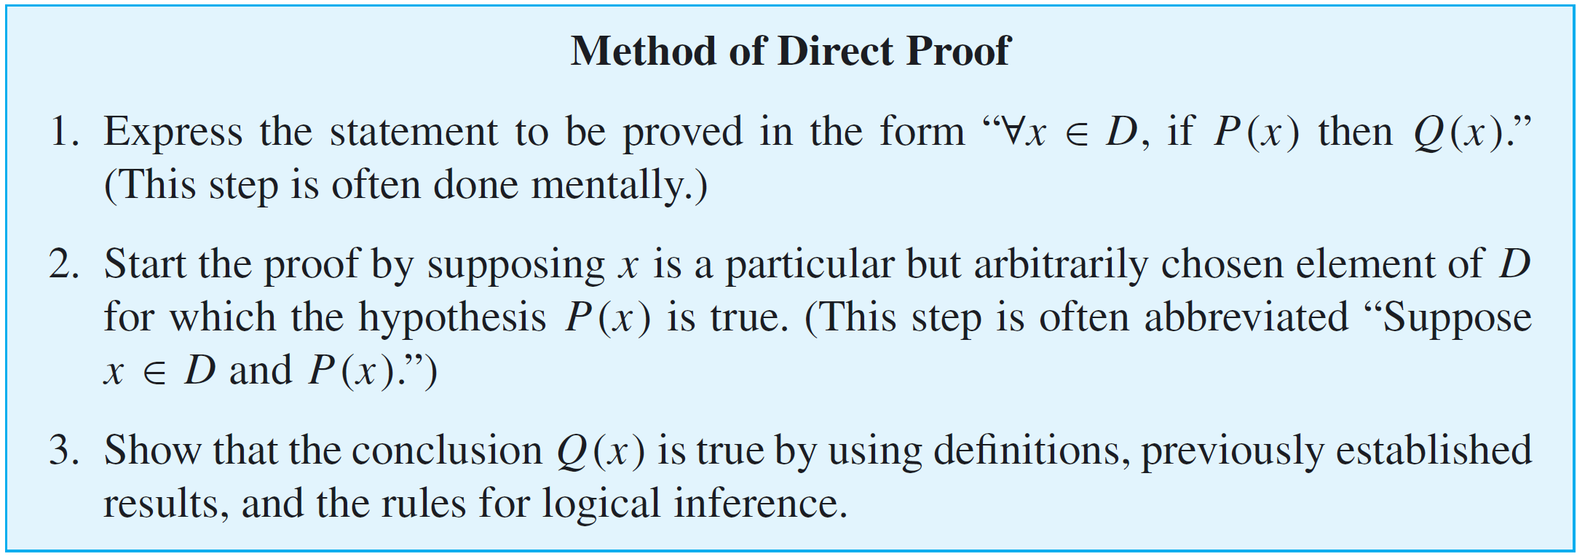
Proving Universal Statements
It follows by the method of generalizing from the generic particular that to show that “∀x, if P(x) then Q(x),” is true for all elements x in a set D, you suppose x is a particular but arbitrarily chosen element of D that makes P(x) true, and then you show that x makes Q(x) true.

Slide 22
Example 7
cont’d
Prove that the sum of any two even integers is even.
Or, more formally, that
∀ integers m and n, if m and n are even then m + n is even.
Proof:
Suppose m and n are [particular but arbitrarily chosen] even integers. [We must show that m + n is even.]

Slide 23
Example 7 – Solution
cont’d
By definition of even, m = 2r and n = 2s for some integers r and s. Then
Let t = r + s. Note that t is an integer because it is a sum of integers. Hence
It follows by definition of even that m + n is even. [This is what we needed to show.]

Slide 24
Directions for Writing Proofs of Universal Statements
Think of a proof as a way to communicate a convincing argument for the truth of a mathematical statement.
Over the years, the following rules of style have become fairly standard for writing the final versions of proofs:
Clearly mark the beginning of your proof with the word Proof.
Make your proof self-contained.
explain the meaning of each variable used in your proof in the body of the proof

Slide 25
Directions for Writing Proofs of Universal Statements
Write your proof in complete, gramatically correct sentences.
This does not mean that you should avoid using symbols and shorthand abbreviations, just that you should incorporate them into sentences.
Keep your reader informed about the status of each statement in your proof.
If something is assumed, preface it with a word like Suppose or Assume.
If it is still to be shown, preface it with words like, “We must show that”.

Slide 26
Directions for Writing Proofs of Universal Statements
Give a reason for each assertion in your proof.
Each assertion in a proof should …
come directly from the hypothesis of the theorem, or
follow from the definition of one of the terms in the theorem, or
be a result obtained earlier in the proof, or
be a mathematical result that has previously been established or is agreed to be assumed.
Indicate the reason for each step of your proof using phrases such as by hypothesis, by definition of . . . , and by theorem . . . .

Slide 27
Directions for Writing Proofs of Universal Statements
Include the “little words and phrases” that make the logic of your arguments clear.
When writing a mathematical argument, especially a proof, indicate how each sentence is related to the previous one.
Does it follow from the previous sentence or from a combination of the previous sentence and earlier ones? If so, start the sentence by stating the reason why it follows or by writing Then, or Thus, or So, or Hence, or Therefore, or Consequently, or It follows that, and include the reason at the end of the sentence.

Slide 28
Directions for Writing Proofs of Universal Statements
If a sentence expresses a new thought or fact that does not follow as an immediate consequence of the preceding statement but is needed for a later part of a proof, introduce it by writing Observe that, or Note that, or But, or Now.
Sometimes in a proof it is desirable to define a new variable in terms of previous variables. In such a case, introduce the new variable with the word Let.
Display equations and inequalities.
The convention is to display equations and inequalities on separate lines to increase readability.

Slide 29
Common Mistakes
The following are some of the most common mistakes people make when writing mathematical proofs.
1. Arguing from examples.
Looking at examples is one of the most helpful practices a problem solver can engage in and is encouraged by all good mathematics teachers.
However, it is a mistake to think that a general statement can be proved by showing it to be true for some special cases.

Slide 30
Common Mistakes
2. Using the same letter to mean two different things.
Some beginning theorem provers give a new variable quantity the same letter name as a previously introduced variable.
3. Jumping to a conclusion.
To jump to a conclusion means to allege the truth of something without giving an adequate reason.
4. Circular reasoning.
To engage in circular reasoning means to assume what is to be proved; it is a variation of jumping to a conclusion.

Slide 31
Common Mistakes
5. Confusion between what is known and what is still to be shown.
A more subtle way to engage in circular reasoning occurs when the conclusion to be shown is restated using a variable.
6. Use of any rather than some.
There are a few situations in which the words any and some can be used interchangeably.
7. Misuse of the word if.
Another common error is not serious in itself, but it reflects imprecise thinking that sometimes leads to problems later in a proof. This error involves using the word if when the word because is really meant.

Slide 32
Getting Proofs Started
Believe it or not, once you understand the idea of generalizing from the generic particular and the method of direct proof, you can write the beginnings of proofs even for theorems you do not understand.
The reason is that the starting point and what is to be shown in a proof depend only on the linguistic form of the statement to be proved, not on the content of the statement.

Slide 33
Example 8 – Identifying the “Starting Point” and the “Conclusion to Be Shown”
Write the first sentence of a proof (the “starting point”) and the last sentence of a proof (the “conclusion to be shown”) for the following statement:
Every complete, bipartite graph is connected.
Solution:
It is helpful to rewrite the statement formally using a quantifier and a variable:
Formal Restatement:

Slide 34
Example 8 – Solution
cont’d
Starting Point: Suppose G is a [particular but arbitrarily chosen] graph such that G is complete and bipartite.
Conclusion to Be Shown: G is connected.
Thus the proof has the following shape:
Proof:
Suppose G is a [particular but arbitrarily chosen] graph such that G is complete and bipartite.
Therefore, G is connected.
…

Slide 35
Showing That an Existential Statement Is False
We have known that the negation of an existential statement is universal.
It follows that to prove an existential statement is false, you must prove a universal statement (its negation) is true.

Slide 36
Example 9 – Disproving an Existential Statement
Show that the following statement is false:
There is a positive integer n such that n² + 3n + 2 is prime.
Solution:
Proving that the given statement is false is equivalent to proving its negation is true.
The negation is
For all positive integers n, n² + 3n + 2 is not prime.
Because the negation is universal, it is proved by generalizing from the generic particular.

Slide 37
Example 9 – Solution
cont’d
Claim: The statement “There is a positive integer n such that n² + 3n + 2 is prime” is false.
Proof:
Suppose n is any [particular but arbitrarily chosen] positive integer. [We will show that n² + 3n + 2 is not prime.]
We can factor n² + 3n + 2 to obtain n² + 3n + 2 = (n + 1)(n + 2).
We also note that n + 1 and n + 2 are integers (because they are sums of integers) and that both n + 1 > 1 and n + 2 > 1 (because n ≥ 1).Thus n² + 3n + 2 is a product of two integers each greater than 1, and so n² + 3n + 2 is not prime.

