Slide 1
Statements with Multiple Quantifiers
When a statement contains more than one quantifier, we imagine the actions suggested by the quantifiers as being performed in the order in which the quantifiers occur.
For instance, consider a statement of the form
∀x in set D, ∃y in set E such that x and y satisfy property P(x, y).

Slide 2
Statements with Multiple Quantifiers
∀ people x, ∃ a person y such that x loves y.
∃ a person y such that ∀ people x, x loves y.
Informally,
∀ … ∃ …such that … is similar to “everyone has something”
∃ … ∀ …such that … is similar to “someone has everything”

Slide 3
Statements with Multiple Quantifiers
Interestingly, however, if one quantifier immediately follows another quantifier of the same type, then the order of the quantifiers does not affect the meaning.
∀ real numbers x and ∀ real numbers y, x+y=y+x.
∀ real numbers y and ∀ real numbers x, x+y=y+x.
Usually, this is expressed more briefly as
∀ real numbers x and y, x+y = y+x.

Slide 4
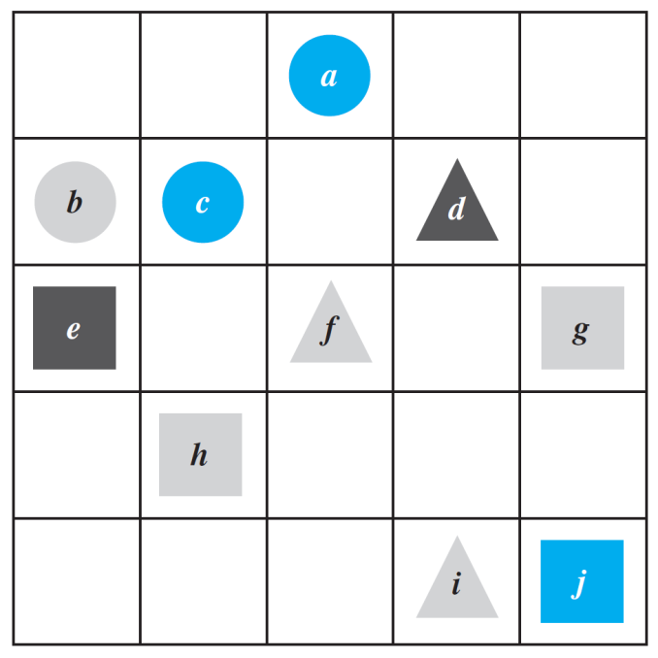
Example 1 – Truth of a ∀∃ Statement in a Tarski World
Consider the Tarski world shown below.
Show that the following statement is true in this world:
For all triangles x, there is a square y such that x and y have the same color.

Slide 5
Example 1 – Truth of a ∀∃ Statement in a Tarski World
Consider the Tarski world shown below.
Show that the following statement is true in this world:
There exists a triangle x such that for all circles y, x and y have different color.

Slide 6
Negations of Multiply-Quantified Statements
You can use the same rules to negate multiply-quantified statements that you used to negate simpler quantified statements.
We already know that
∼(∀x in D, P(x)) ≡ ∃x in D such that ∼P(x).
and
∼(∃x in D such that P(x)) ≡ ∀x in D,∼P(x).

Slide 7
Negations of Multiply-Quantified Statements
We apply these laws to find
∼(∀x in D, ∃y in E such that P(x, y))
by moving in stages from left to right along the sentence.
First version of negation:
∃x in D such that ∼(∃y in E such that P(x, y)).
Final version of negation:
∃x in D such that ∀y in E, ∼P(x, y).

Slide 8
Negations of Multiply-Quantified Statements
Similarly, to find
∼(∃x in D such that ∀y in E, P(x, y)),
we have
First version of negation:
∀x in D,∼(∀y in E, P(x, y)).
Final version of negation:
∀x in D, ∃y in E such that ∼P(x, y).

Slide 9
Negations of Multiply-Quantified Statements
These facts can be summarized as follows:

Slide 10
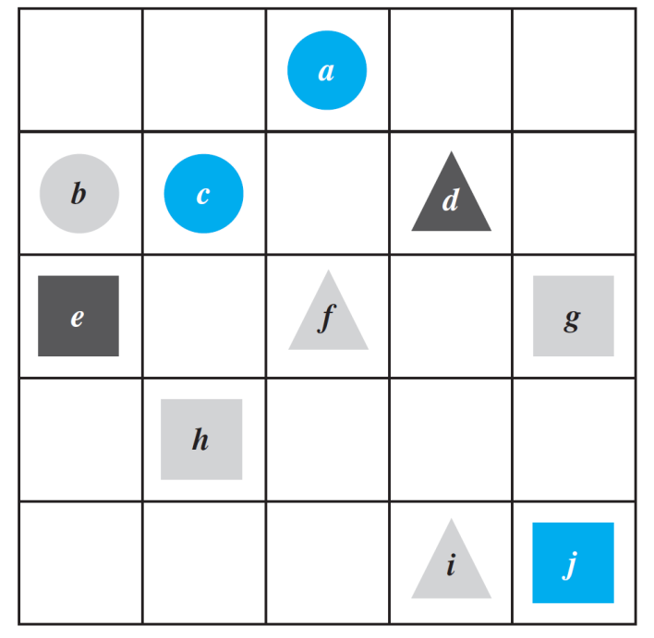
Example 8 – Negating Statements in a Tarski World
Write a negation for each of the following statements, and determine which is true, the given statement or its negation.
a. For all squares x, there is a circle y such that x and y have the same color.
Negation: ∃ a square x such that ∀ circles y,
x and y do not have the same color.
The negation is true. Square e is black and no circle is black, so there is a square that does not have the same color as any circle.

Slide 11
Example 8 – Negating Statements in a Tarski World
Write a negation for each of the following statements, and determine which is true, the given statement or its negation.
b. There is a triangle x such that for all squares y, x is to the right of y.
Negation: ∀ triangles x, ∃ a square y such that
x is not to the right of y.
The negation is true because no matter what triangle is chosen, it is not to the right of square g (or square j ).

Slide 12
Formal Logical Notation
In some areas of computer science, logical statements are expressed in purely symbolic notation.
The notation involves using predicates to describe all properties of variables and omitting the words such that in existential statements.
The formalism also depends on the following facts:
“∀x in D, P(x)” can be written as “∀x(x in D → P(x)),” and
“∃x in D such that P(x)” can be written as “∃x(x in D ∧ P(x)).”

Slide 13
Formal Logical Notation
Formal logical notation is used in branches of computer science such as artificial intelligence, program verification, and automata theory and formal languages.
Taken together, the symbols for quantifiers, variables, predicates, and logical connectives make up what is known as the language of first-order logic.

