Slide 1
Predicates and Quantified Statements I
In logic, predicates can be obtained by removing some or all of the nouns from a statement. For instance,
let P stand for “is a student at UNC”
let Q stand for “is a student at”
Then both P and Q are predicate symbols.
The sentences “x is a student at UNC” and “x is a student at y” are symbolized as P(x) and as Q(x, y) respectively, where x and y are predicate variables that take values in appropriate sets.
When concrete values are substituted in place of predicate variables, a statement results.

Slide 2
Predicates and Domain
Predicate = predicate symbol + predicate variable(s) P(x) is a predicate
Domain of a predicate variable: the set of all values that may be substituted in place of the variable.
Suppose P(x) stands for “is a student at UNC” The domain of x could be “the set of all human beings”
Suppose P(x) stands for “$x^{2}>x$” The domain of x could be the set of real numbers, R.
Truth set of P(x): the set of all elements in x’s domain that make P(x) true.
In the first example: “the set of all UNC students”
In the second example: “{$x∈R | x>1∨x<0$}”

Slide 3
The Universal Quantifier: ∀
Quantifiers are words that refer to quantities such as “some” or “all” and tell for how many elements a given predicate is true.
∀ denotes “for all”
Suppose Q(x) stands for “is a student at UNC”
Let D be “the set of all UNC students,” “$∀x∈D, Q(x)$” is true. Let D be “the set of all human beings,” “$∀x∈D, Q(x)$” is false.
--My father is a counterexample.

Slide 4
Example 3 – Truth and Falsity of Universal Statements
Let D = {1, 2, 3, 4, 5}, and consider the statement
Show that this statement is true.
Solution: Check that “x² ≥ x” is true for each individual x in D.
Hence “∀x ∈ D, x² ≥ x” is true.

Slide 5
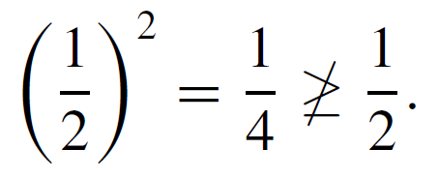
Example 3 – Truth and Falsity of Universal Statements
Consider the statement
Find a counterexample to show that this statement is false.
Solution: Take x = 1/2. Then x is in R (since 1/2 is a real number) and
Hence “∀x ∈ R, x² ≥ x” is false.

Slide 6
The Existential Quantifier: ∃
The symbol ∃ denotes “there exists” and is called the existential quantifier. For example, the sentence “There is a student in Math 140” can be written as
∃ a person p such that p is a student in Math 140,
or, more formally,
∃p ∈ P such that p is a student in Math 140,
where P is the set of all people.
The domain of the predicate variable is generally indicated either between the ∃ symbol and the variable name or immediately following the variable name.

Slide 7
The Existential Quantifier: ∃
The words such that are inserted just before the predicate. Some other expressions that can be used in place of there exists are there is a, we can find a, there is at least one, for some, and for at least one.
In a sentence such as “∃ integers m and n such that m + n = m  n,” the ∃ symbol is understood to refer to both m and n.

Slide 8
The Existential Quantifier: ∃
∃ denotes “there exists”
Suppose Q(x) stands for “is a student at UNC”
Let D be “the set of all human beings,” “$\text{∃}x∈D \text{such} \text{that} Q(x)$” is true.
Let D be “the set of students at Duke,”
“$\text{∃}x∈D \text{such} \text{that} Q(x)$” is false.

Slide 9
Example 4 – Truth and Falsity of Existential Statements
a. Consider the statement
∃m ∈ Z⁺ such that m² = m.
Show that this statement is true.
Solution: Observe that 1² = 1. Thus “m² = m” is true for at least one integer m. Hence “∃m ∈ Z such that m² = m” is true.

Slide 10
Example 4 – Truth and Falsity of Existential Statements
b. Let E = {5, 6, 7, 8} and consider the statement
∃m ∈ E such that m² = m.
Show that this statement is false.
Solution: Note that m² = m is not true for any integers m from 5 through 8:
Thus “∃m ∈ E such that m² = m” is false.

Slide 11
Equivalent Forms of Universal and Existential Statements
Observe that the two statements “∀ real numbers x, if x is an integer then x is rational” and “∀ integers x, x is rational” mean the same thing.
Both have informal translations “All integers are rational.” In fact, a statement of the form
can always be rewritten in the form
by narrowing U to be the domain D consisting of all values of the variable x that make P(x) true.

Slide 12
Equivalent Forms of Universal and Existential Statements
Conversely, a statement of the form
can be rewritten as
“∀ integers x, x is rational”
“∀ real numbers x, if x is an integer then x is rational”

Slide 13
Equivalent Forms of Universal and Existential Statements
Similarly, a statement of the form
“∃x such that P(x) and Q(x)”
can be rewritten as
“∃x∈ D such that Q(x),”
where D is the set of all x for which P(x) is true.
“∃n such that n is a student at UNC and n is under 18”
“∃n ∈ D such that n is under 18”
where D is the set of all UNC students.

Slide 14
Implicit Quantification
Mathematical writing contains many examples of implicitly quantified statements. Some occur, through the presence of the word a or an. Others occur in cases where the general context of a sentence supplies part of its meaning.
For example, in an algebra course in which the letter x is always used to indicate a real number, the predicate
If x > 2 then x² > 4
is interpreted to mean the same as the statement
∀ real numbers x, if x > 2 then x² > 4.

Slide 15
Implicit Quantification
Mathematicians often use a double arrow to indicate implicit quantification symbolically.
For instance, they might express the above statement as
x > 2 ⇒ x² > 4.

Slide 16
Example 12 – Using ⇒ and ⇔
Let
Q(n) be “n is a factor of 8,”
R(n) be “n is a factor of 4,”
S(n) be “n < 5 and n ≠ 3,”
and suppose the domain of n is Z⁺, the set of positive integers. Use the ⇒ and ⇔ symbols to indicate true relationships among Q(n), R(n), and S(n).

Slide 17
Example 12 – Solution
1. As noted in Example 2, the truth set of Q(n) is {1, 2, 4, 8} when the domain of n is Z⁺. By similar reasoning the truth set of R(n) is {1, 2, 4}.
Thus it is true that every element in the truth set of R(n) is in the truth set of Q(n), or, equivalently,
∀n in Z⁺, R(n) → Q(n).
So R(n) ⇒ Q(n), or, equivalently
n is a factor of 4 ⇒ n is a factor of 8.

Slide 18
Example 12 – Solution
cont’d
2. The truth set of S(n) is {1, 2, 4}, which is identical to the truth set of R(n), or, equivalently,
∀n in Z⁺, R(n) ↔ S(n).
So R(n) ⇔ S(n), or, equivalently,
n is a factor of 4 ⇔ n < 5 and n ≠ 3.
Moreover, since every element in the truth set of S(n) is in the truth set of Q(n), or, equivalently,
∀n in Z⁺, S(n) → Q(n), then S(n) ⇒ Q(n), or, equivalently,
n < 5 and n ≠ 3 ⇒ n is a factor of 8.

Slide 19
Tarski’s World

Slide 20
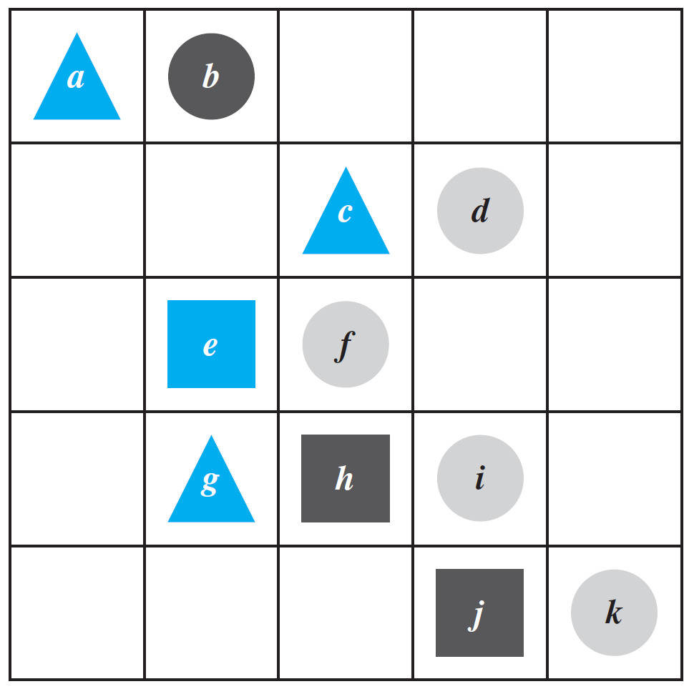
Example 13 – Investigating Tarski’s World
cont’d
Triangle(x), meaning “x is a triangle,”
Blue(y), meaning “y is blue,”
RightOf(x, y), meaning “x is to the right of y (but possibly in a different row).”
Individual objects can be given names such as a, b, or c.
Three colors: blue, black, grey
Three shapes:
triangle, circle, square

Slide 21
Example 13 – Investigating Tarski’s World
cont’d
Determine the truth or falsity of each of the following statements. The domain for all variables is the set of objects in the Tarski world shown above.
a. ∀t, Triangle(t) → Blue(t).
b. ∀x, Blue(x) → Triangle(x).
c. ∃y such that
Square(y) ∧ RightOf(d, y).
d. ∃z such that Square(z) ∧ Gray(z).

Slide 22
Example 13 – Solution
a. This statement is true: All the triangles are blue.
b. This statement is false. As a counterexample, note that e is blue and it is not a triangle.
c. This statement is true because e and h are both square and d is to their right.
d. This statement is false: All the squares are either blue or black.

