Slide 1
Truth Table to Statement Form
p | q | r | ?
T | T | T | T
T | T | F | F
T | F | T | T
T | F | F | T
F | T | T | F
F | T | F | F
F | F | T | F
F | F | F | F
Disjunctive Normal Form (DNF) or sum-of-products form
(p∧q∧r) ∨ (p∧~q∧r) ∨ (p∧~q∧~r)
Conjunctive Normal Form (CNF) or product-of-sums form
(~p∨~q∨r) ∧ (p∨~q∨~r) ∧ (p∨~q∨r) ∧ (p∨q∨~r) ∧ (p∨q∨r)

Slide 2
Application: Digital Logic Circuits
More complicated circuits correspond to more complicated logical expressions.
Electrical engineers continue to use the language of logic when they refer to values of signals produced by an electronic switch as being “true” (1) or “false” (0).
The symbols 0 and 1 are called bits, short for binary digits.

Slide 3
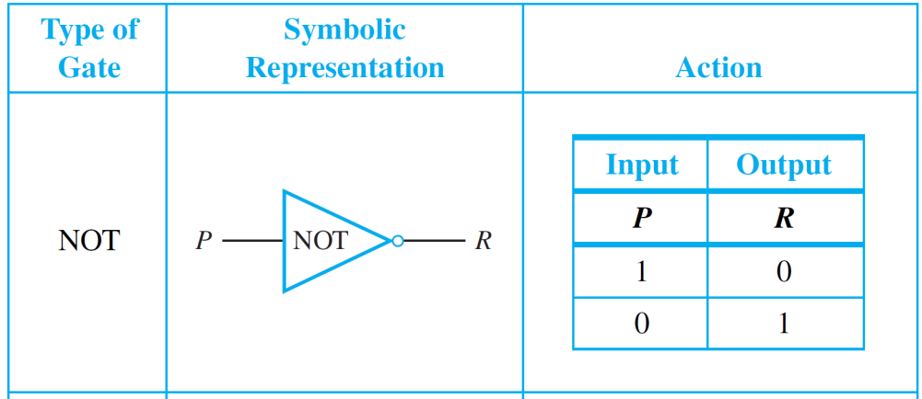
Gates
An efficient method for designing more complicated circuits is to build them by connecting less complicated black box circuits. Three such circuits are NOT-, AND-, and OR-gates.

Slide 4
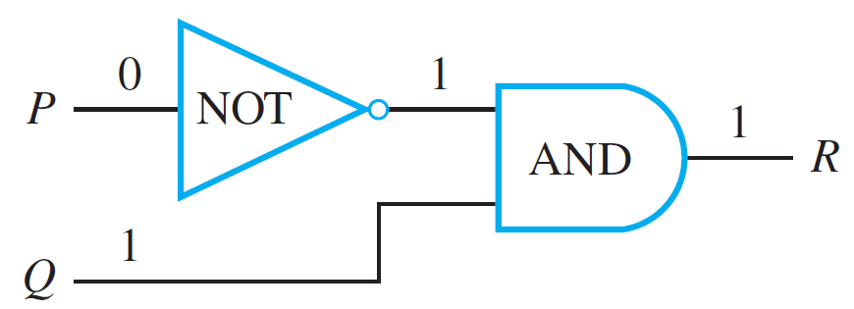
Circuits v.s. Logic
R ≡ ~P ∧ Q
Input signals: P = 0 and Q = 1

Slide 5
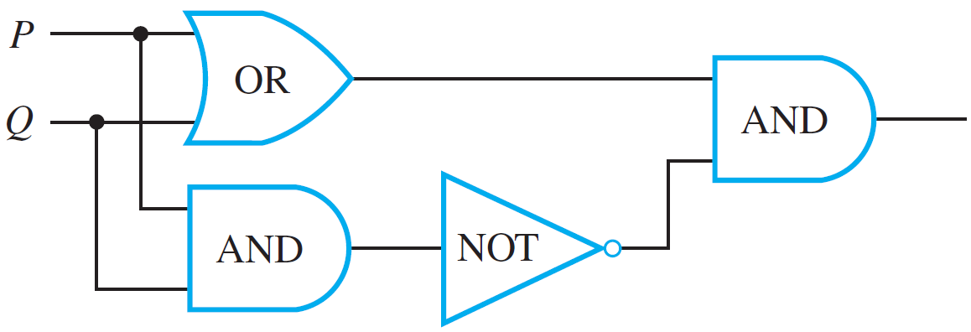
Circuits v.s. Logic
A dot indicates a soldering of two wires.
Wires that cross without a dot are assumed not to touch.
P ∨ Q
(P ∨ Q) ∧ ~ (P ∧ Q)
P ∧ Q
~ (P ∧ Q)

Slide 6
The Boolean Expression Corresponding to a Circuit
In logic, variables such as p, q and r represent statements, and a statement can have one of only two truth values: T(true) or F(false).
A statement form is an expression, such as p ∧ (∼q ∨ r), composed of statement variables and logical connectives.
Any variable, such as a statement variable or an input signal, that can take one of only two values is called a Boolean variable. An expression composed of Boolean variables and the connectives ∼, ∧, and ∨ is called a Boolean expression.

Slide 7
Black Boxes and Gates
Focuses attention on the relation between the input and the output signals.
The operation is completely specified by constructing an input/output table that lists all possible input signals together with their corresponding output signals.

Slide 8
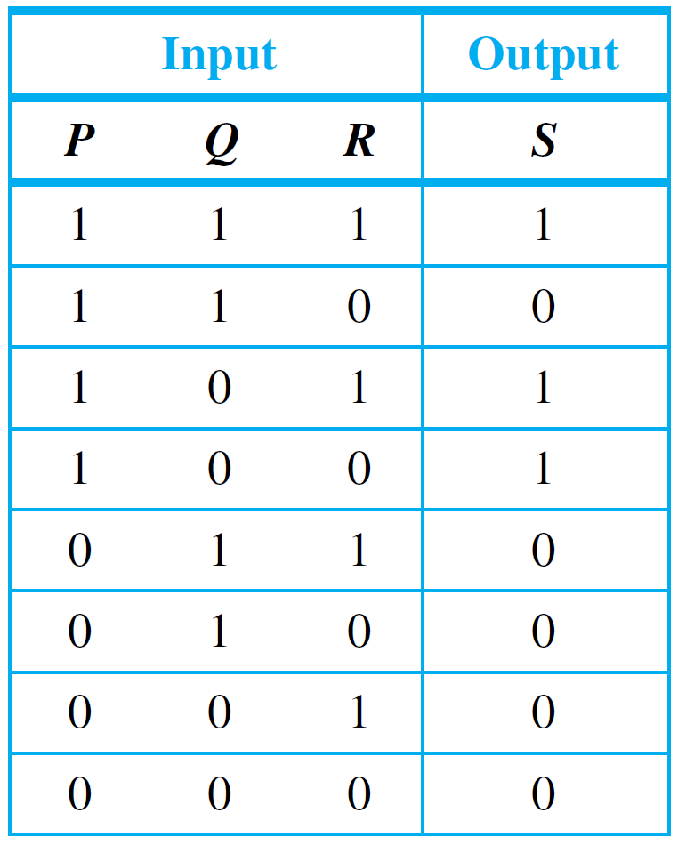
Black Boxes
S ≡ (P∧Q∧R) ∨ (P∧~Q∧R) ∨ (P∧~Q∧~R)
S ≡ (~P∨~Q∨R) ∧ (P∨~Q∨~R) ∧ (P∨~Q∨R) ∧ (P∨Q∨~R) ∧ (P∨Q∨R)
p | q | r | ?
T | T | T | T
T | T | F | F
T | F | T | T
T | F | F | T
F | T | T | F
F | T | F | F
F | F | T | F
F | F | F | F

Slide 9
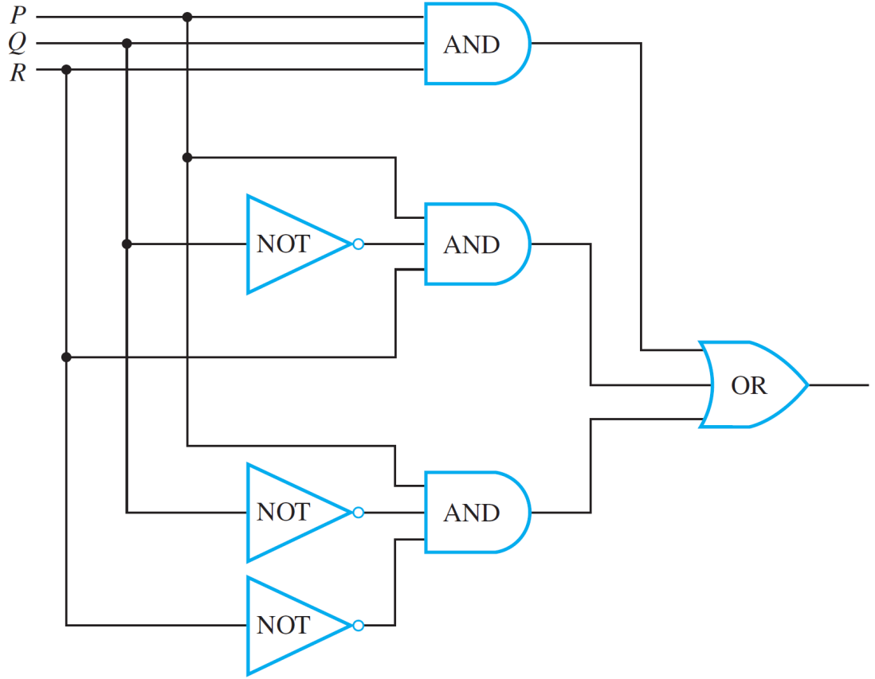
Example 5 – Solution
cont’d
Then draw the diagram for
(P ∧ Q ∧ R) ∨ (P ∧ ~Q ∧ R) ∨ (P ∧ ~Q ∧ ~R)

Slide 10
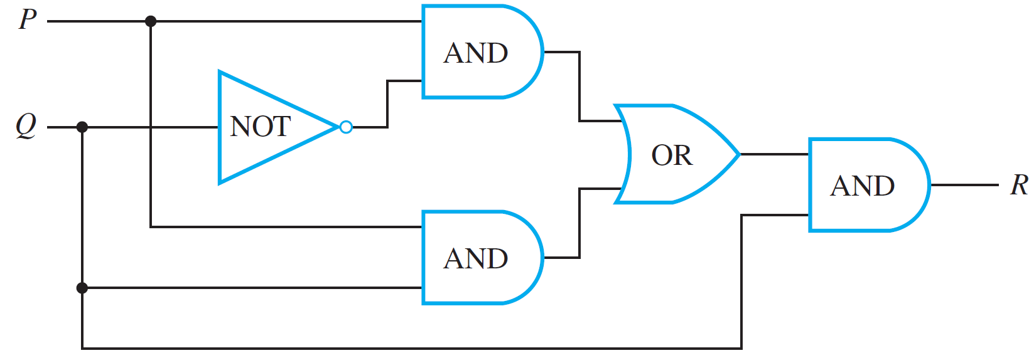
Simplifying Combinational Circuits
Consider the two combinational circuits shown below.
(a)
(b)

Slide 11
Example 6 – Solution
Circuit (a): ((P ∧ ∼Q) ∨ (P ∧ Q)) ∧ Q
Circuit (b): P ∧ Q

Slide 12
NAND and NOR Gates
Another way to simplify a circuit is to find an equivalent circuit that uses the fewest different kinds of logic gates.
Two gates not previously introduced are particularly useful for this: NAND-gates and NOR-gates.
NAND-gate: acts like an AND-gate followed by a NOT-gate; represented by a Sheffer stroke “|”.
NOR-gate: acts like an OR-gate followed by a NOT-gate; represented by a Peirce arrow “↓”.

Slide 13
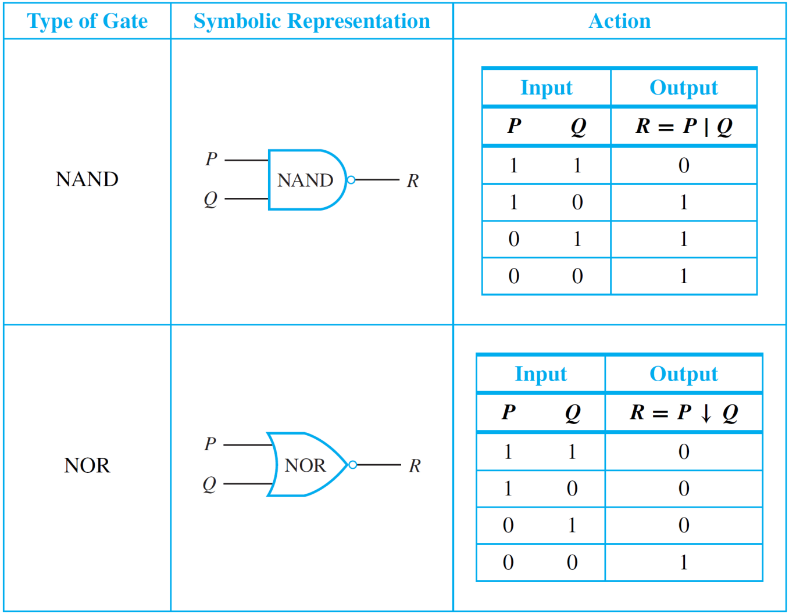
NAND and NOR Gates

Slide 14
NAND and NOR Gates
It can be shown that any Boolean expression is equivalent to one written entirely with Sheffer strokes or entirely with Peirce arrows.
Thus any digital logic circuit is equivalent to one that uses only NAND-gates or only NOR-gates.

Slide 15
Example 7 – Rewriting Expressions Using the Sheffer Stroke
Use logical equivalences to show that

Slide 16
Example 7 – Rewriting Expressions Using the Sheffer Stroke
Use logical equivalences to show that
Use logical equivalences to show that
P∧Q ≡ (P|Q)|(P|Q)
NAND ( | ) is functionally complete.

Slide 17
Summary of Logical Equivalences
A number of logical equivalences are summarized in Theorem 2.1.1 for future reference.

Slide 18
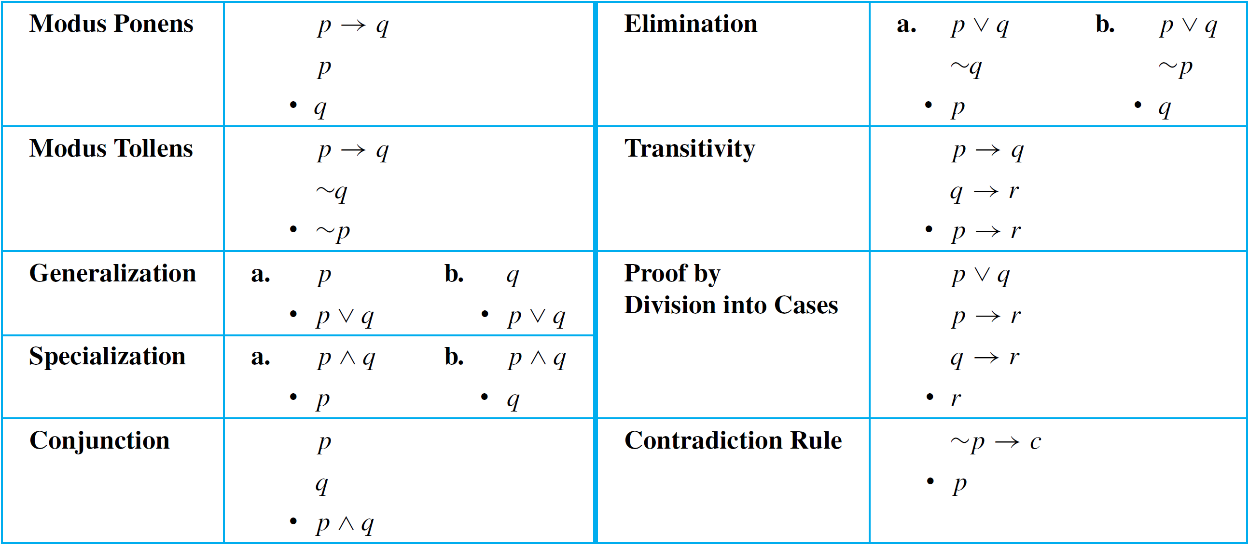
Summary of Rules of Inference
Table 2.3.1 summarizes some of the most important rules of inference.
∴
∴
∴
∴
∴
∴
∴
∴
∴
∴
∴
∴
Valid Argument Forms
Table 2.3.1

