Slide 1
Valid and Invalid Arguments
In mathematics and logic an argument is a sequence of statements ending in a conclusion. We now show how to determine whether an argument is valid—that is, whether the conclusion follows necessarily from the preceding statements. We will show that this determination depends only on the form of an argument, not on its content.
For example, the argument
If Jim is a man, then Jim is mortal.
Jim is a man.
∴ Jim is mortal.

Slide 2
Valid and Invalid Arguments
has the abstract form
If p then q
p
∴ q
When considering the abstract form of an argument, think of p and q as variables for which statements may be substituted.
An argument form is called valid if, and only if, whenever statements are substituted that make all the premises true, the conclusion is also true.

Slide 3
Valid and Invalid Arguments
An argument (form) is a sequence of statements (statement forms).
All statements (statement forms) but the last are called premises, hypotheses, or assumptions.
The last statement (form) is called the conclusion.
The conclusion is preceded by “∴” (said “therefore”).
An argument (form) is valid if whenever its premises are true, then its conclusion is also true.

Slide 4
Valid and Invalid Arguments
Testing an Argument Form for Validity
1. Identify the premises and conclusion of the argument form.
2. Construct a truth table showing the truth values of all the premises and the conclusion.
3. A row of the truth table in which all the premises are true is called a critical row. If there is a critical row in which the conclusion is false, then it is possible for an argument of the given form to have true premises and a false conclusion, and so the argument form is invalid. If the conclusion in every critical row is true, then the argument form is valid.

Slide 5
Example 1 – Determining Validity or Invalidity
Is this a valid argument form?
p → q ∨ ∼r
q → p ∧ r
∴ p → r

Slide 6
Example 1 – Solution
cont’d
Solution:
The truth table shows that even though there are several situations in which the premises and the conclusion are all true (rows 1, 7, and 8), there is one situation (row 4) where the premises are true and the conclusion is false.

Slide 7
Modus Ponens and Modus Tollens
The most argument form in logic is called modus ponens. It has the following form:
If p then q.
p
∴ q

Slide 8
Modus Ponens and Modus Tollens
An argument form consisting of two premises and a conclusion is called a syllogism. The first and second premises are called the major premise and minor premise, respectively.
The most famous form of syllogism in logic is called modus ponens. It has the following form:
If p then q.
p
∴ q

Slide 9
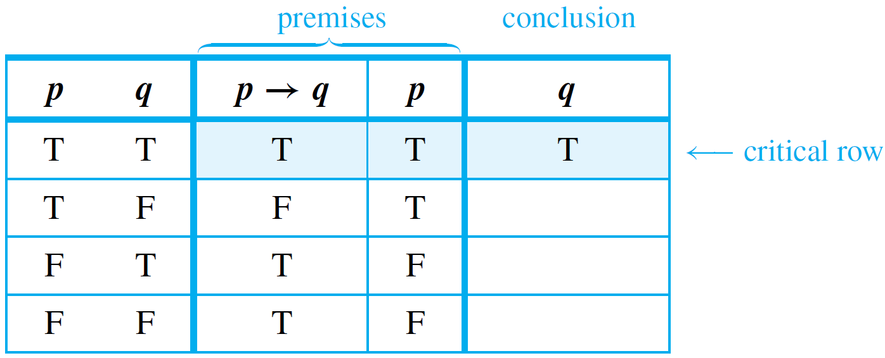
Modus Ponens and Modus Tollens
It is instructive to prove that modus ponens is a valid form of argument, if for no other reason than to confirm the agreement between the formal definition of validity and the intuitive concept.
To do so, we construct a truth table for the premises and conclusion.

Slide 10
Modus Ponens and Modus Tollens
The first row is the only one in which both premises are true, and the conclusion in that row is also true. Hence the argument form is valid.
Now consider another valid argument form called modus tollens. It has the following form:
If p then q.
∼q
∴ ∼p

Slide 11
Example 2 – Recognizing Modus Ponens and Modus Tollens
Use modus ponens or modus tollens to fill in the blanks of the following arguments so that they become valid inferences.
a. If there are more pigeons than there are pigeonholes, then at least two pigeons roost in the same hole. There are more pigeons than there are pigeonholes. ∴ .
b. If 870,232 is divisible by 6, then it is divisible by 3. 870,232 is not divisible by 3.
∴ .

Slide 12
Example 2 – Solution
a. At least two pigeons roost in the same hole.
b. 870,232 is not divisible by 6.

Slide 13
Additional Valid Argument Forms: Rules of Inference
A rule of inference is a form of argument that is valid. Thus modus ponens and modus tollens are both rules of inference.
The following are additional examples of rules of inference that are frequently used in deductive reasoning.

Slide 14
Example 3 – Generalization
The following argument forms are valid:
a. p b. q
∴ p ∨ q ∴ p ∨ q
These argument forms are used for making generalizations. For instance, according to the first, if p is true, then, more generally, “p or q” is true for any other statement q.
As an example, suppose you are given the job of counting the upperclassmen at your school. You ask what class Anton is in and are told he is a junior.

Slide 15
Example 3 – Generalization
cont’d
You reason as follows:
Anton is a junior.
∴ (more generally) Anton is a junior or Anton is a senior.
Knowing that upperclassman means junior or senior, you add Anton to your list.

Slide 16
Example 4 – Specialization
The following argument forms are valid:
a. p ∧ q b. p ∧ q
∴ p ∴ q
These argument forms are used for specializing. When classifying objects according to some property, you often know much more about them than whether they do or do not have that property.
When this happens, you discard extraneous information as you concentrate on the particular property of interest.

Slide 17
Example 4 – Specialization
cont’d
For instance, suppose you are looking for a person who knows graph algorithms to work with you on a project. You discover that Ana knows both numerical analysis and graph algorithms. You reason as follows:
Ana knows numerical analysis and Ana knows graph algorithms.
∴ (in particular) Ana knows graph algorithms.
Accordingly, you invite her to work with you on your project.

Slide 18
Example 5 – Elimination
The following argument forms are valid:
a. p ∨ q b. p ∨ q
∼q ∼p
∴ p ∴ q
These argument forms say that when you have only two possibilities and you can rule one out, the other must be the case.

Slide 19
Example 5 – Elimination
cont’d
For instance, suppose you know that for a particular number x,
If you also know that x is not negative, then x ≠ −2, so
By elimination, you can then conclude that
∴

Slide 20
Example 6 – Transitivity
The following argument form is valid:
p → q
q → r
∴ p → r
Many arguments in mathematics contain chains of if-then statements.
From the fact that one statement implies a second and the second implies a third, you can conclude that the first statement implies the third.

Slide 21
Example 6 – Transitivity
cont’d
Here is an example:
If 18,486 is divisible by 18, then 18,486 is divisible by 9.
If 18,486 is divisible by 9, then the sum of the digits of 18,486 is divisible by 9.
∴ If 18,486 is divisible by 18, then the sum of the digits of 18,486 is divisible by 9.

Slide 22
Example 7 – Proof by Division into Cases
The following argument form is valid:
p ∨ q
p → r
q → r
∴ r
It often happens that you know one thing or another is true. If you can show that in either case a certain conclusion follows, then this conclusion must also be true.

Slide 23
Example 7 – Proof by Division into Cases
cont’d
For instance, suppose you know that x is a particular nonzero real number.
The trichotomy property of the real numbers says that any number is positive, negative, or zero. Thus (by elimination) you know that x is positive or x is negative.
You can deduce that x² > 0 by arguing as follows:
x is positive or x is negative.
If x is positive, then x² > 0.
If x is negative, then x² > 0.
∴ x² > 0.

Slide 24
Example 8 – Application: A More Complex Deduction
You are about to leave for school in the morning and discover that you don’t have your glasses. You know the following statements are true:
a. If I was reading the newspaper in the kitchen, then my glasses are on the kitchen table.
b. If my glasses are on the kitchen table, then I saw them at breakfast.
c. I did not see my glasses at breakfast.
d. I was reading the newspaper in the living room or I was reading the newspaper in the kitchen.
e. If I was reading the newspaper in the living room then my glasses are on the coffee table.
Where are the glasses?

Slide 25
Example 8 – Application: A More Complex Deduction
cont’d
Solution:
Let RK = I was reading the newspaper in the kitchen.
GK = My glasses are on the kitchen table.
SB = I saw my glasses at breakfast.
RL = I was reading the newspaper in the living room.
GC = My glasses are on the coffee table.

Slide 26
Example 8 – Solution
cont’d
Here is a sequence of steps you might use to reach the answer, together with the rules of inference that allow you to draw the conclusion of each step:
1.
2.
∴
∴

Slide 27
Example 8 – Solution
cont’d
3.
4.
Thus the glasses are on the coffee table.
∴
∴

Slide 28
Fallacies
A fallacy is an error in reasoning that results in an invalid argument. Three common fallacies are …
using ambiguous premises, and treating them as if they were unambiguous,
circular reasoning (assuming what is to be proved without having derived it from the premises), and
jumping to a conclusion (without adequate grounds).
Two other fallacies
converse error and
inverse error
which give rise to arguments that superficially resemble those that are valid by modus ponens and modus tollens but are not, in fact, valid.

Slide 29
Example 9 – Converse Error
Show that the following argument is invalid:
If Jim is a cheater, then Jim sits in the back row.
Jim sits in the back row.
∴ Jim is a cheater.
Solution: The first premise gives information about Jim if it is known he is a cheater. It doesn’t give any information about him if it is not already known that he is a cheater.

Slide 30
Example 9 – Solution
cont’d
The general form of the previous invalid argument is as follows:
p → q
q
∴ p
The fallacy underlying this invalid argument form is called the converse error because the conclusion of the argument would follow from the premises if the premise p → q were replaced by its converse.

Slide 31
Example 10 – Inverse Error
Consider the following invalid argument:
If Jim is a cheater, then Jim sits in the back row.
Jim is not a cheater.
∴ Jim does not sit in the back row.
Note that this invalid argument has the following form:
p → q
∼p
∴ ∼q
The fallacy underlying this invalid argument form is called the inverse error because the conclusion of the argument would follow from the premises if the premise p → q were replaced by its inverse.

Slide 32
Example 10 – Inverse Error
cont’d
The fallacy underlying this invalid argument form is called the inverse error because the conclusion of the argument would follow from the premises if the premise p → q were replaced by its inverse.

Slide 33
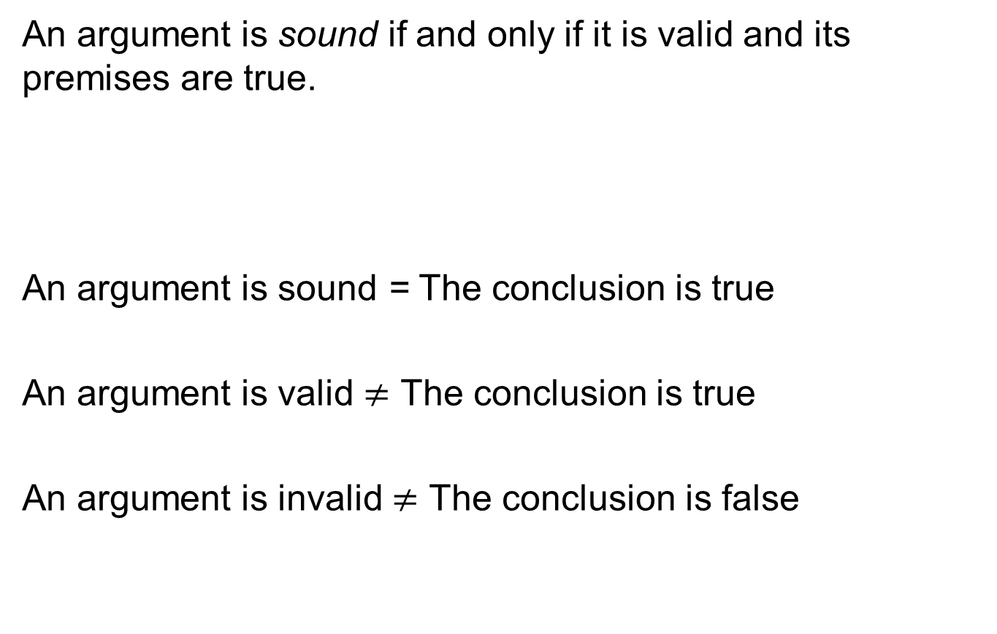
Soundness
An argument is sound if and only if it is valid and its premises are true.
An argument is sound = The conclusion is true
An argument is valid $≠$ The conclusion is true
An argument is invalid $≠$ The conclusion is false

Slide 34
Example 11 – A Valid Argument with a False Premise and a False Conclusion
The argument below is valid by modus ponens. But the first premise is false, and so is its conclusion.
If John Lennon was a rock star, then John Lennon had red hair.
John Lennon was a rock star.
∴ John Lennon had red hair.

Slide 35
Example 12 – An Invalid Argument with True Premises and a True Conclusion
The argument below is invalid by the converse error, but it has a true conclusion.
If New York is a big city, then New York has tall buildings.
New York has tall buildings.
∴ New York is a big city.

Slide 36
Contradictions and Valid Arguments
The concept of logical contradiction can be used to make inferences through a technique of reasoning called the contradiction rule. Suppose p is some statement whose truth you wish to deduce.

Slide 37
Example 13 – Contradiction Rule
Show that the following argument form is valid:
∼p → c, where c is a contradiction
∴ p
Solution: Construct a truth table for the premise and the conclusion of this argument.

Slide 38
Contradictions and Valid Arguments
The contradiction rule is the logical heart of the method of proof by contradiction.
A slight variation also provides the basis for solving many logical puzzles by eliminating contradictory answers: If an assumption leads to a contradiction, then that assumption must be false.

Slide 39
Summary of Rules of Inference

Slide 40
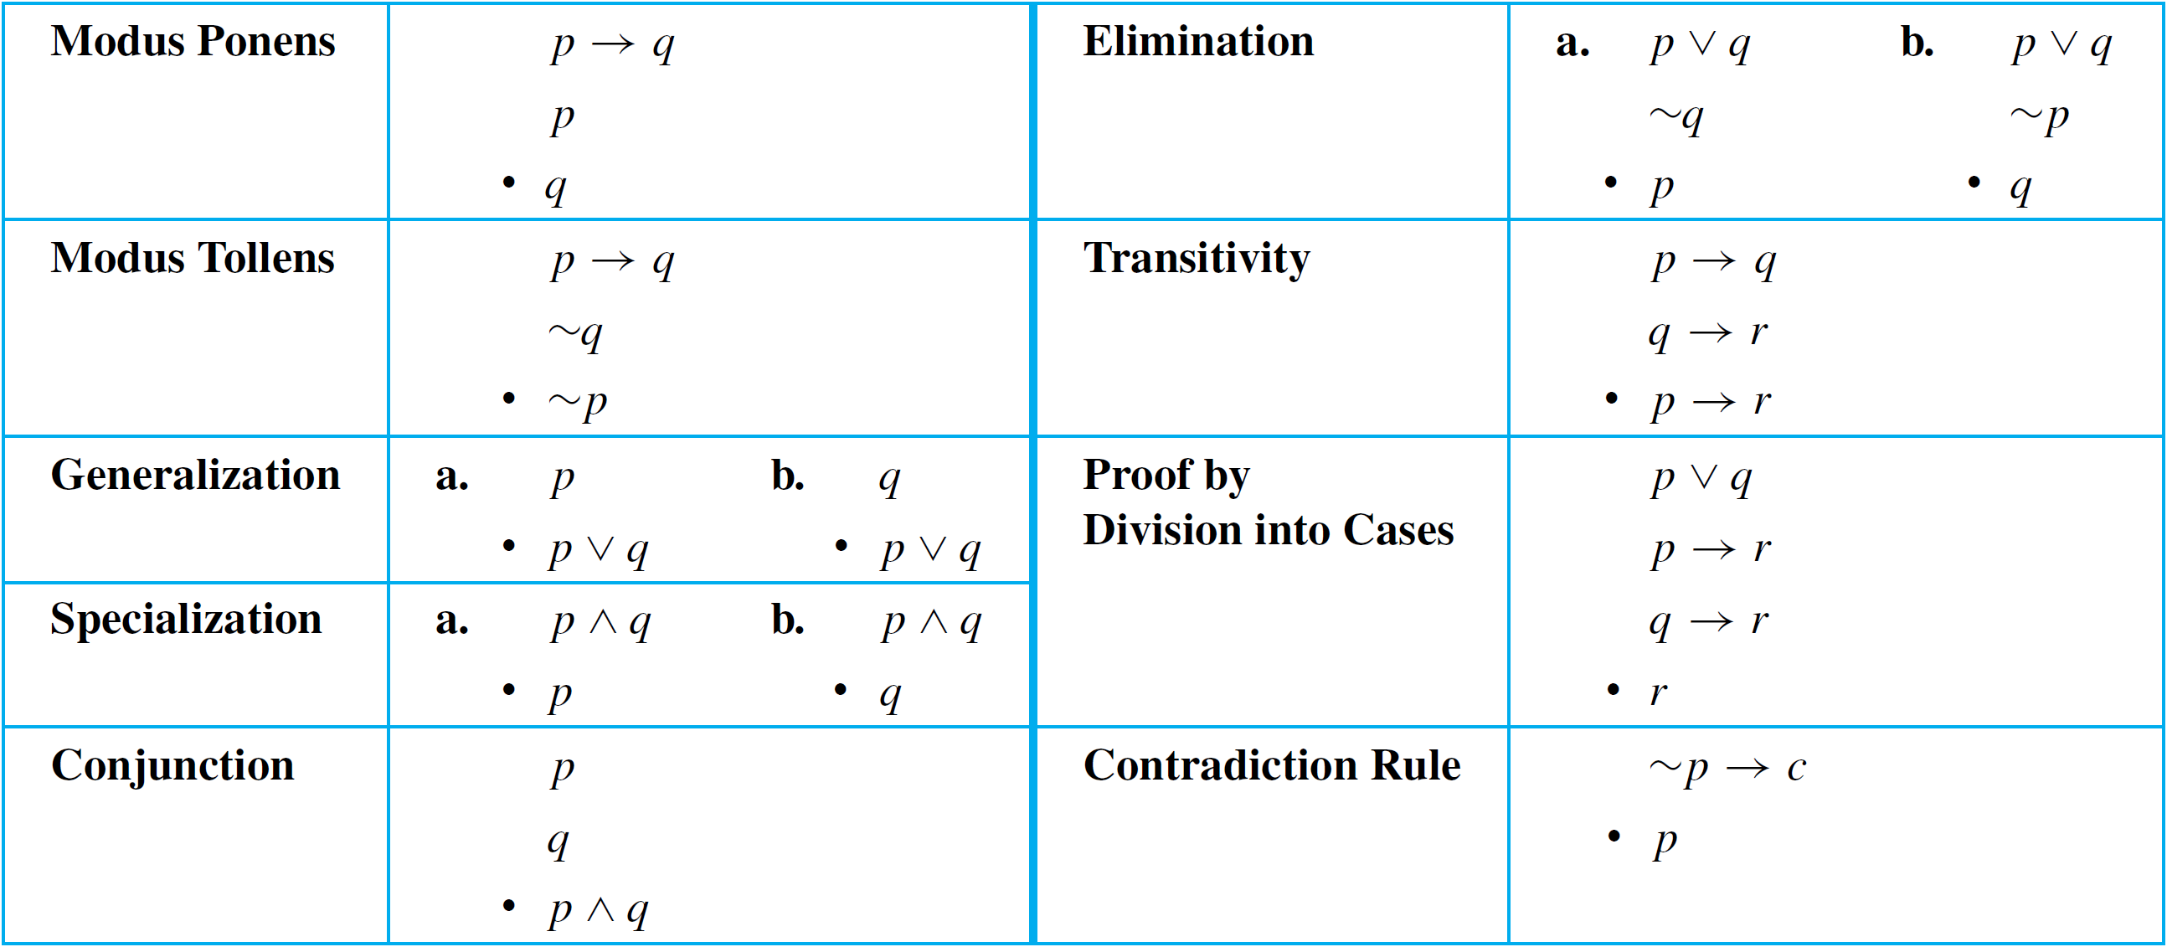
Summary of Rules of Inference
Table 2.3.1 summarizes some of the most important rules of inference.
∴
∴
∴
∴
∴
∴
∴
∴
∴
∴
∴
∴
Valid Argument Forms
Table 2.3.1

