Slide 1
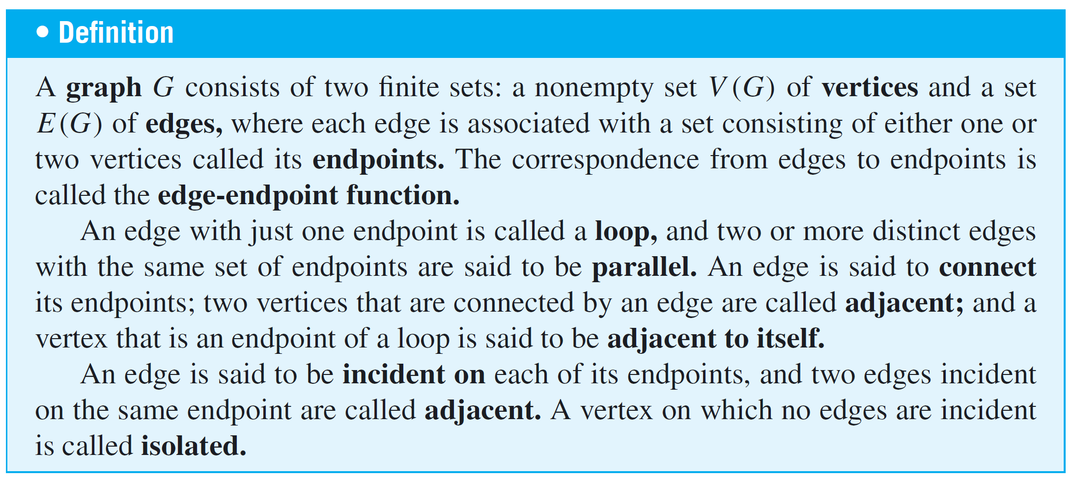
Graphs: Definitions and Basic Properties
The formal definition of a graph follows.

Slide 2
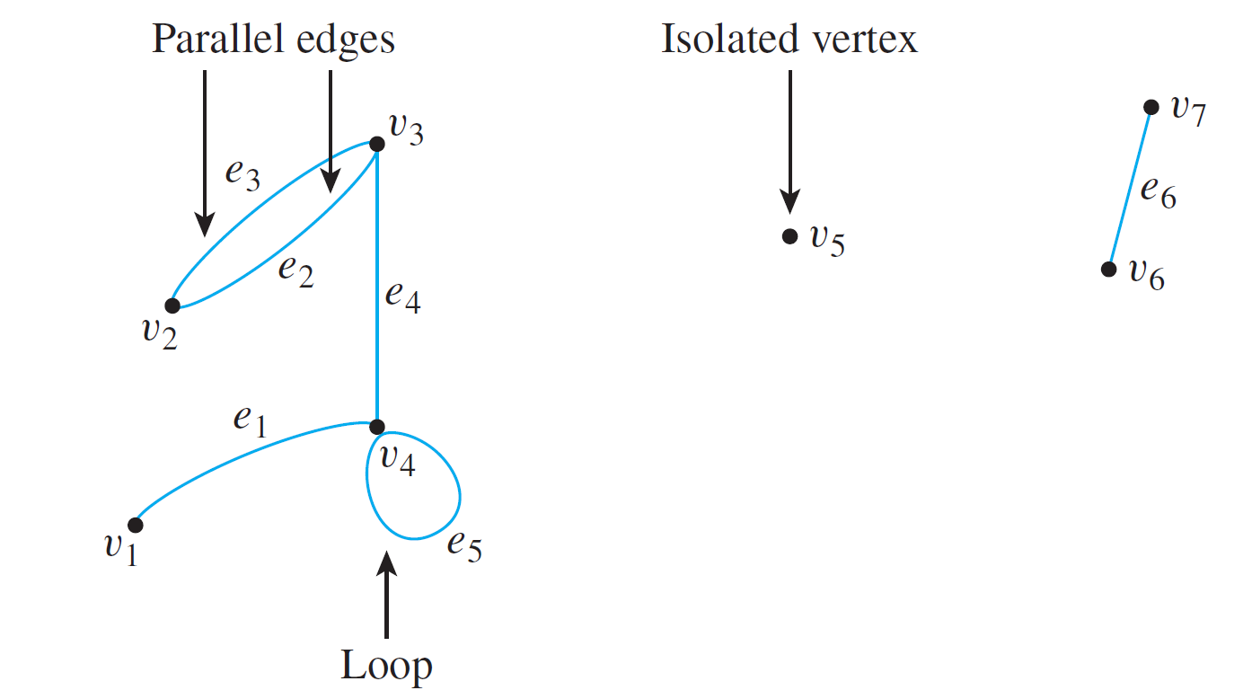
Graphs: Definitions and Basic Properties
The edges may be straight or curved and should either connect one vertex to another or a vertex to itself, as shown below.

Slide 3
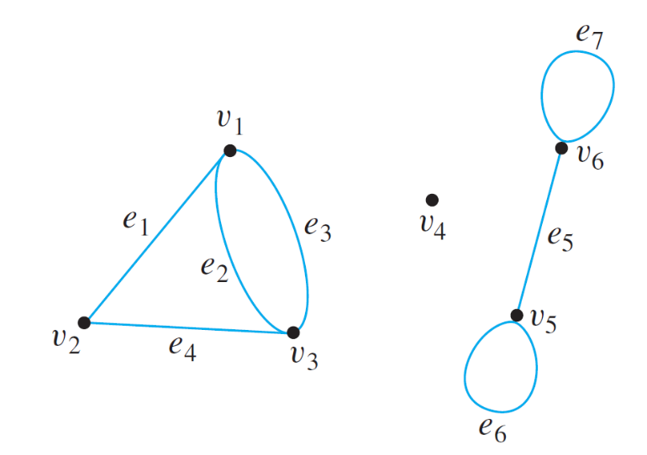
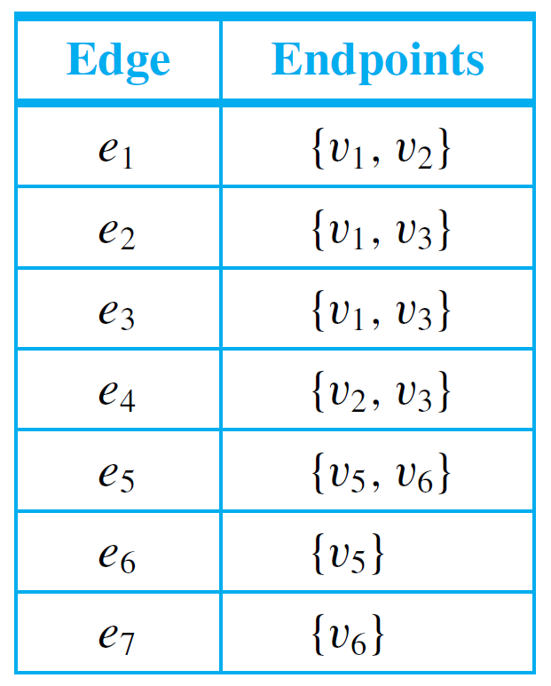
Example 1 – Terminology
Consider the graph at the right.
Write the vertex set and the edge set, and give a table showing the edge-endpoint function.
Solution:
vertex set = {v₁, v₂, v₃, v₄, v₅, v₆}
edge set = {e₁, e₂, e₃, e₄, e₅, e₆, e₇}
edge-endpoint function is
Note that the isolated vertex v₄ does not appear in this table.

Slide 4
Graphs: Definitions and Basic Properties
We have discussed the directed graph of a binary relation on a set.
The general definition of directed graph is similar to the definition of graph, except that one associates an ordered pair of vertices with each edge instead of a set of vertices.
Thus each edge of a directed graph can be drawn as an arrow going from the first vertex to the second vertex of the ordered pair.

Slide 5
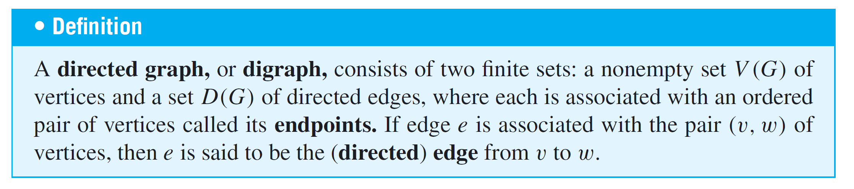
Graphs: Definitions and Basic Properties
Note that each directed graph has an associated ordinary (undirected) graph, which is obtained by ignoring the directions of the edges.

Slide 6
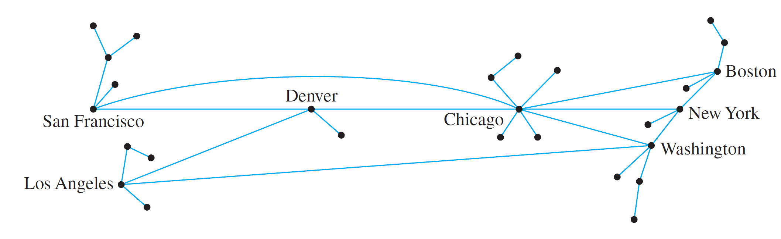
Example 4 – Using a Graph to Represent a Network
Telephone, electric power, gas pipelines, and air transport systems can all be represented by graphs, as can computer networks.
Questions that arise in the design of such systems involve choosing connecting edges to minimize cost, optimize a certain type of service, and so forth.

Slide 7
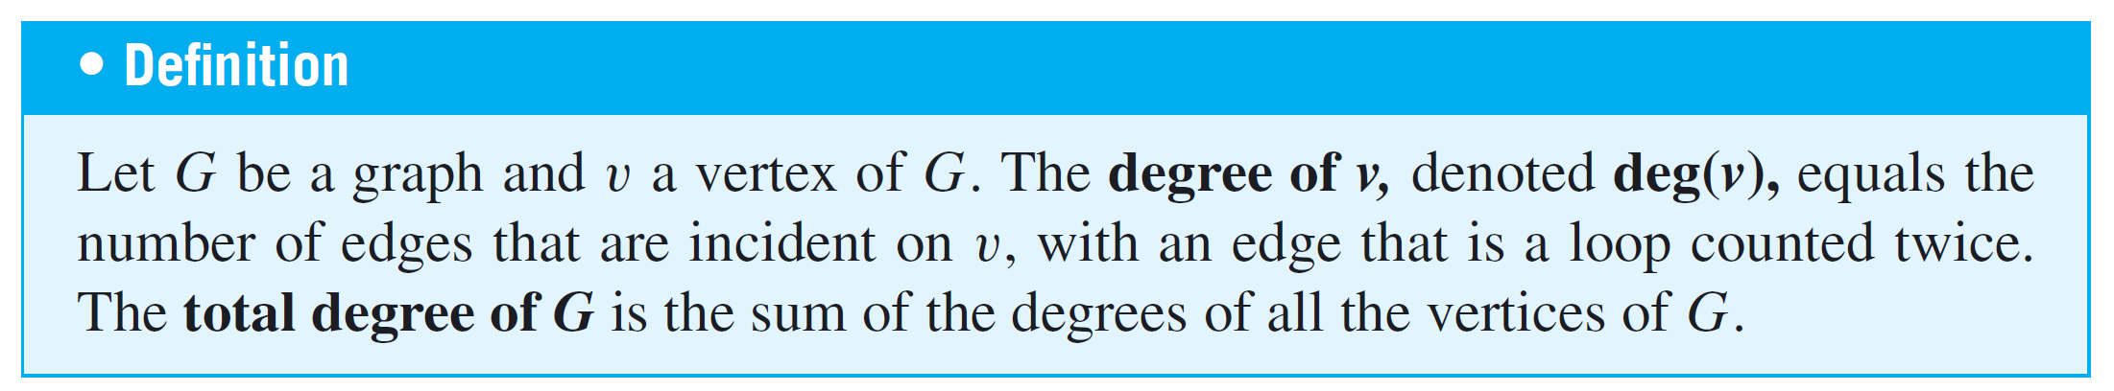
The Concept of Degree
The degree of a vertex is the number of end segments of edges that “stick out of” the vertex.

Slide 8
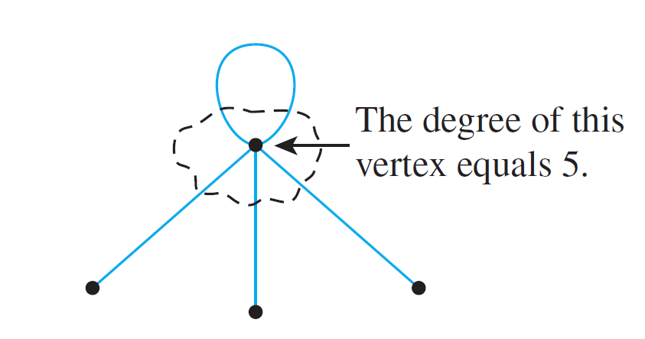
The Concept of Degree
Since an edge that is a loop is counted twice, the degree of a vertex can be obtained from the drawing of a graph by counting how many end segments of edges are incident on the vertex.
This is illustrated below.

Slide 9
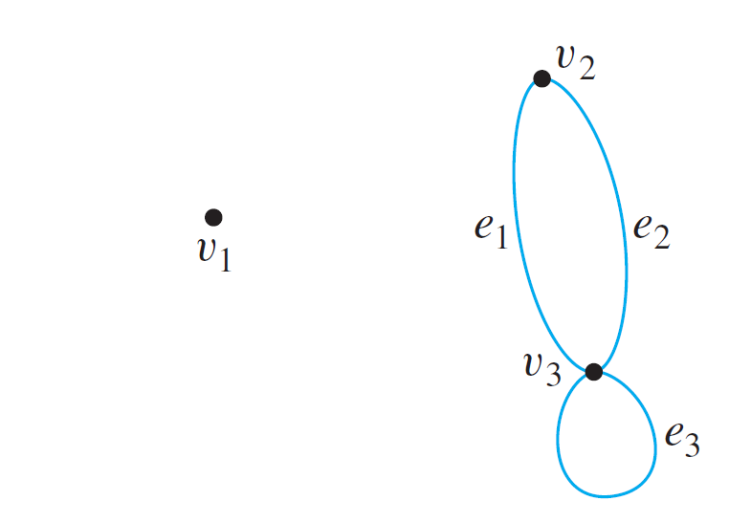
Example 12 – Degree of a Vertex and Total Degree of a Graph
Find the degree of each vertex of the graph G to the right. Then find the total degree of G.
Solution:
deg(v₁) = 0 since no edge is incident on v₁ (v₁ is isolated).
deg(v₂) = 2 since both e₁ and e₂ are incident on v₂.
deg(v₃) = 4 since e₁ and e₂ are incident on v₃ and the loop e₃ is also incident on v₃ (and contributes 2 to the degree of v₃).
total degree of G = deg(v₁) + deg(v₂) + deg(v₃) = 6

Slide 10
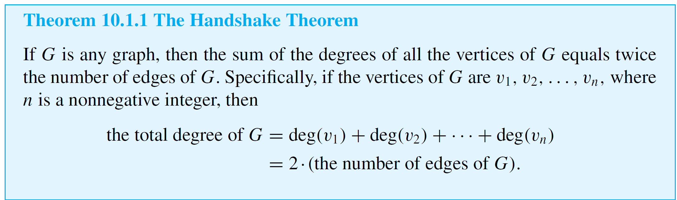
The Concept of Degree
The total degree of the graph G of Example 12, which is 6, equals twice the number of edges of G, which is 3.
This is true because each edge has two end segments, and each end segment is counted once toward the degree of some vertex. This result generalizes to any graph.

Slide 11
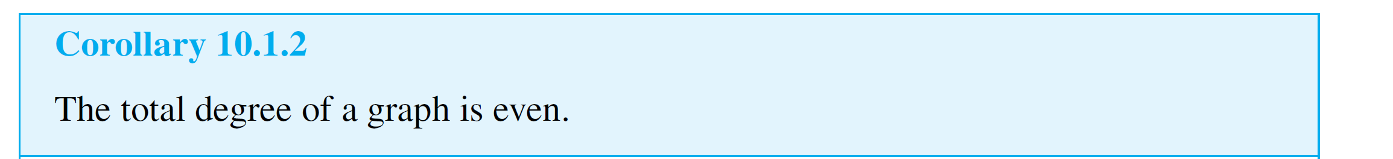
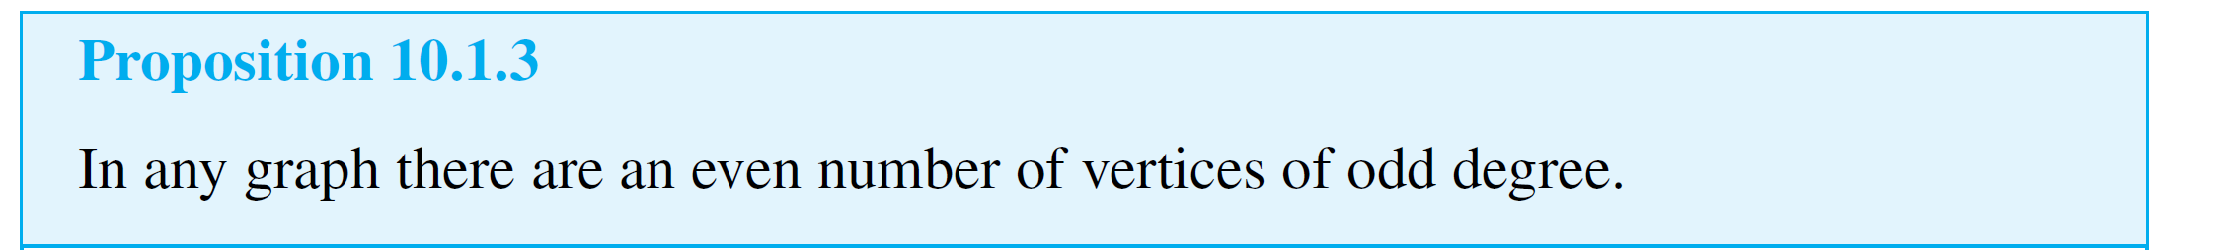
The Concept of Degree
The following proposition is easily deduced from Corollary 10.1.2 using properties of even and odd integers.

Slide 12
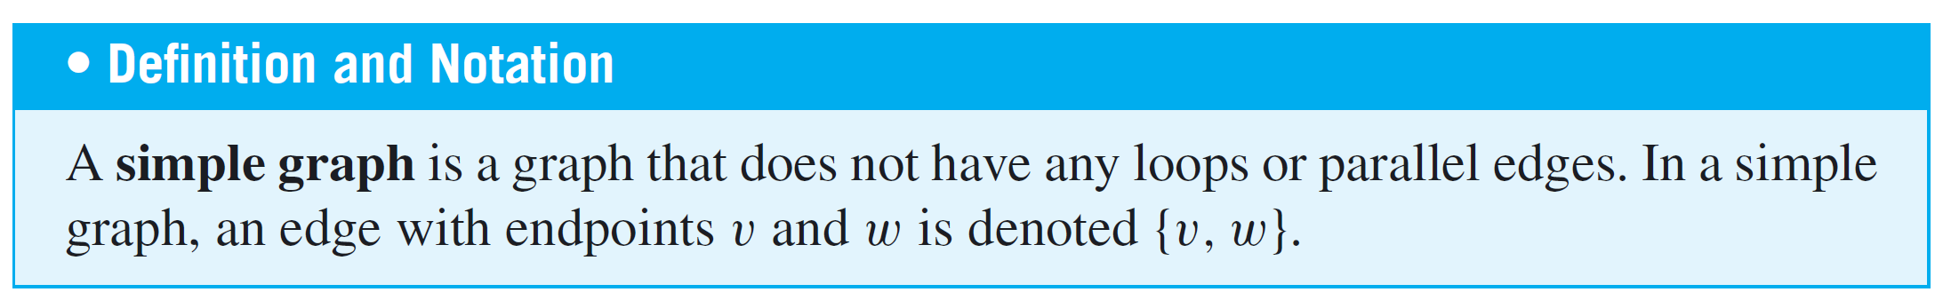
Special Graphs
One important class of graphs consists of those that do not have any loops or parallel edges.
Such graphs are called simple. In a simple graph, no two edges share the same set of endpoints, so specifying two endpoints is sufficient to determine an edge.

Slide 13
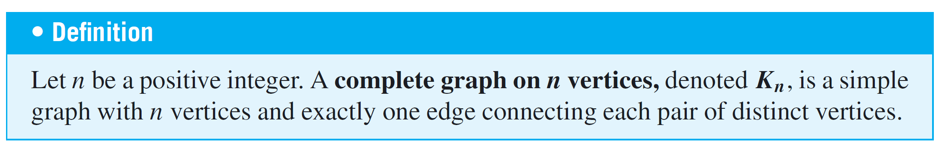
Special Graphs
Another important class of graphs consists of those that are “complete” in the sense that all pairs of vertices are connected by edges.

Slide 14
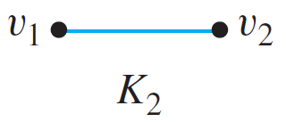
Example 9 – Complete Graphs on n Vertices: K₁, K₂, K₃, K₄, K₅
The complete graphs K₁, K₂, K₃, K₄, and K₅ can be drawn as follows:

Slide 15
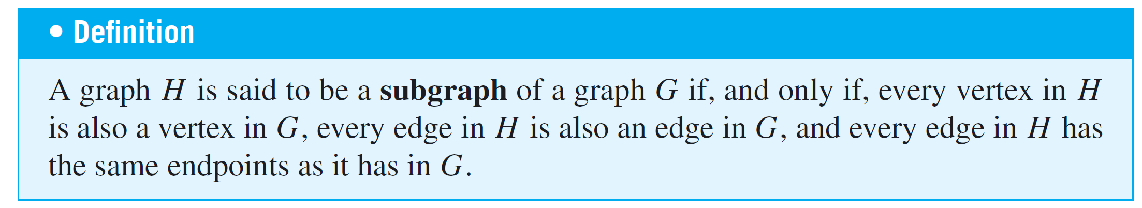
Special Graphs

Slide 16
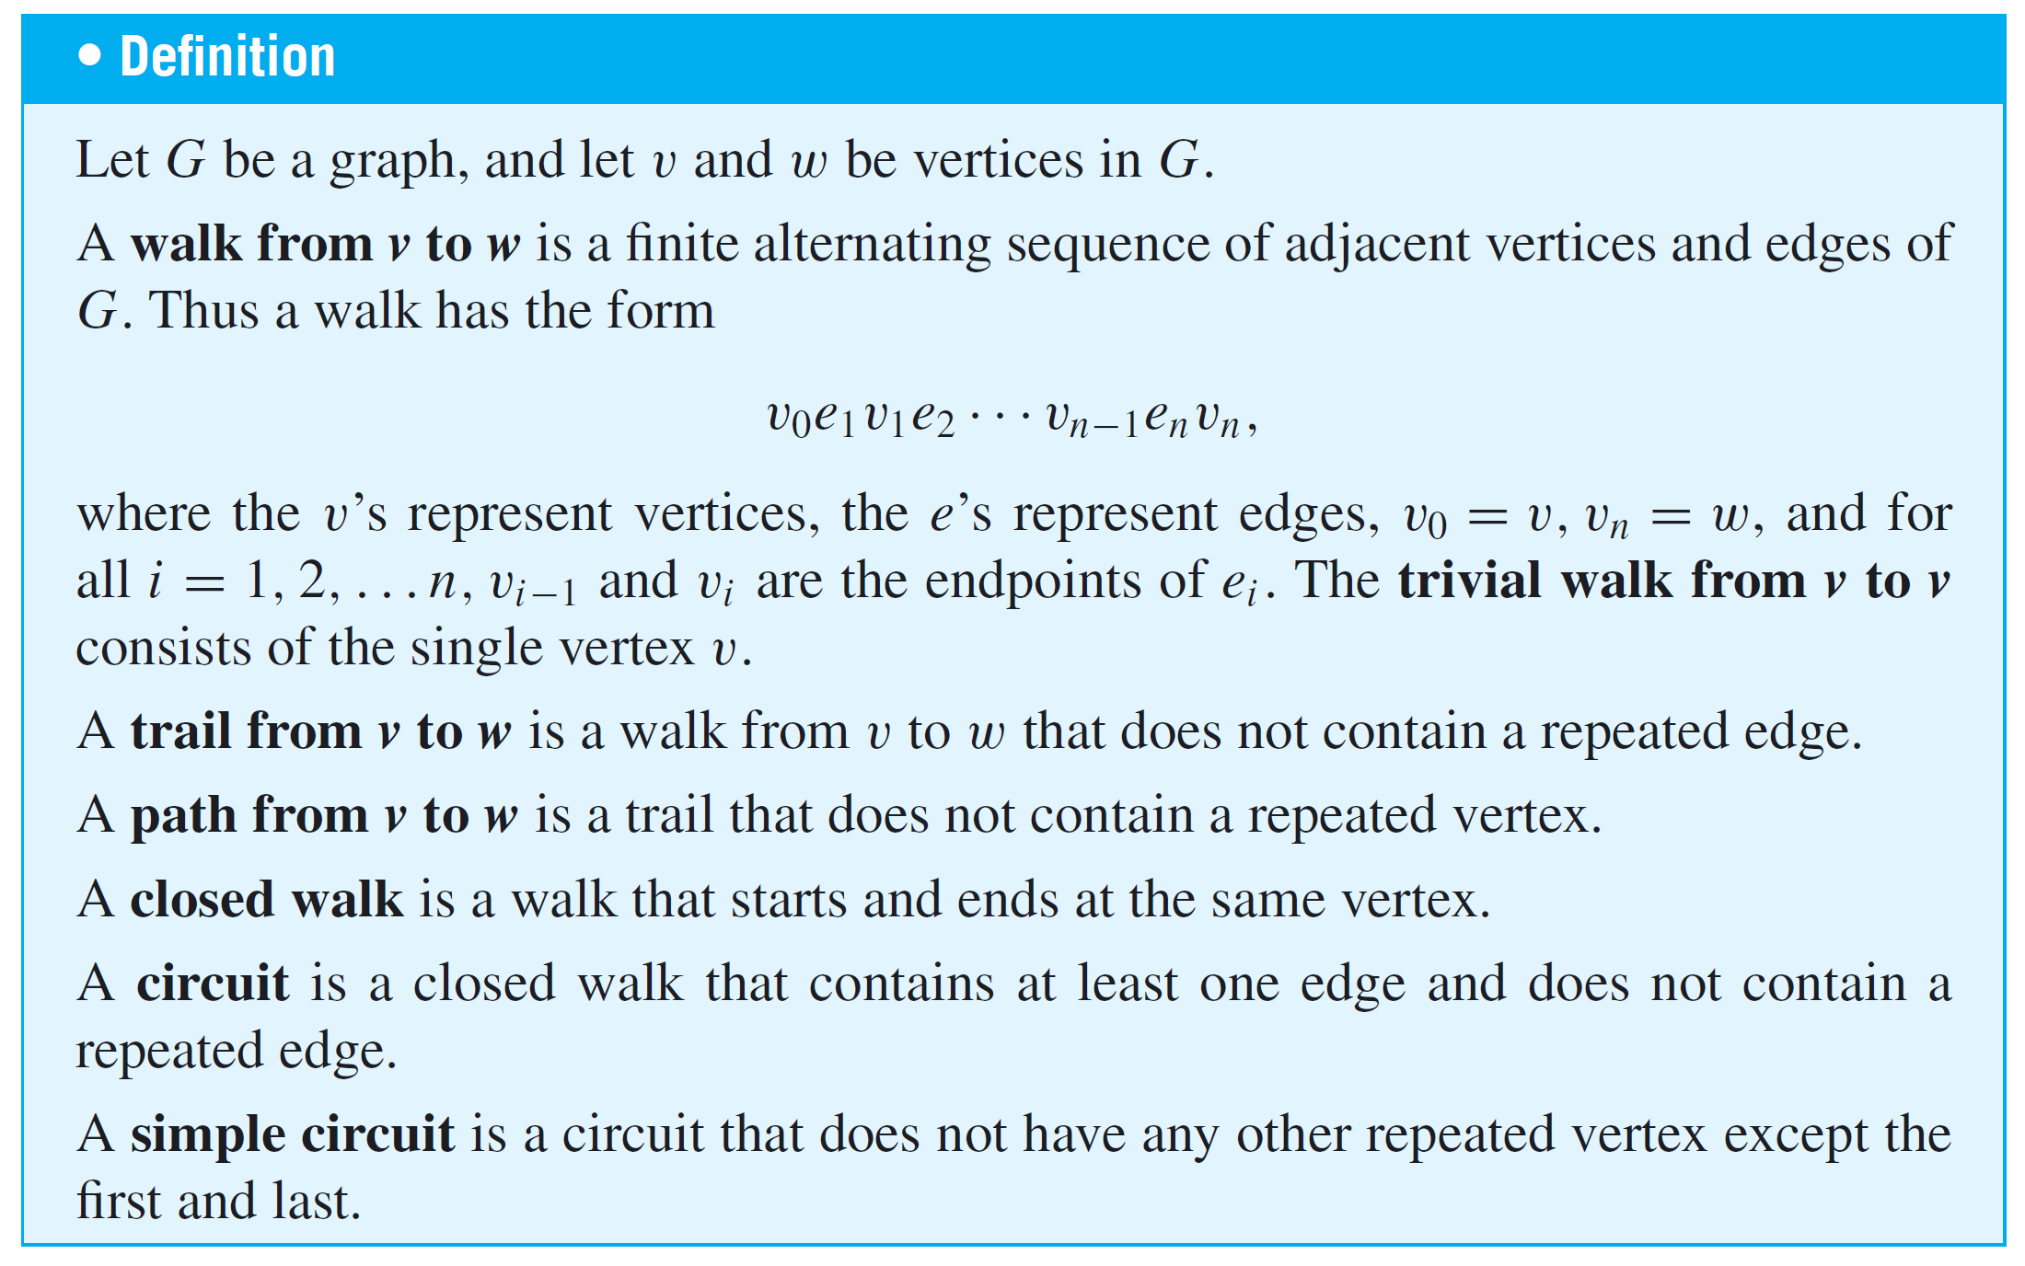
Definitions

Slide 17
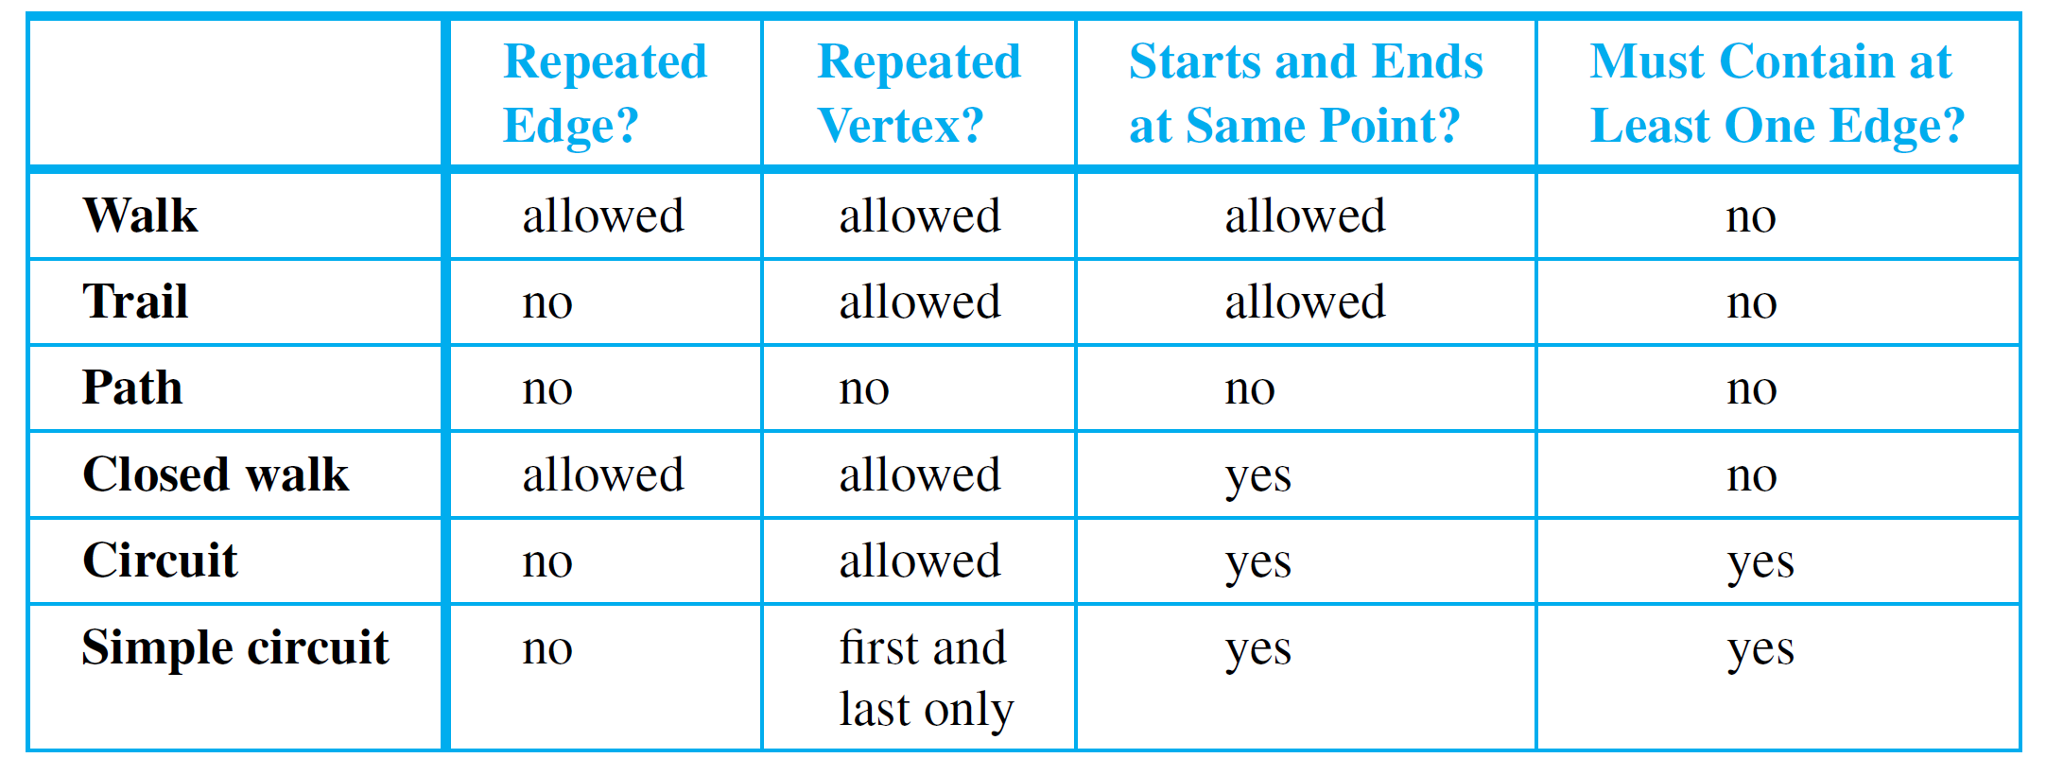
Definitions
For ease of reference, these definitions are summarized in the following table:
Often a walk can be specified unambiguously by giving either a sequence of edges or a sequence of vertices.

Slide 18
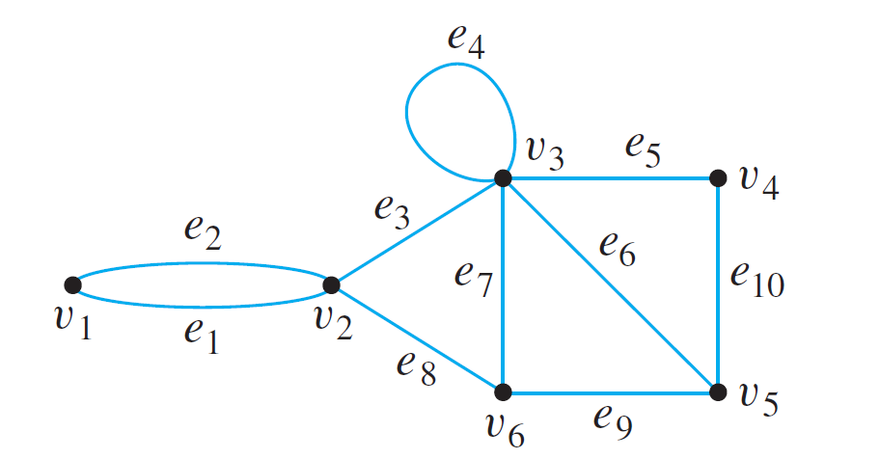
Example 2 – Walks, Trails Paths, and Circuits

Slide 19
Definitions
Because most of the major developments in graph theory have happened relatively recently and in a variety of different contexts, the terms used in the subject have not been standardized. For example,
what this book calls a graph is sometimes called a multigraph,
what this book calls a simple graph is sometimes called a graph,
what this book calls a vertex is sometimes called a node, and
what this book calls an edge is sometimes called an arc.

Slide 20
Definitions
Similarly,
instead of the word trail, the word path is sometimes used;
instead of the word path, the words simple path are sometimes used; and
instead of the words simple circuit, the word cycle is sometimes used.

Slide 21
Connectedness
It is easy to understand the concept of connectedness on an intuitive level.
Roughly speaking, a graph is connected if it is possible to travel from any vertex to any other vertex along a sequence of adjacent edges of the graph.

Slide 22
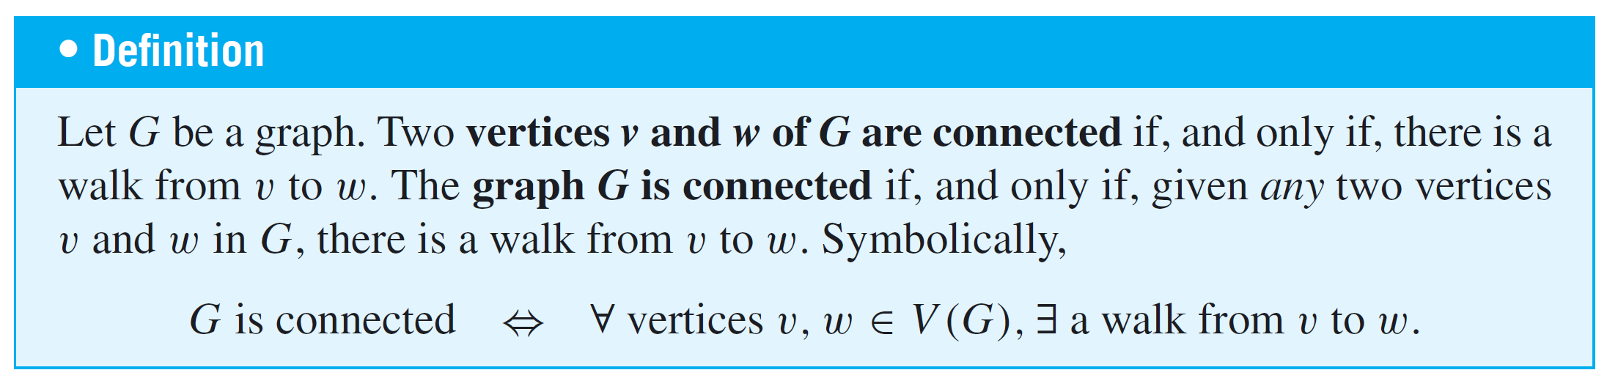
Connectedness
The formal definition of connectedness is stated in terms of
walks.
If you take the negation of this definition, you will see that a graph G is not connected if, and only if, there are two vertices of G that are not connected by any walk.

Slide 23
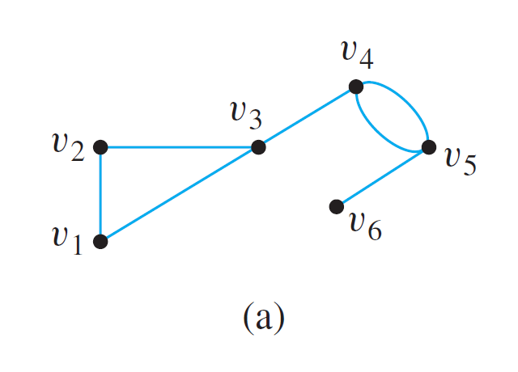
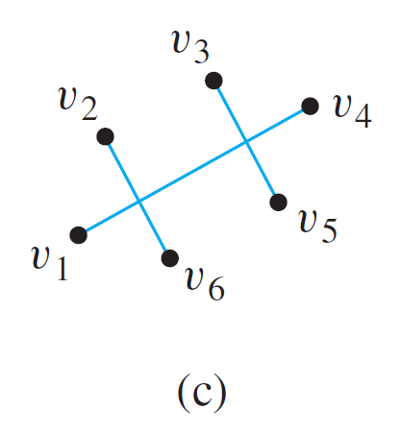
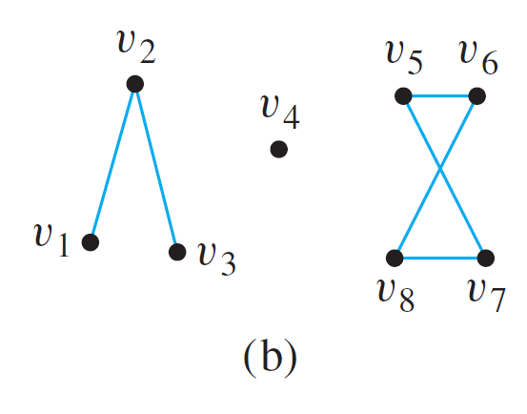
Example 3 – Connected and Disconnected Graphs
Which of the following graphs are connected?
Connected
Not connected
Not connected

Slide 24
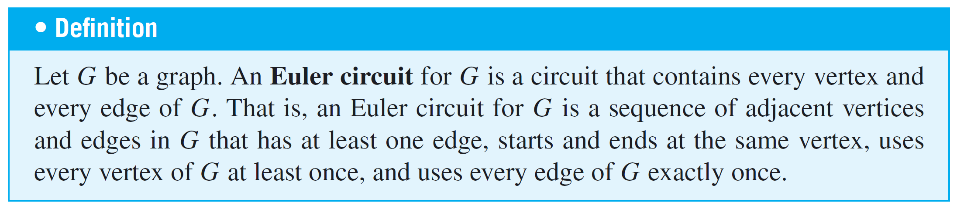
Euler Circuits
The following definition is made in honor of Euler.
Visit all edges exactly once.
Vertices can be visited more than once.

Slide 25
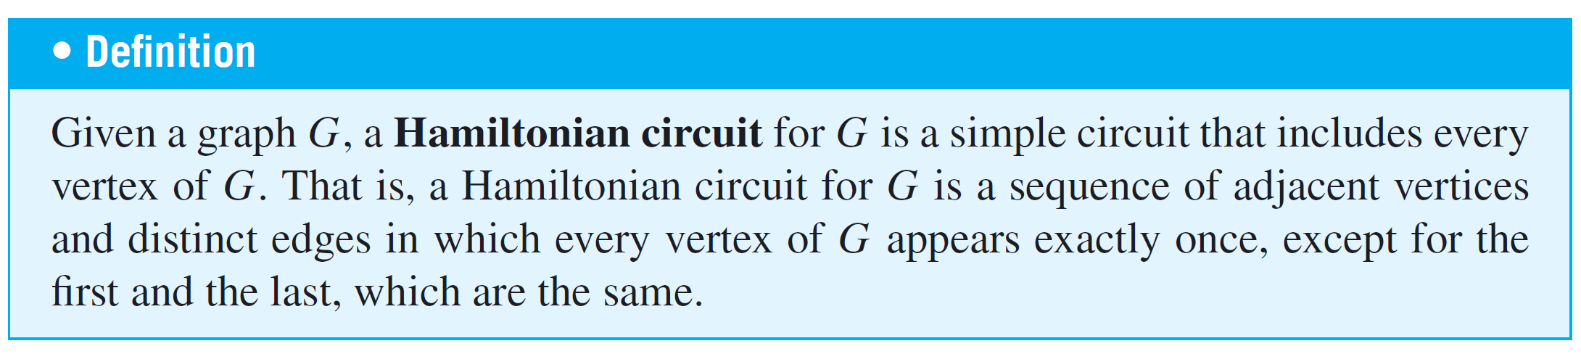
Hamiltonian Circuits
Visit all vertices exactly once.
Each edge may be visited at most once (i.e., possibly not visited).

Slide 26
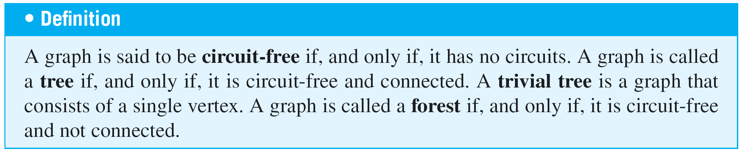
Trees
In mathematics, a tree is a connected graph that does not contain any circuits.
Mathematical trees are similar in certain ways to their botanical namesakes.

Slide 27
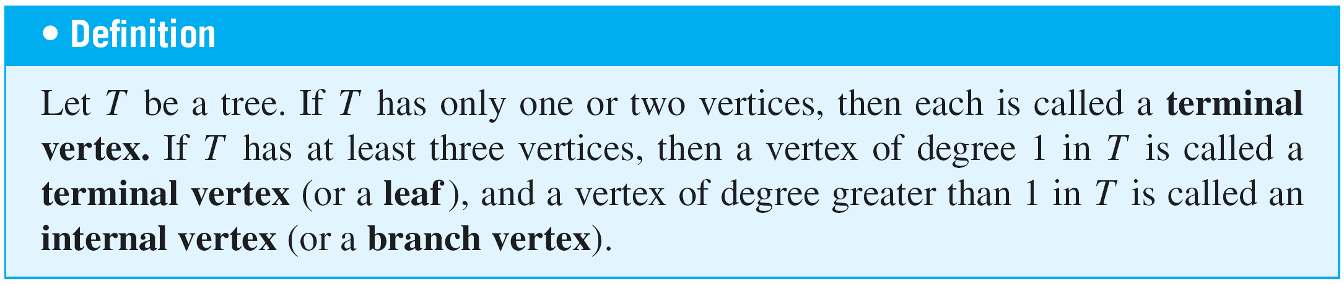
Characterizing Trees
In fact, any tree that has more than one vertex has at least two vertices of degree 1.

Slide 28
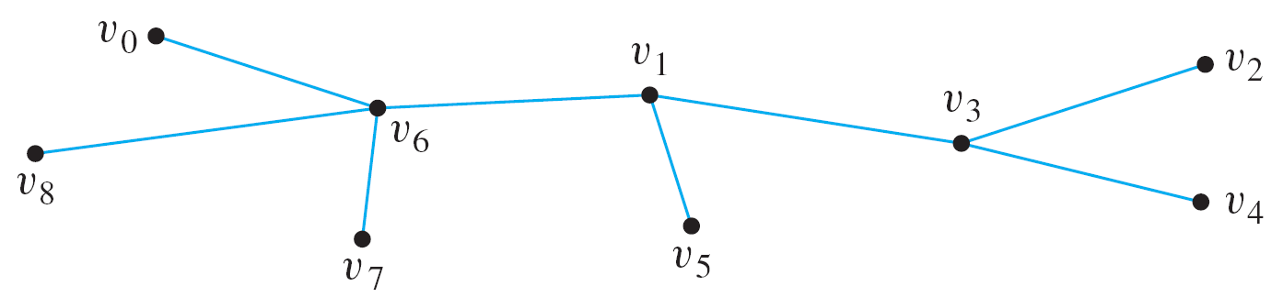
Example 5 – Terminal and Internal Vertices
Find all terminal vertices and all internal vertices in the following tree:
Solution:
The terminal vertices (leaves) are v₀, v₂, v₄, v₅, v₇, and v₈.
The internal vertices are v₆, v₁, and v₃.

Slide 29
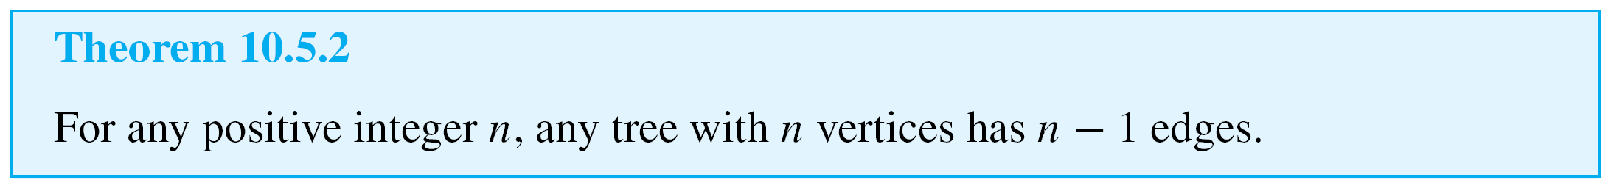
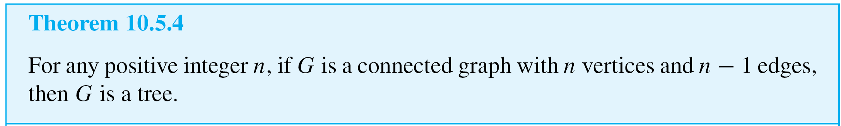
Characterizing Trees
Proof by mathematical induction.
Proof by contradiction.

