Slide 1
COMP 283 Discrete Structures
Instructor: Kecheng Yang
yangk@cs.unc.edu
We meet at FB 009, 1:15 PM – 2:45 PM, MoTuWeThFr
Course Homepage: http://cs.unc.edu/~yangk/comp283/home.html

Slide 2
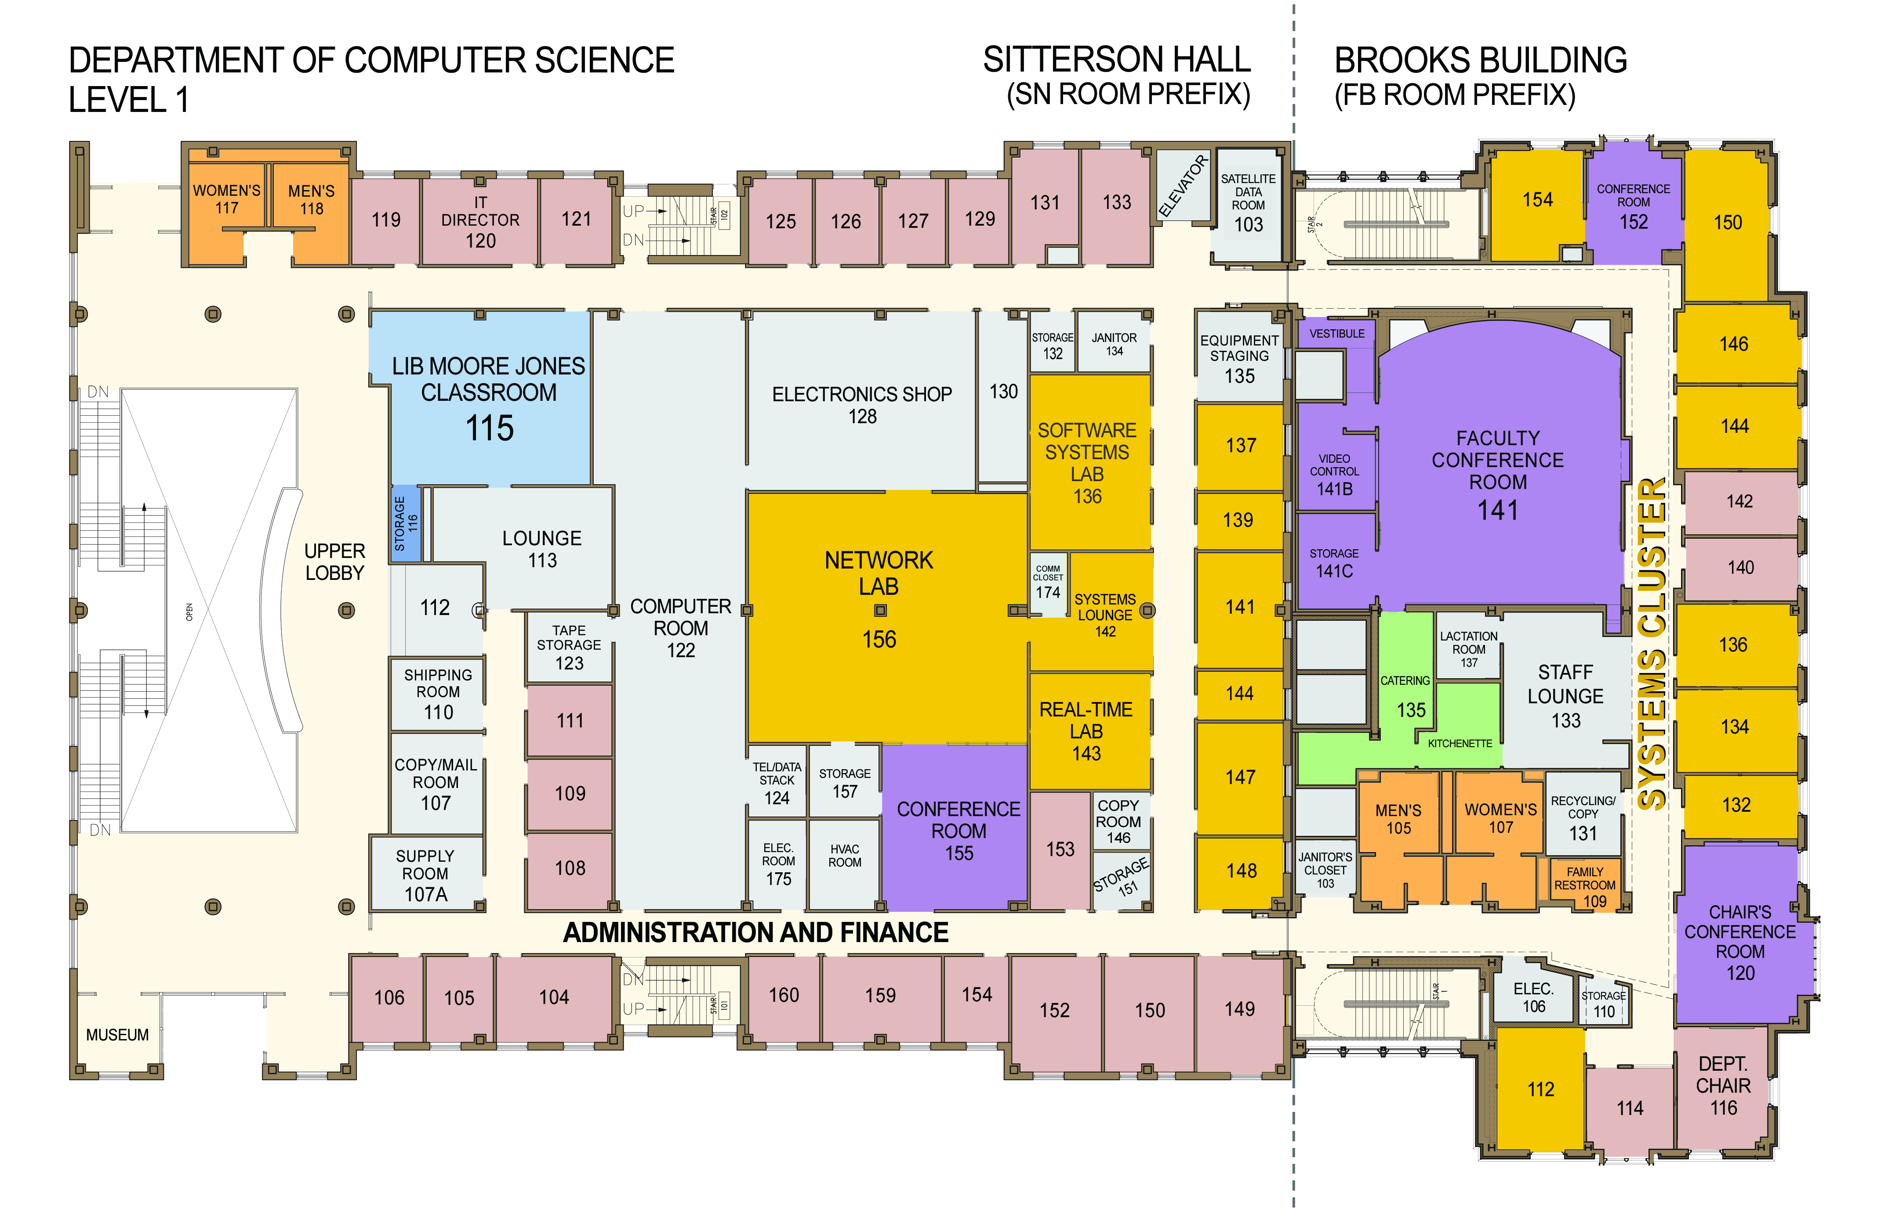
About Me
I am a fourth-year (fifth-year next fall) Ph.D. student.
My research is about scheduling algorithms. My advisor is Prof. Jim Anderson, who teaches the graduate-level algorithm course—COMP 750.
If you find my first name, Kecheng, is hard to pronounce, try pronounce it as two words “Ker-Chen.” It’s, in fact, two separate Chinese characters. My last name, Yang, pronounces almost the same as the English word, young.
My office is SN 139 and tentative office hours are right after lectures (2:50 PM – 4:00 PM) on Tuesdays and Thursdays.

Slide 3
Grading
Quizzes - 5%
in class, without notice in advance
your lowest score will be dropped
Homework - 25%
due in class on the due date (solutions distributed at the same time)
no late homework will be accepted
your lowest score will be dropped
Midterm Exam - 30%
in class, 90-minutes time limit, with notice well in advance
closed-book, one cheat sheet allowed (Letter-size, two-sided)
Final Exam - 40%
Thursday, June 22, 11:30 AM - 2:30 PM
closed-book, two cheat sheets allowed (Letter-size, two-sided)

Slide 4
Collaboration and Communication
Quizzes and Exams: No collaboration allowed
Homework: Discussions are encouraged; however, each student has to write up the final solutions independently
All solutions: illegible ones will not be graded
Honor code and signature
Graded Quizzes, Homework, and Midterm will be returned.
Final Exam will not be returned; however, you will have a chance to look over your graded Final on Friday, June 23.

Slide 5
Collaboration and Communication
Public questions, concerns: encouraged to post on Piazza at https://piazza.com/unc/summer2017/comp283/home
Private/confidential ones: to my email, yangk@cs.unc.edu
Class participation bonus: up to half a letter grade
Class etiquette
Don’t agree with the grading or the standard solutions?
appeal – your right and responsibility
“Anything can be appealed.”
the instructor plays the judge
no cheating will be tolerated

Slide 6
About this course
Undergraduate Bulletin:
  Introduces discrete structures (sets, tuples, relations, functions, graphs, trees) and the formal mathematics (logic, proof, induction) used to establish their properties and those of algorithms that work with them.
  Develops problem-solving skills through puzzles and applications central to computer science.
Mathematically thinking, reasoning, and writing.
A prerequisite for many higher-level COMP courses.
  COMP 455 Models of Languages and Computation
  COMP 550 Algorithms and Analysis
  COMP 521 Files and Databases
  COMP 535 Introduction to Computer Security
  COMP 555 Bioalgorithms
  The first two are prerequisites for many COMP 600+ courses.

Slide 7
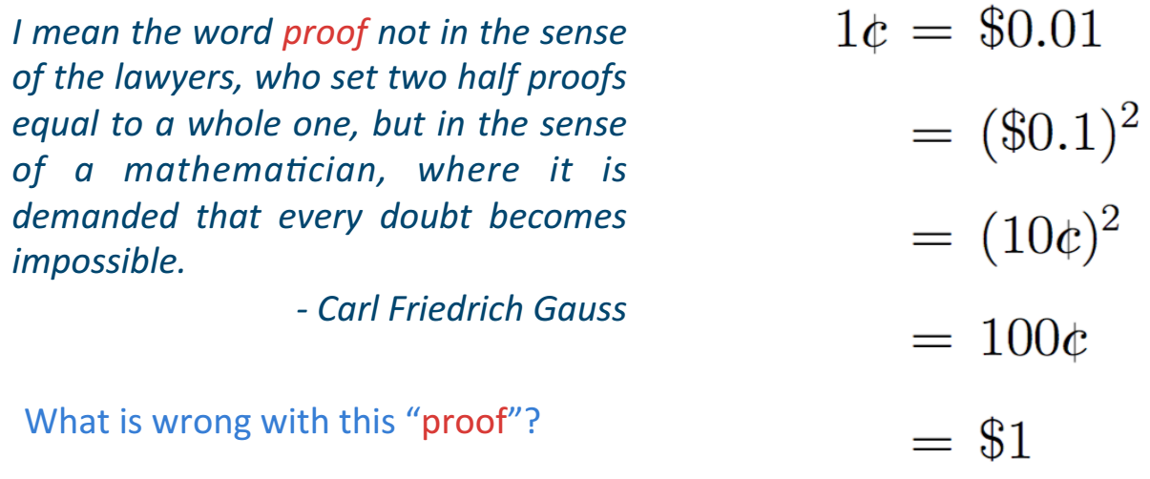
Math: Proof
Undergraduate Bulletin:
  Introduces discrete structures (sets, tuples, relations, functions, graphs, trees) and the formal mathematics (logic, proof, induction) used to establish their properties and those of algorithms that work with them.
  Develops problem-solving skills through puzzles and applications central to computer science.

Slide 8
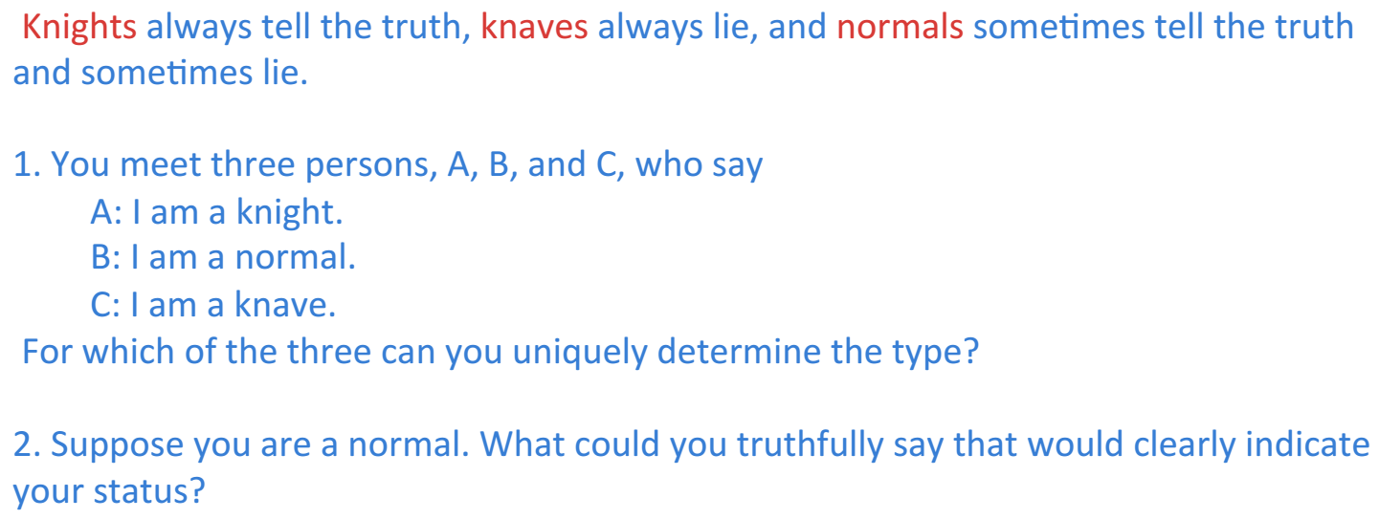
Logic
Undergraduate Bulletin:
  Introduces discrete structures (sets, tuples, relations, functions, graphs, trees) and the formal mathematics (logic, proof, induction) used to establish their properties and those of algorithms that work with them.
  Develops problem-solving skills through puzzles and applications central to computer science.

Slide 9
Math: Numbers and Counting
Undergraduate Bulletin:
  Introduces discrete structures (sets, tuples, relations, functions, graphs, trees) and the formal mathematics (logic, proof, induction) used to establish their properties and those of algorithms that work with them.
  Develops problem-solving skills through puzzles and applications central to computer science.

Slide 10
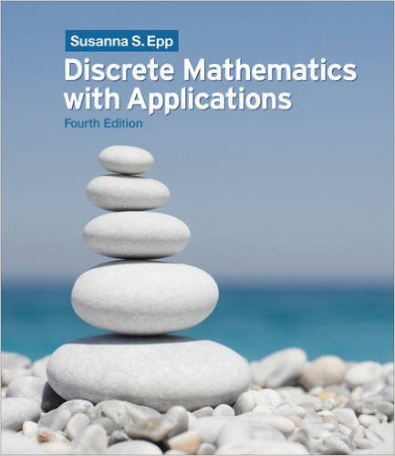
Textbook and Topics
basics of variables, sets,
functions and relations
Propositional Logic
First-order Predicate Logic
Covered in COMP 410 and COMP 550
Covered in COMP 455
Discrete Mathematics with Applications, 4th Edition
by Susanna S. Epp
Ch. 1. Speaking Mathematically
Ch. 2. The Logic of Compound Statements
Ch. 3. The Logic of Quantified Statements
Ch. 4. Elementary Number Theory and Methods of Proof
Ch. 5. Sequences, Mathematical Induction, and Recursion
Ch. 6. Set Theory
Ch. 7. Functions
Ch. 8. Relations
Ch. 9. Counting and Probability
Ch. 10. Graphs and Trees
Ch. 11. Analysis of Algorithm Efficiency
Ch. 12. Regular Expressions and Finite-State Automata

