Slide 1
Computation of Deep Learning(Convnet)

Slide 2
Feed Forward Neural Network (Fully Connected Layer)
$$W∈R^{3x4}$$
x(1)
h(1)
$$h\left(1\right)=$$
$x\left(1\right)∗W\left(1,1\right)$
$$+x\left(2\right)∗W\left(1,2\right)$$
$$+x\left(3\right)∗W\left(1,3\right)$$
$$+x\left(4\right)∗W\left(1,4\right)$$
h(1) = dot(x,W(1,:))
h = Wx
x(2)
h(2)
x(3)
h(3)
x(4)

Slide 3
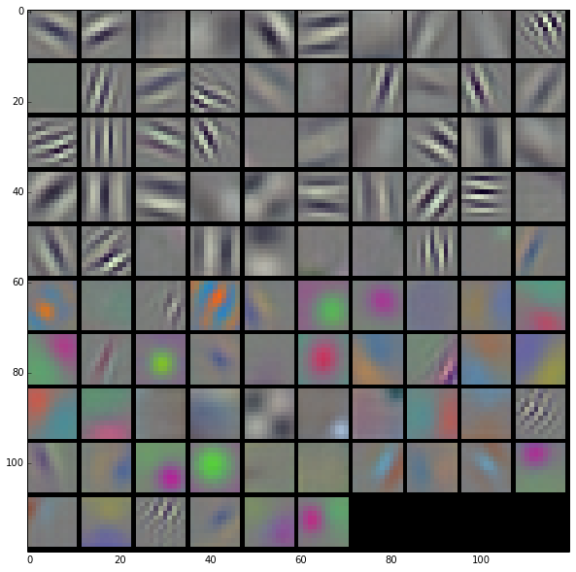
Convolutional Layer

Slide 4
Convolutional Layer
y^{l-1}
x^{l-1}
w
(mxm)
$$∗$$
$$=$$

Slide 5
Lowering Convolution to Matrix Multiplication
1 2 4 5
2 3 5 6
4 5 7 8
5 6 8 9
1 2 3 4 5 6
7 8 9
W1 W2 W3 W4
W1 W2 W3 W4

Slide 6
Lowering Convolution to Matrix Multiplication
1 2 4 5
2 3 5 6
4 5 7 8
5 6 8 9
x
W1 W2 W3 W4
Now, we can use matrix multiplication,
which is extremely optimized ( CBLAS, CUBLAS, … )

Slide 7
Convolutional Layer(Multiple Input Channels)
Filter1 for channel 1
$$∗$$
Channel 1
Filter1 for channel 2
$$∗$$
Channel 2
$$+$$
$$=$$
Filter1 for channel 3
$$∗$$
Channel 3
$$∗$$
Channel 4, channel 5
…….
…….

Slide 8
Convolutional Layer(Multiple Filters)
$$∗$$
Filter1
$$∗$$
$$+$$
$$=$$
$$∗$$
$$∗$$
Filter2
$$∗$$
$$+$$
$$∗$$
$$∗$$
Filter3
$$+$$
$$∗$$
$$∗$$

Slide 9
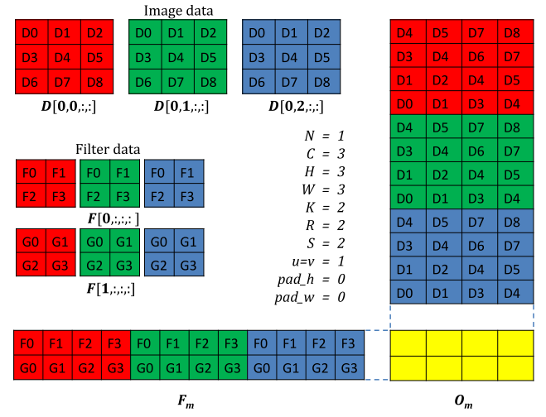
Lowering Convolution to Matrix Multiplication

Slide 10
Alternatives of Computing Convolutions
Lowering convolution to matrix multiplication
Pros: We have highly optimized large matrix multiplication code
Cons: High memory usage
Recent cuDNN library try to solve this problem
We could directly compute convolution, which might be more efficient. However, it requires optimization of a large number of parameter space of convolutions (filter size, padding, stride, batch size….)
E.g. cuda-convnet2 is very efficient with specific batch size
Using FFT

Slide 11
Simple pipeline for Object Detection with Convnet
Tegra X, it can process AlexNet at 184 frames / sec

Slide 12
Convolutional Neural Networks at Constrained Time Cost
Kaiming He and Jian Sun
Microsoft Research
Will be published in CVPR 2015

Slide 13
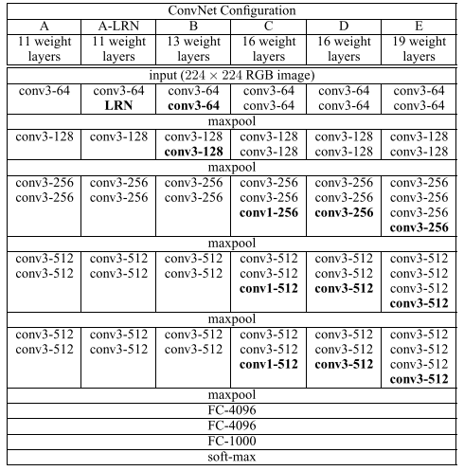
Deeper and Larger

Slide 14
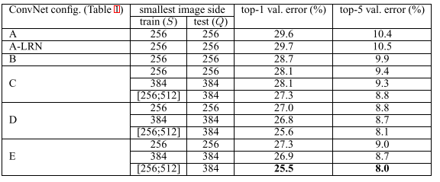
Deeper and Larger

Slide 15
Time Constrains
For real-world applications are often faced with the requirement of constrained time budget.
Cost effective autonomous system
The designs of the network architectures should exhibit as trade-offs among the factors like depth, numbers of filters, filter sizes, etc

Slide 16
Time Complexity of Convolutions
d is the number of convolutional layers
n(l) is the number of filters(or the number of output feature map)
n(l-1) is the number of input feature map
s is the size of filters
m is the spatial size of the output feature map

Slide 17
Tradeoff between depth and filter size
We replace a larger filter with a cascade of smaller filters
Error rate
37.4 -> 35.7
37.4 -> 35.0
35.7 -> 33.8
Note that time complexity is almost same

Slide 18
Trade-offs between Depth and Width
We increase depth while properly reducing the number of filters per layer
Error rate(top-1)
37.4 -> 35.5
37.4 -> 35.5
35.0 -> 34.7

Slide 19
Trade-offs between Width and Filter Sizes
Error rate(top-1)
35.7 -> 35.5
33.8 -> 33.9

Slide 20
Memory efficient Convolutional Networks
Memory Bounded Deep Convolutional Networks, Maxwell D. Collins and Pushmeet Kohli
They investigate the use of sparsity-inducing regularizers during training of Convolution Neural Networks (CNNs)
These regularizers encourage that fewer connections in the convolution and fully connected layers take non-zero values and in effect result in sparse connectivity

Slide 21
Questions

