Slide 1
A Common Computer Vision Pipeline
Eunbyung Park & Zhishan Guo

Slide 2

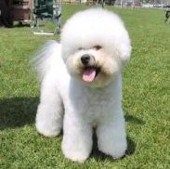
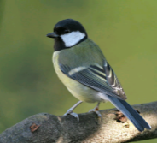

A common computer vision pipeline for image classification
Feature Extraction
Feature Extraction
Coding
K-means Clustering
Pooling
dictionary
Classifier
Slide credit: http://ufldl.stanford.edu/eccv10-tutorial/

Slide 3
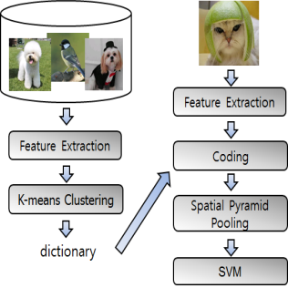
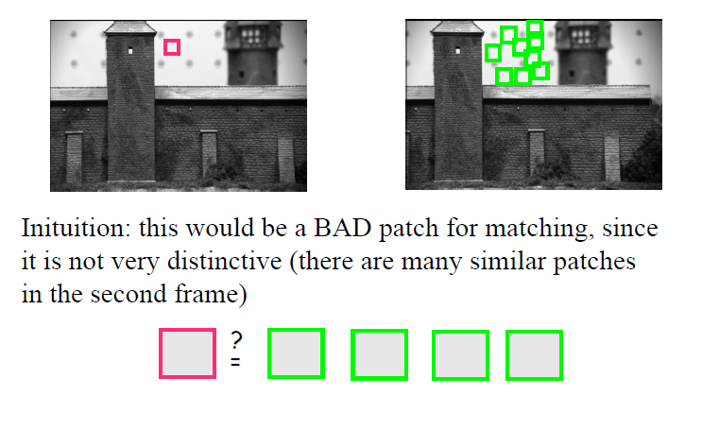
Where to put features?
Slide credit: Robert Collins

Slide 4
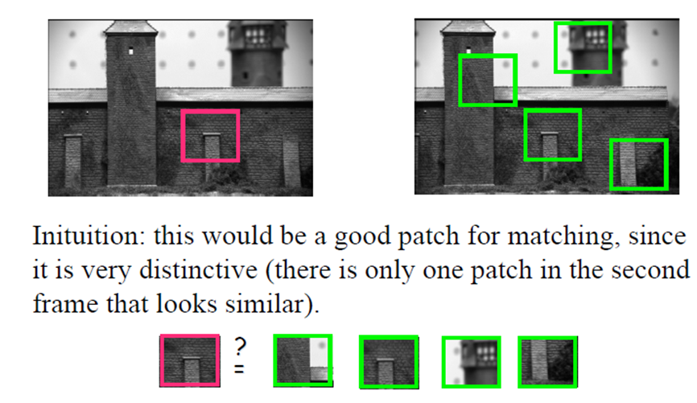
Where to put features?
Slide credit: Robert Collins

Slide 5
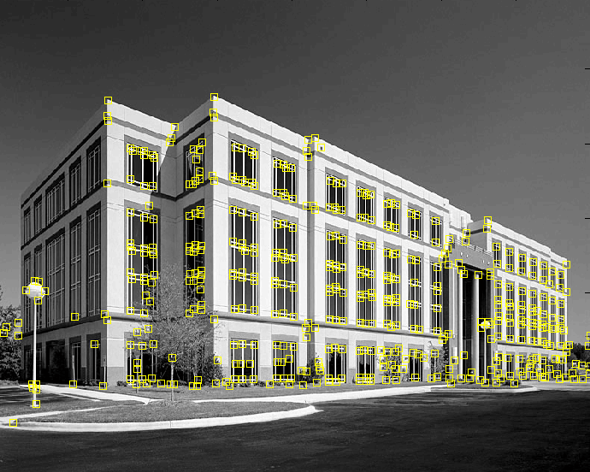
Where to put features?
Corners
Slide credit: Svetlana Lazebnik

Slide 6

Corner Detection: Basic Idea
We should easily recognize the point by looking through a small window
Shifting a window in any direction should give a large change in intensity
“flat” region:
no change in all directions
“edge”:
no change along the edge direction
“corner”:
significant change in all directions

Slide 7
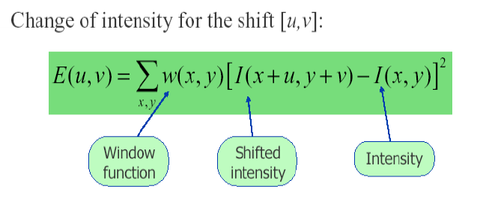
Corner Detection: Basic Idea
We should easily recognize the point by looking through a small window
Shifting a window in any direction should give a large change in intensity

Slide 8

Corner Detections
C.Harris and M.Stephens. "A Combined Corner and Edge Detector.“ Proceedings of the 4th Alvey Vision Conference: pages 147--151.
source: Svetlana Lazebnik

Slide 9
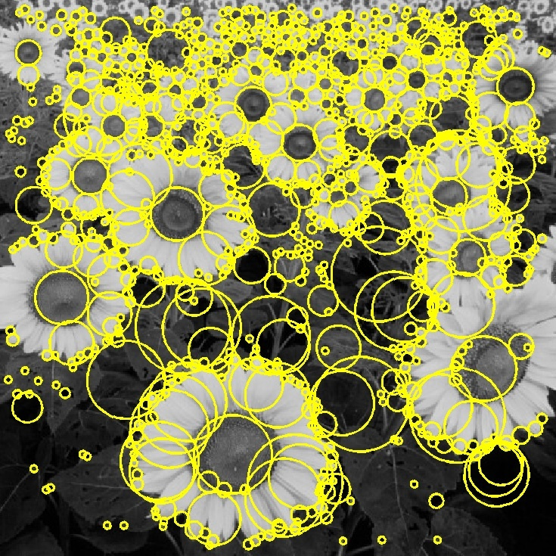
Interest Point Detection
Blobs
Slide credit: Svetlana Lazebnik

Slide 10
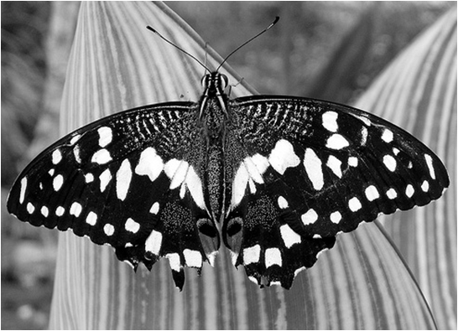
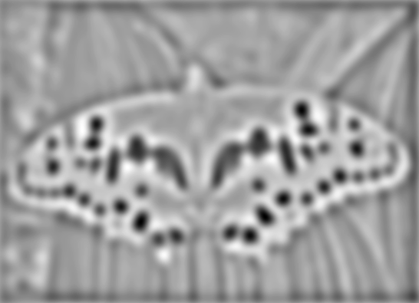

Blob detection: Basic idea
minima
*
=
maxima
Find maxima and minima of blob filter response
Source: N. Snavely

Slide 11


Blob Filter
Laplacian of Gaussian: Circularly symmetric operator for blob detection in 2D
Source: N. Snavely

Slide 12
Feature detection with scale selection
We want to extract features with characteristic scale that is covariant with the image transformation

Slide 13
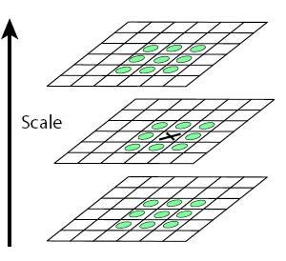
Scale-space blob detector
Convolve image with Laplacian at several scales
Find maxima of Laplacian response in scale-space

Slide 14

Scale Invariant Feature Transform
Basic idea:
  Take 16x16 square window around detected feature
  Compute edge orientation for each pixel
  Throw out weak edges (threshold gradient magnitude)
  Create histogram of surviving edge orientations
0
2π
angle histogram

Slide 15
SIFT descriptor
Full version
  Divide the 16x16 window into a 4x4 grid of cells (2x2 case shown below)
  Compute an orientation histogram for each cell
  16 cells * 8 orientations = 128 dimensional descriptor

Slide 16
Eliminating rotation ambiguity
To assign a unique orientation:
  Create histogram of local gradient directions in the patch
  Assign canonical orientation at peak of smoothed histogram
0
2
π

Slide 17
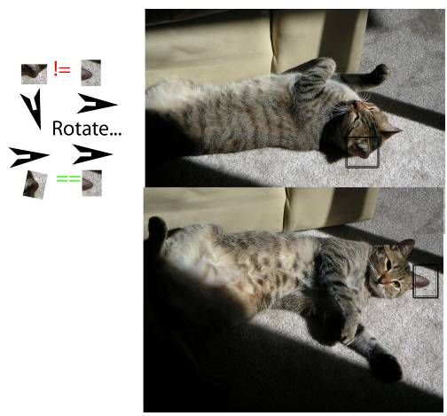
Rotation Invariance
Slide source: Tom Duerig
Notes:
In the top image the peak of the orientation bin would be in the downwards direction while the bottom image would be in the rightward direction. We basically take the patch and rotate it to a canonical direction (ie rightward) before computing the feature descriptor. In this way you can encode rotation invariance.

Slide 18


Properties of SIFT (look for tiny colored squares…)
NASA Mars Rover images with SIFT feature matches
Figure by Noah Snavely

Slide 19
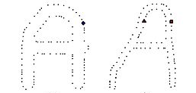
Toward denser sampling
Just sample points randomly on edges
source: Tamara Berg

Slide 20
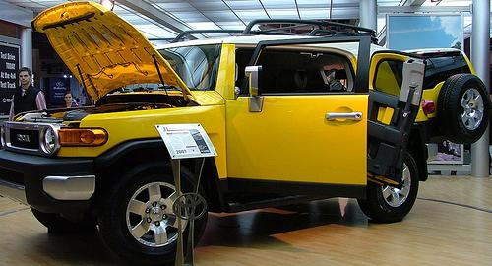
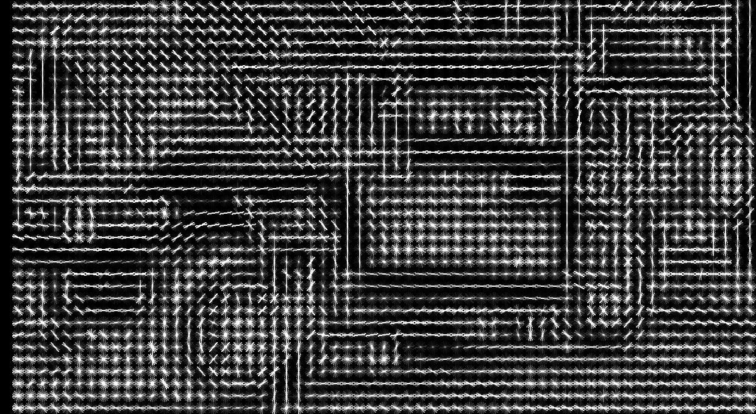
Fully dense sampling
Or sample everywhere!
source: Tamara Berg
Notes:
Recent methods have seemed to move toward fully dense sampling – where we just compute a feature point every k pixels in the image
What have we lost here? Not invariant to scale changes! Maybe have to sample features at multiple scales.
Of course this is a lot of features! so then often later other things are done to make the representation smaller – like compute a bag of words histogram which we will talk about later, but often it seems to be better to sample densely for recognition problems.

Slide 21
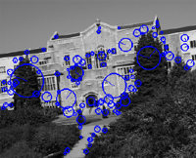
Feature detection and representation
…
Compute descriptor
e.g. SIFT [Lowe’99]
Slide credit: Josef Sivic

Slide 22

Codewords Dictionary Formation
Codewords
…
+
+
+
Vector quantization
128-D SIFT space
Slide credit: Josef Sivic

Slide 23

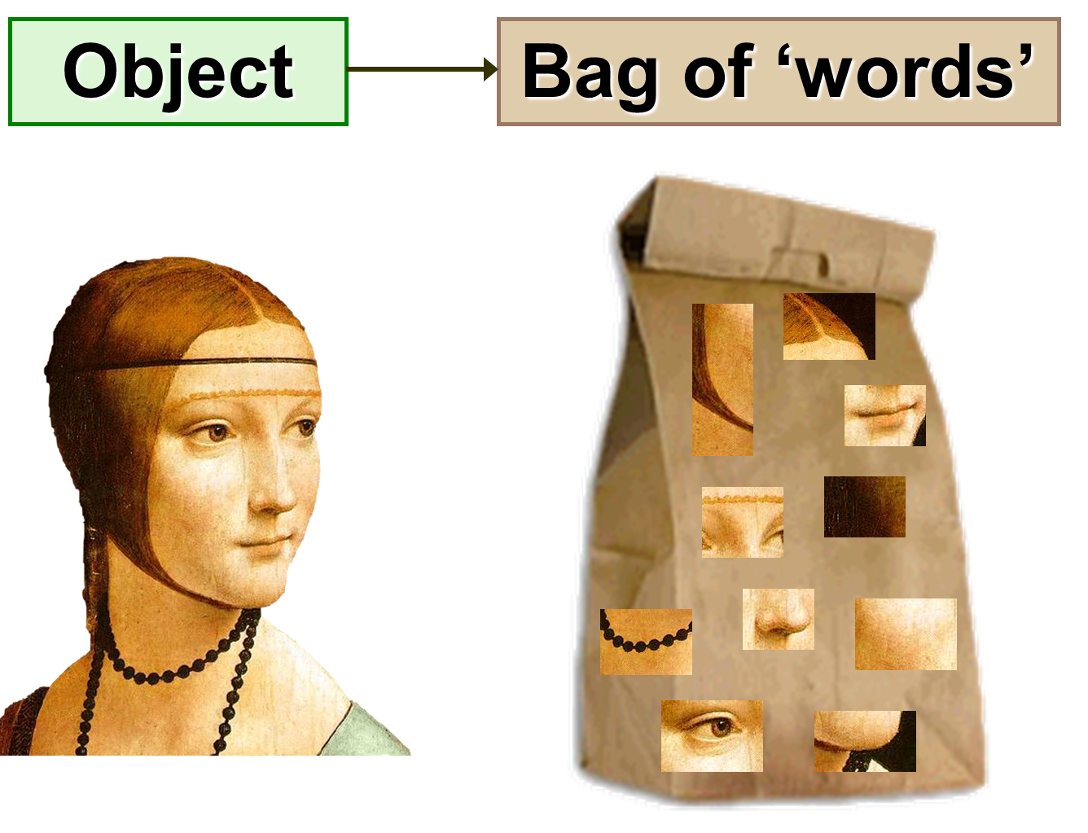
Bag of Words Representation
Slide credit: Josef Sivic

Slide 24
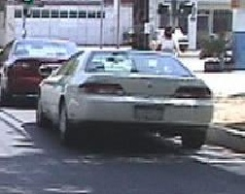
Bag of Words Representation
Histogram of features
assigned to each cluster
frequency
…..
codewords
Slide credit: Josef Sivic

Slide 25
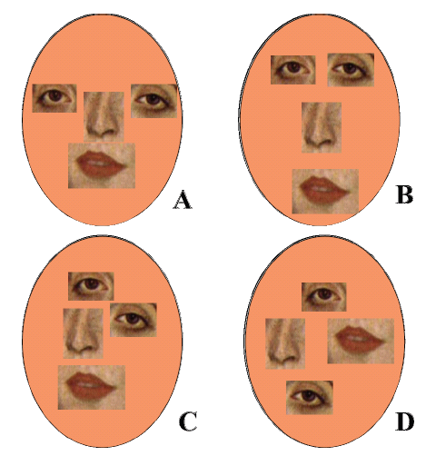
Issues in BoW
The BoW removes spatial layout
Slide credit: Bill Freeman

Slide 26
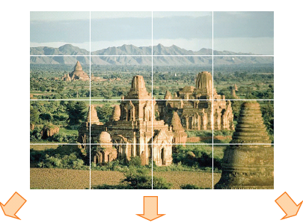
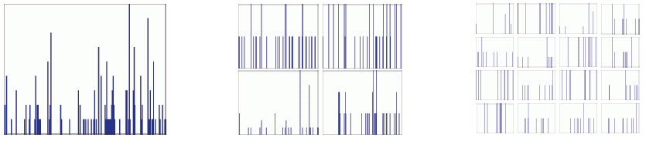
Spatial Pyramid Pooling
Compute BoW for image regions at different locations in various scales
Slide credit: Svetlana Lazebnik

Slide 27
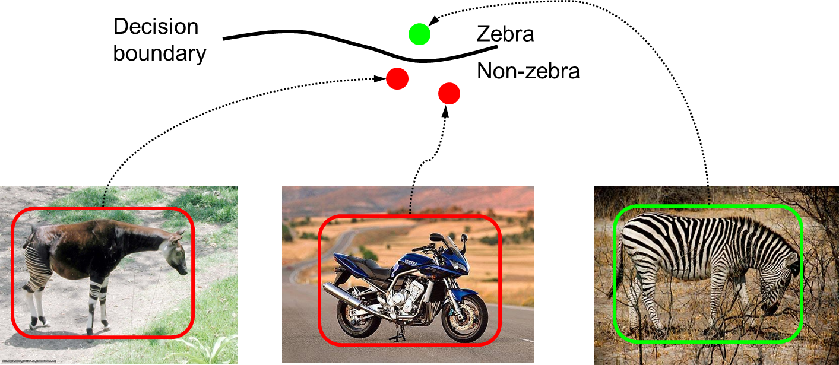
Classifiers
Now, we have fixed length high-dimentional vector representations of images
Time to learn a decision rule assigning representations of images to different classes
Slide credit: Svetlana Lazebnik

Slide 28
Linear classifiers
Find linear function (hyperplane) to separate positive and negative examples
Slide credit: Svetlana Lazebnik

Slide 29
Linear classifiers
Which hyperplane
is best?
Slide credit: Svetlana Lazebnik

Slide 30
Support Vector Machines
Find hyperplane that maximizes the margin
between the positive and negative examples
For support vectors,
Distance between point and hyperplane:
Therefore, the margin is 2 / ||w||
Support vectors
Margin
Slide credit: Svetlana Lazebnik

Slide 31
Nonlinear SVMs
What if data is non linearly seperable?
  General idea: the original input space can always be mapped to some higher-dimensional feature space where the training set is separable
Φ: x → φ(x)
Slide credit: Andrew Moore

Slide 32
Nonlinear SVMs
The kernel trick: instead of explicitly
computing the lifting transformation φ(x),
define a kernel function K such that
K(x , y) = φ(x) · φ(y)
This gives a nonlinear decision boundary in the original feature space:

Slide 33
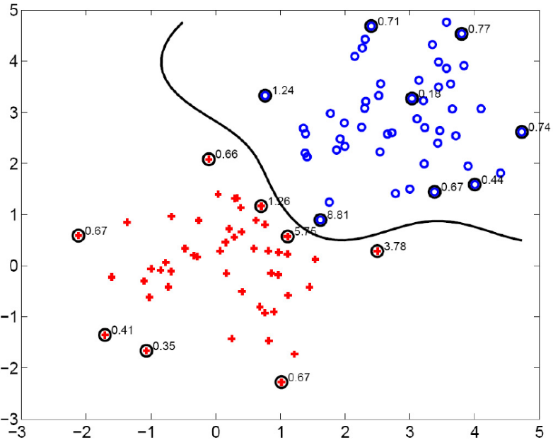
Gaussian Kernel
Known as the radial basis function kernel:
The corresponding mapping φ(x) is infinite-dimensional!

Slide 34
AdaBoost
Robert E. Schapire (Princeton University)
Yoav Freund (University of California at San Diego)

Slide 35
Ensemble Learning
A machine learning paradigm where multiple learners are used to solve the problem
Previously:
Ensemble:
Problem
Problem
… ...
Learner
… ...
Learner
Learner
Learner
The generalization ability of the ensemble is usually significantly better than that of an individual learner
Boosting is one of the most important families of ensemble methods

Slide 36
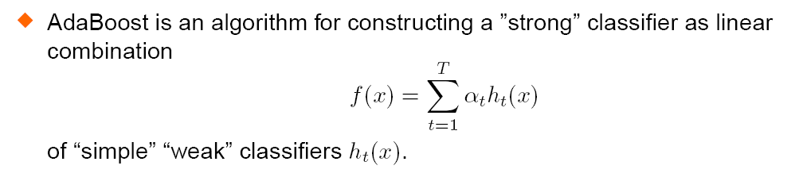
Boosting
Significant advantageous:
  Solid theoretical foundation
  Very accurate prediction
  Very simple (“just 10 lines of code” [R. Schapire])
  Wide and successful applications
  … …

Slide 37
An Easy Flow
training instances that are wrongly predicted by Learner₁ will play more important roles in the training of Learner₂
Original training set
Data set ₁
Data set ₂
… ...
Data set _{T}
… ...
Learner₁
Learner₂
… ...
Learner_{T}
weighted combination

Slide 38
A toy example
Training set: 10 points (represented by plus or minus)
Original Status: Equal Weights for all training samples

Slide 39
A toy example(cont’d)
Round 1: Three “plus” points are not correctly classified;
They are given higher weights.

Slide 40
A toy example(cont’d)
Round 2: Three “minuse” points are not correctly classified;
They are given higher weights.

Slide 41
A toy example(cont’d)
Round 3: One “minuse” and two “plus” points are not correctly classified;
They are given higher weights.

Slide 42
A toy example(cont’d)
Final Classifier: integrate the three “weak” classifiers and obtain a final strong classifier.

Slide 43
Random Forests
Some slides are due to Robert Schapire, Pier Luca Lnzi, and Predrag Radenković

Slide 44
Decision tree
Each node is a test on
one attribute
Outlook
sunny
rain
Possible attribute values
of the node
overcast
Humidity
Yes
Windy
high
normal
true
false
Leafs are the
decisions
No
Yes
No
Yes

Slide 45
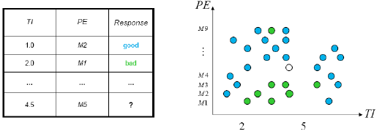
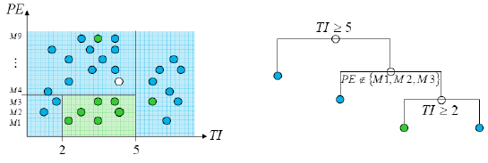
Decision tress involve greedy, recursive partitioning.
Simple dataset with two predictors
Greedy, recursive partitioning along TI and PE

Slide 46
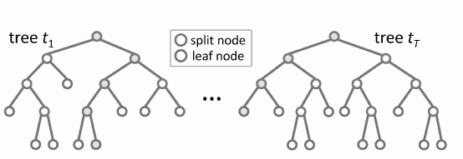
Random Forests
Random forests (RF) are a combination of tree
predictors
Each tree depends on the values of a random vector
sampled in dependently
The generalization error depends on the strength of
the individual trees and the correlation between them
Using a random selection of features yields results
favorable to AdaBoost, and are more robust w.r.t. noise
Notes:
It is unexcelled in accuracy among current algorithms.
It runs efficiently on large data bases.
It can handle thousands of input variables without variable deletion.
It gives estimates of what variables are important in the classification.
It generates an internal unbiased estimate of the generalization error as the forest building progresses.
It has an effective method for estimating missing data and maintains accuracy when a large proportion of the data are missing.
It has methods for balancing error in class population unbalanced data sets.

Slide 47
Compared with Boosting
Pros:
It is more robust.
It is faster to train (no reweighting, each split is on a small subset of data and feature).
Can handle missing/partial data.
Is easier to extend to online version.
Cons:
The feature selection process is not explicit.
Feature fusion is also less obvious.
Has weaker performance on small size training data.

Slide 48
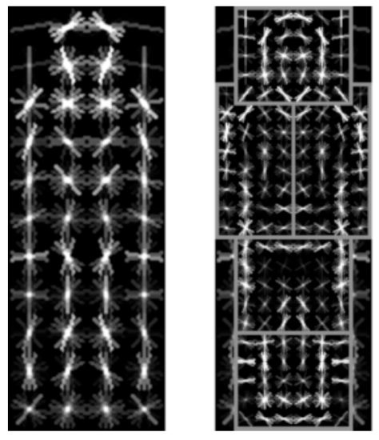
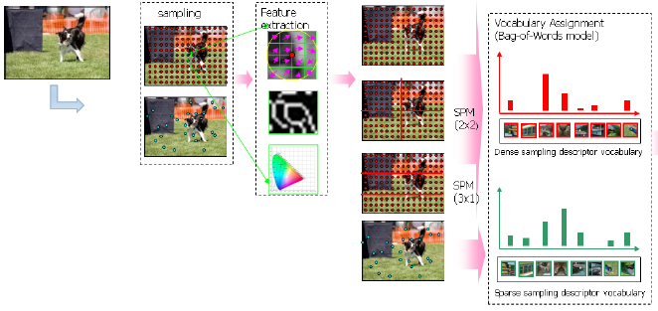

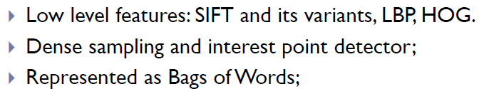
Recognition
Features are key to recent progress in recognition
Multitude of hand-designed features currently in use
  SIFT, HOG, ………….
Where next? Better classifiers? More features?
Felzenszwalb, Girshick,
McAllester and Ramanan, PAMI 2007
Yan & Huang
(Winner of PASCAL 2010 classification competition)

Slide 49
Deep Convolutional Network
Dog
Feature Extraction
Coding
Spatial Pyramid
Pooling
SVM
Deep
Convolutional
Network
Cat

Slide 50
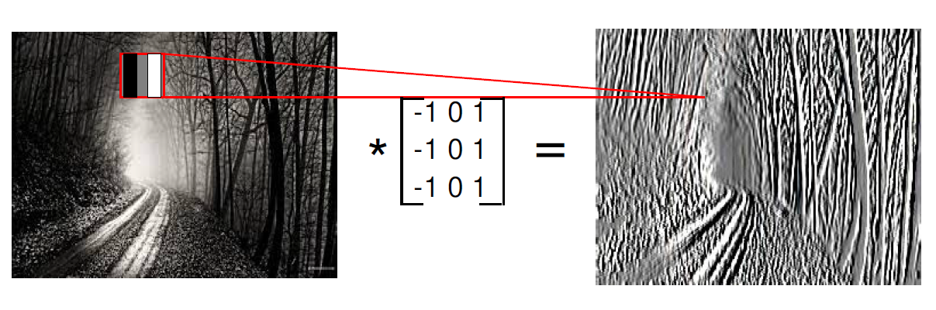
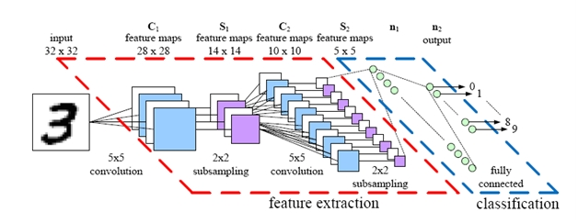
Deep Convolutional Network

Slide 51
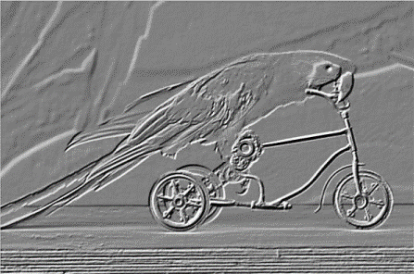
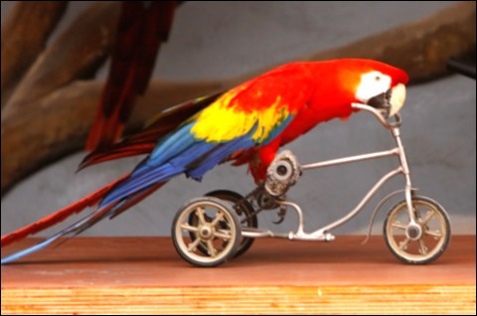
A Basic Module of the CNN
Pooling
Convolution
Image

Slide 52


How does it work?
Pooling
Pooling
………………………………………………………………….
………………………………………
………………………………………
………………………….
………………………….

Slide 53
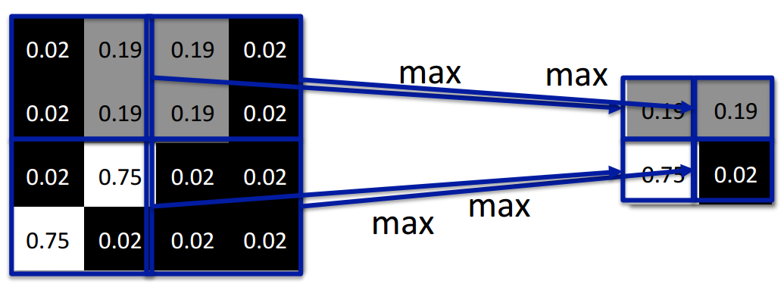

Max Pooling

Slide 54
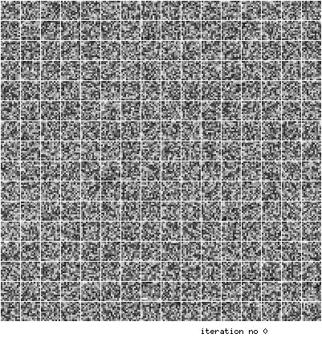
An Example of Learned Filters

Slide 55
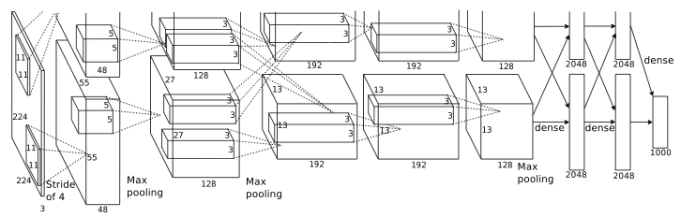
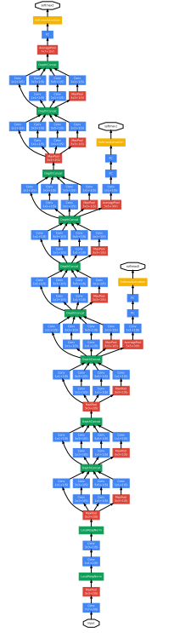
Deep Convolutional Network
Alex Krishevsky, 2012 Imagenet Challenge Winner (error rate 15.315)
GoogleNet, 2014 Imagenet Challenge Winner (error rate 6.656)
Well-trained human (error rate human1: 5.1% human2: 12.0%)

Slide 56
Useful Materials
Machine Learning
  https://www.coursera.org/course/ml
  http://cs229.stanford.edu/materials.html
Computer Vision
  http://vision.stanford.edu/teaching/cs131_fall1415/
  http://web.engr.illinois.edu/~slazebni/spring13/
  http://people.csail.mit.edu/torralba/shortCourseRLOC/
  https://github.com/jbhuang0604/awesome-computer-vision
Deep learning
  http://www.iro.umontreal.ca/~bengioy/dlbook/
  http://vision.stanford.edu/teaching/cs231n/

