Slide 1
DARPA Urban Challenge & Google Car
01/14/2015 Automotive Cyber-Physical Systems
Cheng-Yang Fu

Slide 2
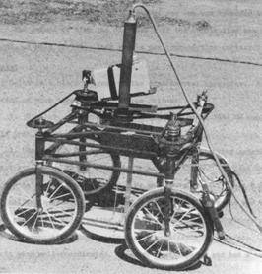
History of Autonomous car
The Stanford Cart
Stanford cart with cable, 1961
Constructed by James L. Adams
Cited : http://web.stanford.edu/~learnest/cart.htm

Slide 3
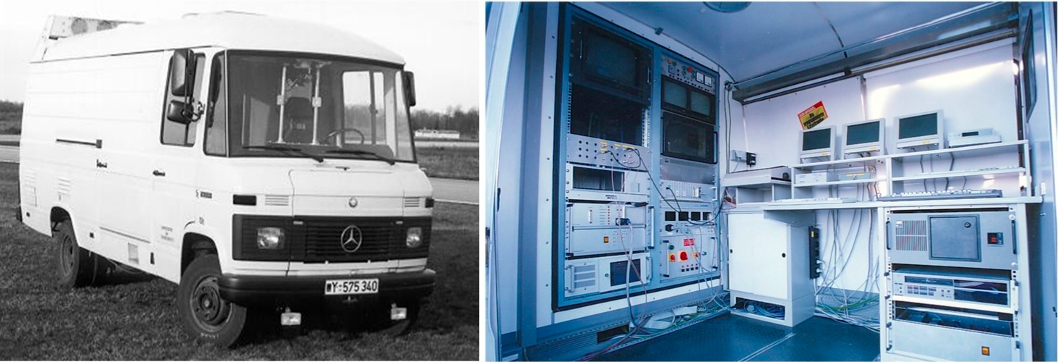
History of Autonomous car
The earliest autonomous car
Director : Ernst Dickmanns
1980s
Credit: © Ernst D. Dickmanns.
Notes:
http://www.wired.com/2012/02/autonomous-vehicle-history/#slideid-126221

Slide 4
DARPA Grand Challenge -2004
The First long distance competition for driverless car in the world
Motivation: making one-third of guard military forces autonomous by 2015
Notes:
Cited from Wikipedia

Slide 5
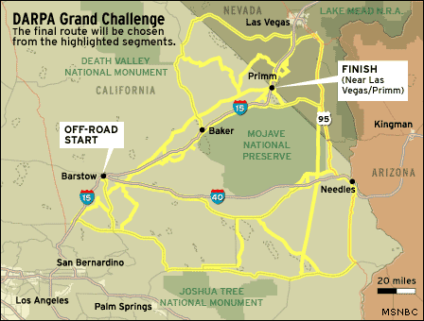
DARPA Grand Challenge -2004(cont.)
Route = 150 miles
No teams finished
Best Result :
CMU car Sandstorm
7.32 miles
Cited from NBC news

Slide 6
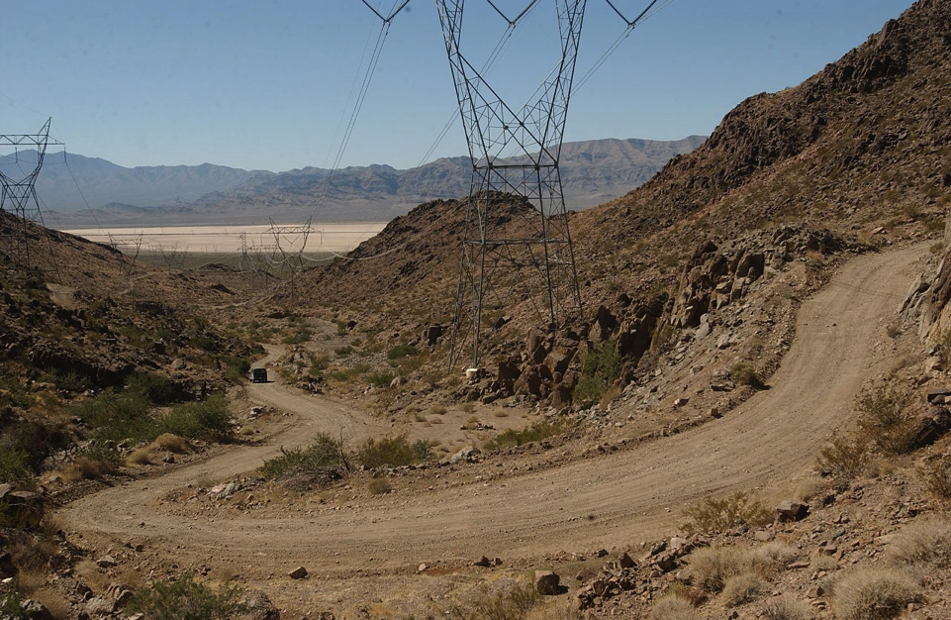
DARPA Grand Challenge -2005
More difficult than 2004
132 miles
5 teams
Cited from Wikipedia

Slide 7
DARPA Urban Challenge - 2007
Motivation
Rural -> Urban
Goals
Obeying all traffic regulations while negotiating with other traffic and obstacles and merging into traffic
Example : 4-way stop intersection

Slide 8
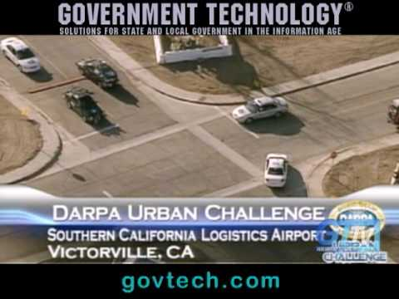
Cited from govtech.com
Notes:
Cited from govtech.com

Slide 9
Map provided by DARPA
Cited from :Toward Robotic Cars, By Sebastian Thrun

Slide 10
DARPA Urban Challenge (cont.)
Incidents in final challenge
http://youtu.be/-xibwwNVLgg?t=29m39s

Slide 11
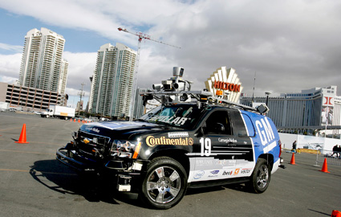
Team – Tartan Racing - Boss
1th place
Composed of Carnegie Mellon University and General Motors Corporation
2007 Chevrolet Tahoe
https://www.youtube.com/watch?v=lULl63ERek0

Slide 12
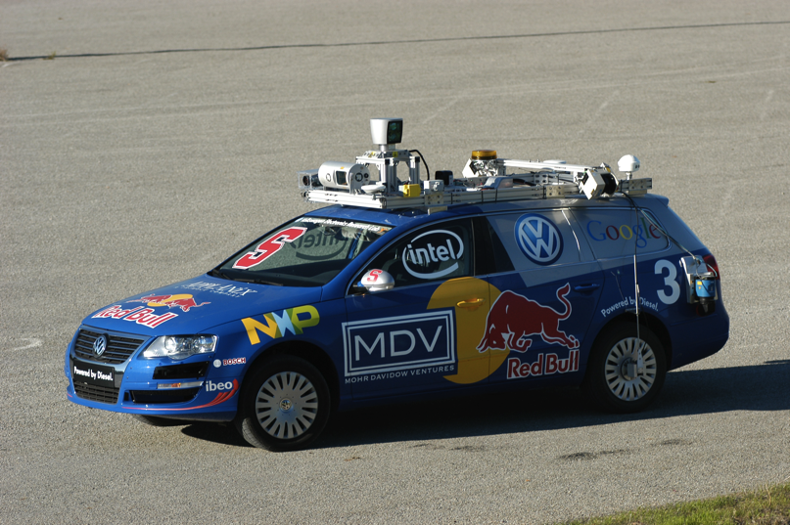
Team – Stanford Racing - Junior
2th place
2006 Volkswagen Passat Wagon
1th in 2005 grand challenge (Stanley)
http://cs.stanford.edu/group/roadrunner/team.html
Notes:
http://cs.stanford.edu/group/roadrunner/team.html

Slide 13
Team – VictorTango - Odin
3th place
2005 Ford Hybrid Escape
JAUS (Joint Architecture for Unmanned Systems)
Only finisher not using Velodyne sensor

Slide 14
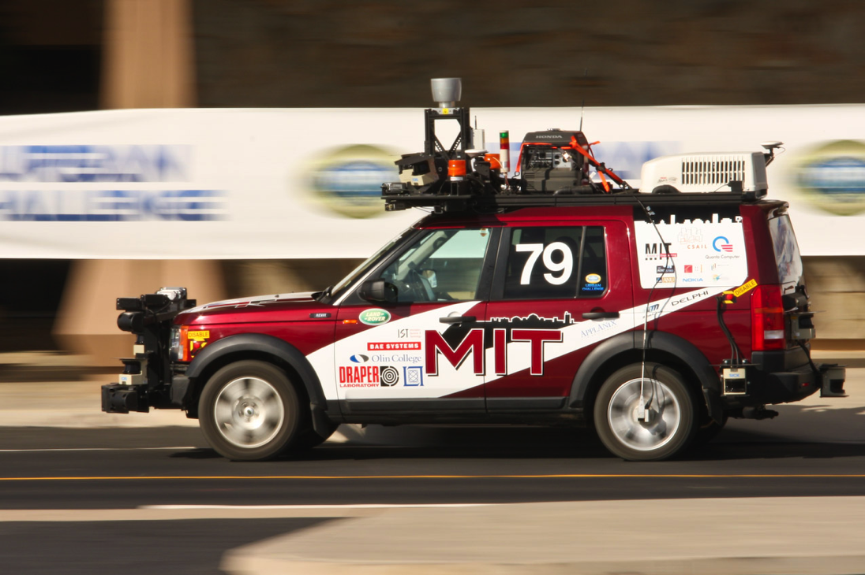
Team – MIT - Talos
4th place – approximate 6 hours
Cluster with 40 cores
Extra Power generator and air conditioner are used

Slide 15
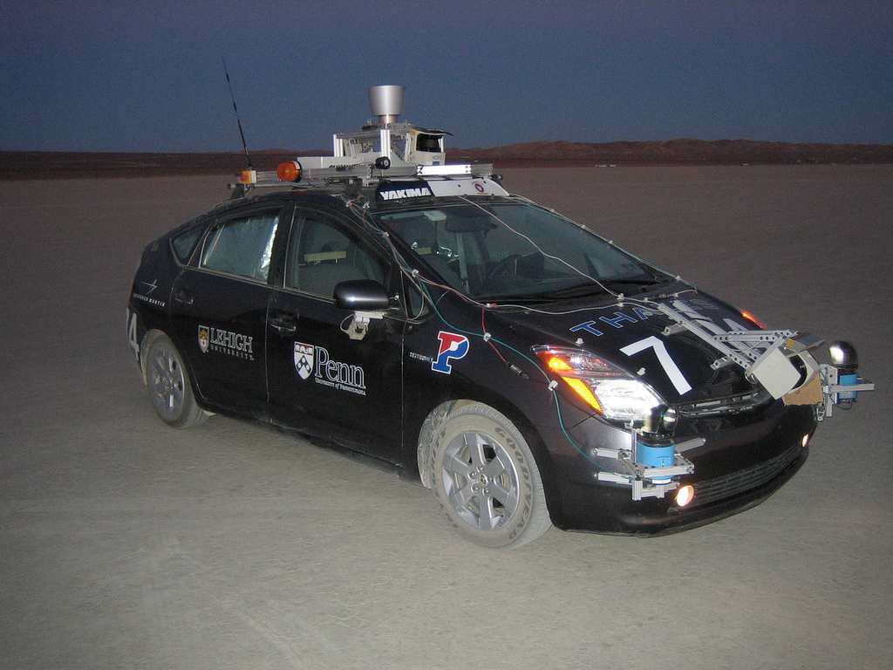
Team - The Ben Franklin Racing Team – Little Ben
No Official time
Programing Languages : MATLAB

Slide 16
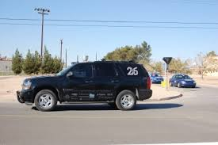
Team – Cornell - Skynet
Bayesian inference is used in planning.
Source code was released in 2008

Slide 17
Race participants and Results
http://en.wikipedia.org/wiki/DARPA_Grand_Challenge
Notes:
http://en.wikipedia.org/wiki/DARPA_Grand_Challenge

Slide 18
Perception System
Use Junior as example
Velodyne HD Lidar
Every direction 10 times a second
Combine 64 lasers into millions of 3D points at up to 65m range
Cited from http://cs.stanford.edu/group/roadrunner/team.html

Slide 19
Perception System (cont.)
Five BOSCH radar
sensors point straight and to each side to track up to 32 obstacles simultaneously over a range of 200m
Two IBEO ALASCA XT Lidars
in the front and two SICK LD-LRS Lidars in the rear handle ranges up to 100m
http://cs.stanford.edu/group/roadrunner/team.html

Slide 20
Perception System of Junior
Notes:
Cited: http://robots.stanford.edu/papers/junior08.pdf

Slide 21
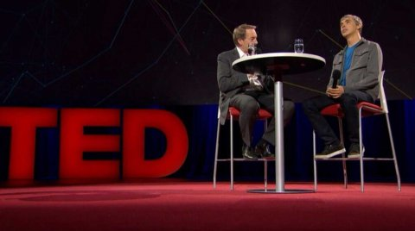
Google driverless Car
Larry Page talked about Google car
Save lives
The leading cause of death for people under 34 is car accident
30,000 people die in car accident each year
Save labor time
Cited from TED

Slide 22
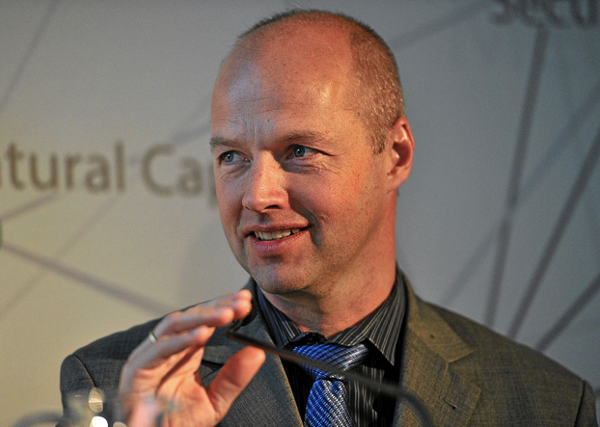
Google driverless Car
Led by Sabastian Thrun (the director of the Stanford Team in DARPA challenge)
Notes:
Pic : Wikipedia

Slide 23
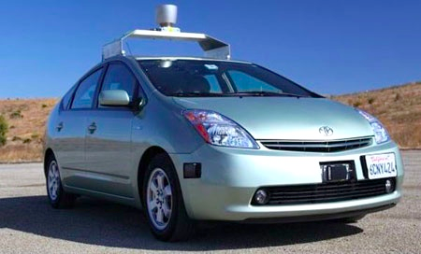
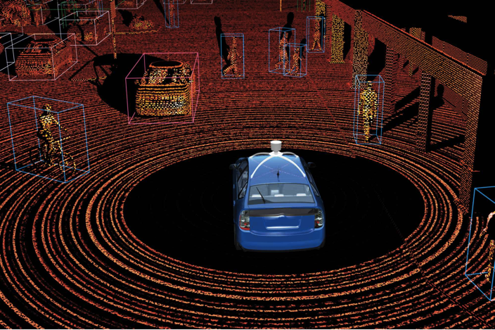
Google car : Technology
Equipment : $150, 000
LIDAR system : $70,000

Slide 24
Google car : Technology
High definition inch-precision map
How high the traffic lights are
Limitation : Google driverless car cannot go to new place
Remote computation is also needed

Slide 25
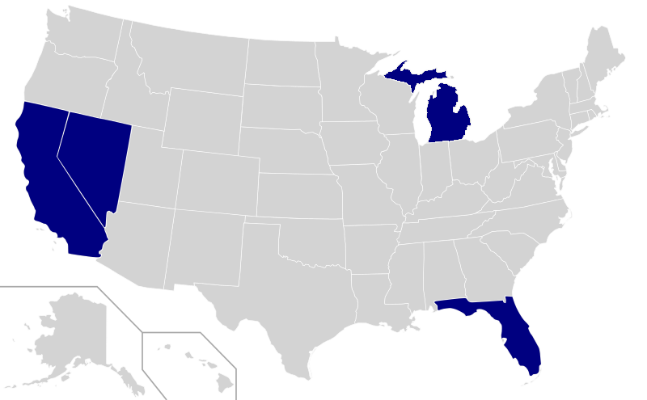
Google car : Law
Four U.S. states have passed laws permitting autonomous cars as of December 2013:
Nevada, Florida, California, and Michigan.
Require a human in the driver seat all time
Texas would establish criteria for allowing “autonomous motor vehicle “
Cited from Wikipedia

Slide 26
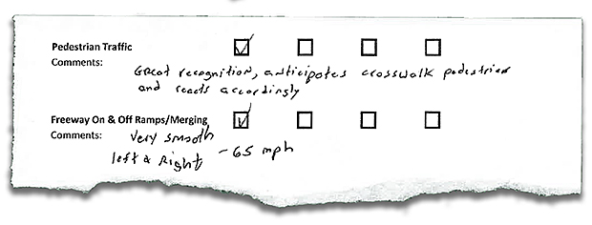
Google car : Law (cont.)
How Google car passed the first U.S. State Self-driving Test
http://spectrum.ieee.org/transportation/advanced-cars/how-googles-autonomous-car-passed-the-first-us-state-selfdriving-test

Slide 27
Google car : Limitations
Weather : heavy rain and snow
Lidar system cannot spot potholes
Cannot
Recognize temporary traffic signals
Recognize crumpled paper from rocks
Recognize police officers from pedestrian

Slide 28
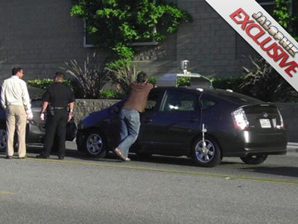
Google car : Accident ?
In August 2011, a Google driverless car is involved in a crash in Mountain View.
Google claim
"Safety is our top priority. One of our goals is to prevent fender-benders like this one, which occurred while a person was manually driving the car."
No accidents are reported after this
Cited from Business Insider

Slide 29
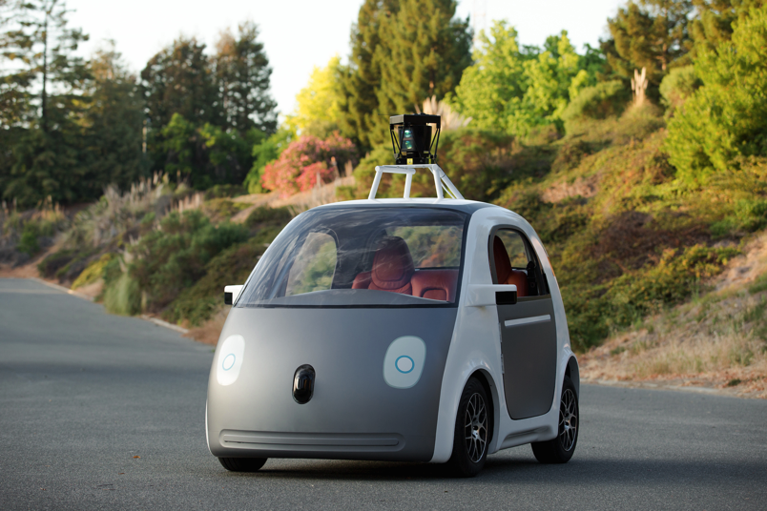
Google : Self-Driving Car Future?
2014 (Last Year) new prototype
No steering wheel ,pedals
Law question ?
Carlifornia’s DMV said a driver must be able to take “immediate physical control” of a vehicle on public roads.

Slide 30
Q & A
Thank you for your Attention

