Slide 1
Duty-Cycle-Aware Real-Time Scheduling of Wireless Links in Low Power WANs
Md Tamzeed Islam

Slide 2

Popularity of Low Power Wide Area Network
Long Range
Low Power
Low Data Rate
LPWAN is becoming popular day-by-day

Slide 3
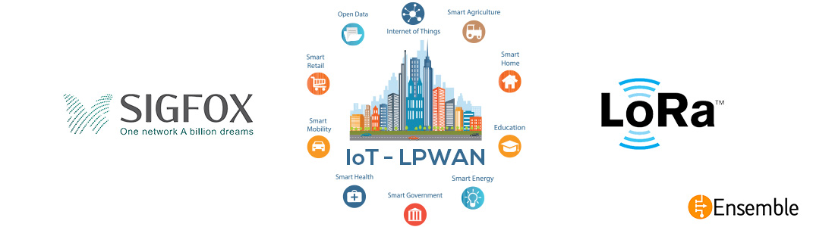
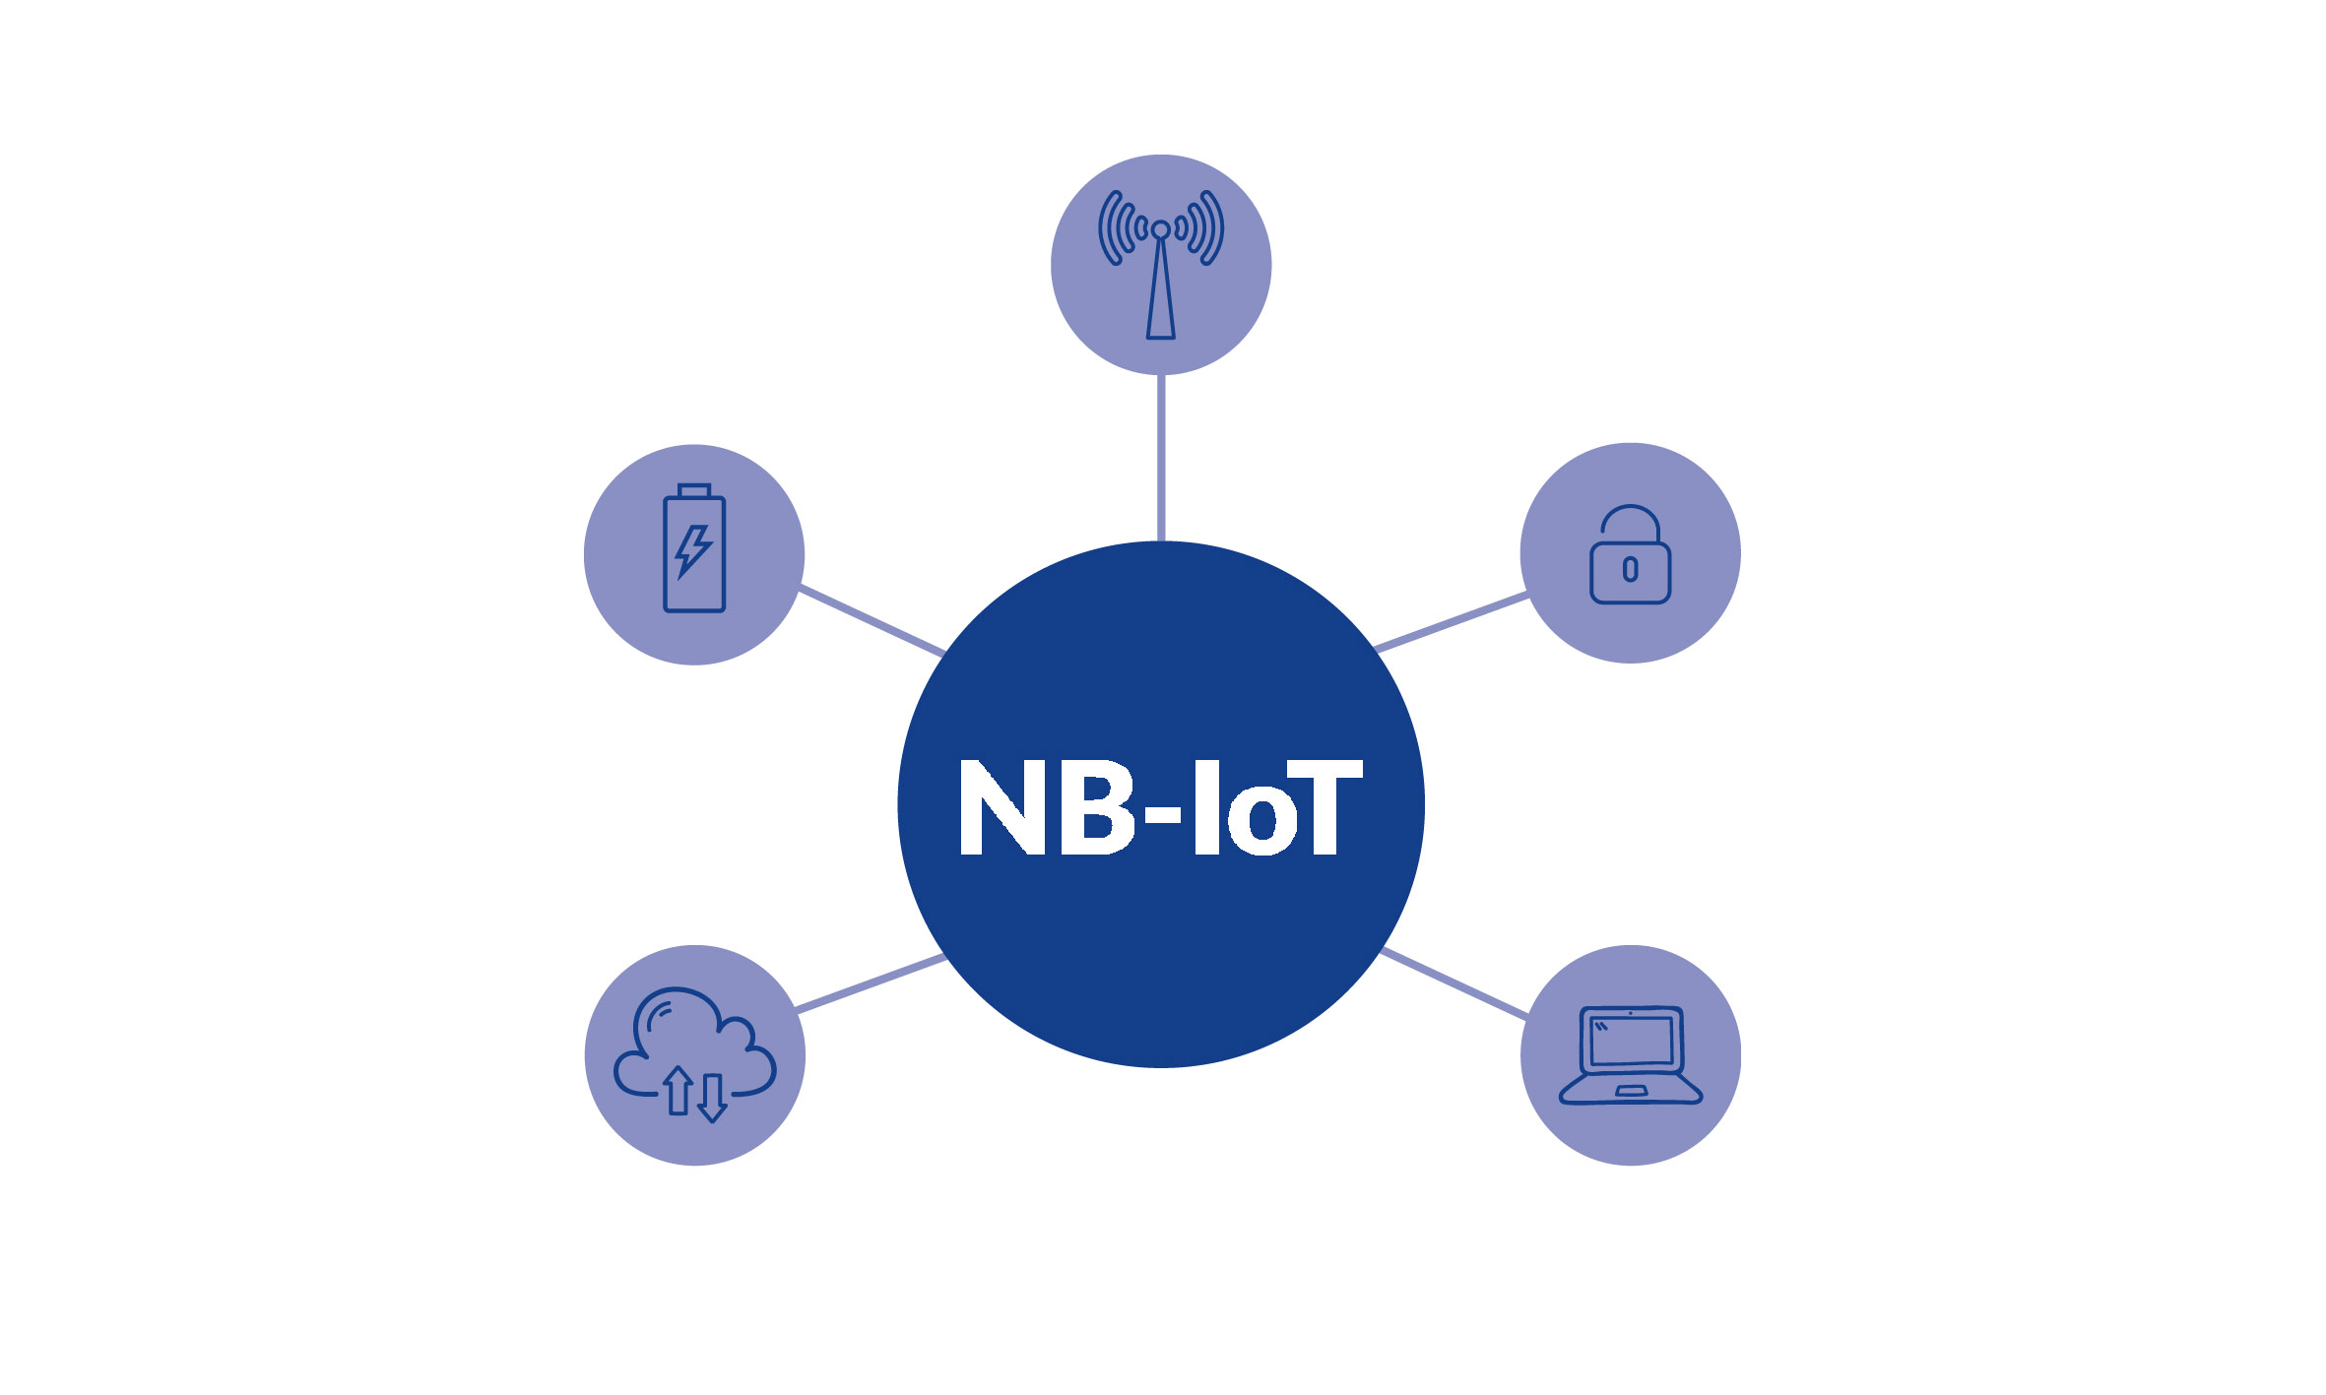
Different LPWANs
LoRa is one of the most popular LPWANs

Slide 4
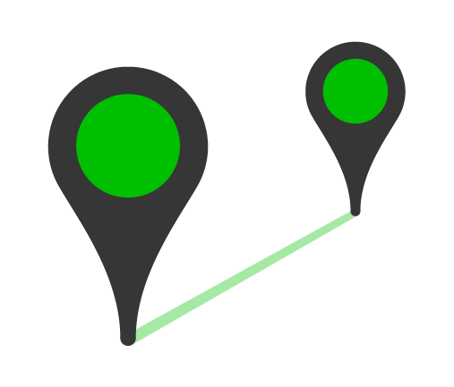

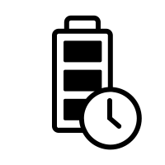
Features of LoRa
9 miles
50 kbps
10 years

Slide 5
Overview of LoRa

Slide 6
Overview of LoRa

Slide 7
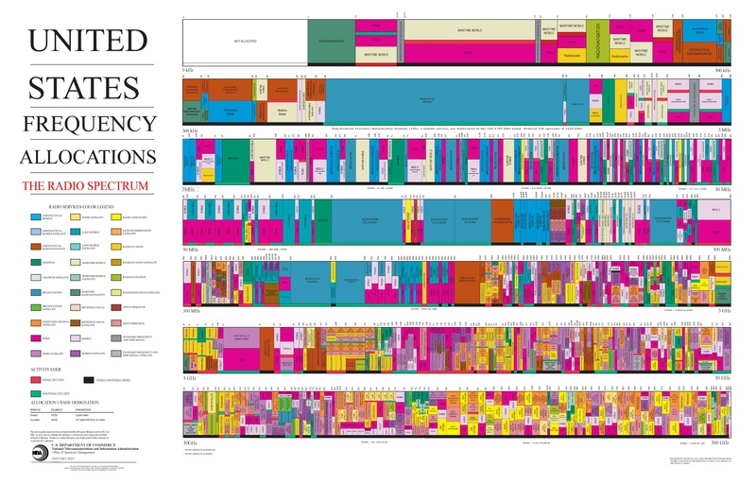
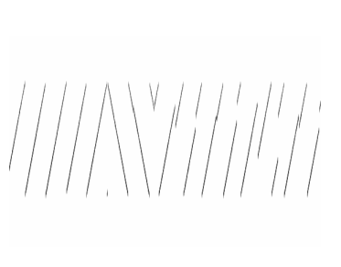
LoRa Properties
Chirp Spread Spectrum (CSS) Modulation
frequency
time
Figure: CSS
Operates on ISM band

Slide 8
Issues
Pure Aloha
Uses ALOHA for MAC Layer protocol.

Slide 9
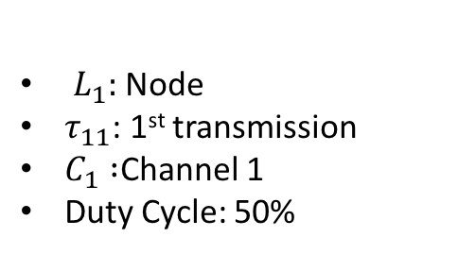
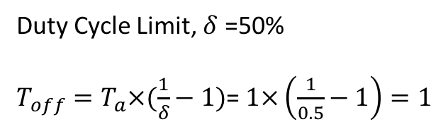
Duty-Cycle Limit
$L_{1}:$Node
$τ_{11}$: 1st transmission
$C_{1} :$Channel 1
Duty Cycle: 50%
Duty Cycle Limit, $δ$ =50%
$T_{off}=T_{a}×(\frac{1}{δ}−1)$= $1×\left(\frac{1}{0.5}−1\right)=1$
L₁ Can not use Channel 1 (C₁) for duty-cycle limit
τ₁₁
L₁
0 1 2 3 4 5 6 7 8 9 10
Time
Channel1 (C₁)
Figure: Duty Cycle Limit

Slide 10
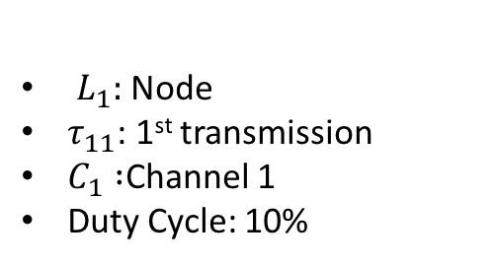
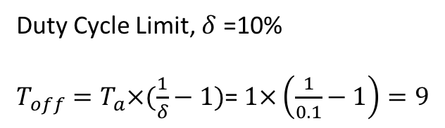
Duty-Cycle Limit
$L_{1}:$Node
$τ_{11}$: 1st transmission
$C_{1} :$Channel 1
Duty Cycle: 10%
Duty Cycle Limit, $δ$ =10%
$T_{off}=T_{a}×(\frac{1}{δ}−1)$= $1×\left(\frac{1}{0.1}−1\right)=9$
L₁ Can not use Channel 1 (C₁) for duty-cycle limit
τ₁₁
L₁
0 1 2 3 4 5 6 7 8 9 10
Time
Channel1 (C₁)
Figure: Duty Cycle Limit

Slide 11
Real Time Scheduling for LoRa

Slide 12
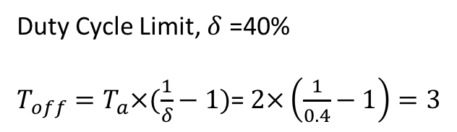
Motivation
Link | Release Time | Time on Air | Deadline | Period
L1 | 0 | 2 | 3 | 5
L2 | 0 | 4 | 5 | 5
L₁ Can not use Channel 1 (C₁) for duty-cycle limit
Duty Cycle Limit, $δ$ =40%
$T_{off}=T_{a}×(\frac{1}{δ}−1)$= $2×\left(\frac{1}{0.4}−1\right)=3$
τ₁₁
τ₁₂
L₁
0 1 2 3 4 5 6 7 8 9 10
Time
Channel1 (C₁)

Slide 13
Traditional Scheduling Algorithm
L₁ Can not use Channel 1 (C₁) for duty-cycle limit
Deadline miss
τ₁₁
τ₁₂
L₁
L₂ Can not use Channel 2 (C₂) for duty-cycle limit
τ₂₁
τ₂₂
L₂
0 1 2 3 4 5 6 7 8 9 10
Time
Channel1 (C₁)
Channel2 (C₂)

Slide 14
Desired Scenario

Slide 15
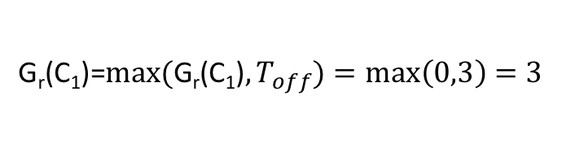

Proposed Solution
G_{r}(C₁, 2) = 3
G_{r}(C₁, 5) = 0
τ₁₁
L₁
Time
Channel1 (C₁)
$T_{off}=T_{a}×(\frac{1}{δ}−1)$= $2×\left(\frac{1}{0.4}−1\right)=3$
$$\text{G}\text{r}\text{(}\text{C}\text{1}\text{)}\text{=}{max⁡(\text{G}\text{r}\text{(}\text{C}\text{1}\text{)},T}_{off})=\max\left(0,3\right)=3$$

Slide 16
Proposed Solution
Packet Selection: Least Laxity First
Channel Selection: Available channel with the maximum gravity.

Slide 17
Proposed Solution
G_{r}(C₁, 2) = 3
G_{r}(C₂, 4) = 6
G_{r}(C₂, 5) = 5
G_{r}(C₁, 5) = 0
τ₁₁
τ₁₂
L₁
τ₂₁
τ₂₂
L₂
0 1 2 3 4 5 6 7 8 9 10
Time
Channel1 (C₁)
Channel2 (C₂)

Slide 18
Implementation & Setup

Slide 19
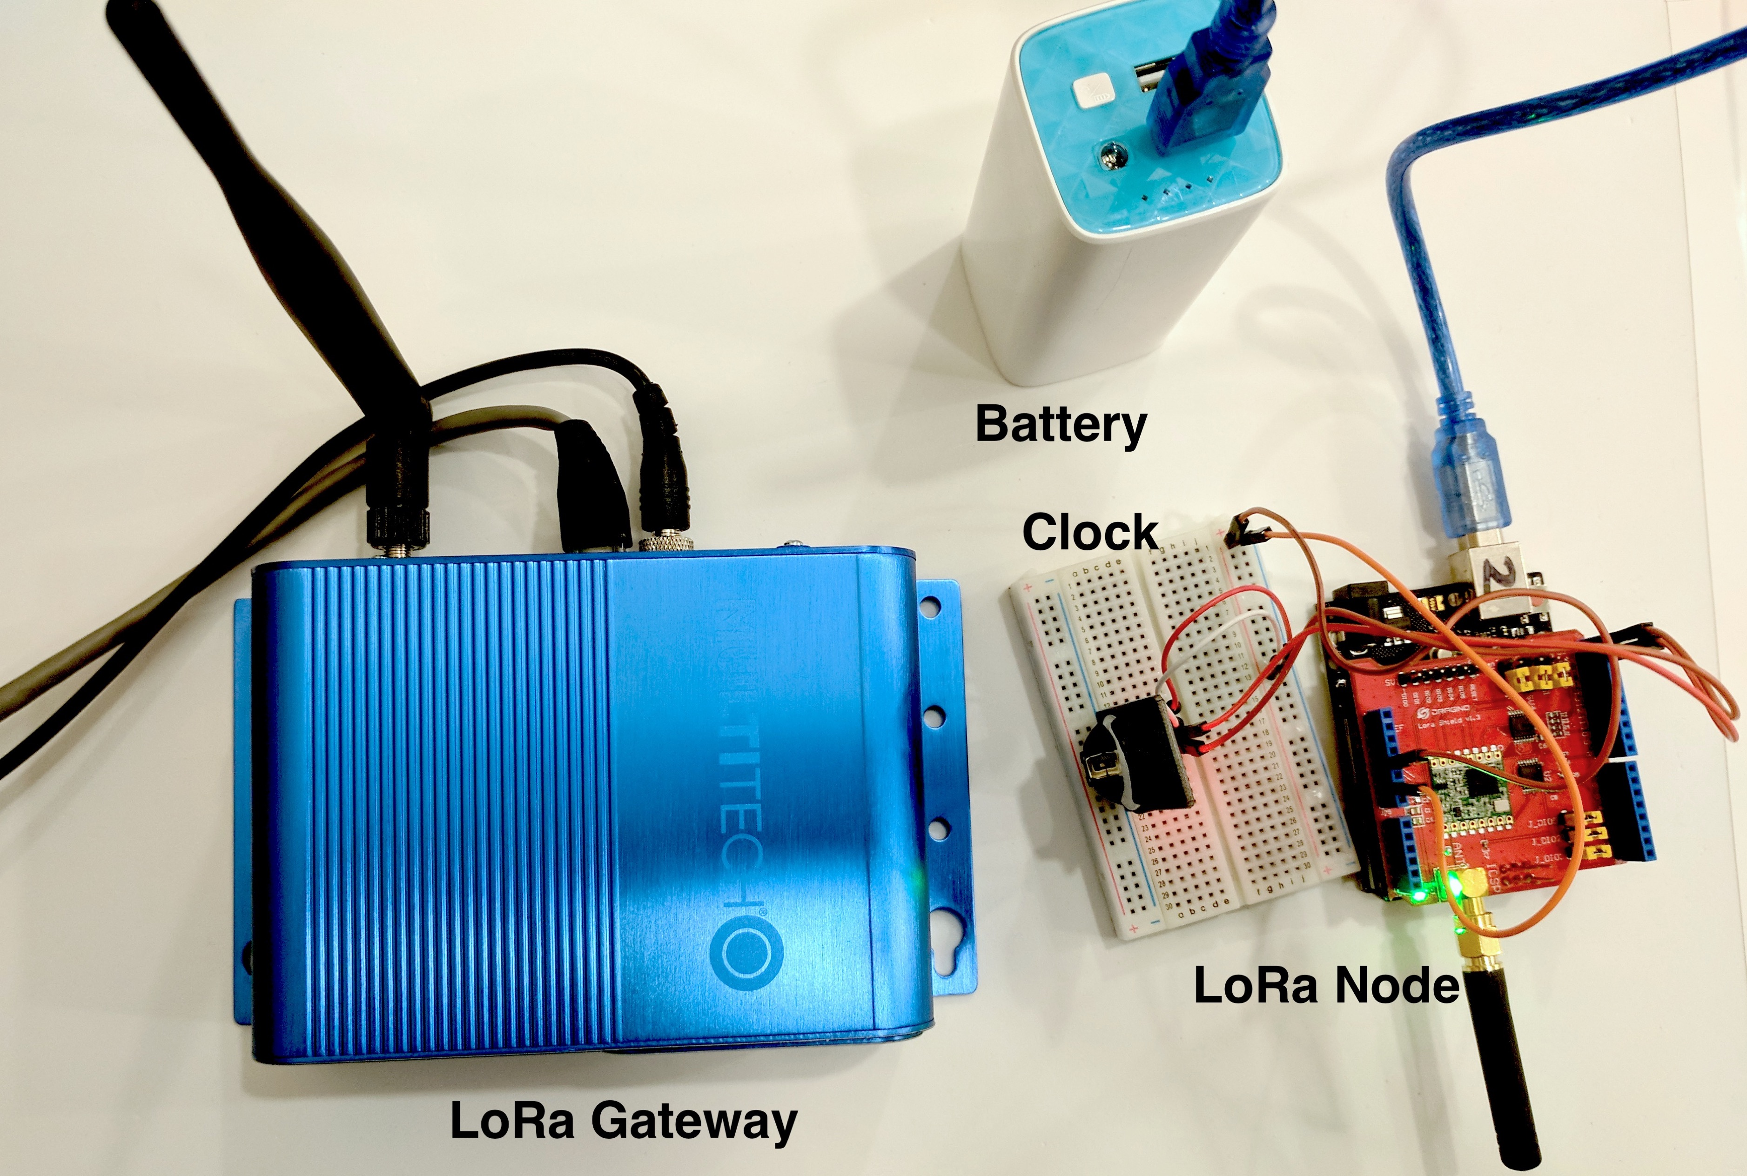
Implementation

Slide 20
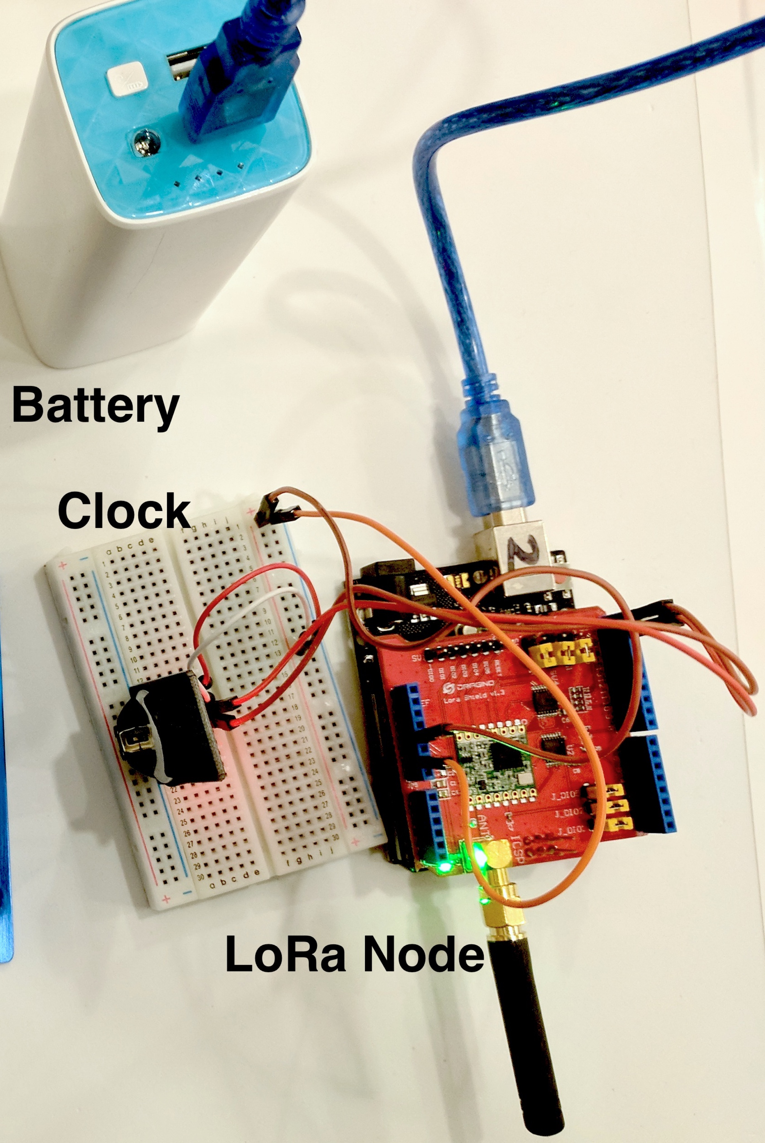
Implementation (LoRa Node)
Components: A LoRa radio shield with an Arduino Uno.
LoRa radio shield: transceiver SX1272/73.
Software: IBM lmic Library.
Power: 10,000mAh USB power bank.
Clock: an external real-time clock.

Slide 21
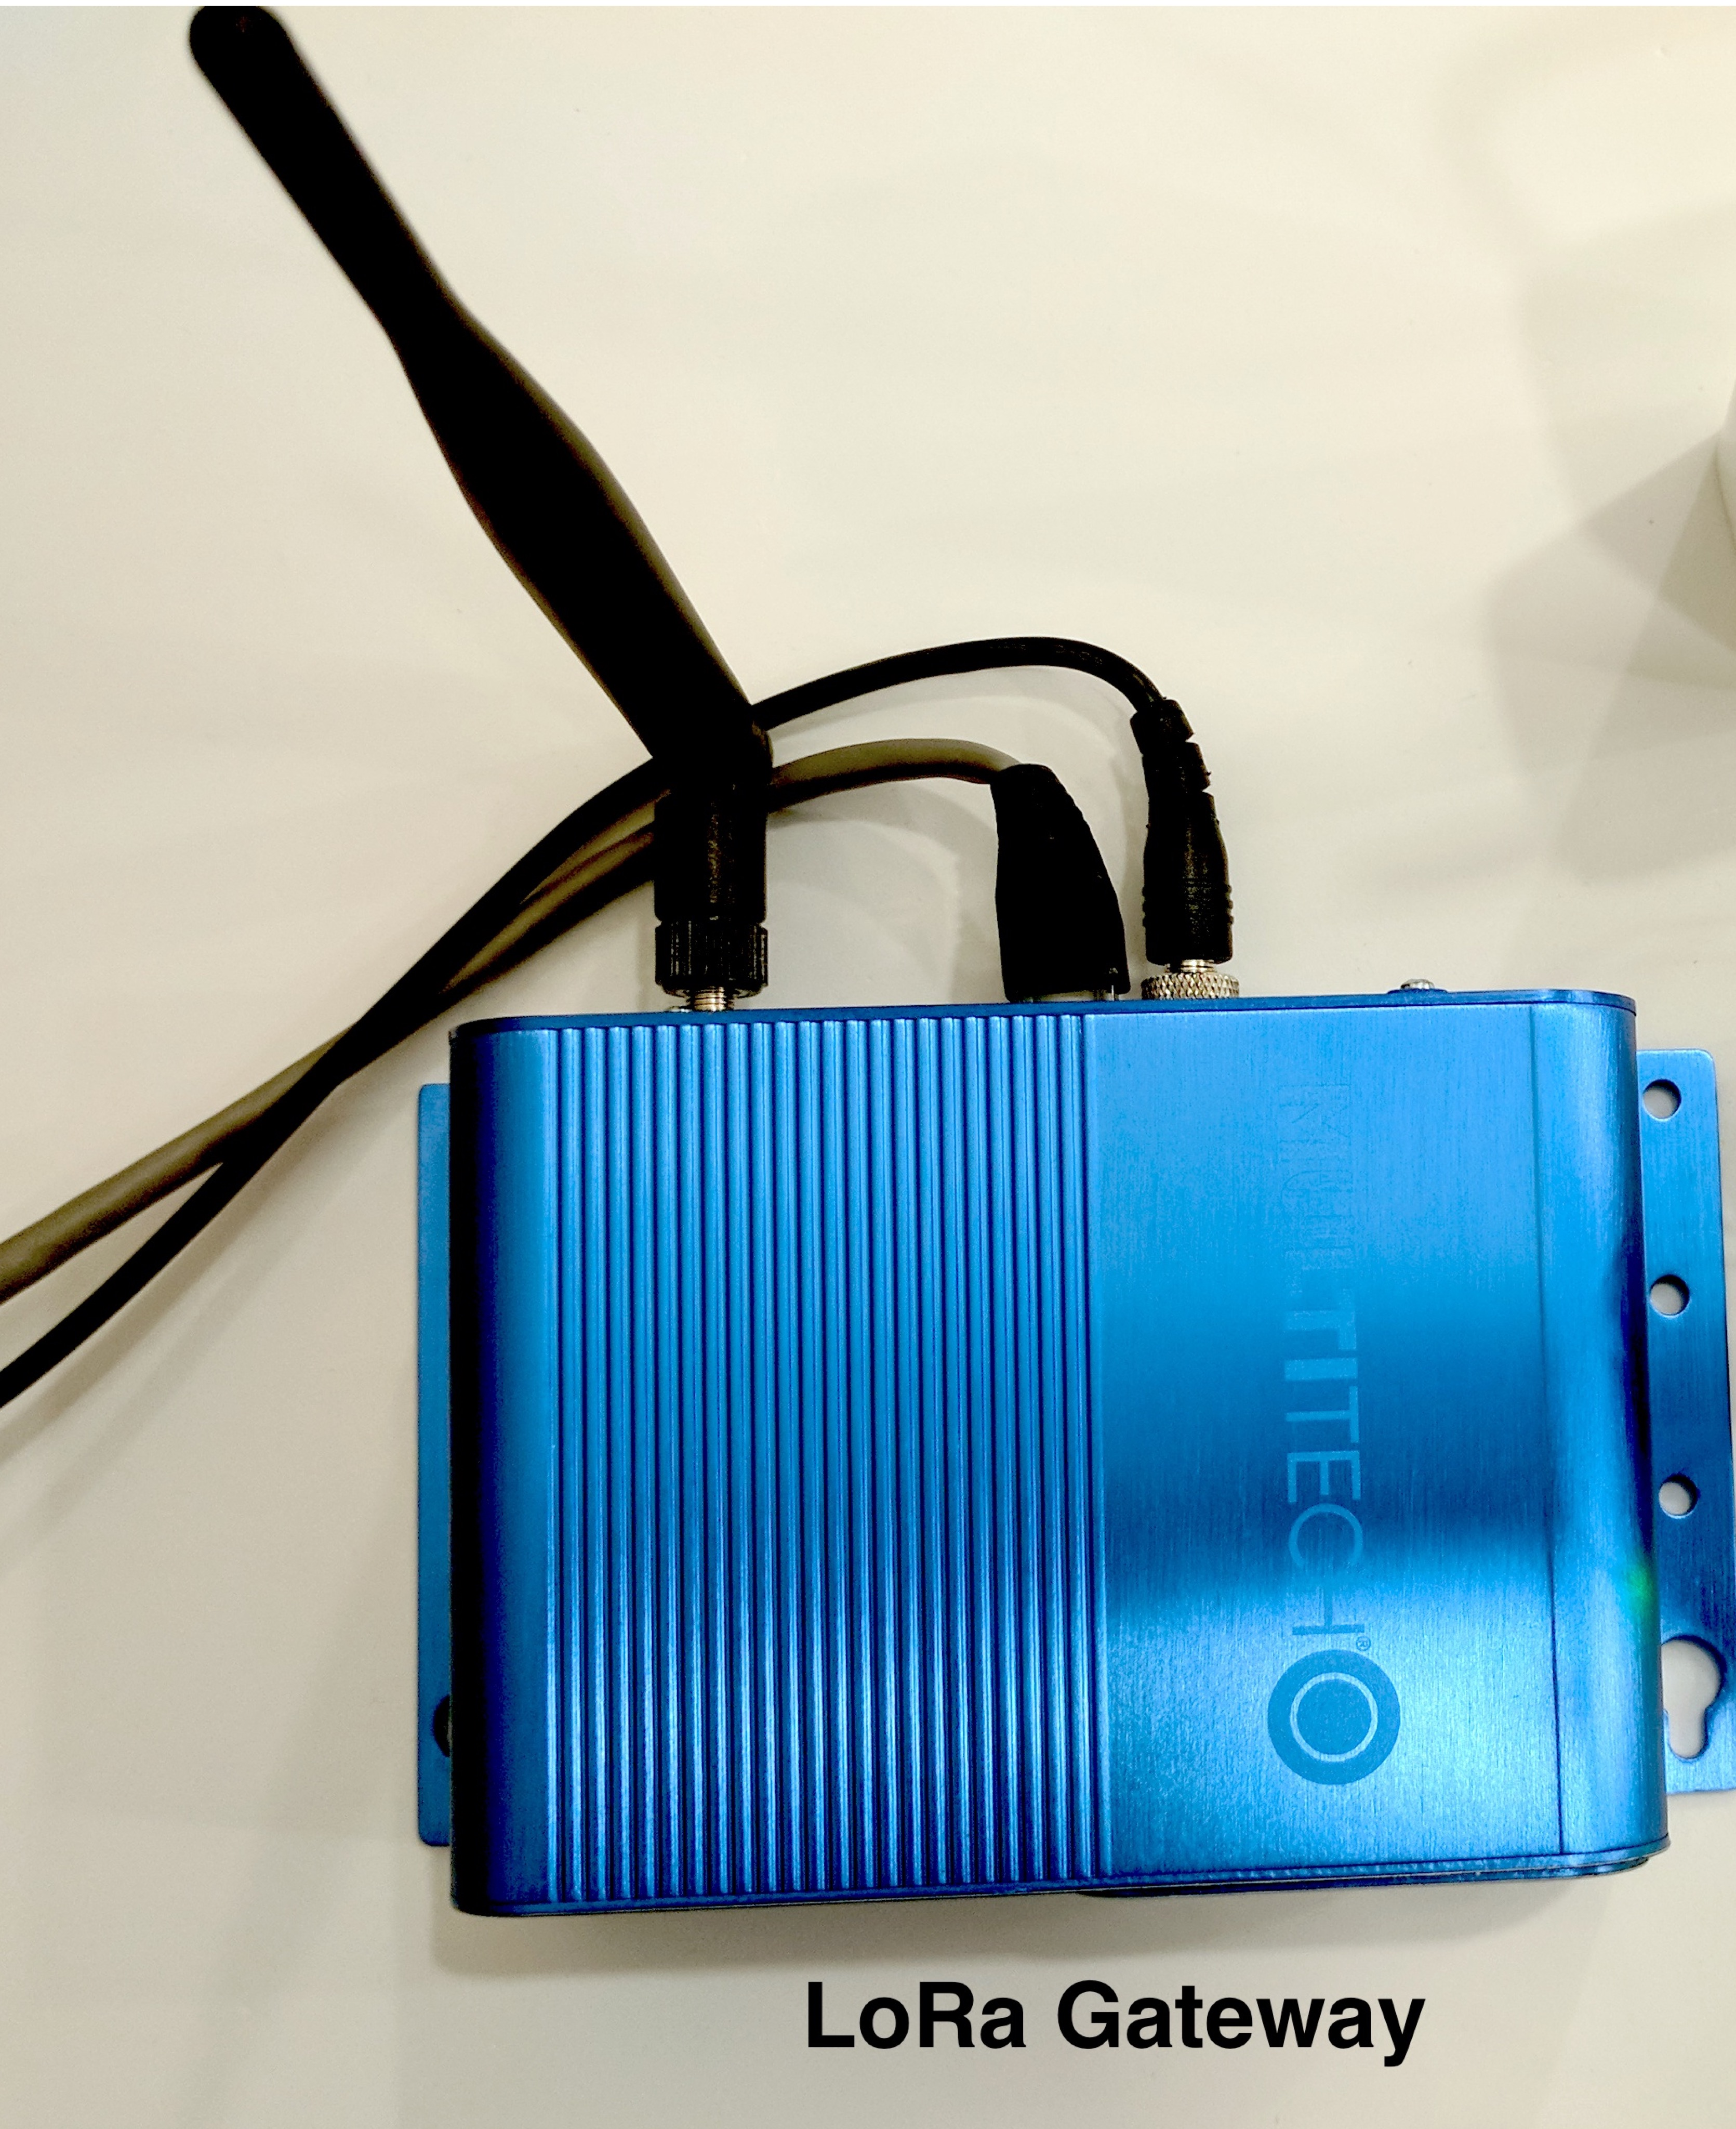
Implementation(Gateway)
Multitech Conduit device.
  Runs on an enhanced closed source embedded Linux platform.
  a configurable and scalable Internet gateway for industrial IoT.
listens to one sub-band at a time.
  a gateway can listen to eight channels simultaneously.

Slide 22


Implementation (Application Server)

Slide 23
Setup

Slide 24
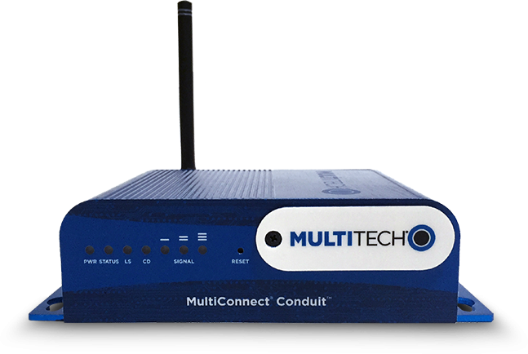
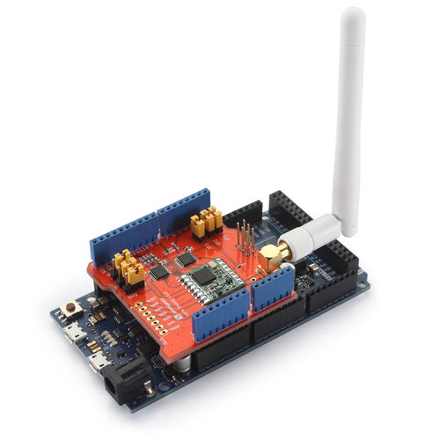
Setup

Slide 25
Indoor Setup
5 transmitters
1 receiver

Slide 26
Result Indoor

Slide 27
Outdoor Setup

Slide 28
Result Outdoor

Slide 29
Future Work
Fixing issues in simulation.
Necessary/sufficient condition for schedulibility.
Distributed version of scheduling algorithm.

Slide 30
Thank You

