Slide 1
Introduction to
Cloud Security
Former Intel CEO, Andy Grove: “only the paranoid survive”
Notes:
Cloud Computing Quotes from Vivek Kundra (Federal CIO):
"The cloud will do for government what the Internet did in the '90s," he said. "We're interested in consumer technology for the enterprise," Kundra added. "It's a fundamental change to the way our government operates by moving to the cloud. Rather than owning the infrastructure, we can save millions."
http://www.nextgov.com/nextgov/ng_20081126_1117.php
“I believe it's the future," he says. "It's moving technology leaders away from just owning assets, deploying assets and maintaining assets to fundamentally changing the way services are delivered.“
http://www.cio.de/news/cio_worldnews/867008
"It's definitely not hype," says Vivek Kundra, CTO for the District of Columbia government, which plans to blend IT services provided from its own data center with external cloud platforms like Google Apps. "Any technology leader who thinks it's hype is coming at it from the same place where technology leaders said the Internet is hype.“
http://www.cio.de/news/cio_worldnews/867008/

Slide 2
Outline
Review of Cloud Computing
High-level discussion of the security and privacy challenges in cloud computing
Top threats to Cloud Computing

Slide 3
BACKGROUND

Slide 4
What is Cloud Computing?
Cloud computing includes application software delivered as services over the Internet, and
the hardware and systems software in the datacenters that facilitate these services*
Key characteristics of cloud computing include:
  the illusion of infinite hardware resources, the elimination of up-front
  commitment, and the ability to pay for resources as needed.
* Armbrust et al., “Above the Clouds: A Berkeley View of Cloud Computing”
Notes:
“Above the Clouds: A Berkeley View of
Cloud Computing,”

Slide 5





What is Cloud Computing?
NIST Definition “A model for enabling ubiquitous, convenient, on-demand network access to a shared pool of configurable computing resources that can be rapidly provisioned and released with minimal management effort or service provider interaction.”
Cloud
providers
Infrastructure-as-a-service
Platform-as-a-service
Software-as-a-service
Notes:
Fig taken from Tom’s slides on Cloud security
These utility computing services are exciting because of the business model they represent.
They allow small businesses or individuals to replace sunk infrastructure costs with day-to-day operating costs.
Cloud provides gain economies of scale by being able to statistically multiplex across all the users.

Slide 6
Five essential Cloud Characteristics
On-demand self-service
Broad network access
Resource pooling
  Location independence
Rapid elasticity
Measured service
Notes:
From NIST slides

Slide 7
Three Cloud Service Models
Cloud Software as a Service (SaaS)
  Use provider’s applications over a network
Cloud Platform as a Service (PaaS)
  Deploy customer-created applications to a cloud
Cloud Infrastructure as a Service (IaaS)
  Rent processing, storage, network capacity, and other fundamental computing resources
To be considered “cloud” they must be deployed on top of cloud infrastructure that has the key characteristics
Notes:
From the NIST slides

Slide 8
Architectures for SaaS, PaaS, and IaaS
Notes:
From the NIST slides

Slide 9
Four Cloud Deployment Models
Private cloud
  enterprise owned or leased
Community cloud
  shared infrastructure for specific community
Public cloud
  Sold to the public, mega-scale infrastructure
Hybrid cloud
  composition of two or more clouds

Slide 10
Introducing Cloud Security

Slide 11
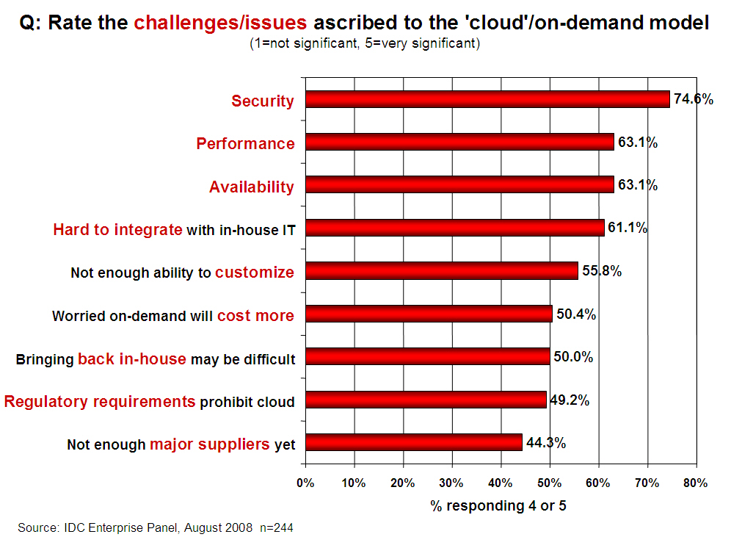
Security
Notes:
Attribute this to NIST slides on Cloud Computing

Slide 12
Cloud Security
Some key issues:
  trust, multi-tenancy, encryption, compliance
Clouds are massively complex systems can be reduced to simple primitives that are replicated thousands of times and common functional units
Cloud security is a tractable problem
  There are both advantages and challenges
Notes:
From the NIST slides

Slide 13
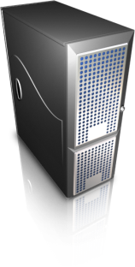
A simplified Model of Cloud Computing
Users run Virtual Machines (VMs) on cloud provider’s infrastructure
User A
Owned/operated
by cloud provider
virtual machines (VMs)
User B
virtual machines (VMs)
Virtual
Machine
Manager

Slide 14
A simplified Model of Cloud Computing
Multitenancy (users share physical resources)
Virtual Machine Manager (VMM) manages physical server resources for VMs
To the VM should look like dedicated server

Slide 15
Trust models in public cloud computing
User A
virtual machines (VMs)
Bad guy
User B
virtual machines (VMs)
Threats due to
sharing of physical infrastructure ?
Users must trust third-party provider to
  not spy on running VMs / data
  secure infrastructure from external attackers
  secure infrastructure from internal attackers
Your business competitor
Script kiddies
Criminals
…
Notes:
From Tom’s slides…

Slide 16
Challenges and Threats

Slide 17
Data Center Security
Data Centers are protected by several layers of security
  Physical security and isolation
  Power
  Fire Detection and Suppression
  Climate and Temperature Safeguards
Backups for stored data
Physical devices are erased using DoD or NIST media sanitation techniques

Slide 18
Challenges due to Shared Resources
Cloud computing introduces a shared resource environment, leading to:
  unexpected side channels (passively observing information), and
  covert channels (actively sending data)
Reputation fate-sharing
  Cloud users benefit from the security expertise at major cloud providers, but
  a single subverter can disrupt many users.
* Above the Clouds: A Berkeley View of Cloud Computing
Notes:
Fate-sharing example: For example, spammers subverted EC2 and caused Spamhaus to blacklist a large fraction of EC2’s IP addresses, causing major service disruptions

Slide 19
Top Threats to Cloud Computing*
Abuse and Nefarious Use of Cloud Computing
  relative anonymity behind the registration and usage models for IaaS
  spammers, malicious code authors, and other criminals have been able to conduct their activities with relative impunity
Insecure Interfaces and APIs
  Provisioning, management, orchestration, and monitoring are all performed using APIs
  Authentication, access control, encryption and activity monitoring
  APIs must be designed to protect against both accidental and malicious attempts to circumvent policy
* https://cloudsecurityalliance.org/topthreats/csathreats.v1.0.pdf

Slide 20
Top Threats to Cloud Computing
Malicious Insiders
  convergence of IT services and customers under a single management domain
  general lack of transparency into provider process and procedure
Shared Technology Issues
  virtualization hypervisor mediates access between guest operating systems and the physical compute resources
  Strong compartmentalization should be employed

Slide 21
Top Threats to Cloud Computing
Data Loss or Leakage
  Threat of data compromise increases in the cloud
Account or Service Hijacking
  Eavesdrop on your activities and transactions, manipulate data, return falsified information, and redirect your clients to illegitimate sites
Unknown Risk Profile
  Security by obscurity may be low effort, but it can result in unknown exposures
Notes:
threat of data compromise increases in the cloud, due to the number of and interactions between risks and challenges which are either unique to cloud, or more dangerous because of the architectural or operational characteristics of the cloud environment.

Slide 22
Virtualization and Security (OS view)

Slide 23
Security Issues from Virtualization
Virtualization providers provide
  is using- ParaVirtualization or full system virtualization.
Instance Isolation: ensuring that Different instances running on the same physical machine are isolated from each other.
  Control of Administrator on Host O/s and Guest o/s.
  Current VMs do not offer perfect isolation: Many bugs have been found in all popular VMMs that allow to escape from VM!
Virtual machine monitor should be ‘root secure’, meaning that no level of privilege within the virtualized guest environment permits interference with the host system.

Slide 24
Operating Systems: The Classical View
Programs run as
independent processes.
Each process has a private virtual address space and one or more threads.
data
data
Protected system calls
...and upcalls (e.g., signals)
Protected OS kernel mediates access to shared resources.
Threads enter the kernel for OS services.
The kernel code and data are protected from untrusted processes.

Slide 25
OS Platform: A Model
Applications/services. May interact and serve one another.
API
Libraries/frameworks: packaged code used by multiple applications
API
Protection boundary
OS platform: same for all applications on a system
E,g,, classical OS kernel
OS mediates access to shared resources.
That requires protection and isolation.
[RAD Lab]

Slide 26
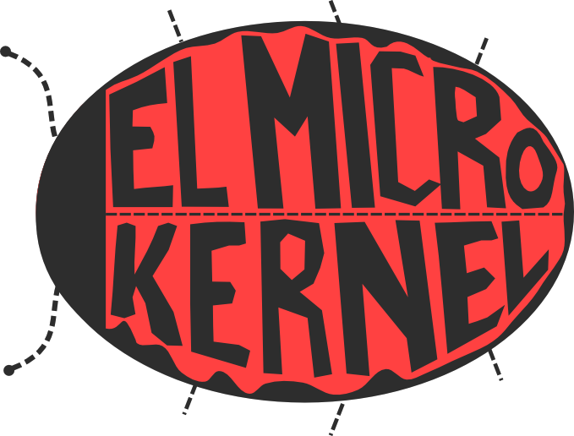
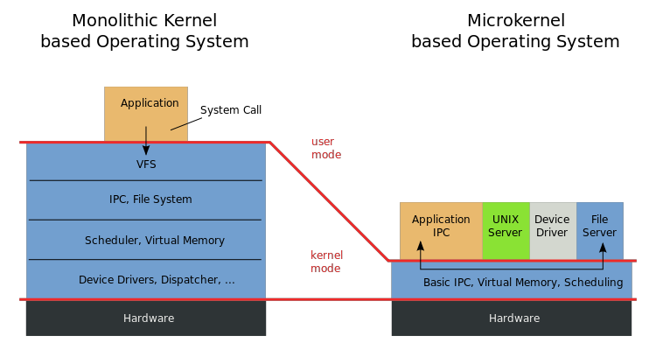
“OS as a service”

Slide 27
Point of “OS as a Service”
Kernel support for fast cross-domain call (“local RPC) enables OS services to be provided as user programs, outside the kernel, over a low-level “microkernel” syscall interface. This low-level syscall interface is not an API: it is hidden from applications, which are built to use the higher-level OS service APIs.
Many systems use this structure. Android uses it. Android is a collection of libraries and services over a “standard” Linux kernel, with binder supported added to the kernel as a plug-in module (a special device driver).
This structure originated with research “microkernel” systems in the 1980s, most notably the Mach project at CMU. The kernel code base for MacOSX derives substantially from Mach.
Windows uses this structure to some extent. Microsoft’s first modern OS was Windows NT (released in 1993). NT was strongly influenced by the research work in microkernels.

Slide 28
Virtual Machines
Virtual Appliances

Slide 29
Native virtual machines (VMs)
Slide a hypervisor underneath the kernel.
  New OS layer: also called virtual machine monitor (VMM).
Kernel and processes run in a virtual machine (VM).
  The VM “looks the same” to the OS as a physical machine.
  The VM is a sandboxed/isolated context for an entire OS.
Can run multiple VM instances on a shared computer.
hypervisor

Slide 30
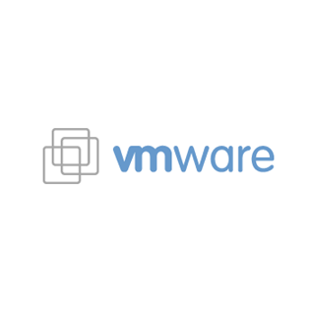


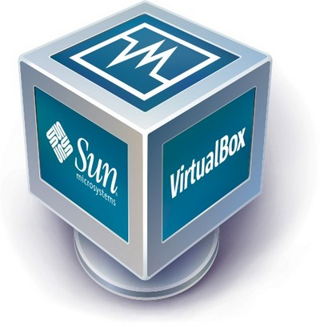

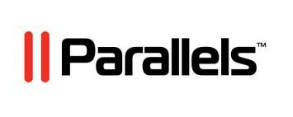
guest VM1
guest VM2
guest VM3
guest or tenant
VM contexts
P1A
P2B
P3C
OS kernel 1
OS kernel 2
OS kernel 3
hypervisor/VMM
host

Slide 31
Image/Template/Virtual Appliance
A virtual appliance is a program for a virtual machine.
  Sometimes called a VM image or template
The image has everything needed to run a virtual server:
  OS kernel program
  file system
  application programs
The image can be instantiated as a VM on a cloud.
  Not unlike running a program to instantiate it as a process

Slide 32
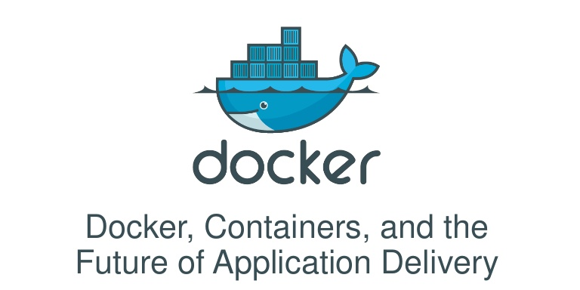
Containers
Note: lightweight container technologies offer a similar abstraction, but the VMs share a common kernel.
  E.g., Docker

Slide 33
Accountability vs. Freedom
Partition world into two parts:
  Green Safer/accountable
  Red Less safe/unaccountable
Two aspects, mostly orthogonal
  User Experience
  Isolation mechanism
    Separate hardware with air gap
    VM
    Process isolation
Notes:
Red-Green is our name for the creation of two different environments for each user in which to do their computing. One environment is carefully managed to keep out attacks – code and data are only allowed if of known trusted origin – because we know that the implementation will have flaws and that ordinary users trust things that they shouldn’t. This is the “Green” environment; important data is kept in it. But because lots of work, and lots of entertainment, requires accessing things on the Internet about which little is known, or is even feasible to know, regarding their trustworthiness (so it can not be carefully managed), we need to provide an environment in which this can be done – this is the “Red” environment. The Green environment backs up both environments, and when some bug or user error causes the Red environment to become corrupt, it is restored to a previous state (see the recovery slide); this may entail loss of data, which is why important data is kept on the Green side, where it is less likely to be lost. Isolation between the two environments is enforced using IPsec.
The big unknown is the user experience, at this point. We know different models:
The KVM switch model (as in NetTop)
The X-Windows model (with windows actually fronting for an execution on some other machine)
What the users will find preferable is an open question, still.
More to the point, the security of the system depends on separation that will be visible to the user. There will be things that the user will not be allowed to do because of the security policy. What also needs to be researched is the best way to communicate that separation to the user. The KVM switch model, in which the user envisions two separate PCs that have to use network shares to share files might be the simplest to grasp.
Implementation is still a matter of debate within the company – and even within the team.
Today we are going to talk about the VM-based isolation solution

Slide 34
Without R|G: Today
Less trustworthy
Less accountable
entities
More trustworthy
More accountable
entities
(N >> m)
N attacks/yr
m attacks/yr
My Computer
Less
valuable
assets
More
valuable
assets
Entities
- Programs
- Network hosts
- Administrators
Total: N+m attacks/yr on all assets
Notes:
Almost everyone has a “red” machine
Security settings optimized for immediate productivity not long-term security
So… The untrustworthy or unaccountable get to interact with important assets

Slide 35
With R|G
Less trustworthy
Less accountable
entities
More trustworthy
More accountable
entities
(N >> m)
m attacks/yr
N attacks/yr
My Red Computer
My Green Computer
More
valuable
assets
Less
valuable
assets
More
valuable
assets
Entities
- Programs
- Network hosts
- Administrators
N attacks/yr on less
valuable assets
m attacks/yr on more
valuable assets

Slide 36
Must Get Configuration Right
Keep valuable stuff out of red
Keep hostile agents out of green
Less trustworthy
Less accountable
entities
More trustworthy
More accountable
entities
My Red Computer
My Green Computer
More
valuable
assets
Less
valuable
assets
More
valuable
assets
Valuable
Asset
Hostile
agent

Slide 37
Why R|G?
Problems:
  Any OS will always be exploitable
    The richer the OS, the more bugs
  Need internet access to get work done, have fun
    The internet is full of bad guys
Solution: Isolated work environments:
  Green: important assets, only talk to good guys
    Don’t tickle the bugs, by restricting inputs
  Red: less important assets, talk to anybody
    Blow away broken systems
Good guys: more trustworthy / accountable
  Bad guys: less trustworthy or less accountable

Slide 38
Linux Containers

Slide 39
Linux Containers
The problem?
  Many payloads
    backend services (API), databases
    distributed stores, webapps
    Java, Node.js, PHP, Python, Ruby, …
    Plus your code
  Many targets
    your local development environment
    your coworkers’ development environment
    some random test server / the production server
    bare metal / virtual machines
    your Raspberry Pi
Adapted from slides at linuxfoundation.org

Slide 40
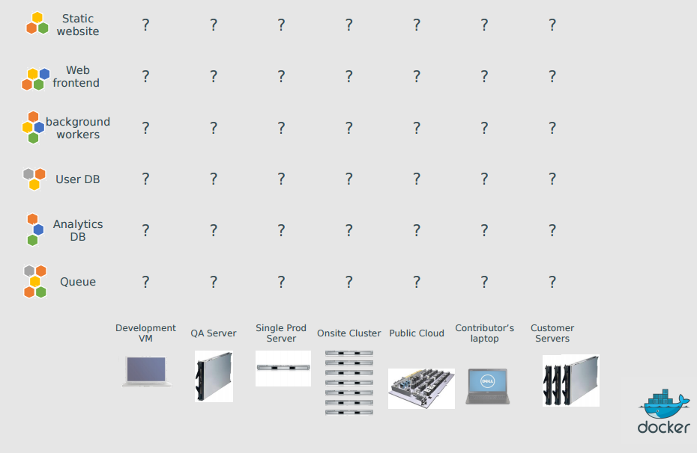
The Matrix

Slide 41
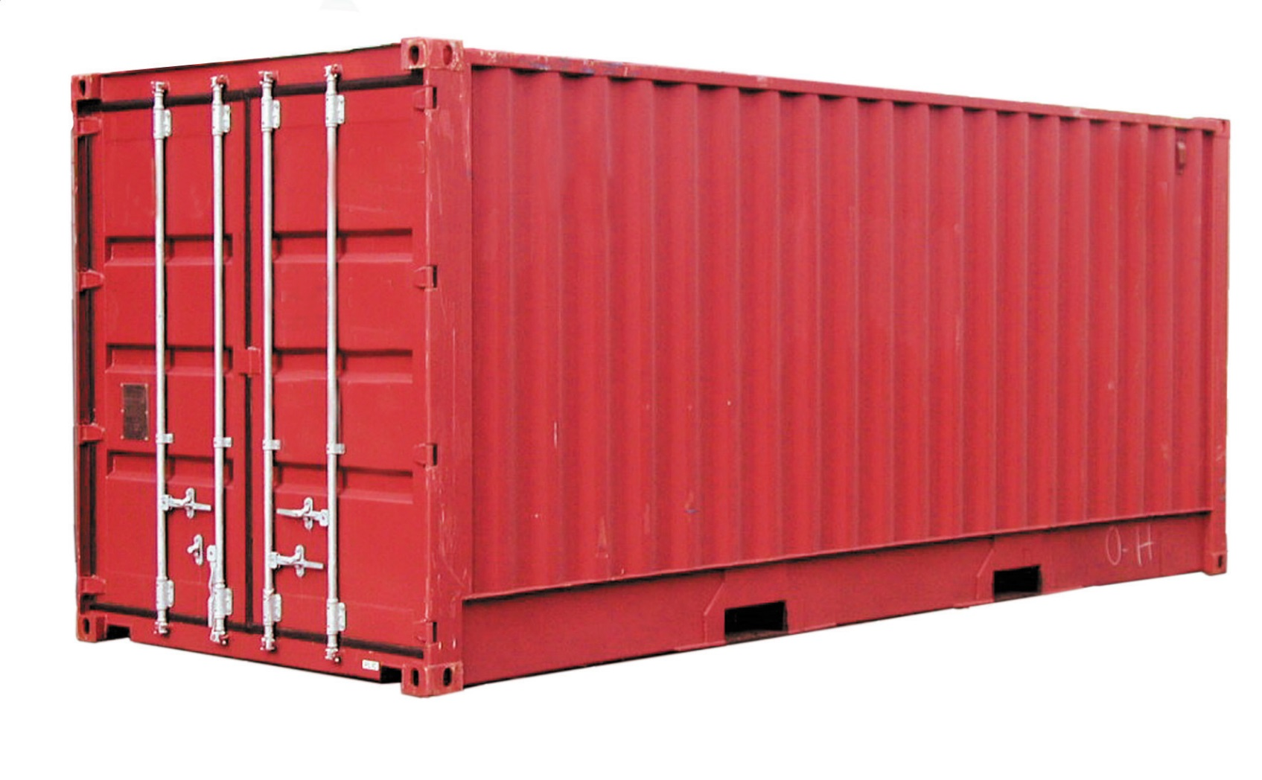
Real-world Analogy
Containers

Slide 42
Real-world
The problem?
  Many products
    clothes
    electronics
    raw materials
    wine
    …
  Many transportation methods
    ships
    trains
    trucks
    …
Adapted from slides at linuxfoundation.org

Slide 43
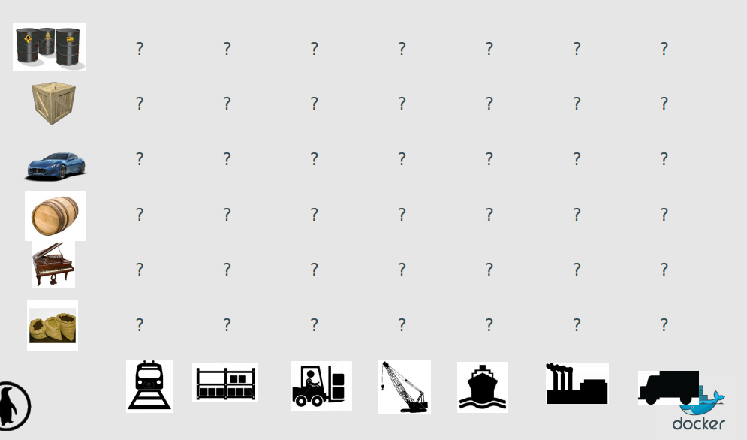
The Matrix

Slide 44
Solution to the Transportation Problem
The intermodal shipping container
90% of all cargo now shipped in a standard container
faster and cheaper to load and unload on ships (by an order of magnitude)
less theft, less damage
freight cost used to be >25% of final goods cost, now <3%
5000 ships deliver 200M containers per year

Slide 45
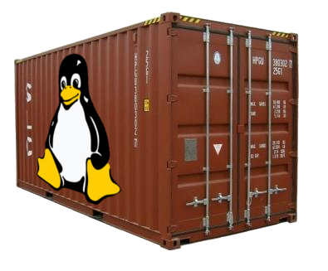
Solution to the Deployment Problem

Slide 46
Linux containers…
run everywhere
  regardless of kernel version
  regardless of host distro
  (but container and host architecture must match)
run anything
  if it can run on the host, it can run in the container
  i.e., if it can run on a Linux kernel, it can run

Slide 47
What is a Linux container?
It’s a lightweight VM
  own process space
  own network interface
  can run stuff as root
  can have its own /sbin/init (different from the host)

Slide 48
What is a Linux container?
Low-level approach: it’s chroot on steroids
  can also not have its own /sbin/init
  container = isolated process(es)
  share kernel with host
  no device emulation (neither HVM nor PV)

Slide 49
Separation of concerns
Dave the Developer
  My code, my libraries, my package manager, my app, my data
Oscar the Ops guy
  Outside the container – logging, remote access, network configuration, monitoring
How does it work?
  Isolation with namespaces – pid, mnt, net, uts, ipc, user
How does it work?
  Isolation with cgroups – memory, cpu, blkio, devices

Slide 50
Efficiency
Almost no overhead
  processes are isolated, but run straight on the host
  CPU performance = native performance
  memory performance = a few % shaved off for (optional) accounting
  network performance = small overhead; can be optimized to zero overhead
Storage-friendly
  provisioning now takes a few milliseconds
  … and a few kilobytes
  creating a new base/image/whateveryoucallit takes a few seconds

Slide 51
Docker

Slide 52
What is Docker?
Open Source engine to commoditize LXC
using copy-on-write for quick provisioning
allowing to create and share images
propose a standard format for containers
It’s true you can do all that stuff with LXC tools, rsync, some scripts (true for apt, dpkg, yum, etc.)
The whole point is to commoditize, i.e. make it ridiculously easy to use!
Adapted from slides at linuxfoundation.org

Slide 53
Docker: authoring images
you can author « images »
  either with « run+commit » cycles, taking snapshots
  or with a Dockerfile (=source code for a container)
  both ways, it's ridiculously easy
you can run them
  anywhere
  multiple times

Slide 54
Docker – the community
Docker: >160 contributors
latest milestone (0.6): 40 contributors
GitHub repository: >600 forks
http://docker.io/

